Slide 1
Fundamentals of Data Science – introduction to the course content and rules Szymon Łukasik, slukasik@agh.edu.pl, AGH Kraków, room 319, D-7
Credits: anonymous author

Slide 2
Process of data exploration
Goal and expert knowledge
Data acquisition
Data preprocessing
Data mining
Inference, synthesis, visualization

Slide 3
Plan of the course 1. Introduction to Data Science – history and methodological background. 2. Typical workflow of data analysis. 3. Data preprocessing – data reduction, cleaning, handling missing elements. 4. Unsupervised learning – outlier detection and cluster analysis. 5. Classification and regression. 6. Recommender systems and text mining. 7. Big Data – brief overview of issues and computational methods.

Slide 4
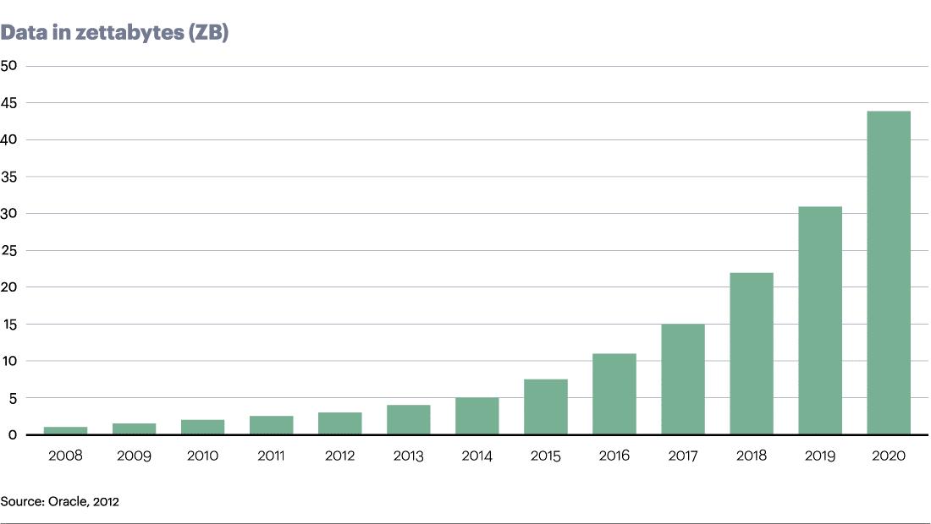
Main problem of data science
Our ability to collect and store data is increasing at a faster rate than our ability to analyze it
(Keim et al, 2007)

Slide 5
Big Data
Big Data – term used for the first time in 1980 by sociologist - Charles Tilly. In 1998 it appeared in computer science world thanks to John Mashey (representing SGI).
BigData = data characterized by 4V (volume, variety, velocity, value)
By some ML (Machine Learning) experts Big Data is perceived as a popular word with no astonishing informative value (so called buzz word).

Slide 6
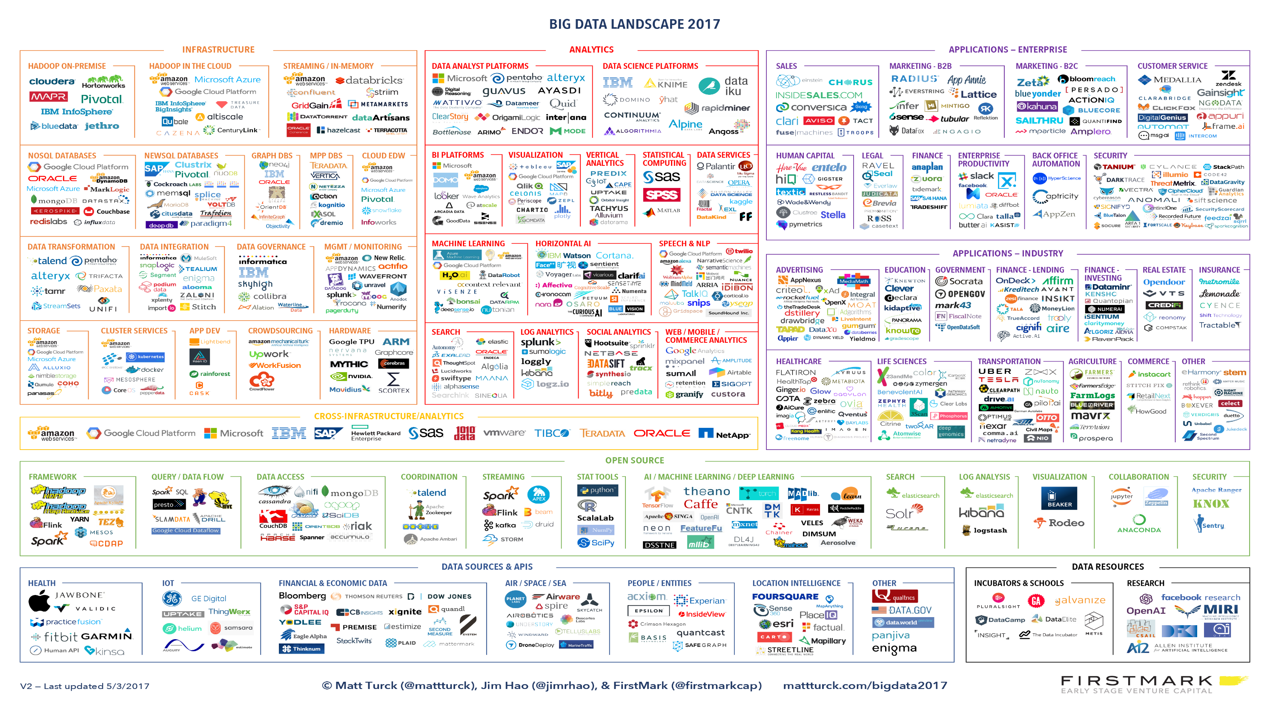

Slide 7
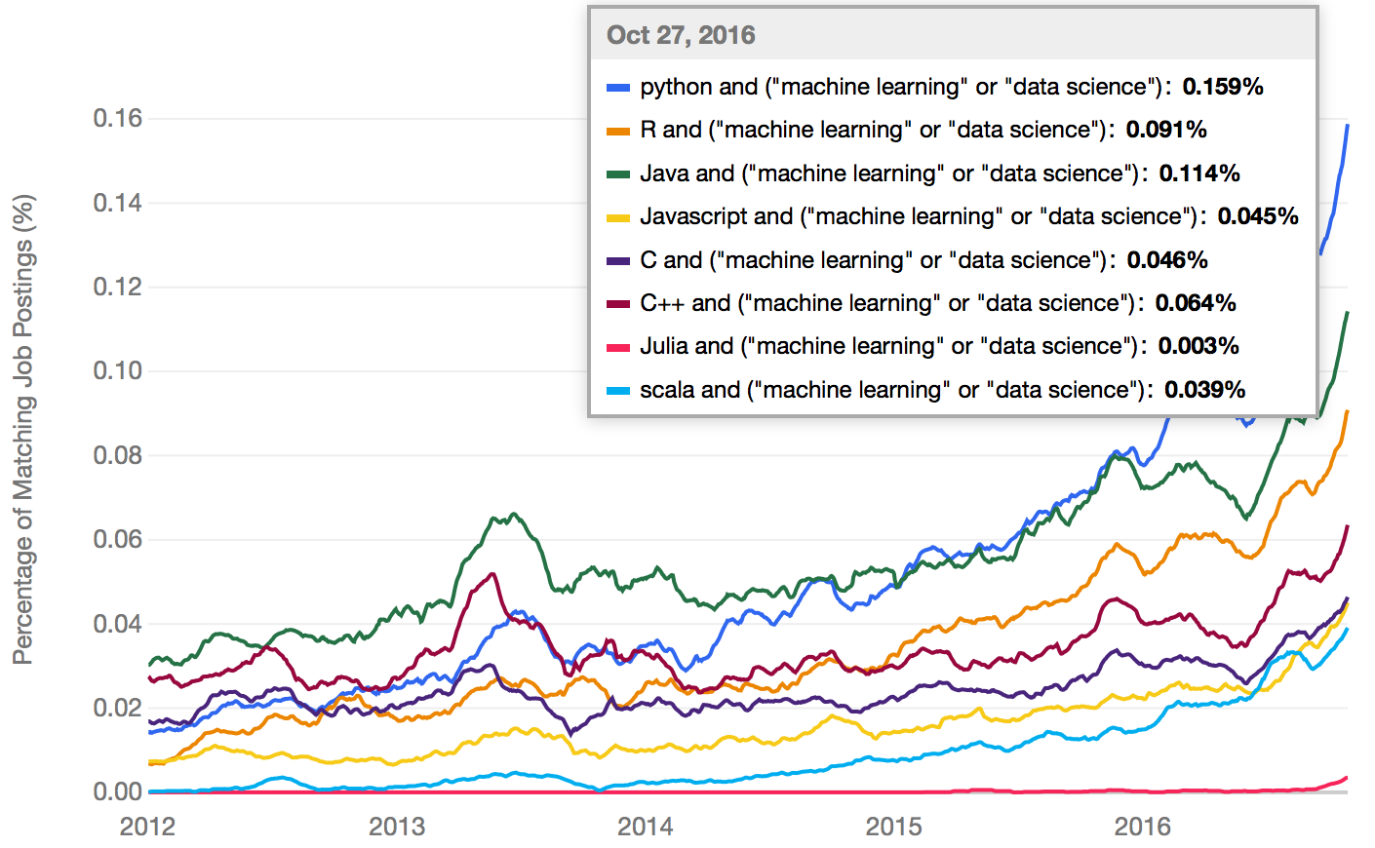
Data Science Tools
indeed.com

Slide 8
Our course – paper work
5 lectures (including the one today)
5 lab meetings
5 project meetings
Final grade: Weighted average of exam final grade (weight 2/3) and project’s grade (weight 1/3). Note: According to ESA rules our course should end with an exam. Exam will cover lectures and labs. List of topics covered on the exam will be provided to you two weeks before the actual exam.

Slide 9
Our course – paper work
Laboratory classes are obligatory. One unjustified absence is allowed in the case of these classes.
Absences (also justified) in laboratory classes need to be reworked in the form and time agreed with the instructor.
Half of the unjustified classes result in a lack of credit. From that decision the student teacher may appeal to the instructor and/or the Dean.
Slides: published in MS Teams Files folder.

Slide 10
Additional resources
Jiawei Han, Jian Pei,Micheline Kamber, “Data Mining: Concepts and Techniques”, Elsevier, 2011.
Jake VanderPlas, “Python Data Science Handbook: Essential Tools for Working with Data”. O’Reilly Media, 2016.
Hadley Wickham, “R for Data Science: Import, Tidy, Transform, Visualize, and Model Data”, O’Reilly Media, 2017.
Jeffrey Solka, Angel R. Martinez, “Exploratory Data Analysis with MATLAB”, Chapman & Hall, 2017.
UCI Machine Learning Repository, https://archive.ics.uci.edu/ml/
Kaggle Competitions, https://www.kaggle.com/competitions

Slide 11
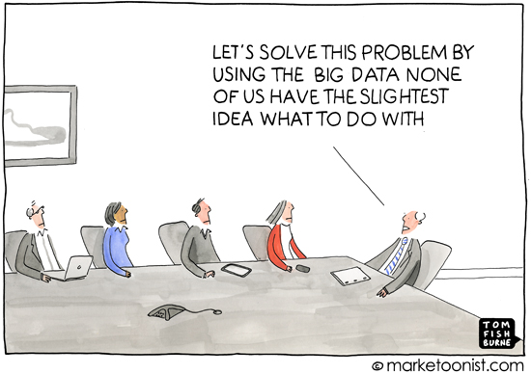
Summary
Data in the 21st Century is like Oil in the 18th Century: an immensely, untapped valuable asset
(The Wired, 2014)
The world’s most valuable resource is no longer oil, but data
(The Economist, 2017)

Slide 12
Thank you for your attention!

