Slide 1

Data preprocessing – missing values, sample length reduction, normalization, outliers
Szymon Łukasik
Faculty of Physics and Applied Computer Science, AGH Kraków

Slide 2
Missing values
No | Temperature | Headache | Nausea | Flu
1. | High | ? | No | Yes
2. | V. High | Yes | Yes | Yes
3. | ? | No | No | No
4. | High | Yes | Yes | Yes
5. | High | ? | Yes | No
6. | Normal | Yes | No | No
7. | Normal | No | Yes | No
8. | ? | Yes | ? | Yes
What we can do?

Slide 3
Method I: remove cases
No | Temperature | Headache | Nausea | Flu
1. | High | ? | No | Yes
2. | V. High | Yes | Yes | Yes
3. | ? | No | No | No
4. | High | Yes | Yes | Yes
5. | High | ? | Yes | No
6. | Normal | Yes | No | No
7. | Normal | No | Yes | No
8. | ? | Yes | ? | Yes

Slide 4
Method II: replace with the most common
No | Temperature | Headache | Nausea | Flu
1. | High | ? | No | Yes
2. | V. High | Yes | Yes | Yes
3. | ? | No | No | No
4. | High | Yes | Yes | Yes
5. | High | ? | Yes | No
6. | Normal | Yes | No | No
7. | Normal | No | Yes | No
8. | ? | Yes | ? | Yes
Yes
High
Yes
High
Yes

Slide 5
Method III: Replace with all values
No | Temperature | Headache | Nausea | Flu
1a. | High | ? | No | Yes
1b. | High | ? | No | Yes
2. | V. High | Yes | Yes | Yes
3a. | ? | No | No | No
3a. | ? | No | No | No
3a. | ? | No | No | No
4. | High | Yes | Yes | Yes
5a. | High | ? | Yes | No
5b. | High | ? | Yes | No
Yes
No
High
V. High
Normal
Yes
No

Slide 6
Method IV: replace with average
No | Temperature | Headache | Nausea | Flu
1. | 38,7 | ? | No | Yes
2. | 38,6 | Yes | Yes | Yes
3. | ? | No | No | No
4. | 37,1 | Yes | Yes | Yes
5. | 37,3 | ? | Yes | No
6. | 36,7 | Yes | No | No
7. | 36,5 | No | Yes | No
8. | ? | Yes | ? | Yes
Yes
37,5
Yes
37,5
Yes

Slide 7
Sample length reduction
Most of data analysis algorithm has O(m) or O(m²) computational complexity. Sample length can represent a serious problem for many of them – for a broad range of large-scale practical problems.
The aim of sample reduction is obtaining reduced representation of the dataset having M (M << m) elements, while keeping the most important properties intact. It can be performed e.g with :
Simple random sampling without replacement (SRSWOR) – we select randomly M elements from initial set of length m, each is sampled at first with probability 1/m, selected element can’t be chosen again.
Simple random sampling with replacement (SRSWR) – as above but single element can be selected again (even many times)..

Slide 8
Sample length reduction (2)
Grouping – elements of the sample are automatically grouped (e.g. by clustering) and then, with SRSWR the representatives are being selected (either points from each group or their centers)
Stratified random sampling – dataset is split into so calld strata (by a value of single attribute or many of them) and its reduced representation is obtain through maintaining the same proportion of elements in each strata

Slide 9
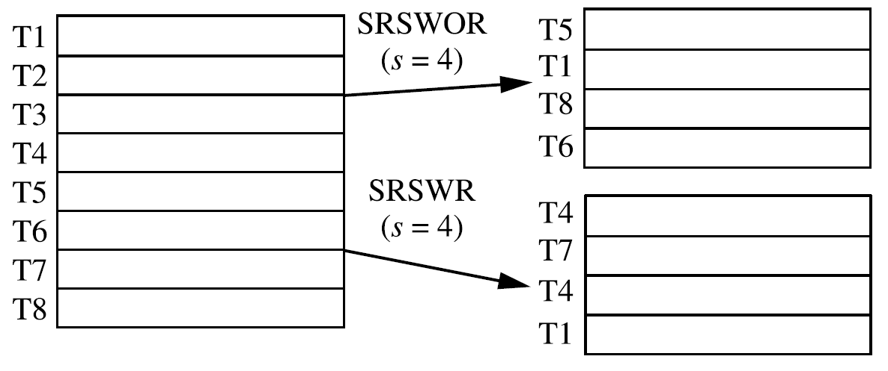
Sample length reduction - example

Slide 10
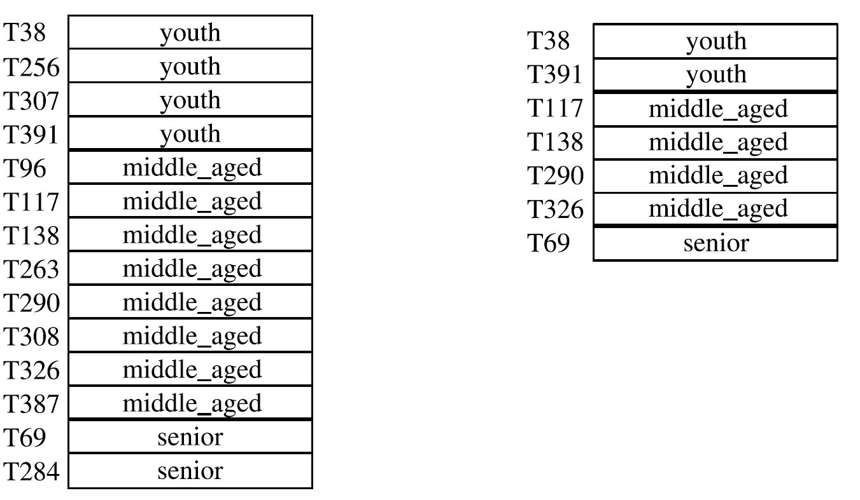
Sample length reduction – example (2)

Slide 11
Normalization
Task of normalization is equivalent to shifting and rescaling vaues of attributes to have their values at comparable level.
Normalization is typically done according to the formula:
where a_{k} defines shifting coefficient and b_{k} – rescaling ratio for variable k.

Slide 12
Normalization in detail
As a shifting coefficient the following could be used:
For rescaling factor one could choose:

Slide 13
Normalization in practice
The most common variant of normalization if standardization – shifting by mean value and rescaling by standard deviation:
To obtain attribute values in [0,1] range they can be normalized using the following formula:

Slide 14

Outlier detection
„Anormality” in data science can be understood as not typival value of one variable or ”strange” combination of few features’ values.
Atypical elements could represent:
Errors or missing values
Outliers representing „information nuggets”
Methods of outlier detection
Univariate outlier detection
Multivariate outlier detection

Slide 15
Univariate outlier detection – introduction
Most of one-dimensional methods of outlier detection finds anormal values of distance from the point of reference. It can be represented by the following rule/equation:
where n(X_{k}) represents reference value of feature X_{k} while r(X_{k}) typical spread of values around the reference point. Value of t indicates sensitivity of the algorithm.

Slide 16
Univariate outlier detection – 3 strategies
Three most common strategies
First method is known as 3-sigma, second – Hampel coefficient, third – boxplot, with m(X_{k}) being a median X_{k}, S(X_{k}) representing a term called MAD - median absolute deviation, and Q(X_{k}) being interquartile range.

Slide 17
Method I
For 3-sigma (t=3) outliers are elements situated over 3 standard deviations from the average. Assuming normal distribution of data observing such case is characterized by very low (0.3%) probability.
Main drawback: very susceptible for the masking problem (of an outlier by the same or other outlier). In consequence this method is not able to distinguish single outlier, even situated very far, for sample sizes < 10!
In general: masking – too few outliers, swamping – too many outliers…

Slide 18

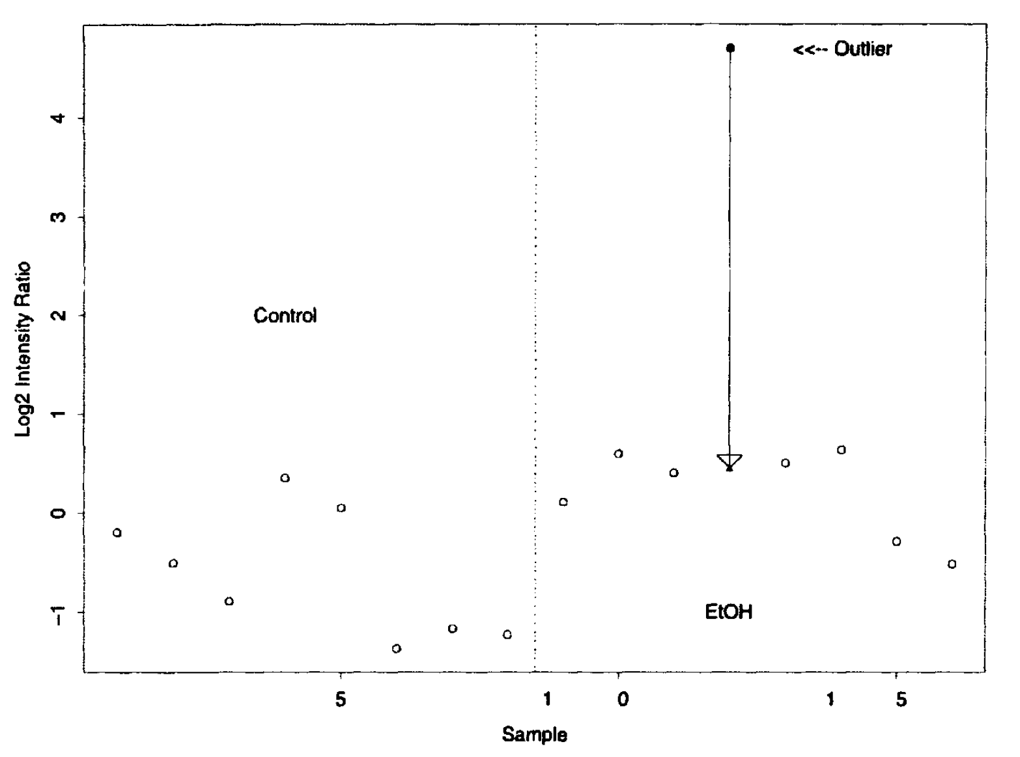
Method I - illustration

Slide 19
Method II
Hampel method uses median as a measure of central tendency with MAD being used as a spread factor:
while:
Properties: in essences more effective, however frequently too aggressive in classifying elements as outliers. If most of elements are close to each other value of S is equal to 0.

Slide 20
Method III
Quartile method uses median as a central tendency measure and interquartile range as a measure of spread:
while:
Properties: quite effective, can be modified to detect outliers for assymetric distributions.
If used in a form of a plot: symmetric boxplot

Slide 21
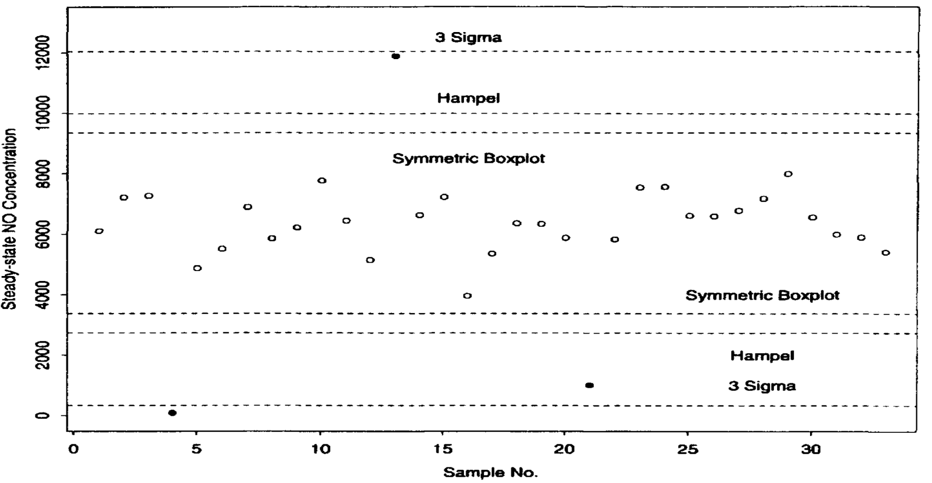
Example 1

Slide 22
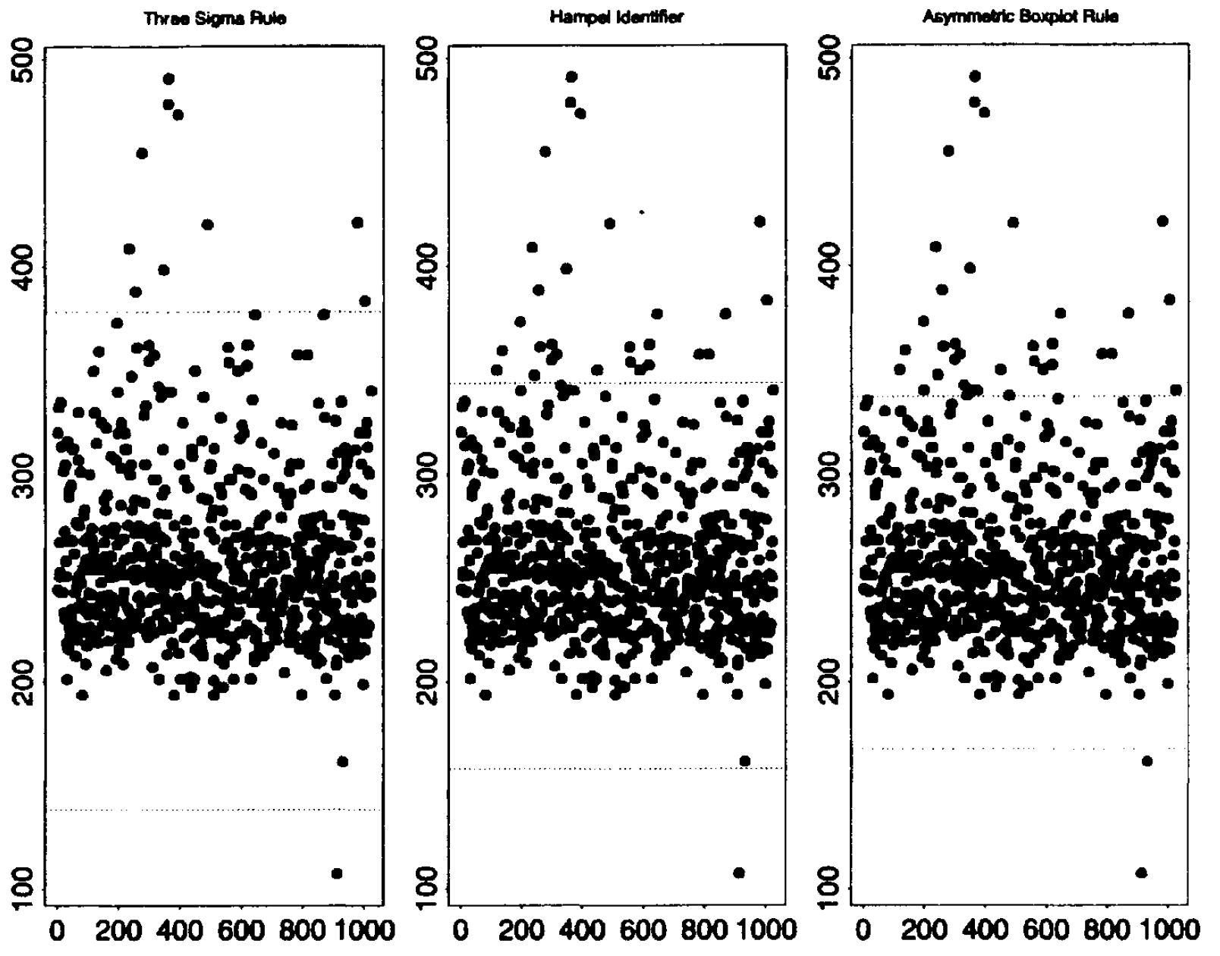
Example 2

Slide 23
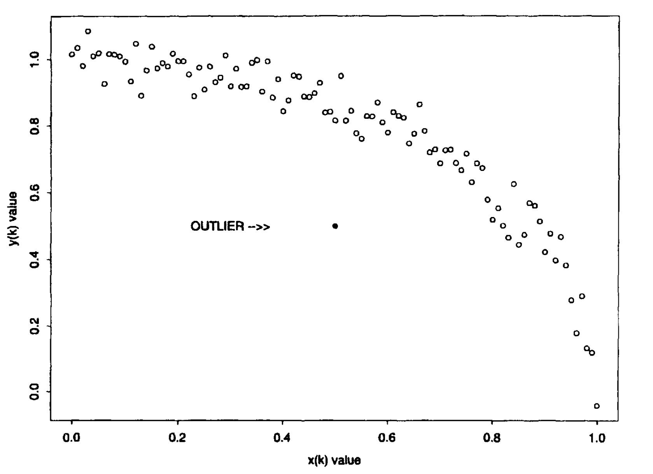
Multivariate methods – motivation

Slide 24
Multivariate methods
Three classes of methods using multidimensional information to classify elements as outliers:
Statistical methods
Distance-based methods
Density-based methods

Slide 25
Statistical approach – example
In case of one dimensional normal distribution
represents squared distance of x_{i} from the average measured in standard deviation units. It is called Mahalanobis distance. It can be generalized for multidimensional case:
where µ is a vector of means and Σ – covariance matrix. Such a distance has a chi-square distribution of n degrees of freedom.

Slide 26
Statistical methods - example
Using the definition of the distance and analogy to univariate detection, the following criterion can serve as a method to identify outliers in multivariate manner:
Where χ_{n}²(r) is a quantile of r rank for chi-square distribution of n degrees of freedom. It is recommended to use variants of this method – less prone to the influence of outliers on the value of Mahalanobis distance (e.g. MCD).

Slide 27
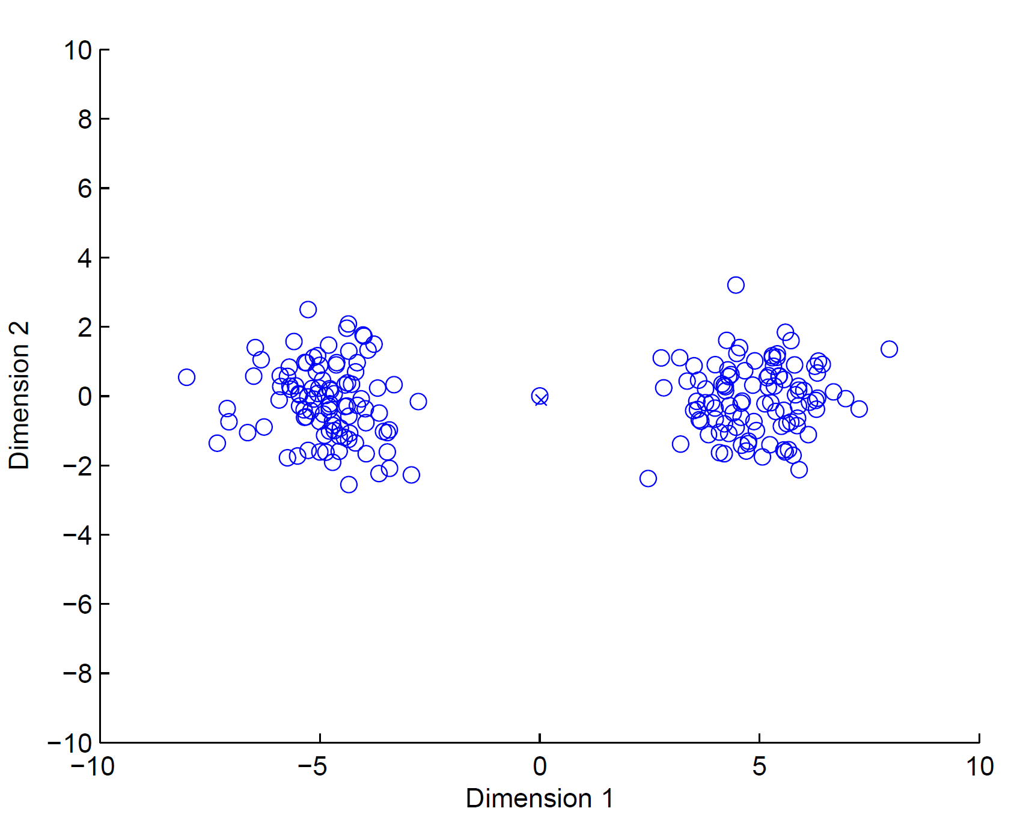
How to cheat statistics?

Slide 28
Distance-based outliers
This class of methods uses only relations of distance between elements to identify outliers
Three basic approaches of this class:
Outliers are elements for which within distance d less than p other elements can be found.
Outliers are p elements for which the distante to their k-neighbor is the highest.
Outliers are p elements for which average distance to k nearest neighbors is the highest.

Slide 29
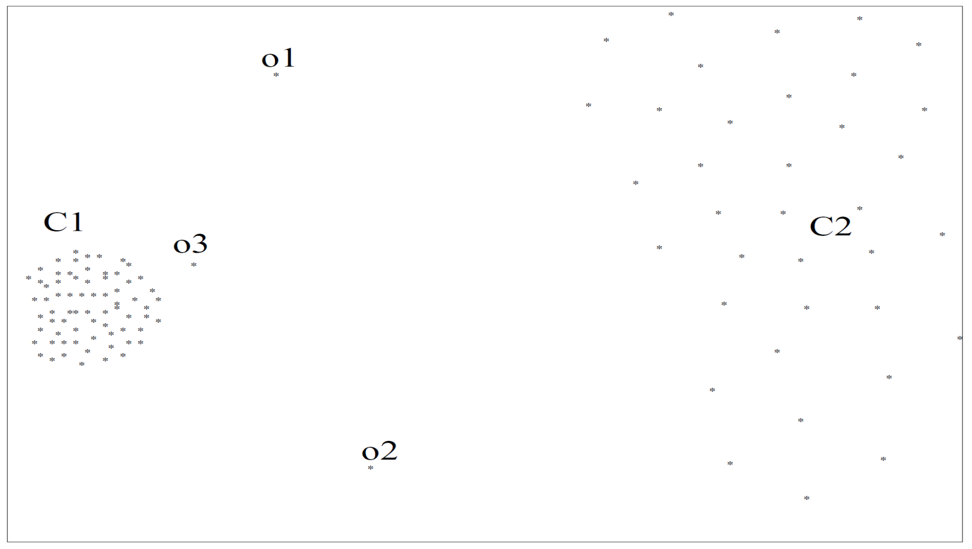
Seems clear but…

Slide 30
Density-based outliers
Density based methods uses density in the neighborhood of investigated data elements.
Density is defined as:
with N(x_{i},k) representing k-nearest neighbors for x_{i}, and |A| - stands for numerosity of the set A.

Slide 31
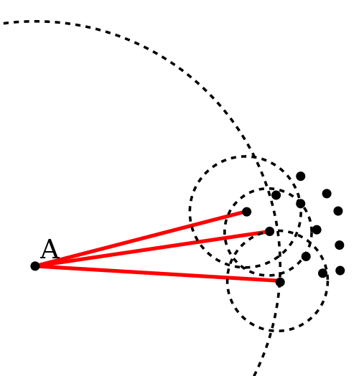
Density-based outlier detection
To judge if an element is an outlier relative density for a single point (in reference to the other points lying in its neighborhood) is used:
The closer this coeeffient is towards 0 the more outlying is the investigating element (1 – element close to the dense area’s center).

Slide 32
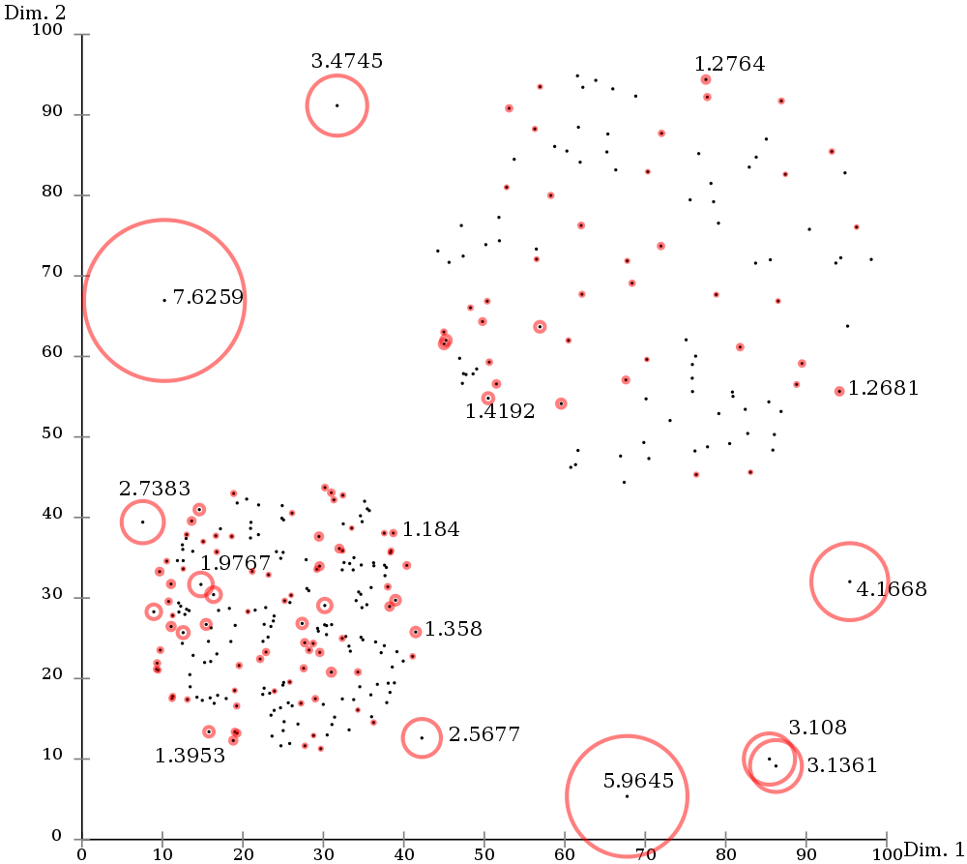
It works!

Slide 33
Thank you for your attention!

