Slide 1

Dimensionality reduction
Szymon Łukasik
Faculty of Physics and Applied Computer Science, AGH Krakow

Slide 2

Why?
Because high dimensionality of data implies large computational time for most of data mining procedures.
Because more dimensions you have more data you need to get a representative result (e.g. 4^(n+1) rule for kernel density estimation).
But above all:
Because multidimensional datasets posses negative geometrical properties known under the name „curse of dimensionality”. It turns out that even simple operations like finding nearest neighbor could bring unexpected results.

Slide 3

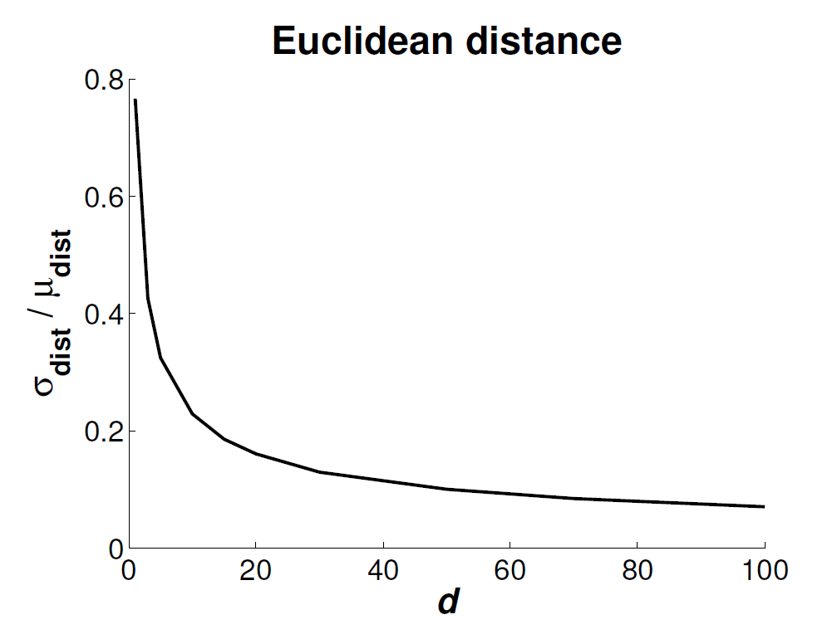
CoD, example: norm concentration

Slide 4
Dealing with dimensionality reduction – feature selection
Feat. 1 | Feat. 2 | … | Feat. n
Feat. 1 | … | Feat. N
Feature selection
N << n
X
Y

Slide 5
Dealing with dimensionality reduction – feature extraction
Feat. 1 | Feat. 2 | … | Feat. n
Feat. 1 | … | Feat. N
Feature extraction/reduction
N << n
X
Y
transform

Slide 6
Taxonomy of dimensionality reduction
Transformation type
Linear, i.e. Y = X A
Non-linear i.e. Y=f(X) or not explicitly given
Interaction type
Unsupervised
Supervised
Generality (out-of-sample extension)
General
Point-to-point
and others…

Slide 7
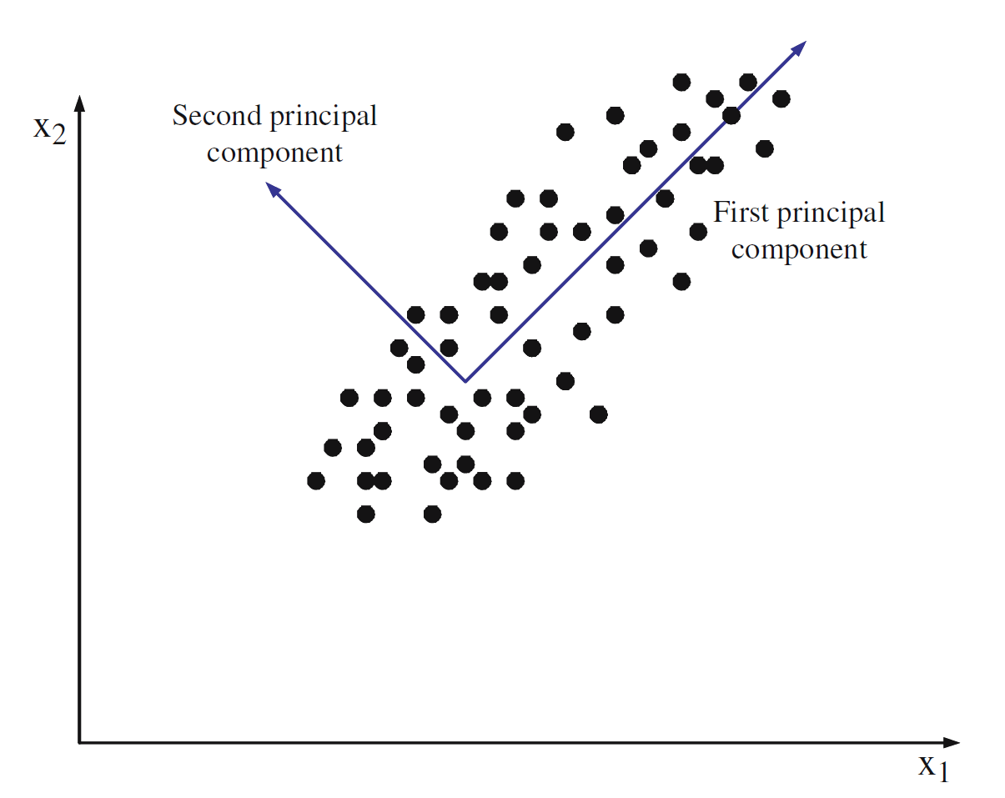
Principal Component Analysis (Hotelling, around 1930)

Slide 8
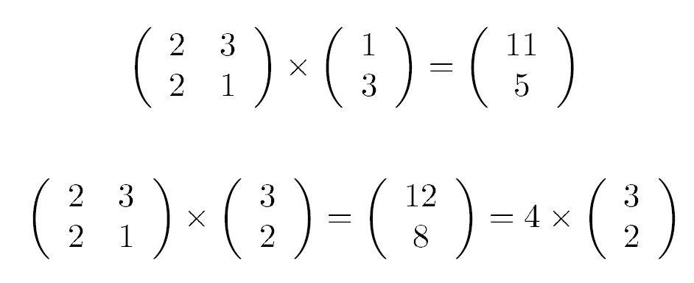
How to find PCs?
We look for elements of matrix A [Nxn] such as, the data is projected along the axes of maximal variances.
We assume that the data is normalized (i.e. vector of means µ = [0 … 0]).
It turns out that matrix A with such properties consists of eigenvectors of covariance matrix cov(X).
Eigen-who?

Slide 9
Obtaining eigenvectors
Vector A_{i} is an eigenvector of cov(X) if :
Matrix A consists of n eigenvectors – forming rows of A – orthogonal to each other and values of eigenvalue λ_{i} correspond to variance along axis i. Multiplying dataset through full A [nxn] matrix corresponds to data rotation to have its representation with maximum variance along axes.
To obtain eigenvectors we first calculate eigenvalues from the characteristic equation:

Slide 10
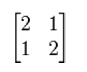
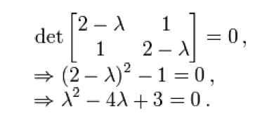


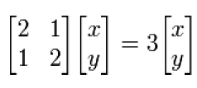




Eigenvectors live

Slide 11
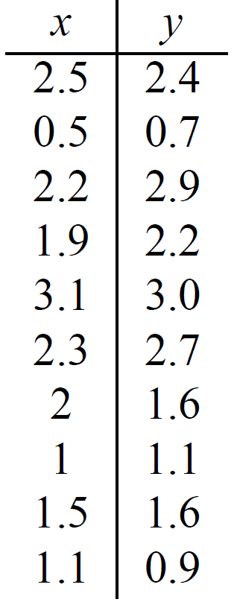
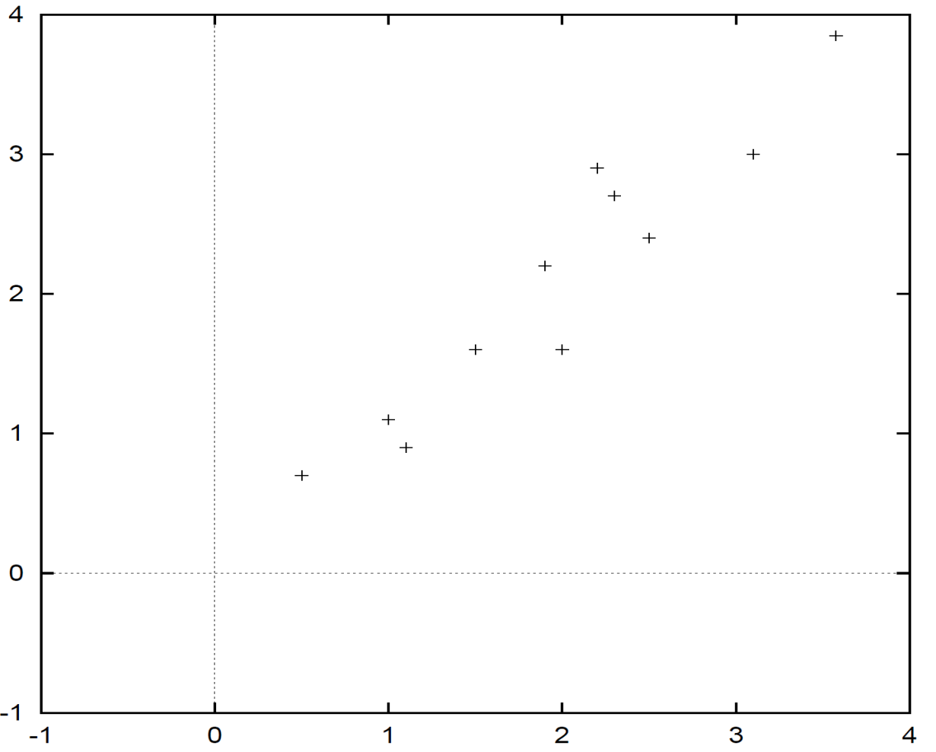
PCA – example

Slide 12
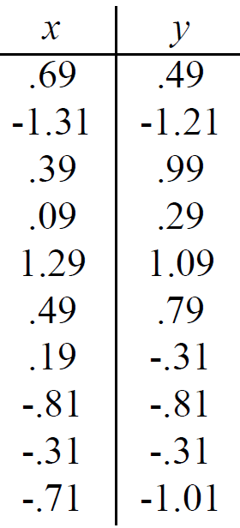
How to proceed?

Slide 13
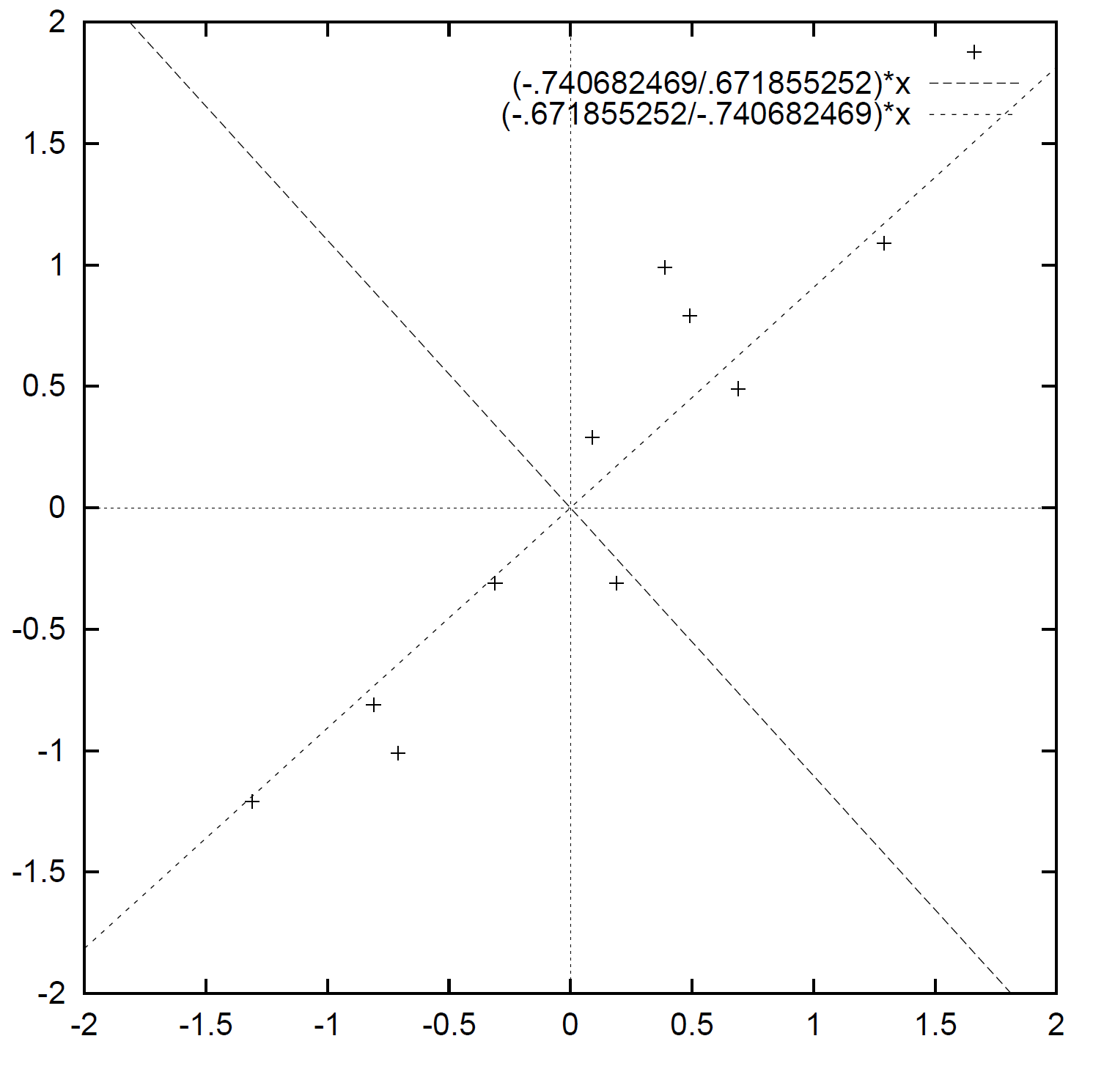
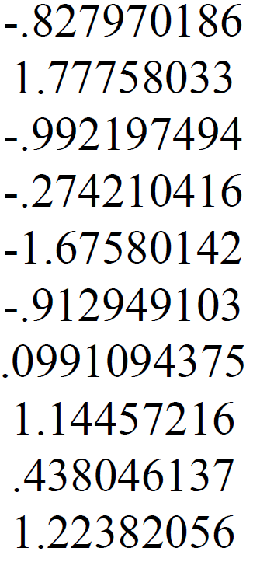
PCA – projection

Slide 14
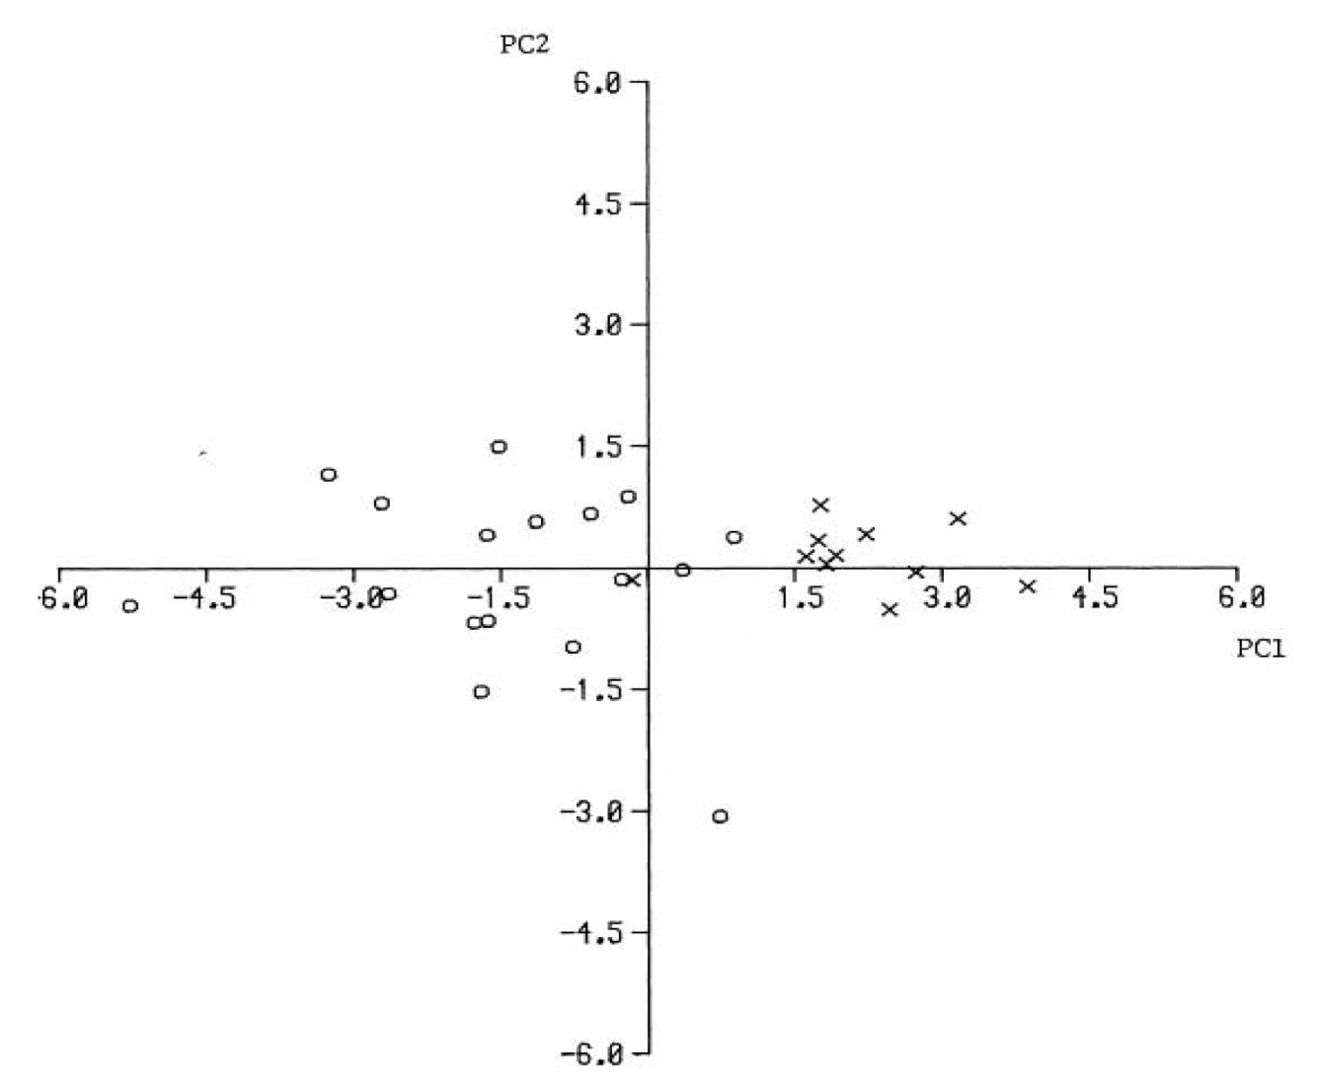
How many axes to keep?
PC1 – 80% variance
Conclusion: you should keep N features having e.g. 90% of share of overall variance

Slide 15
Multidimensional scaling
Multidimensional scaling (Young, Householder, 1938; Torgerson 1952) is a group of dimensionality reduction/visualization which aims at preserving distances between points in the initial and transformed feature space. It is realized through minimizing a cost indicator called stress value:
As MDS operates only on distances it does not require data points (!). Transformation performed by MDS is point-to-point based and it is not explicitly given (no out-of-sample extension).

Slide 16
Nonlinear Sammon Mapping
Nonlinear Sammon Mapping is trhe most common variant of MDS with well defined optimization apparatus and cost function (called Sammon stress):
To minimize the value of S iterative Newton algorithm is employed. Each point is moved according to (α=0,3 ÷ 0,4) (the second term could be named translation vector):

Slide 17
NSM – procedure
Get distance in X.
Set initial locations of points in Y – either randomly or with PCA
Get translation vectors.
Update positions in Y.
Execute 3-4 until the value of S is decreasing.

Slide 18
Example: MDS

Slide 19
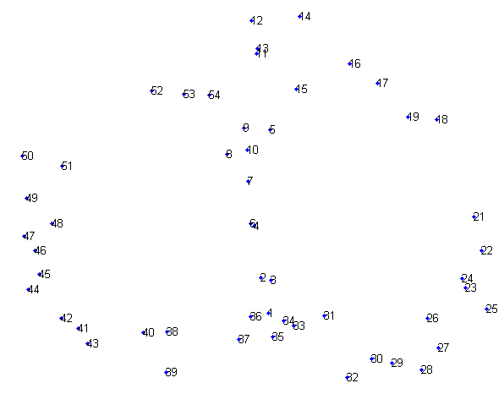
Example: MDS

Slide 20
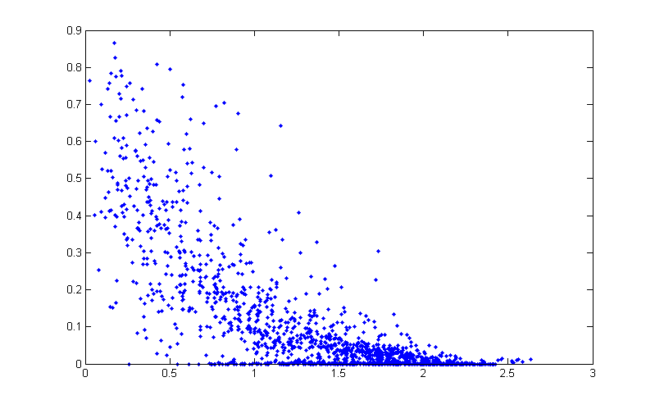
How it works?
Signal
strength
Distance

Slide 21
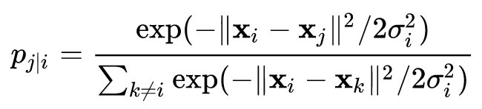
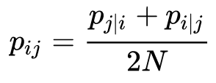
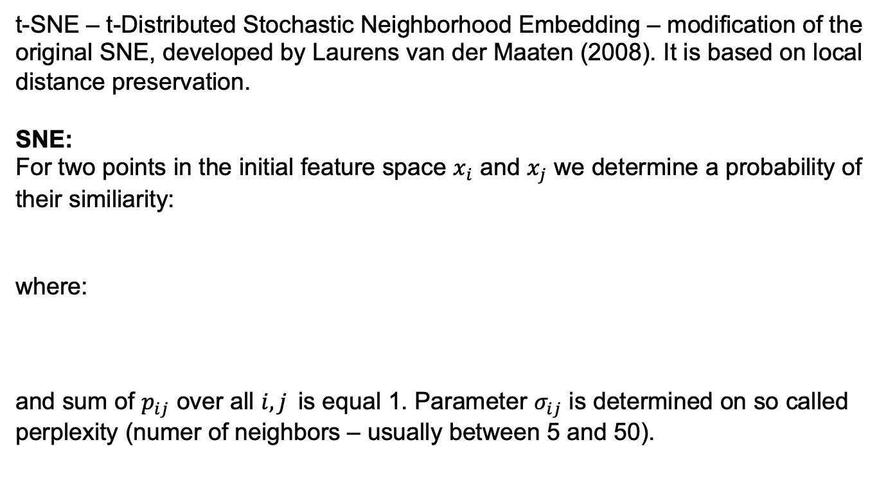
t-SNE
t-SNE – t-Distributed Stochastic Neighborhood Embedding – modification of the original SNE, developed by Laurens van der Maaten (2008). It is based on local distance preservation.
SNE:
For two points in the initial feature space $x_{i}$ and $x_{j}$ we determine a probability of their similiarity:
where:
and sum of $p_{ij}$ over all $i, j$is equal 1. Parameter $σ_{ij}$ is determined on so called perplexity (numer of neighbors – usually between 5 and 50).

Slide 22
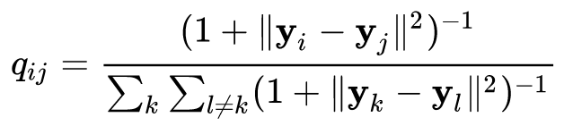
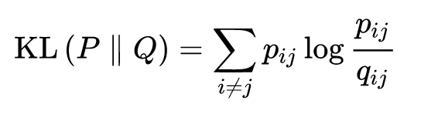
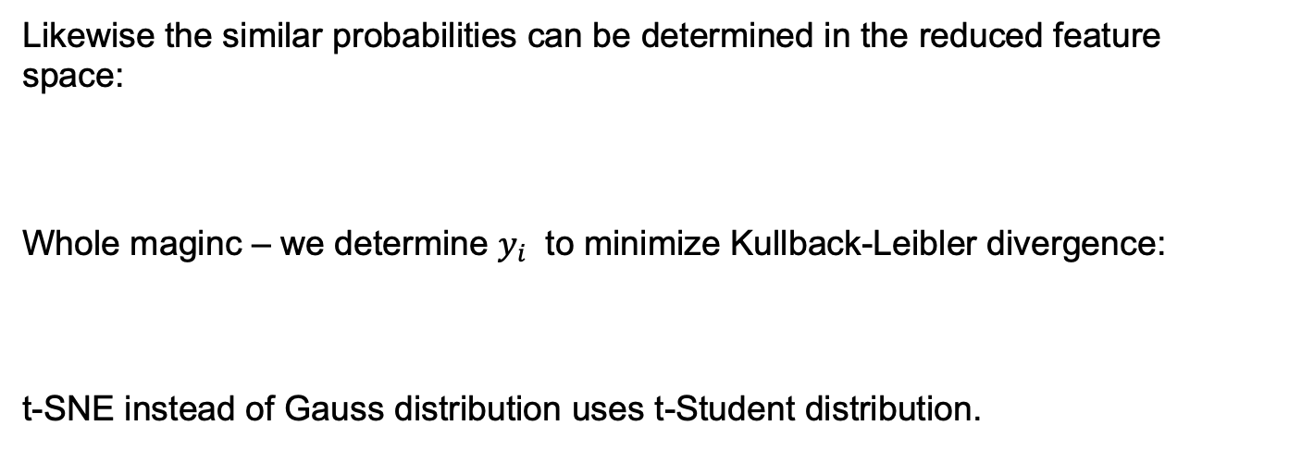
t-SNE
Likewise the similar probabilities can be determined in the reduced feature space:
Whole maginc – we determine $y_{i}$ to minimize Kullback-Leibler divergence:
t-SNE instead of Gauss distribution uses t-Student distribution.

Slide 23
Ilustration
https://www.oreilly.com/content/an-illustrated-introduction-to-the-t-sne-algorithm/

Slide 24
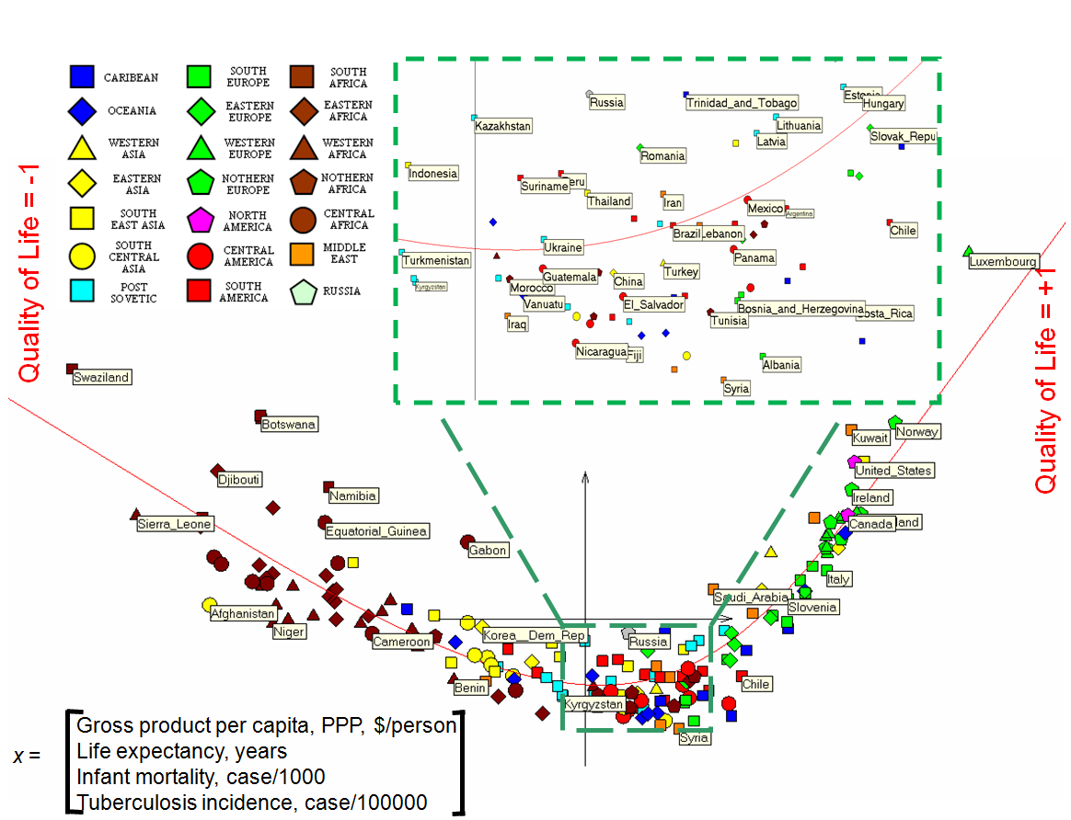
Inny przykład

Slide 25
THE END

