Slide 1
SECURITY OPERATIONS CENTRE / THREAT REVIEW
SOC INCIDENT\nANALYSIS
412
RECORDED INCIDENTS
37
September 2026 | Threat landscape, control effectiveness & remediation roadmap
COMPROMISES
66%
Executive briefing and technical assessment
BLOCKED EVENTS
BASED ON THE PROVIDED SOC DASHBOARD WORKBOOK

Slide 2
SOC SECURITY REVIEW
Executive summary
A month-level view of threat volume, containment and residual exposure
RECORDED INCIDENTS
COMPROMISES
BLOCKED EVENTS
CRITICAL + EMERGENCY
412
37
272
123
September 1–30, 2026
9.0% of incidents
66.0% blocked rate
29.9% of all incidents
EXECUTIVE READOUT
• DDoS is the clearest control gap: the highest compromise rate (23.5%) and the lowest blocked rate among attack categories (54.9%).
• Web Server is the most exposed asset: 103 incidents and 17 recorded compromises; it should lead the remediation queue.
• Nearly 30% of events are Critical or Emergency, requiring strong severity-based triage and escalation.
• Average response time is approximately 33.8 minutes; high-volume and high-impact events warrant faster containment targets.
INTERNAL SECURITY ANALYSIS • SOURCE: SOC DASHBOARD WORKBOOK
02

Slide 3
SOC SECURITY REVIEW
Scope, data sources & interpretation
All workbook tabs were reviewed and mapped to the findings in this briefing
WORKBOOK COVERAGE
INTERPRETATION NOTES
• by_attack — attack mix, unique sources, response time, blocked and compromise rates
• by_country — source geography, critical/emergency volume and asset reach
• by_asset — incident volume, compromise counts, severity and response time
• by_hour — 24-hour activity and severity/response patterns
• top_sources — leading source IPs, target breadth and compromise counts
• daily_trend — daily incident and compromise trajectory
• All_Events — event-level records used as the underlying detail set
• Reporting window: September 1–30, 2026.
• Rates in the attack summary are interpreted as category-level percentages; overall rates are incident-weighted.
• Country of source is a telemetry attribute, not proof of attacker identity or physical location.
• IP addresses shown in the workbook are documentation-range examples; treat them as illustrative identifiers, not attributable public actors.
• One final All_Events compromised field appears malformed/truncated. Summary sheets consistently total 37 compromises; validate the raw event row before operational use.
INTERNAL SECURITY ANALYSIS • SOURCE: SOC DASHBOARD WORKBOOK
03

Slide 4
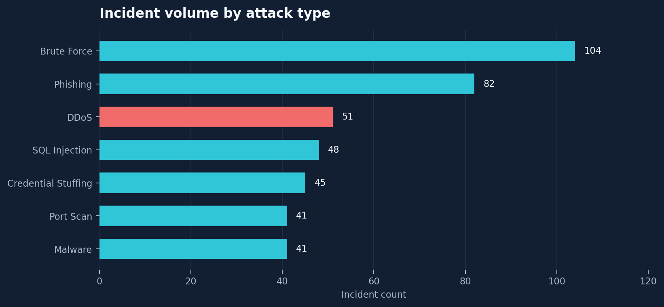
SOC SECURITY REVIEW
Attack landscape: brute force dominates volume
ATTACK TYPE ANALYSIS
WHAT THE DATA SAYS
• Brute Force leads with 104 events (25% of total).
• Phishing is second at 82 events; together these two categories account for 45% of incidents.
• DDoS (51) and SQL Injection (48) are smaller by volume but carry higher compromise risk.
• Prioritise identity hardening alongside application and DDoS controls.
INTERNAL SECURITY ANALYSIS • SOURCE: SOC DASHBOARD WORKBOOK
04

Slide 5
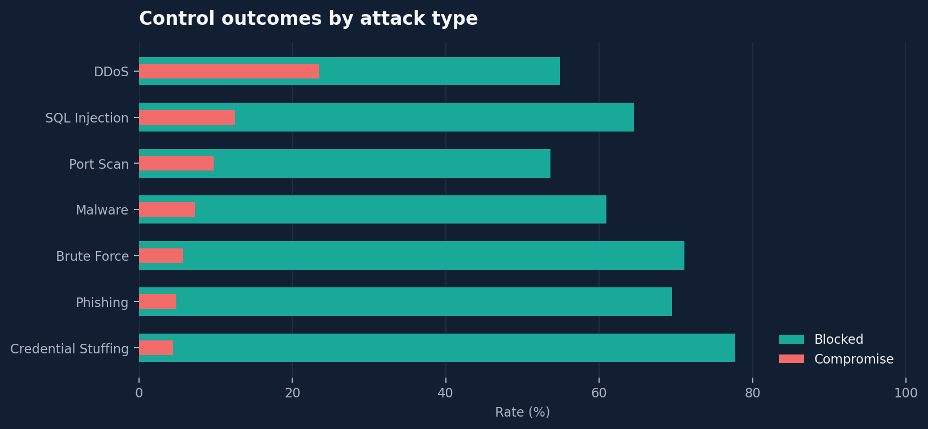
SOC SECURITY REVIEW
Control effectiveness varies sharply by attack type
BLOCKING & COMPROMISE RATES
WHAT THE DATA SAYS
• DDoS: 23.5% compromise rate and only 54.9% blocked.
• SQL Injection: 12.5% compromise rate; review WAF rules and application-layer validation.
• Port Scan: lowest block rate (53.7%); validate detection-to-block automation.
• Credential Stuffing has the strongest block rate (77.8%) and lowest compromise rate (4.4%).
INTERNAL SECURITY ANALYSIS • SOURCE: SOC DASHBOARD WORKBOOK
05

Slide 6
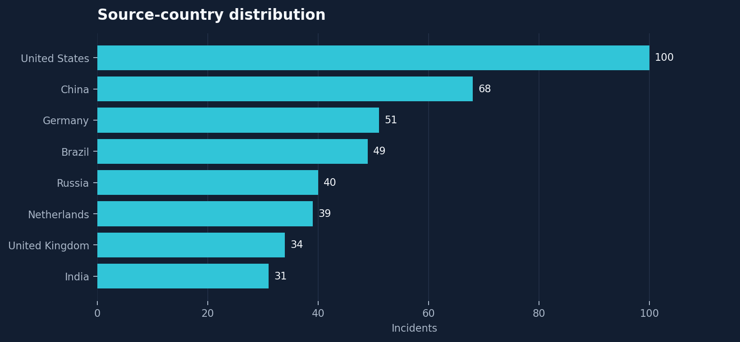
SOC SECURITY REVIEW
Geographic sources: US and China lead volume
SOURCE COUNTRY ANALYSIS
WHAT THE DATA SAYS
• United States: 100 events (24%); China: 68 (17%).
• China contributes 21 Critical/Emergency events; the US contributes 29.
• Russia has the highest blocked rate (80%), while China and the Netherlands are below 60%.
• Use geo-data as a prioritisation signal only; combine with behaviour, reputation and threat intelligence.
INTERNAL SECURITY ANALYSIS • SOURCE: SOC DASHBOARD WORKBOOK
06

Slide 7
SOC SECURITY REVIEW
Geographic risk: severity matters more than volume alone
Critical/emergency counts across source countries
Source country
Incidents
Critical / emergency
Blocked rate
Unique assets
KEY SIGNAL
United States
100
29
63.0%
7
123
China
68
21
58.8%
7
Critical + Emergency events
Germany
51
15
66.7%
7
Brazil
49
15
67.3%
7
29.9%
India
31
12
74.2%
6
Russia
40
12
80.0%
6
of all recorded incidents
United Kingdom
34
11
70.6%
6
Netherlands
39
8
59.0%
7
Operational note: geography is useful for correlation and tuning, but should not drive blocking decisions on its own.
INTERNAL SECURITY ANALYSIS • SOURCE: SOC DASHBOARD WORKBOOK
07

Slide 8
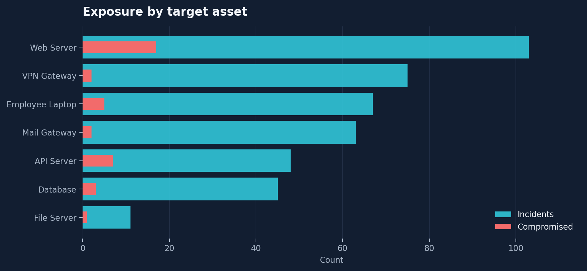
SOC SECURITY REVIEW
Asset exposure: Web Server is the top priority
TARGET ASSET ANALYSIS
WHAT THE DATA SAYS
• Web Server: 103 incidents and 17 compromises (16.5% of its incident volume).
• API Server: 7 compromises from 48 incidents (14.6%).
• Employee Laptop: 67 incidents and 5 compromises; phishing and endpoint controls remain important.
• Database has the highest average severity score (3.29), despite fewer incidents.
INTERNAL SECURITY ANALYSIS • SOURCE: SOC DASHBOARD WORKBOOK
08

Slide 9
SOC SECURITY REVIEW
Asset-specific security priorities
Translate incident distribution into defensive engineering work
WEB SERVER
WAF tuning, virtual patching, secure headers, exposed-service review and continuous vulnerability scanning.
API SERVER
Strong authN/authZ, schema validation, rate limits, secrets rotation, API inventory and abuse detection.
DATABASE
Least privilege, network segmentation, parameterised queries, audit logging, tested backups and encryption.
EMPLOYEE LAPTOP
EDR coverage, patch SLAs, phishing-resistant MFA, application control and local admin reduction.
VPN / MAIL
MFA enforcement, conditional access, attachment/link sandboxing, SPF/DKIM/DMARC and login anomaly alerts.
INTERNAL SECURITY ANALYSIS • SOURCE: SOC DASHBOARD WORKBOOK
09

Slide 10
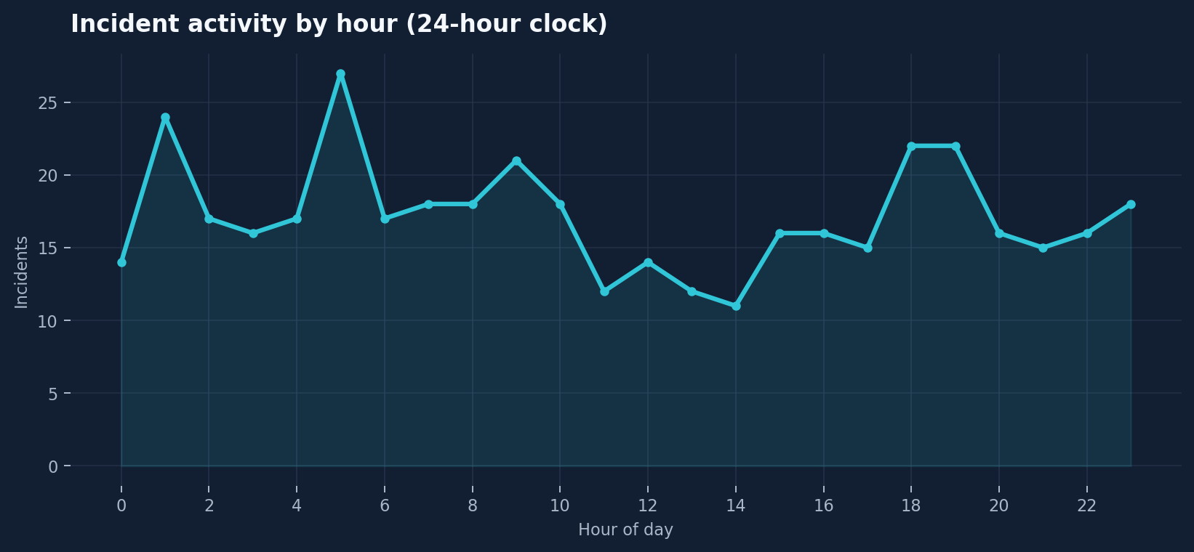
SOC SECURITY REVIEW
Activity is distributed across the full day
HOURLY PATTERN ANALYSIS
WHAT THE DATA SAYS
• The busiest hour is 05:00 (27 incidents), followed by 01:00 (24).
• Activity also rises at 18:00–19:00 (22 incidents each).
• No single short time window captures the threat load; maintain 24/7 alert coverage.
• Check staffing, escalation and automated response coverage for early-morning and evening peaks.
INTERNAL SECURITY ANALYSIS • SOURCE: SOC DASHBOARD WORKBOOK
10

Slide 11
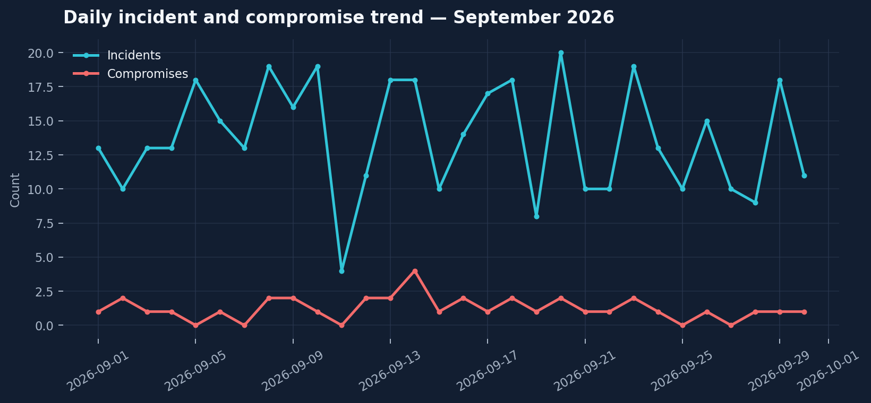
SOC SECURITY REVIEW
Daily trend: incidents fluctuate, compromises persist
DAILY TREND ANALYSIS
WHAT THE DATA SAYS
• 412 incidents and 37 compromises are recorded across September.
• Peak day: September 20 (20 incidents, 2 compromises).
• Other high-volume days include September 8, 10 and 23 (19 incidents each).
• Investigate spikes against change windows, exposed services, campaigns and alert-rule changes.
INTERNAL SECURITY ANALYSIS • SOURCE: SOC DASHBOARD WORKBOOK
11

Slide 12
SOC SECURITY REVIEW
Top source IPs: a small set drives repeated activity
Five highest-volume source identifiers from the workbook
192.0.2.17
14
0 comp.
WHAT STANDS OUT
• 192.0.2.10: 61 incidents, 7 targets and 6 compromises.
• Top three sources generate 126 incidents (31% of total) and 15 compromises.
• Repeated targeting across many assets suggests value in correlation and behavioural grouping.
• Validate reputation and context before blocklisting; IPs can be shared, spoofed or reassigned.
192.0.2.13
18
1 comp.
192.0.2.12
28
4 comp.
192.0.2.11
37
5 comp.
192.0.2.10
61
6 comp.
INTERNAL SECURITY ANALYSIS • SOURCE: SOC DASHBOARD WORKBOOK
12

Slide 13
SOC SECURITY REVIEW
Severity and response: high-impact events need fast containment
Prioritisation should combine severity, exploitability, asset criticality and compromise evidence
CRITICAL / EMERGENCY
AVERAGE RESPONSE
MEAN SEVERITY SCORE
COMPROMISE RATE
123
33.8 min
2.90
9.0%
29.9% of incidents
Incident-weighted estimate
Scale represented in workbook
Summary-sheet derived
RECOMMENDED TRIAGE MODEL
• Emergency / Critical + confirmed compromise: immediate incident commander, isolate affected asset where safe, preserve evidence and invoke escalation.
• High severity or exposed critical asset: rapid containment with explicit owner and short SLA.
• Medium / Low: queue by exploitability, recurrence and asset criticality; hunt for related activity.
• Track time-to-detect, time-to-contain and time-to-recover separately; response time alone does not measure full incident handling.
INTERNAL SECURITY ANALYSIS • SOURCE: SOC DASHBOARD WORKBOOK
13

Slide 14
SOC SECURITY REVIEW
Key security issues identified
Evidence-led findings ranked by impact and urgency
01
DDoS resilience gap
23.5% compromise rate; only 54.9% blocked.
02
Internet-facing web exposure
Web Server: 103 incidents and 17 compromises.
03
Application-layer attack exposure
SQL Injection: 12.5% compromise rate; API Server also shows 7 compromises.
04
Identity attack pressure
Brute Force leads volume (104); phishing adds 82 incidents.
05
Detection / containment opportunity
Port Scan and DDoS have comparatively low block rates; average response ~33.8 min.
06
Data quality limitation
One raw event-level compromised value appears malformed/truncated.
INTERNAL SECURITY ANALYSIS • SOURCE: SOC DASHBOARD WORKBOOK
14

Slide 15
SOC SECURITY REVIEW
Security improvement plan
Practical actions mapped to the highest-risk findings
P0 | NOW
DDoS protection
Validate upstream scrubbing/CDN capacity, WAF and rate-limit policies, autoscaling, runbooks and provider escalation. Test under controlled conditions.
P0 | NOW
Web & API hardening
Run focused external attack-surface and vulnerability assessment; patch critical issues; tighten WAF/API validation and authentication.
P1 | 30 DAYS
Identity resilience
Enforce phishing-resistant MFA for privileged and remote access; tune lockout/risk-based controls; deploy credential-stuffing detection.
P1 | 30 DAYS
Endpoint & email
Confirm EDR coverage, patch compliance, email authentication and attachment/link detonation; run targeted phishing simulations.
P1 | 30 DAYS
SOC automation
Automate enrichment, source/asset correlation, safe containment and escalation for high-confidence DDoS, scanning and brute-force patterns.
P2 | 60–90 DAYS
Governance & resilience
Review segmentation, least privilege, backup restore tests, logging coverage, incident exercises and event-data quality controls.
INTERNAL SECURITY ANALYSIS • SOURCE: SOC DASHBOARD WORKBOOK
15

Slide 16
SOC SECURITY REVIEW
90-day remediation roadmap
Sequence work to reduce immediate exposure while improving operational maturity
0–14 DAYS
15–30 DAYS
31–60 DAYS
61–90 DAYS
Stabilise
Strengthen
Reduce attack surface
Prove resilience
DDoS readiness check • Web/API urgent patching • Review critical alerts • Confirm owners and escalation paths
MFA and credential controls • WAF/API tuning • EDR and email control validation • SOC playbook automation
External exposure review • Segmentation and least privilege • Vulnerability remediation sprint • Restore test
Tabletop exercise • DDoS simulation • Detection coverage review • KPI baseline and continuous improvement
Success criteria: fewer confirmed compromises, higher block effectiveness for DDoS/scan activity, faster containment and verified control coverage.
INTERNAL SECURITY ANALYSIS • SOURCE: SOC DASHBOARD WORKBOOK
16

Slide 17
SOC SECURITY REVIEW
How to measure improvement
Suggested operational KPIs — establish a baseline, then set targets with SOC and system owners
COMPROMISE RATE
Reduce from 9.0%
DDoS BLOCK RATE
Improve from 54.9%
Track by attack type and asset; investigate every confirmed compromise.
Measure blocked / mitigated traffic and service availability during tests.
MEAN TIME TO CONTAIN
Baseline ~33.8 min response
WEB SERVER EXPOSURE
Reduce 103 incidents / 17 compromises
Separate detection, triage, containment and recovery timestamps.
Track critical vulnerabilities, exposed services and repeat incidents.
MFA / EDR COVERAGE
Target 100% privileged MFA & managed endpoints
DATA QUALITY
100% valid event fields
Measure coverage and exceptions, not policy statements alone.
Schema validation, null/enum checks, deduplication and reconciliation.
INTERNAL SECURITY ANALYSIS • SOURCE: SOC DASHBOARD WORKBOOK
17

Slide 18
SOC SECURITY REVIEW
Conclusion: focus on resilience and exposed services
The dataset points to clear, actionable priorities
THREE DECISIONS TO MAKE
BOTTOM LINE
• Fund and test DDoS resilience; this is the most pronounced control weakness in the attack summary.
• Treat Web Server and API Server as priority remediation surfaces, with vulnerability, WAF and secure-configuration work.
• Improve SOC containment through identity-focused detection, playbook automation and measurable response SLAs.
412
incidents reviewed
37 compromises\nrequire focused prevention and containment.
END OF BRIEFING • Recommendations are based on the workbook evidence and should be validated against live telemetry.
INTERNAL SECURITY ANALYSIS • SOURCE: SOC DASHBOARD WORKBOOK
18

Slide 19
SOC SECURITY REVIEW
Appendix: workbook tabs and key metrics
Traceability from source workbook to the analysis
by_attack
7 attack categories; volume, source diversity, response time, block and compromise rates
by_country
8 source countries; volume, Critical/Emergency count, target breadth and block rate
by_asset
7 target assets; volume, compromises, average severity and response time
by_hour
24 hourly buckets; count, severity and response time
top_sources
5 leading source IPs; incident count, target breadth and compromises
daily_trend
30 daily buckets; incident and compromise counts
All_Events
412 event records; incident metadata, timestamp, source, asset, severity, response and outcome fields
INTERNAL SECURITY ANALYSIS • SOURCE: SOC DASHBOARD WORKBOOK
19

