Slide 1

HUBLOT TEAM Predicting french language difficulty
Krzysztof Szerenos
Daniel Poças

Slide 2
presentation plan 1.Accuracy results for basic models 2. lemmanization & stopwords 3.BERT MODEL 4.final model

Slide 3
Initial assumptions Non-Biased dataset Sufficient training size Pertinent distinction between levels

Slide 4
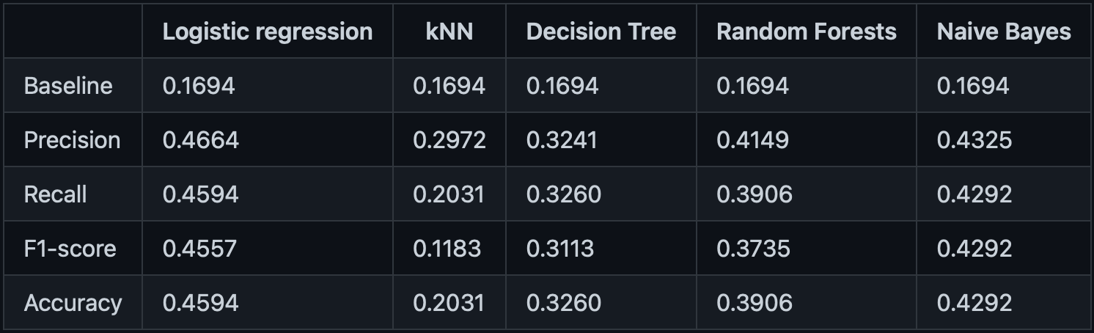
BASIC MODEL RESULTS French language level prediction

Slide 5
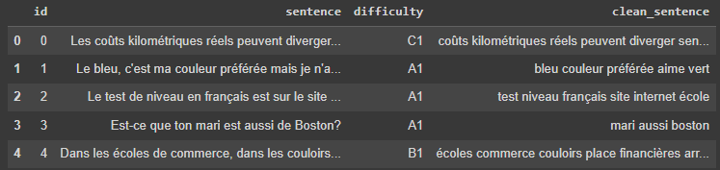
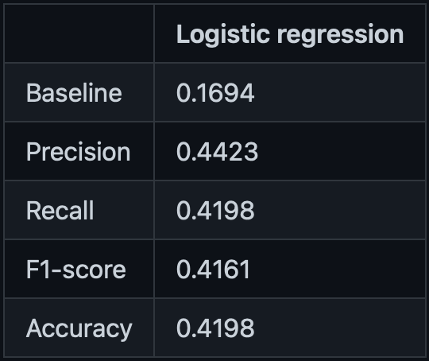
logistic regression Lemmanization & STOPWORDS

Slide 6



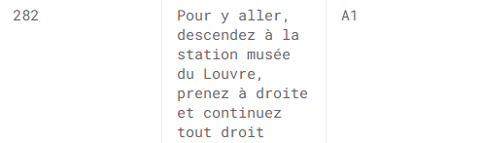
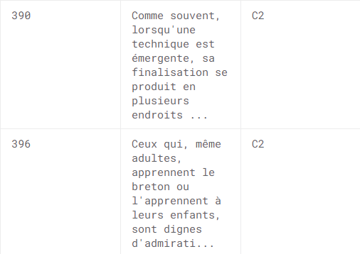

Model Biais

Slide 7
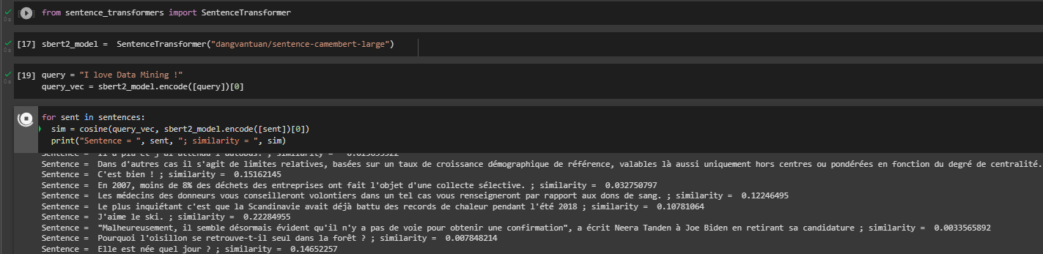
BERT MODEL
Source MODEL
CAMEMBERT LARGE

Slide 8
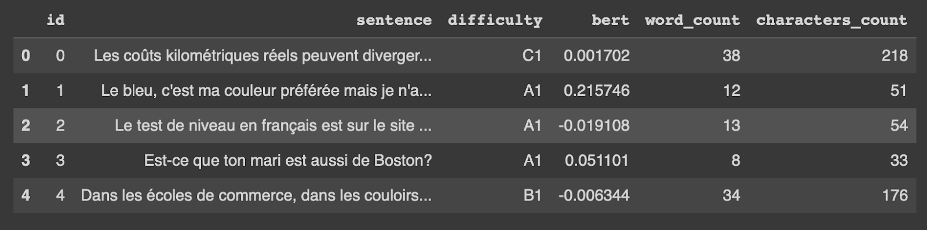
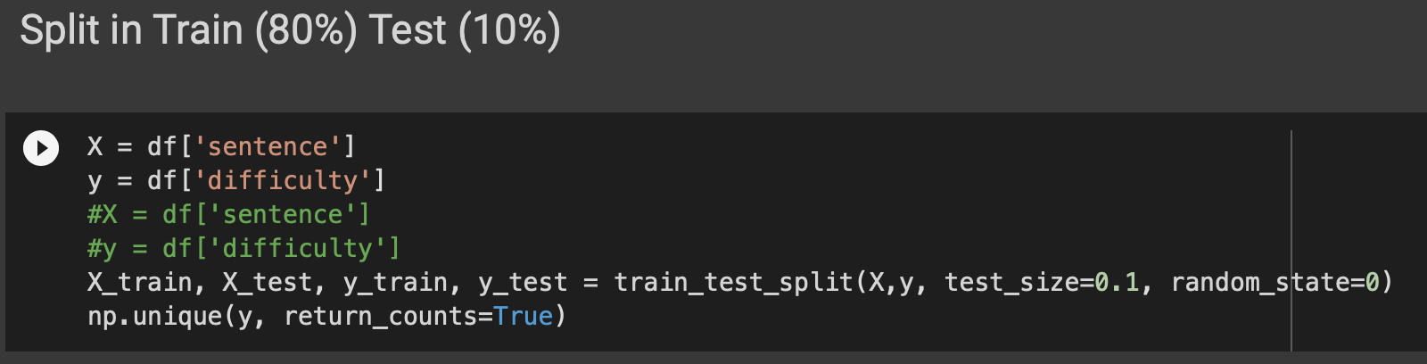
SUBMITTED MODEL (LOGISTIC REGRESSION CV)

Slide 9
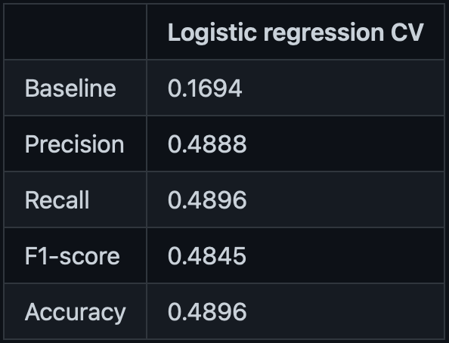
SUBMITTED MODEL (LOGISTIC REGRESSION CV)
RESULT ON THE DATA FROM TRAIN, TEST SPLIT
RESULT OF KAGGLE SUBMISSION

