Slide 1



Wybrane elementy kanału PDSCH systemu 5g NR modelowane w języku opisu sprzętu
Krzysztof Wojtasik
Notes:
Note: After adding your pictures, right click on it and “Send To Back”.

Slide 2

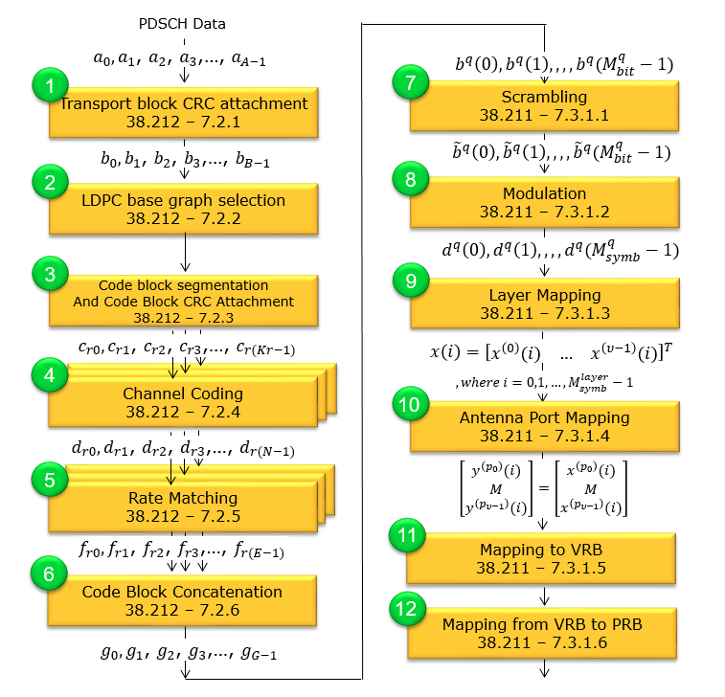
PDSCH
Notes:
Note: After adding your pictures, right click on it and “Send To Back”.

Slide 3
01
Zgodność ze standardem 3GPP
02
Wynik zgodny z danymi referencyjnymi
Założenia
03
Magistrala 64-bit
04
Deterministyczność działania

Slide 4
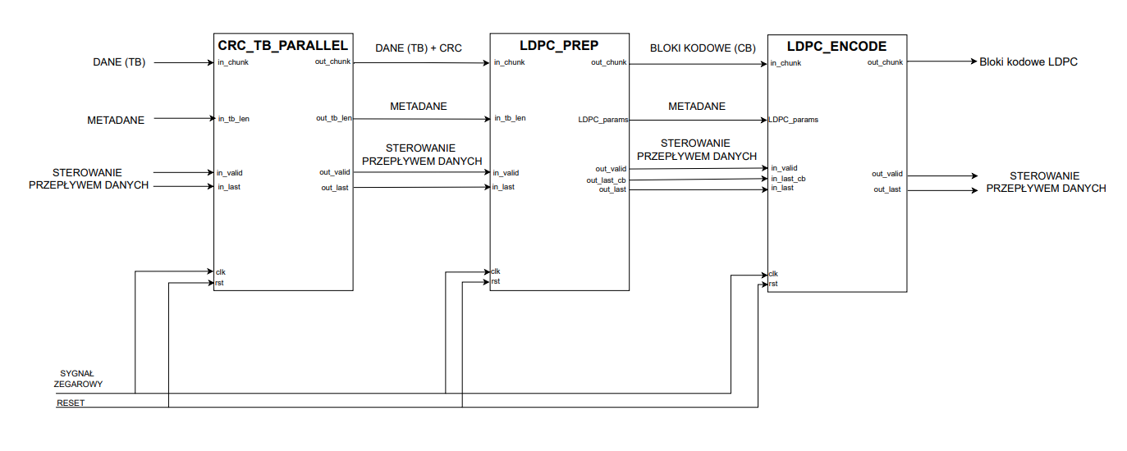
PDSCHTx
Notes:
Note: After adding your pictures, right click on it and “Send To Back”.

Slide 5
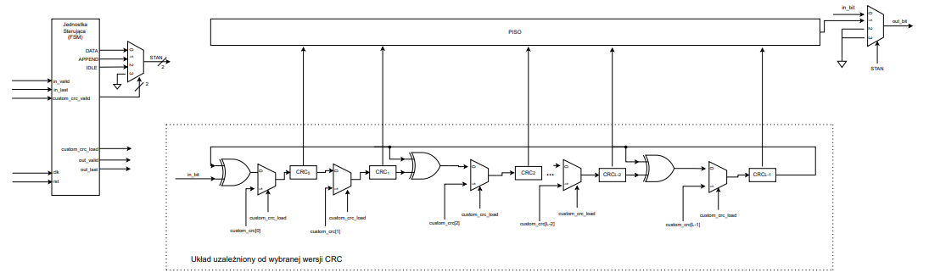
CRC_SERIAL
Notes:
Note: After adding your pictures, right click on it and “Send To Back”.

Slide 6
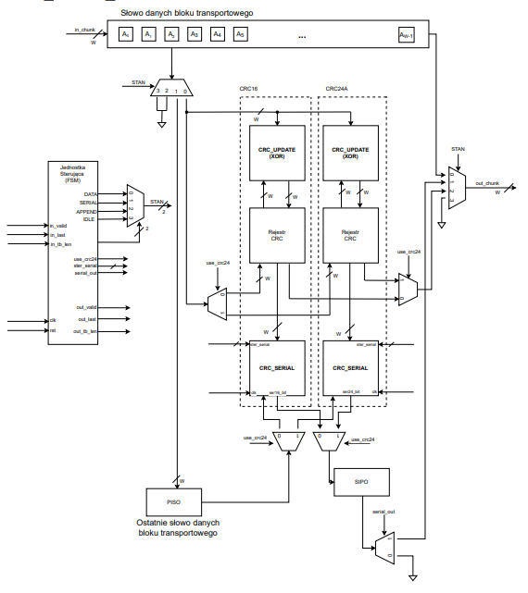
CRC_TB_PARALLEL
Notes:
Note: After adding your pictures, right click on it and “Send To Back”.

Slide 7
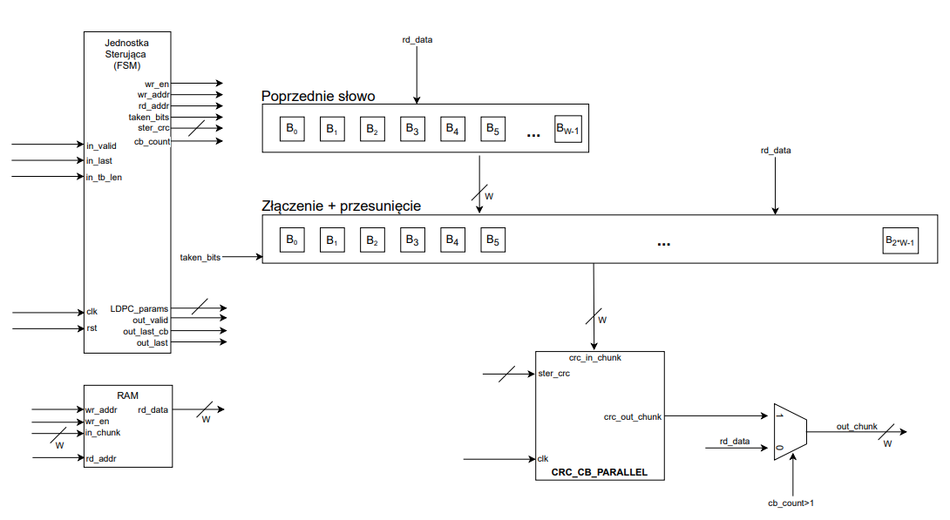
LDPC_PREP
Notes:
Note: After adding your pictures, right click on it and “Send To Back”.

Slide 8
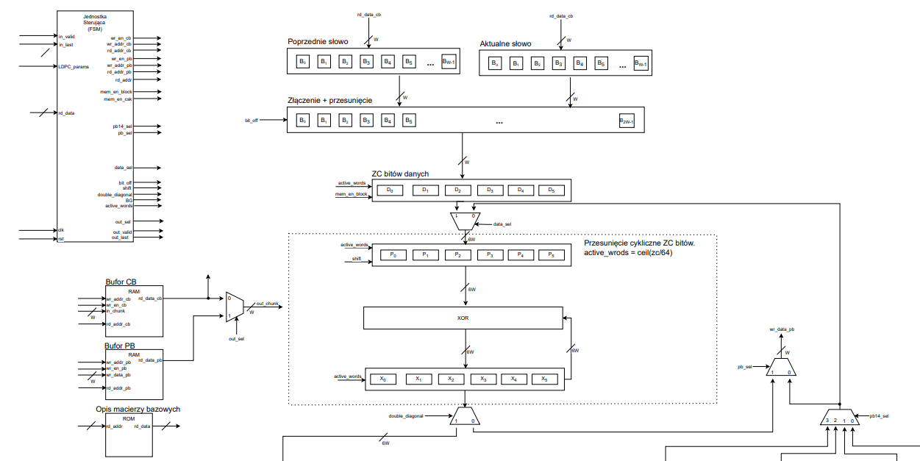
LDPC_ENCODE
Notes:
Note: After adding your pictures, right click on it and “Send To Back”.

Slide 9
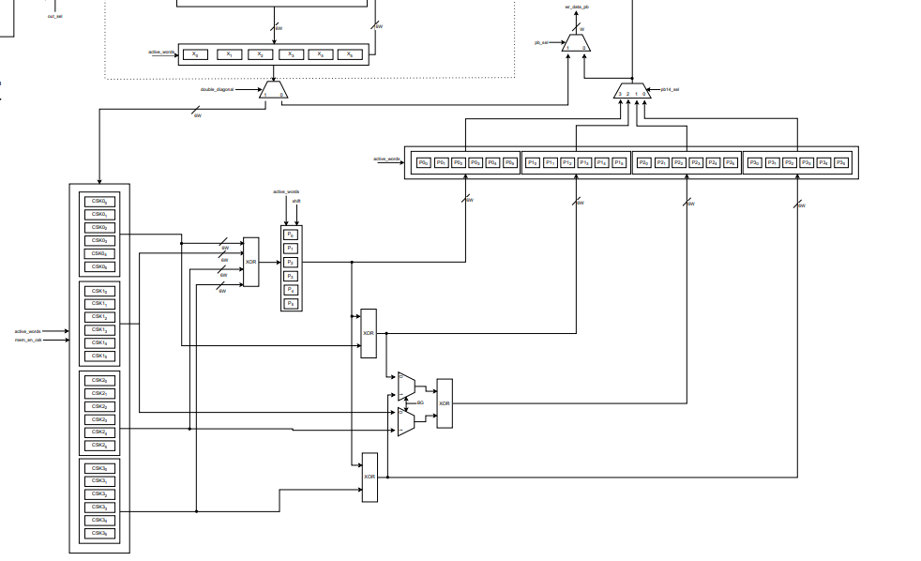
LDPC_ENCODE
Notes:
Note: After adding your pictures, right click on it and “Send To Back”.

Slide 10
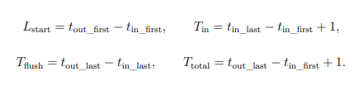
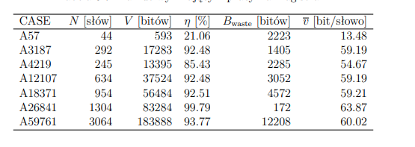
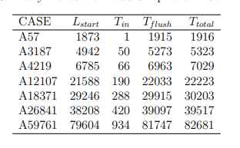
TESTOWANIE

Slide 11

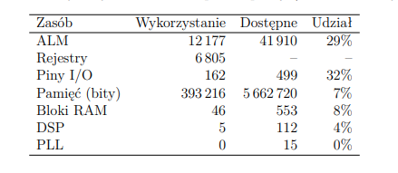
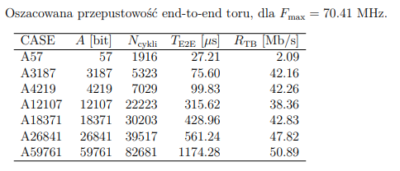
SYNTEZA

Slide 12
WNIOSKI
ORAZ
POTENCJALNE KIERUNKI KONTYNUACJI
Notes:
Note: After adding your pictures, right click on it and “Send To Back”.

