Slide 1
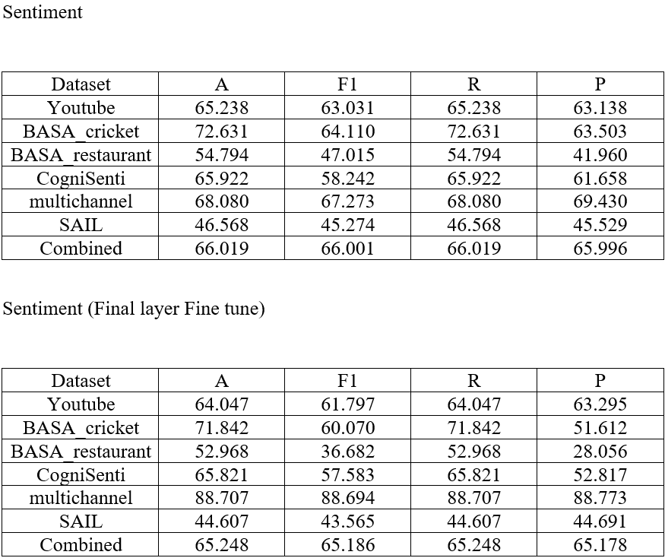
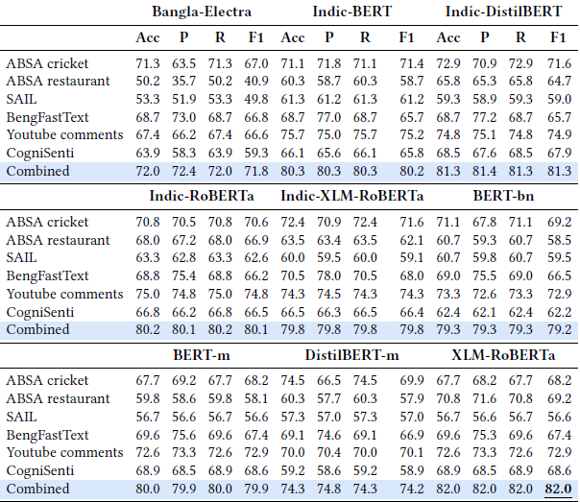
Sentiment Classification
Tiny model
FIROJ ALAM

