Slide 1

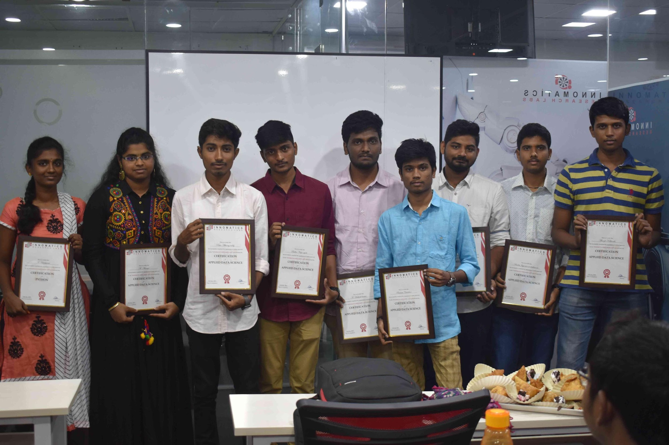
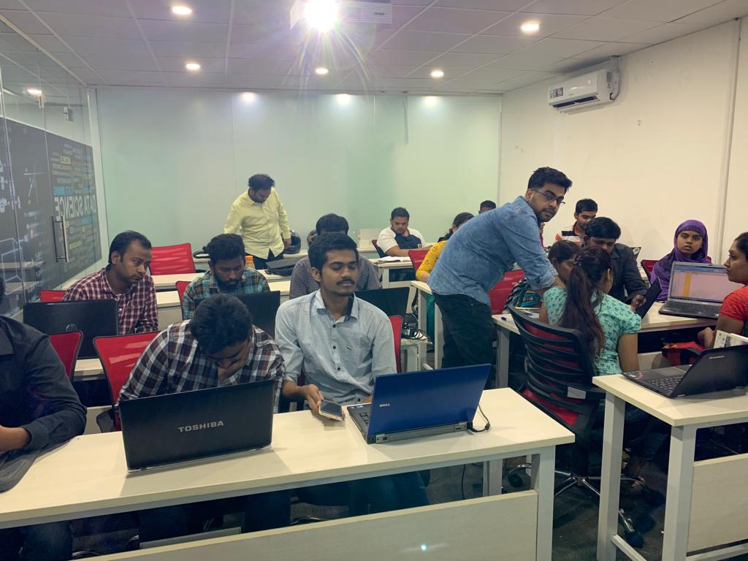





Slide 2
IPL T20
STATISTICS OF INDIAN PRIMERE LEAGUE
2015 TO 2019

Slide 3
About me
My self : K.S.Tejashwini
D/o K.C.Srinivasan
I’m pursuing M.sc(Statistics) in S.V.University Tirupati
I’m from Puttur , near to Tirupati
Being a Statistics student and I know the Basics of c, c++
This made an Interest to learn about Data Science
I’m Interested to Start my Career in Data Science
About Innomatics :
It is really a good platform to learn Data Science
Not only statistics students many of them are achieving in this course,
because the faculties in Innomatics are very experienced
They are available any time to clarify our doubts
Being satisfied for selecting this Institute

Slide 4
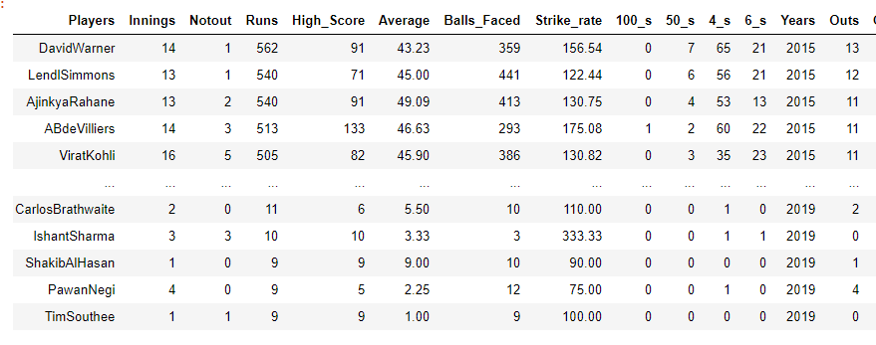
IPL 2015 to 2019
Top 100 players in every year
Extracted from: www.iplt20.com

Slide 5
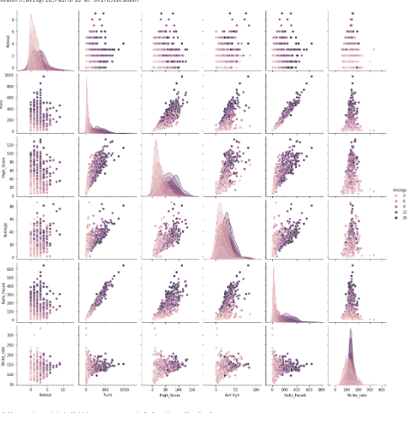
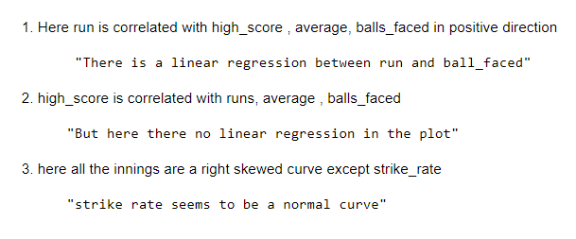
Multi variate Analysis
Pair Plot:
This plot is used to check the relation between
the columns given
Innings

Slide 6
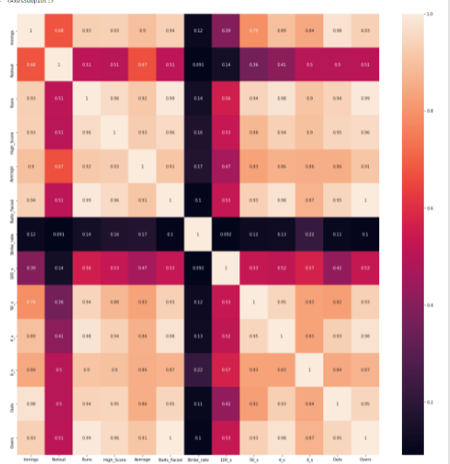
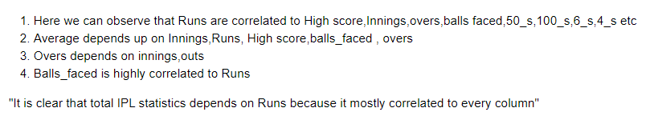
Runs:
Heat map:
This is used to check the correlation between the given variables

Slide 7
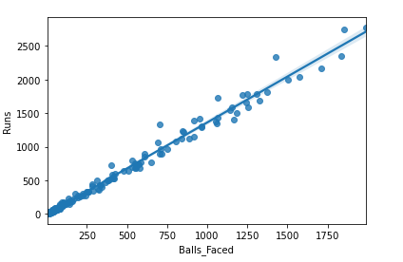
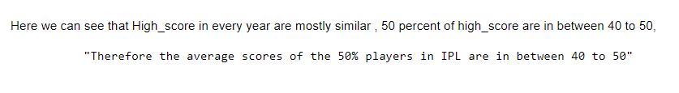
Bi variate Analysis
Balls Faced
High Score
Regression Plot:
This plot gives a line and that line is
said to be as regression line , by that
Line we can say the variable is
correlated to each other or not
Box plot:
This plot is used to check the range of the
given observations
By this plot we’ll have the clear estimation

Slide 8
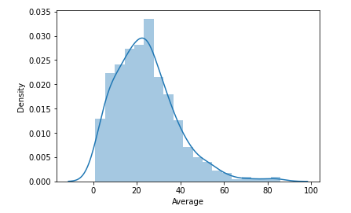
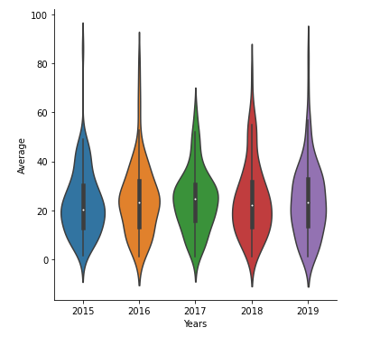


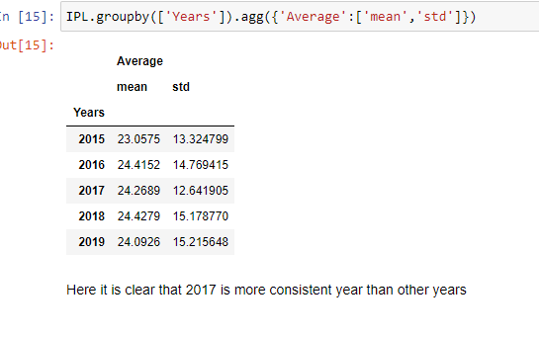
Average
Dist plot : It is a uni variate plot which takes histogram and gives a curve to it
Cat /violin plot : It is a bi variate plot which is equal to
box plot

Slide 9
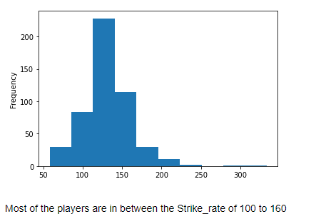
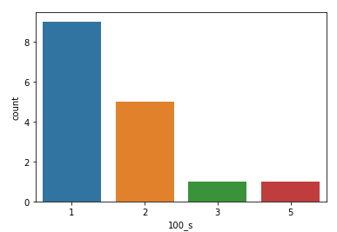

Uni Variate Analysis
Strike Rate
100’s/Centaury
Histogram Plot:
This shows the frequency of the given column
By this we can use dist plot to check the skewness
of the data
Count plot:
This plot counts the values of the
given column in the Data Frame

Slide 10
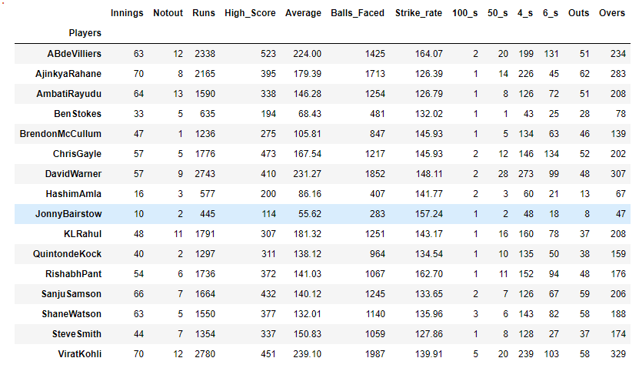
100_s/Centaury

Slide 11
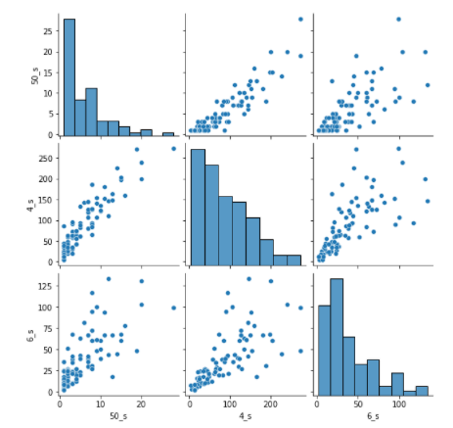
50’s or Half centaury
Pair Plot:
This plot is used to check the relation between
the columns given
This can be plotted by both matplotlib and seaborn
Here the diagonal places show the histogram
If need we can change to other plots also

Slide 12
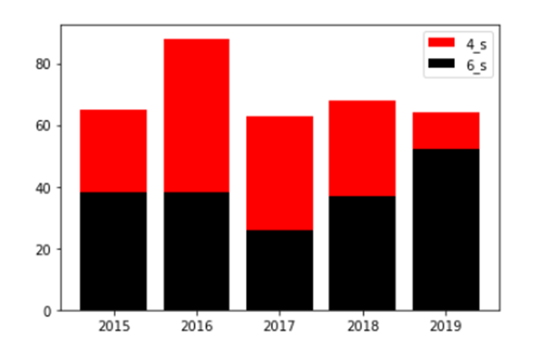
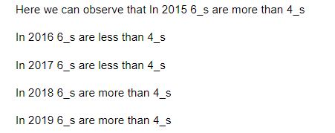
4’s and 6’s
Two Phase Bar plot:
This is a two phase bar chart in which
we can understand easily that which is lower and
which is higher

Slide 13
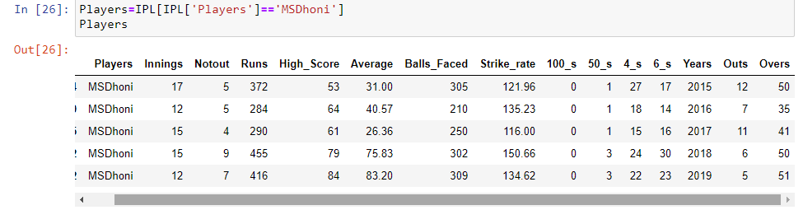
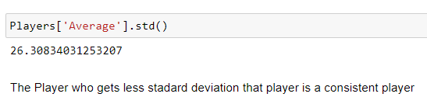
Players scorings details

Slide 14
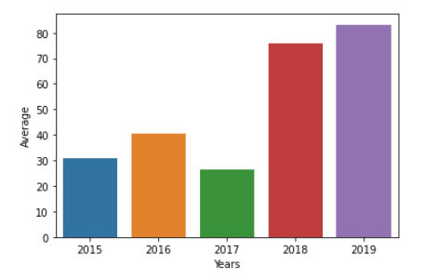
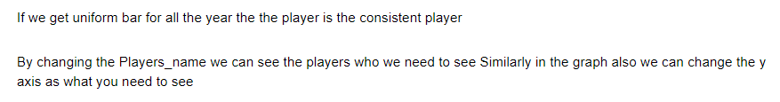
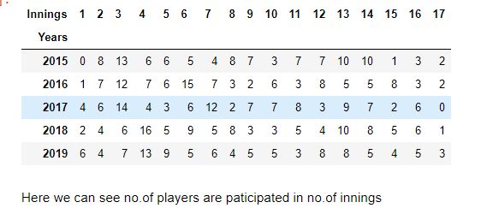
Single Bar chart:
It bi variate plot which describes the range
of the given column

Slide 15
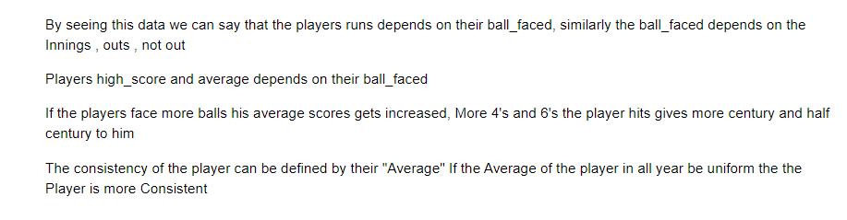
Conclusion :
Future scopes:
In future by using these maps we can analyse who is the consistent player ,
by analysing this we can predict the result of the IPL
We can also predict the players Score by seeing their strike rate from year to year

Slide 16

THANK YOU

