Slide 1
1. Problem & Goal: Personalizing 62,000 Movies in Milliseconds
0:00–1:00 | Large-Scale Two-Stage Personalized Recommendation Engine
• Catalog scale challenge: scoring 62,000+ MovieLens films with a deep feature-cross network per request is too slow at scale.
• Industry Two-Stage solution: fast ANN candidate generation (62k → 300) followed by rich neural ranking (300 → 10).
• Strict evaluation discipline: chronological 80 / 10 / 10 time split (1996–2016 Train, 2016–2018 Val, 2018–2019 Test).
• Key target metrics: Stage-1 Recall@K, Stage-2 NDCG@10, Simulated Replay CTR, and p95 Latency (<10 ms).

Slide 2
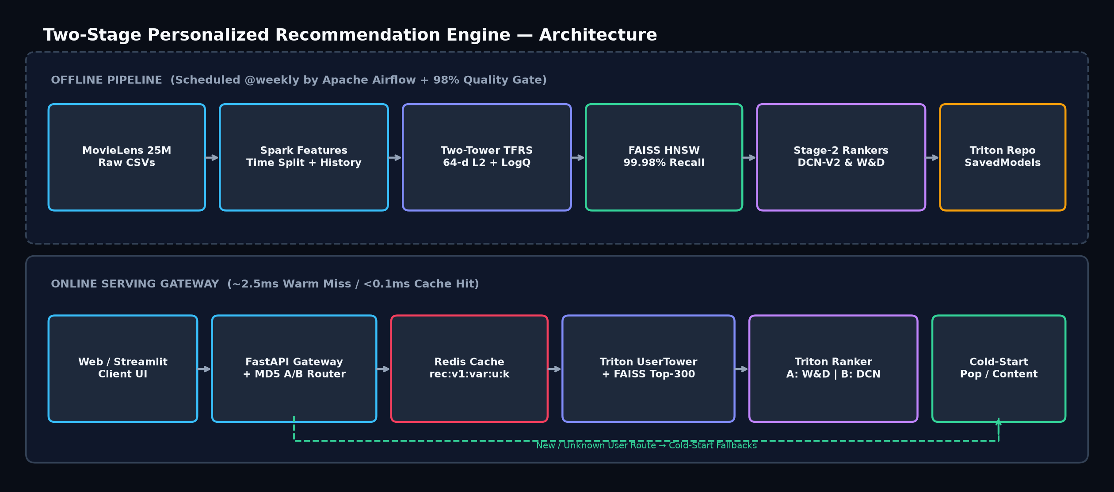
2. End-to-End Two-Stage Architecture
1:00–2:00 | Offline Weekly Pipeline + Low-Latency Online Gateway
• Stage 1 Retrieval: Two-Tower neural net (64-d L2 embeddings + LogQ frequency correction) indexed in FAISS HNSW.
• Stage 2 Ranking: DCN-V2 (3 explicit feature-cross layers) vs Wide & Deep over 50 shared user/item/cross features.
• Online Stack: FastAPI gateway + deterministic MD5 A/B router + versioned Redis TTL cache + Cold-Start fallbacks.
• Cloud Ready: Docker + Triton SavedModels AND zero-config Vercel & Netlify serverless deployment bundle.

Slide 3
3. Why Time Split, FAISS HNSW & Explicit Crosses?
2:00–3:00 | Preventing Data Leakage & Scaling Vector Search
• Why chronological split: random splits leak future popularity & user tastes (predicting 2015 from 2019 ratings).
• Why FAISS HNSW: 99.98% exact@100 accuracy at 28,736 QPS (25.63x faster at 300k scale).
• Why DCN-V2: learns combinatorial interactions (User Genre Affinity × Movie Genre × Recent Popularity × Retrieval Cosine).
• Zero Training-Serving Skew: single build_dense() function in src/ranking/features.py imported by training & serving.

Slide 4
4. Build: Leak-Free Feature Engineering
3:00–3:45 | 2-Pass 5-Core Filtering, Past-Only Windows & Train-Only Statistics
• ID Mapping: dense_rank integer IDs built strictly from Train; index 0 reserved for padding & unseen cold-start entities.
• Sliding History Window: rowsBetween(-20, -1) guarantees current movie never leaks into its own input history.
• 50 Dense Ranking Features: log1p(u_n), u_avg, 20 user genre affinities, log1p(n_pos), 90-day recency, 20 genres, cosine & cross.
• Verified automatically by pytest leakage guards (test_time_split_no_overlap & test_history_is_past_only).

Slide 5
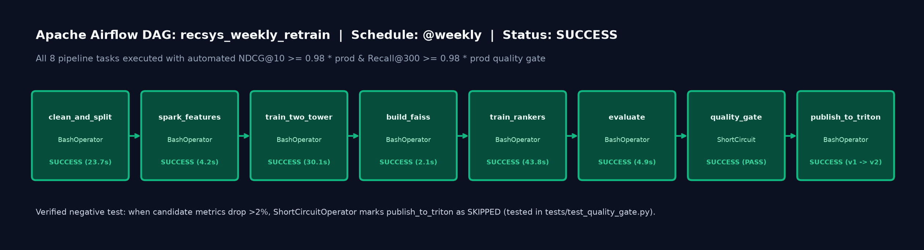
5. Build: Serving Stack & Weekly Airflow Retraining
3:45–4:30 | Triton SavedModels, Versioned Cache & Automated Quality Gate
• Triton Repository: user_tower, ranker (DCN-V2), and ranker_wd (Wide & Deep) exported with matching config.pbtxt.
• Cache Isolation: Redis keys embed model version (rec:v1:variant:uid:k) so retraining invalidates stale cache cleanly.
• Cold-Start Matrix: Warm (>=5 likes), Lukewarm 50/50 blend (1–4 likes), Content-Based Onboarding, and Genre Popularity.
• Airflow Quality Gate: ShortCircuitOperator blocks model promotion if NDCG@10 or Recall@300 drops >2% below prod.

Slide 6
6. Three Real Challenges & How We Fixed Them
4:30–6:00 | Debugging Selection Bias, Popularity Penalization & Git Ignore Collisions
• 1. Ranker Cosine Inversion: sampling negatives only from FAISS top-120 while positives included unretrieved items inverted cosine weights → fixed by session-level Stage-1 top-300 candidate impressions on Val.
• 2. In-Batch Negative Popularity Bias: popular movies appeared as negatives in every batch → fixed with LogQ frequency correction, lifting Recall@300 to 0.2979 vs 0.2694 popularity.
• 3. Root vs Nested .gitignore & Redis Latency: unanchored 'data/' ignored src/data/, and offline Redis retried sockets per call → fixed with '/data/' anchoring and a 15s circuit-breaker.

Slide 7
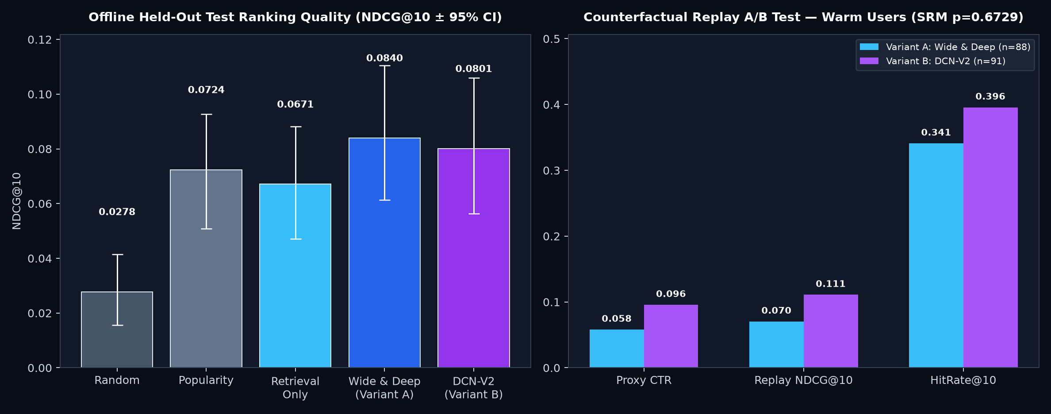
7. Offline Evaluation: Retrieval & Ranking Results
6:00–7:00 | Held-Out 2018–2019 Test Split Performance
• Stage-1 Recall@100: Two-Tower 0.1610 vs Popularity 0.1493 vs Random 0.0066.
• Stage-1 Recall@300: Two-Tower 0.2979 (+10.6% relative lift over Popularity 0.2694).
• Stage-2 NDCG@10: Wide & Deep 0.0840, DCN-V2 0.0801 vs Retrieval-only 0.0671 (+25% lift).
• HitRate@10: Stage-2 rankers place at least one future liked film in Top-10 for 36.5% of warm test users.

Slide 8
8. Counterfactual Replay A/B Test & Latency
7:00–8:00 | 1,100 Simulated Visitors (Proxy Click = Held-Out Rating >= 4.0)
• Sample Ratio Mismatch (SRM) Check: A=557 vs B=543 (Chi-square p=0.6729 — Pass).
• Warm Cohort Proxy CTR: Variant A (Wide & Deep) = 0.0580 vs Variant B (DCN-V2) = 0.0956 (diff +0.0376, p=0.0913).
• Warm Cohort HitRate@10: Variant B reaches 39.6% vs Variant A 34.1% (honest replay simulation, overlapping 95% CIs).
• Serving Latency: Warm Miss p50=2.53ms (p95=3.84ms) → Cache Hit p50=0.06ms (~42x faster).

Slide 9
9. Interactive Demo: Local, Docker, Vercel & Netlify
8:00–9:00 | 5-Tab Web Application + Streamlit UI + Swagger /docs
• 1. Warm User Request: inspect watched history, Stage-2 logits, and click Repeat to drop latency to <0.1 ms via cache.
• 2. Cold-Start Onboarding Lab: compare Zero-Info Popularity vs picking 3 Sci-Fi films (Matrix, Star Wars, Inception).
• 3. A/B Ranker Arena: side-by-side Wide & Deep vs DCN-V2 rankings highlighting feature-cross rank shifts.
• 4. One-Click Cloud Deployment: exported 1.86 MB model bundle runs live on both Vercel and Netlify serverless.

Slide 10
10. Honest Limitations & Production Next Steps
9:00–10:00 | Roadmap Beyond MovieLens 25M
• Honest Limitations: explicit ratings >=4.0 proxy for clicks; offline replay lacks position-bias & real UI impressions.
• Sequential User Tower: upgrade masked-average history to a Transformer (SASRec / BERT4Rec) to capture watch order.
• Diversity & Freshness Re-Ranker: add Maximal Marginal Relevance (MMR) to prevent single-genre saturation in Top-10.
• Online Feature Store & Observability: integrate Feast + Prometheus/Grafana drift alerts on Triton port 8002.

