Slide 1
WiGLE.net: A Comprehensive Overview
Presented by: Sam Mendez

Slide 2

Introduction to WiGLE.net
What is WiGLE.net?
Wireless Geographic Logging Engine (WiGLE)
Platform for collecting and sharing information on wireless networks worldwide
Purpose:
Assist in security research
Aid in geographic analysis of wireless network data

Slide 3
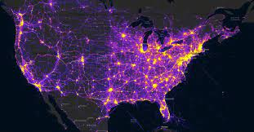
Key Features of WiGLE.net
Comprehensive Database:
Over 500 Million Wi-Fi networks logged
Search and Visualization:
Interactive map to locate and visualize wireless network
Data Collection:
User-contributed data through various methods
WiGLE app: Automatically logs Wi-Fi networks as users move around
API integration: Developers can use WiGLE’s API to submit data programmatically
Wardriving: Collecting Wi-Fi data by driving or walking around area with Wi-Fi scanning tools
Network Details:
Service Set Identifier – Name of the Network (SSID), Basic Service Set Identifier – MAC Address (BSSID), encryption types and GPS coordinate

Slide 4
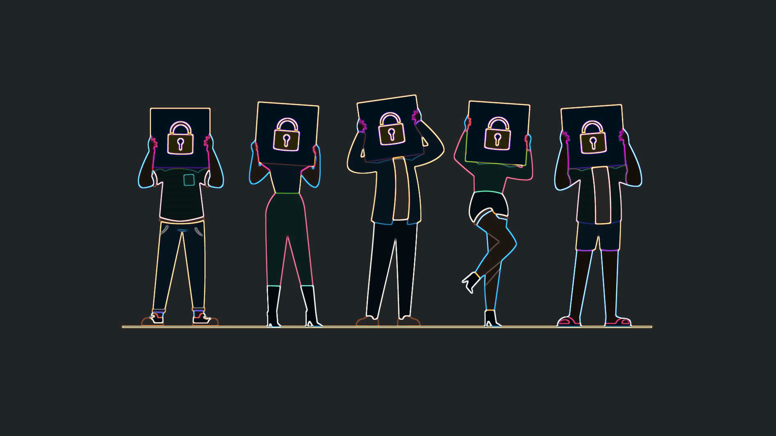
Data Privacy and Security
Anonymized Data:
No Personal data collected, only network metadata
User Consent:
Users voluntarily contribute data
Security Measures:
Data Transmission is encrypted
Regular audits and updates to ensure security

Slide 5

Benefits for Cybersecurity Professionals
Network Security Assessment:
Identify unsecured or poorly networks
Penetration Testing:
Gather reconnaissance data for wireless security audits
Geolocation Analysis:
Track the spread and density of wireless networks
Educational Tool:
Aid in teaching wireless security concepts

Slide 6



Potential Misuse by Threat Actors
Reconnaissance
Threat actors can use WiGLE to identify and locate vulnerable networks
Mapping Attack Vectors:
Visualize areas with dense networks for targeted attacks
BSSID Tracking:
Track specific devices or users based on BSSID data
Identifying Weak Encryption:
Exploit networks with weak or outdated encryption

Slide 7
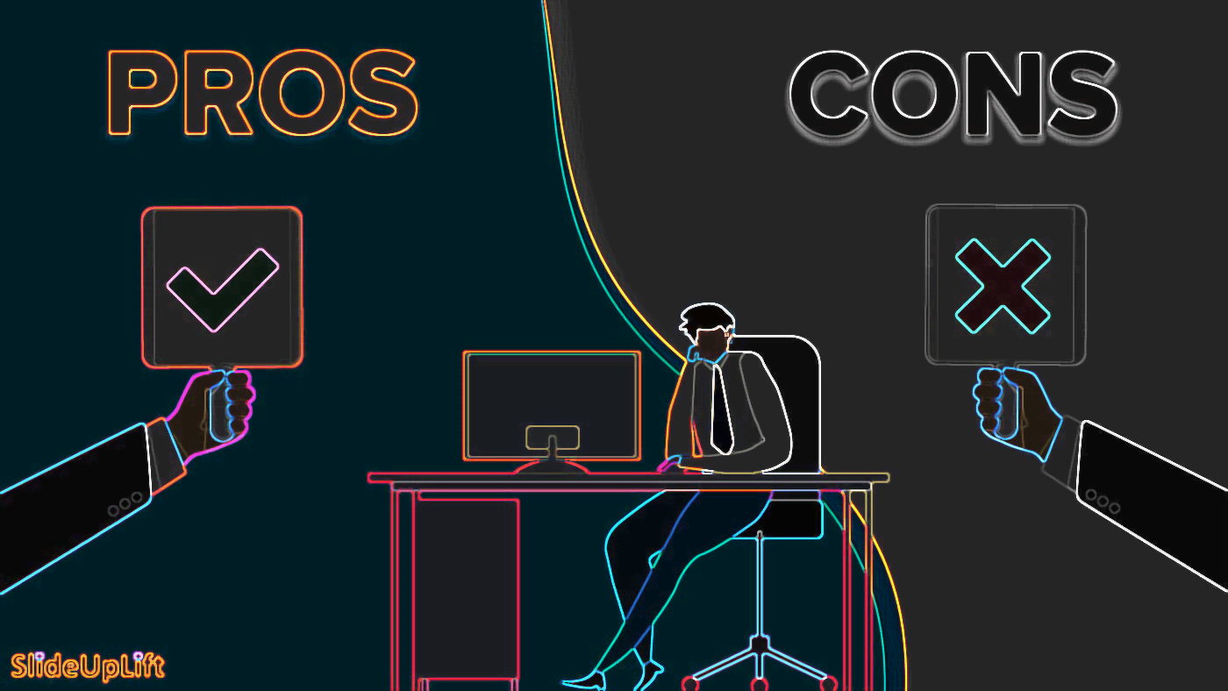
Extensive Data Collection
Large Database of wireless networks for research
Useful for Security Research
Helps identify security weaknesses and trends
Geographic Insight
Provides spatial analysis of wireless networks
Education Resource
Valuable for learning and teaching network security concepts
Privacy Concerns
Potential misuse of network data for malicious purposes
Anonymity Issues
Despite anonymization, specific devices could be tracked
Security Risks
Identifying vulnerable networks might lead to unauthorized access
Ethical Considerations
Use of the data should adhere to ethical guidelines and legal regulations

Slide 8

Conclusion
Summary
WiGLE is a powerful tool with significant benefits for cybersecurity research and education
Potential for misuse requires careful consideration and responsible use
Recommendation
Utilize WiGLE for legitimate security research and educational purposes
Adhere to ethical guidelines and legal regulations
Implement robust security measures protect data privacy and integrity

