Slide 1

Welcome to the
Ottawa

Slide 2

Agenda
Time | Details
08h30-9h00 | Arrival/ Coffee
09h00-9h15 | Intro
09h15-10h00 | Lab 1 - CI/CD
10h00-10h45 | Lab 2 - ARM template
10h45-11h30 | Lab 3 - Container 1
11h30-12h15 | Lab 4 - Containers 2
12h15-13h00 | Lunch
13h00-13h45 | Lab 5 - AI
13h45-14h30 | Lab 6 - Serverless
14h30-15h15 | Lab 7 - Security
15h15-12h30 | Endind
This Photo by Unknown Author is licensed under CC BY-SA

Slide 3

Are you ready?
Did you install all the pre-requisites?
Do you have an Azure Subscription?
Did you download the Repository?
Not sure?
github.com/msdevmtl/GlobalAzureBootcamp-2019
This Photo by Unknown Author is licensed under CC BY-SA-NC

Slide 4
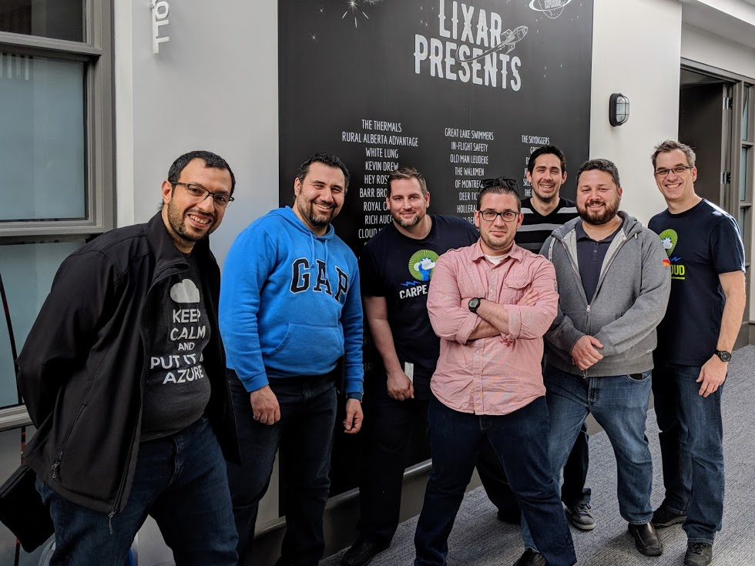
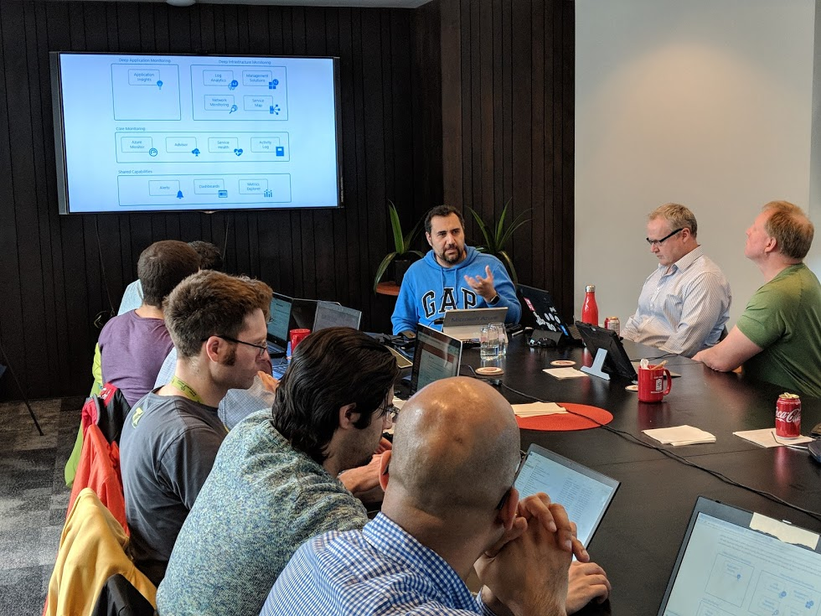

Slide 5
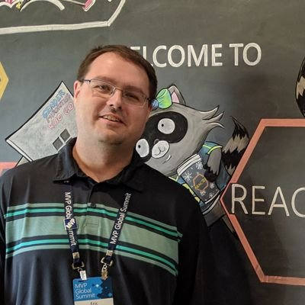
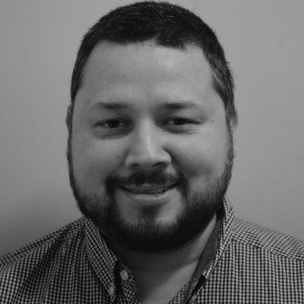
Speakers
Eric Leonard
Juan Martinez
Twitter: @erleonard
Blog: erleonard.me
Other: linkedin.com/in/juancarlosmartinez
This Photo by Unknown Author is licensed under CC BY-SA-NC

Slide 6
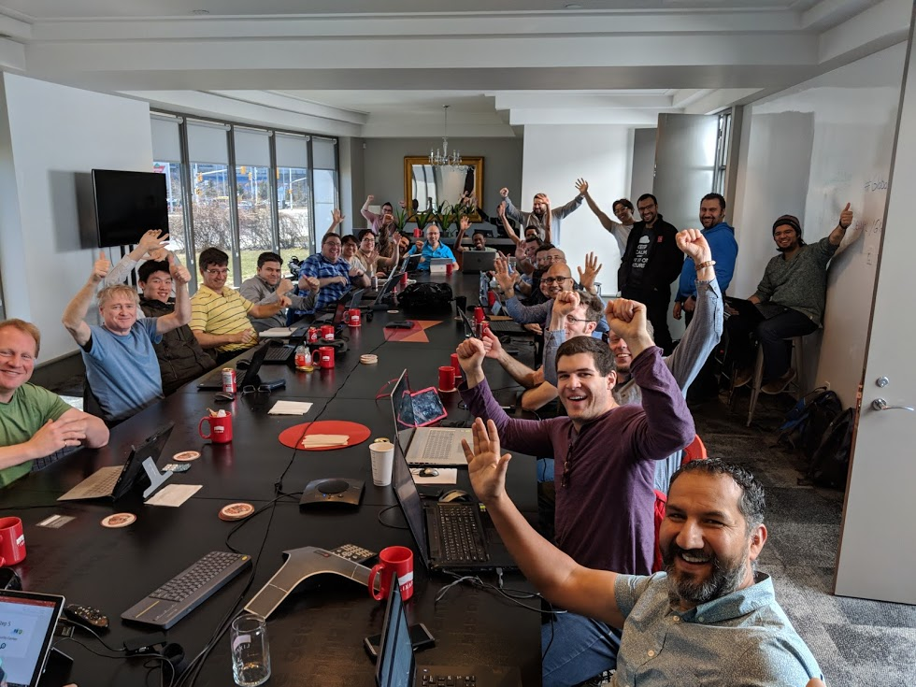
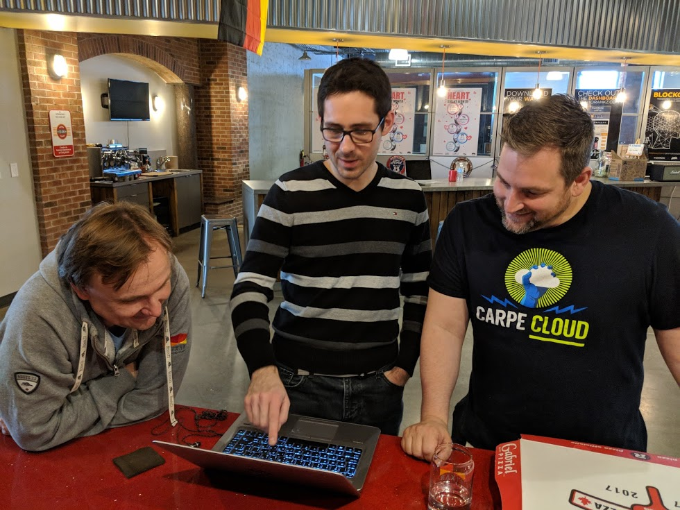

Slide 7
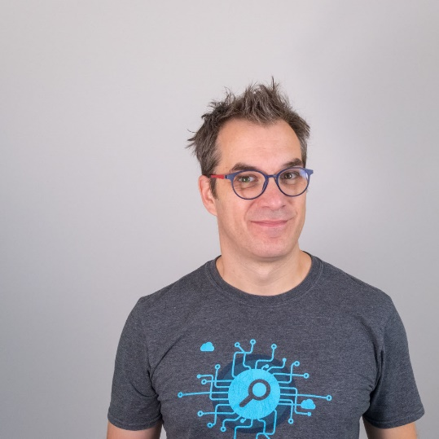
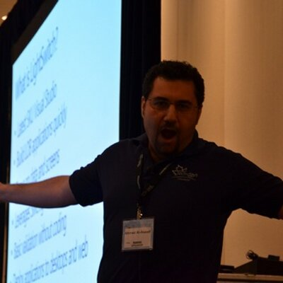
Speakers
Frank Boucher
Ahmed Al-Asaad
Twitter: fboucheros
Blog: frankysnotes.com
Other: YouTube.com/fboucheros
Twitter: AhmedAlAsaad
Other: lajak.com
This Photo by Unknown Author is licensed under CC BY-SA-NC

Slide 8
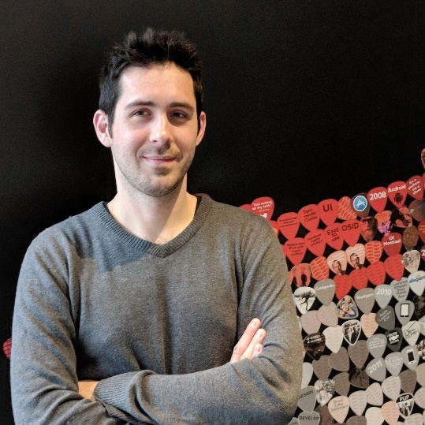
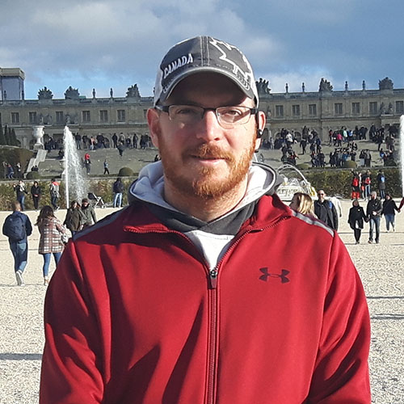
Speakers
Vivien Chevallier
Carl-Hugo Marcotte
Twitter: vchevallier
Blog: vivien-chevallier.com
Twitter: CarlHugoM
Blog: forevolve.com
Other: github.com/Carl-Hugo
This Photo by Unknown Author is licensed under CC BY-SA-NC

Slide 9
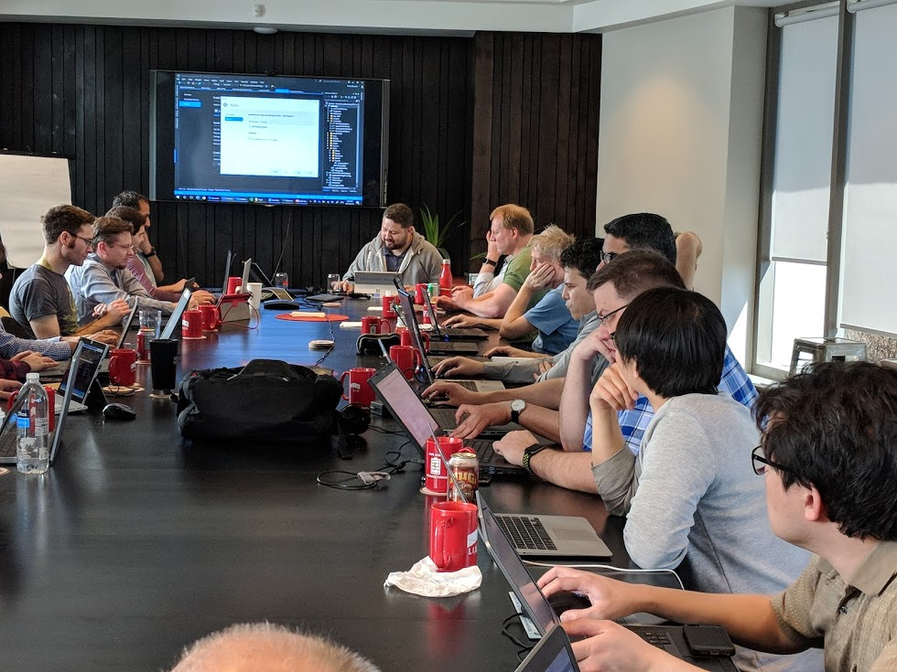
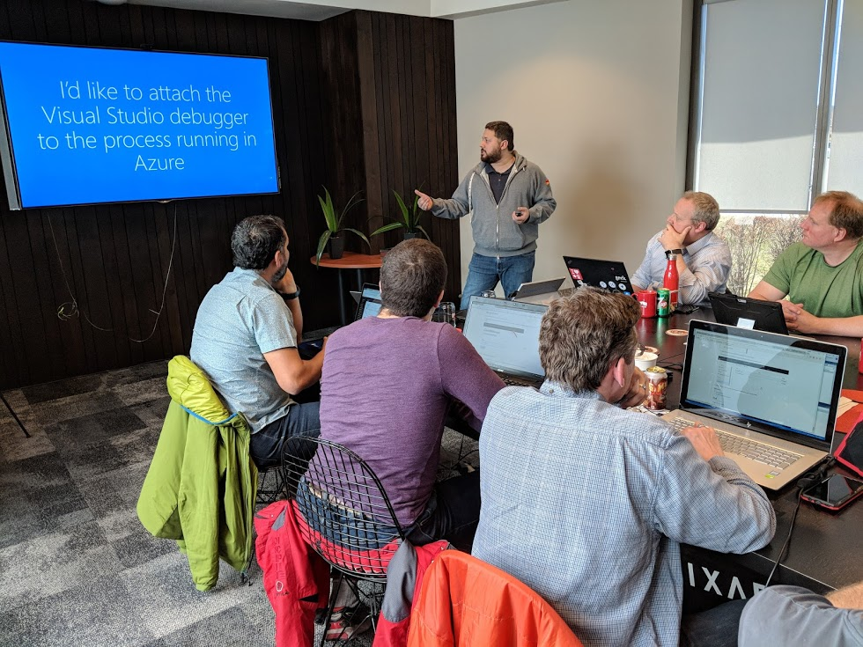

Slide 10
References:
Get started with Azure: https://docs.microsoft.com/en-us/azure/
GitHub – Repository: https://github.com/MsDevMtl/GlobalAzureBootcamp-2019

