Slide 1
MSC DISSERTATION
Procedural Fairness in
Healthcare AI
A six-criterion fairness framework, tested on a heart disease prediction model
Kaylee Scarce
Newcastle University · 2026
Supervised by Dr Vlad González-Zelaya

Slide 2
OVERVIEW
What We'll Cover
01
02
03
Motivation &
Research Question
Data &
Methodology
Baseline
Results
04
05
06
Fairness Problems
& Root Causes
Mitigation
& Results
Survey, Limitations
& Recommendations
Procedural Fairness in Healthcare AI
1

Slide 3
MOTIVATION
When an accurate model is not a safe one
AI now supports high-stakes decisions across society and is increasingly used in healthcare, where a wrong decision is not just an inconvenience, it can mean a missed diagnosis.
93.5%
70%
0.957
Men with heart disease correctly identified
Women with heart disease correctly identified
Overall score…The model looks excellent
Procedural Fairness in Healthcare AI
2
Notes:
Same model, two patients: men caught 93.5%, women only 70%
Judge it on that one number and you'd deploy it — but it hides who it's failing

Slide 4
RESEARCH QUESTION
How can procedural fairness be defined, measured, and communicated in a healthcare prediction model?
1. Define
2. Measure
3. Communicate
Operationalize all six criteria: quantitative metrics for technical rules, structured checklist for sociotechnical
Translate Leventhal’s procedural justice rules into fairness criteria for healthcare AI
Present the results to stakeholders of mixed technical backgrounds
Procedural Fairness in Healthcare AI
3
Notes:
My whole project comes down to one question: how can procedural fairness be defined, measured, and communicated in a healthcare prediction model?
Those three verbs structure everything that follows.
Define — I take Leventhal's procedural justice rules, written for human decisions, and translate them into fairness criteria for healthcare AI.
Measure — I turn those criteria into something testable: quantitative metrics for the technical rules, and a structured checklist for the ones that aren't purely technical.
Communicate — and because fairness only matters if people can see it, I present the results in a way that works for stakeholders whether or not they have a technical background — which is the dashboard.
So: define it, measure it, communicate it. Keep those three in mind — they're the thread through the rest of the talk.

Slide 5
DEFINING FAIRNESS
From Justice Theory to Testable Criteria
Leventhal's (1980) six procedural justice rules, written for human decision making, adapted into criteria that can be assessed in a healthcare prediction model (following Jabagi et al., 2025)
Rule | Leventhal (1980) | Adapted For Healthcare
Accuracy | Decisions based on accurate and complete | High-quality data, low error rate; patient-safety risk
Bias Suppression | Free from personal bias, self-interest, or prejudice | Protected attributes must not unfairly drive predictions
Representativeness | Interest of all affected parties considered | Training data must represent all patient subgroups
Consistency | Applied consistently across people over time | Same logic for all groups; stable over time
Correctability | Mechanisms to review, appeal, or correct decisions | Clinicians can challenge and override; audit trail
Ethicality | Compatible with fundamental moral and ethical values | Respect patient rights, and meet all ethical and legal standards
Procedural Fairness in Healthcare AI
4
Notes:
This is where I define what fairness means → Leventhal's 1980 framework, six rules for a fair process
Key thing: he wrote them for humans — managers deciding between people, not algorithms
So my job was translating each rule into something you can test in a model (point at the table)
Left column = his original wording, right column = my healthcare version
Example: correctability (point to it) → for him, "review or appeal a decision"; for me, "can a clinician override it? is there an audit trail?“
Not the first to adapt him — Jabagi did it for HR algorithms in 2025; I'm bringing it into healthcare

Slide 6
METHODOLOGY
Setting the bar for each criterion
Six criteria, each with a measured bar and a clear reason it sits where it does.
CRITERION
MEASURED BY
PASS THRESHOLD
WHERE THE BAR COMES FROM
Accuracy
AUC-ROC
≥ 0.80
Established convention (Mandrekar, 2010)
Bias suppression
Parity & equalised odds diff.
within ±0.10
Researcher-defined benchmark
Representativeness
Representation ratio
≥ 0.80
Adapted from the four-fifths rule
Consistency
Instability under perturbation
< 5%
Researcher-defined benchmark
Correctability
Correctability checklist
≥ 80% met
Researcher-defined benchmark
Ethicality
Ethics & legal checklist
≥ 80% met
Researcher-defined benchmark
Model Evaluation Framework
5
Notes:
Before scoring anything, I had to define what "passing" means for each of the six criteria
Some bars are standard (point to Accuracy) → AUC 0.80 is a recognised convention
thers I set myself (point to the right column) → labelled "researcher-defined"

Slide 7
METHODOLOGY
The Model and the Pipeline
ALGORITHM
DATA
SPLIT
PREDICTS
Logistic regression classifier
UCI Heart Disease — 918 records
734 / 184, stratified 80/20
Presence of heart disease
THE PIPELINE
918 patient
records
→
734 train /
184 test
→
6 criteria
tested
→
2 mitigations
applied
→
Re-tested
on all 6
Why a logistic model?
It was chosen deliberately for this fairness audit because its decisions are easier to interpret. This transparency makes it possible to better understand where bias may be coming from and how the model is treating different groups.
Procedural Fairness in Healthcare AI
6

Slide 8
METHODOLOGY
Design Decisions
No data leakage
Missing values were filled in, and the data was scaled using only the training set, so the model never saw anything about the test patients before it was evaluated.
2. A split that protects the smallest group
The train/test split was balanced on both outcome and sex, so the test set was guaranteed a fair share of female patients instead of leaving it to chance.
3. Sex and age kept in on purpose
Removing them would not stop the model picking up those patterns through related measurements, so keeping them in lets the effect be measured openly rather than hidden.
Procedural Fairness in Healthcare AI
7
Notes:
Three choices that make this a careful fairness analysis, not just a model
No leakage → prepped everything on training data only → so results are real, not the model peeking at test patients
Split protects the smallest group → women are a minority → a random split could've left too few to judge → I balanced it so fairness wasn't left to chance
Kept sex and age in on purpose → this is the counterintuitive one → removing them doesn't help, the model just relearns bias invisibly → keeping them means I can see it and measure it

Slide 9
BASELINE RESULTS
A Strong Model…On the Surface
0.957 ≥ 0.80
AUC-ROC threshold
3 OF 6 PROCEDURAL FAIRNESS CRITERIA PASSED AT BASELINE
Accuracy
Bias
Suppression
Representativeness
Consistency
Correctability
Ethicality
Procedural Fairness in Healthcare AI
8
Notes:
AUC = Area Under the Curve ROC = Receiver Operating Characteristic
On accuracy → excellent. 0.957, way above the 0.80 bar
Judged the usual way, you'd deploy it (pause)
But accuracy is only 1 of 6 criteria Score all six → passes 3, fails 3
(point at the dots) Green: accuracy, consistency, ethicality. Red: bias suppression, representativeness, correctability
Looks ready — but half the fairness criteria fail. That gap is the whole talk

Slide 10
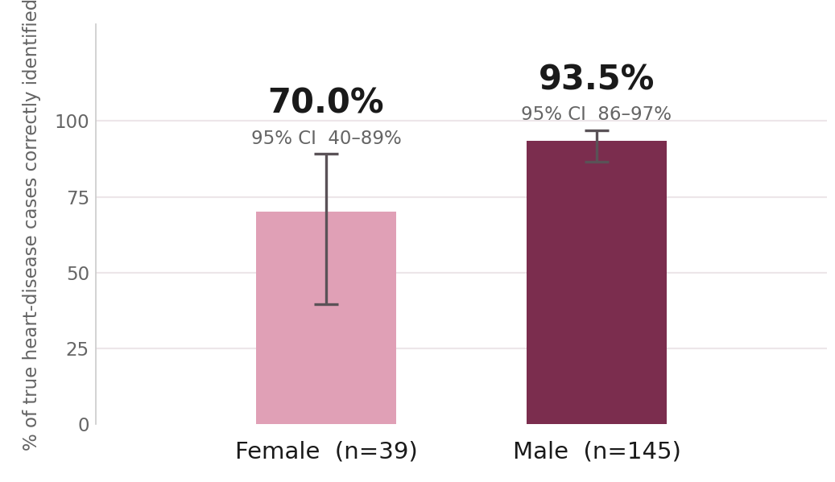
FAIRNESS PROBLEMS · 1 OF 2
Female Patients Were Missed More Often
Recall by sex, heart-disease-present class: percentage of actual cases the model correctly identified.
Equalised odds diff: 0.235 · Demographic parity diff: 0.457 — both exceed the ±0.10 threshold
Procedural Fairness in Healthcare AI
9
Notes:
Recall by sex → % of real heart-disease cases the model caught
With only 10 women in the test set, that 70% rests on 7 of 10 cases, so the true rate could be anywhere from 40 to 89% — I report that range to be honest about the uncertainty."
Bottom box → formal metrics agree, both past the 0.10 line

Slide 11
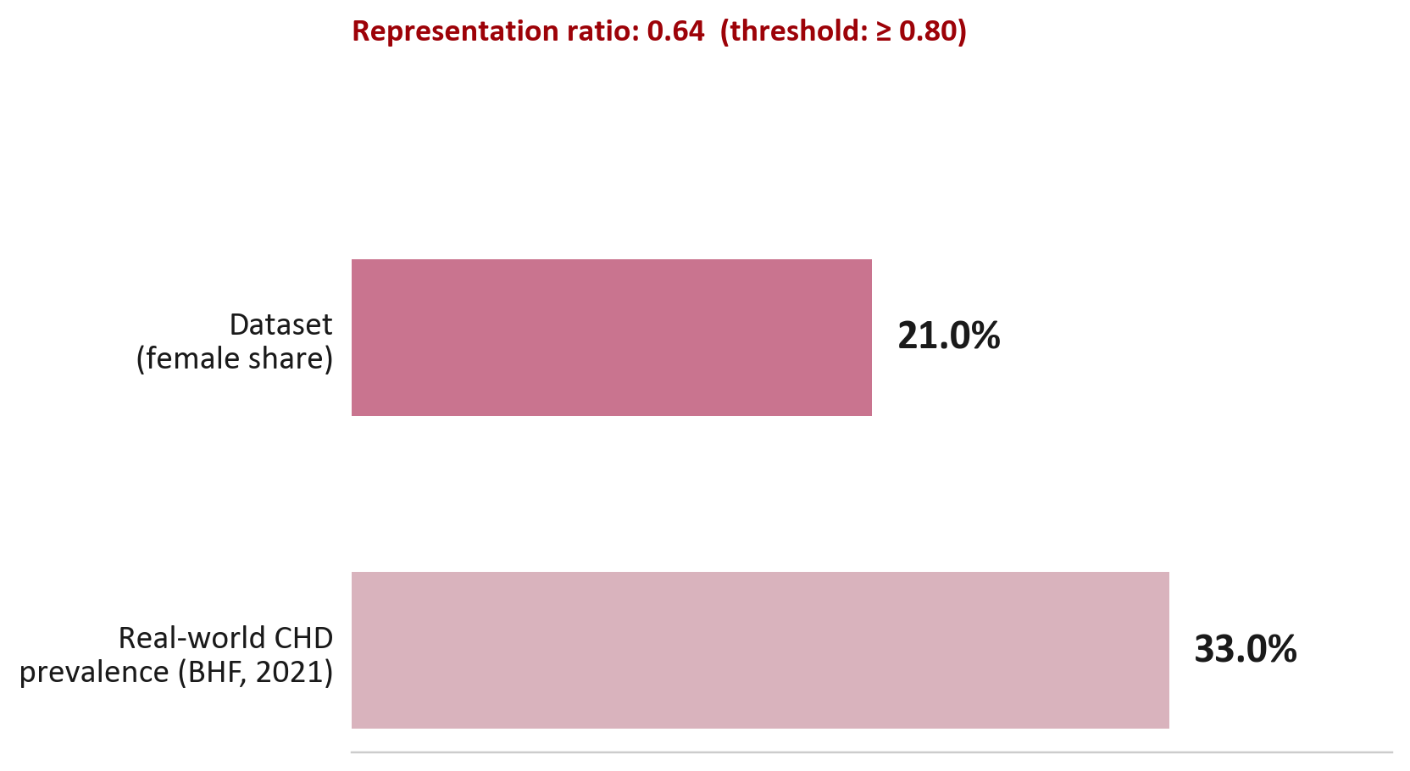
FAIRNESS PROBLEMS · 2 OF 2
Two More Gaps: Data and Oversight
CORRECTABILITY
3 of 7
checklist criteria met (threshold: ≥ 80%)
✅ Prediction outputs are visible and interpretable
✅ Confidence scores are provided with predictions
❌ Clinician override
❌ Patient challenge mechanism
❌ Audit trail of predictions
❌ Model version history is recorded
✅ Dashboard communicates uncertainty to stakeholders
(female share)
Procedural Fairness in Healthcare AI
10

Slide 12
MITIGATION APPROACH
Two Targeted Interventions
1
Fairness-Aware Training
2
Confidence-Based Flagging
ADDRESSES BIAS SUPPRESSION
PARTIALLY ADDRESSES CORRECTABILITY
An ExponentiatedGradient algorithm, constrained by Fairlearn's EqualizedOdds criterion (tolerance 0.01), re-weighted the training data so error rates moved closer together across male and female patients.
Predictions with model confidence between 30% and 70% are automatically flagged for clinician review. This allows for human oversight on the cases the model is least certain about. A first step toward correctability, though not a full override mechanism.
Procedural Fairness in Healthcare AI
11
Notes:
Normal training just chases accuracy. Fairness-aware training adds a second goal — don't be much worse for one group than another — so the model balances both as it learns

Slide 13
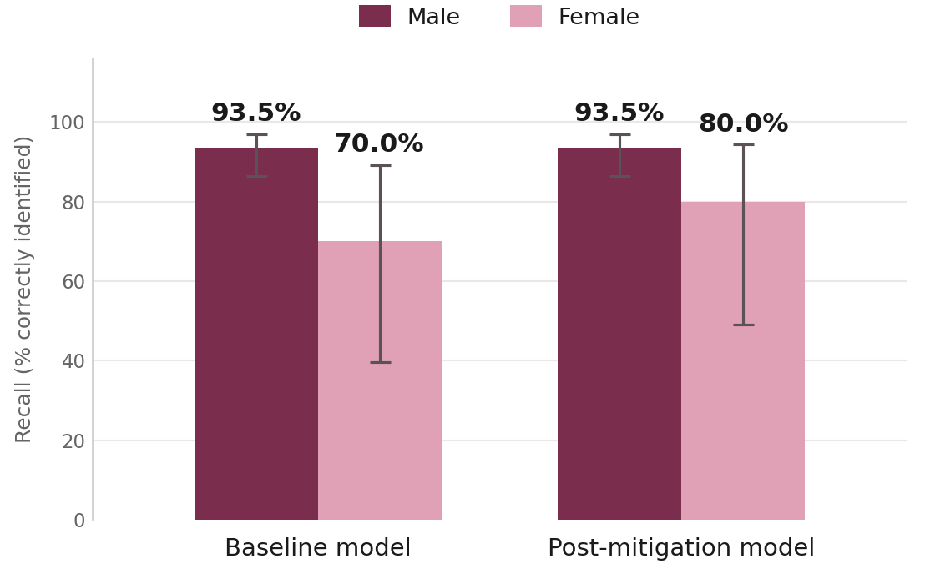
RESULTS · 1 OF 2
The Gap Narrowed, But Didn't Close
The visible gap almost closed: female recall rose from 70% to 80%, with no loss for men. But both formal fairness measures improved without clearing the 0.10 limit, so bias suppression reached partial, not a full pass. Overall accuracy barely moved: 0.957 to 0.895
Procedural Fairness in Healthcare AI
12

Slide 14
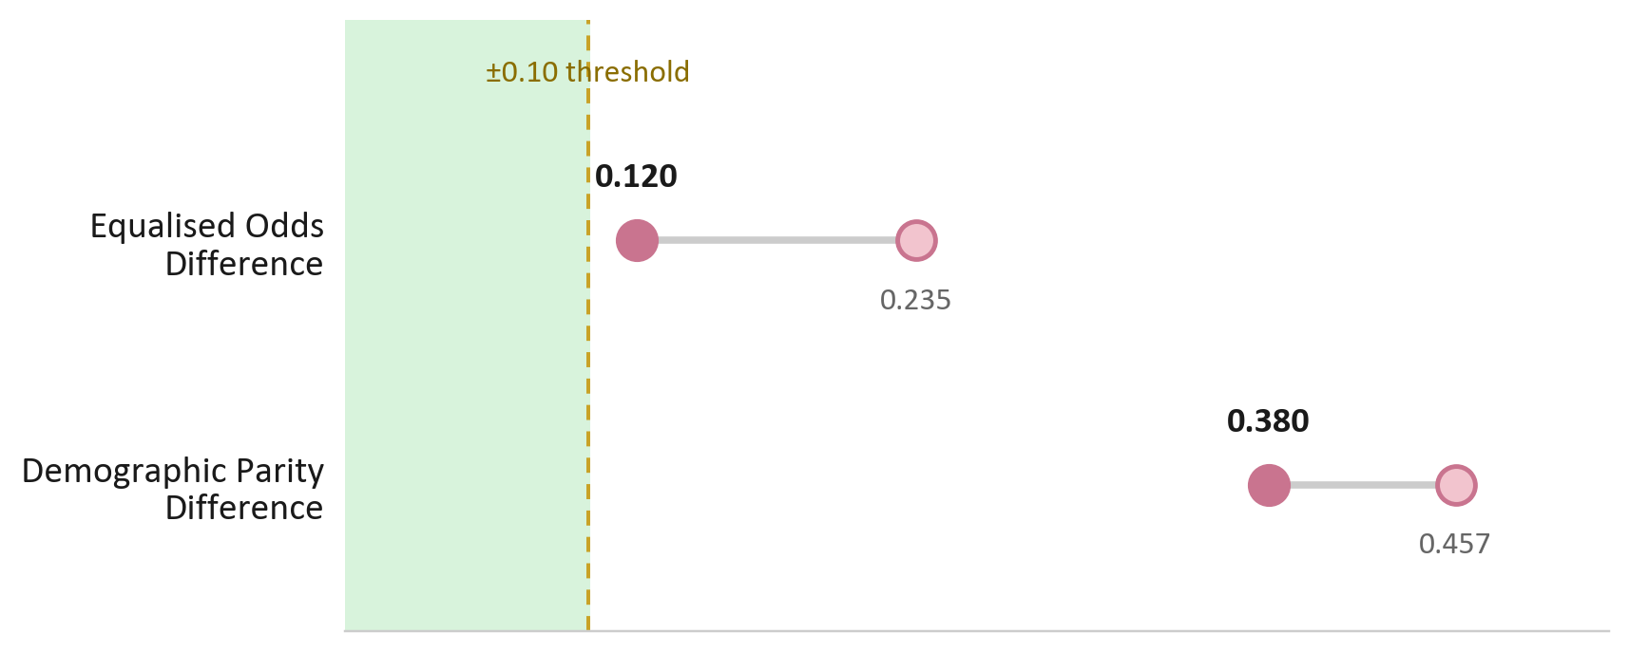
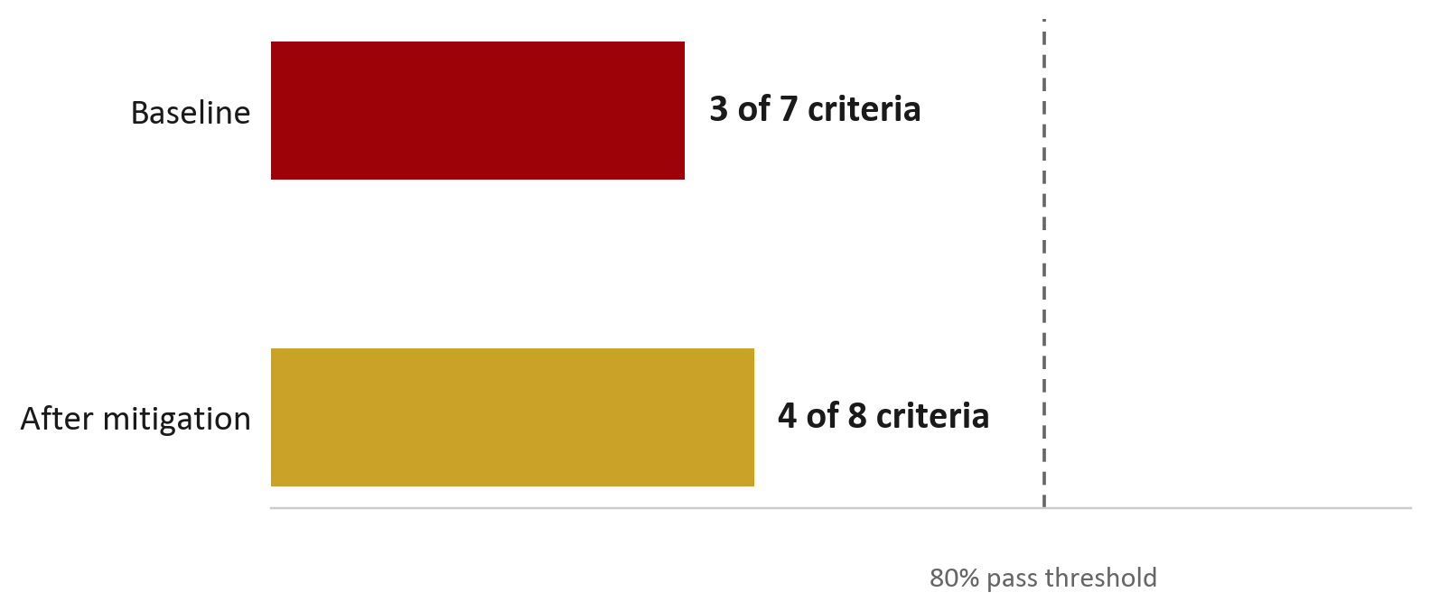
RESULTS · 2 OF 2
Two Criteria Moved From Fail to Partial
Bias Suppression
Correctability
Representativeness stayed at 0.64: unchanged, because mitigation cannot fix a data problem.
AFTER MITIGATION: 3 PASS · 2 PARTIAL · 1 FAIL
Accuracy
Bias
Suppression
Representativeness
Consistency
Correctability
Ethicality
Procedural Fairness in Healthcare AI
13
Notes:
The checklist grew bc mitigation added a new capability, which became a new thing worth measuring
Changing correctability makes it hard to compare before and after

Slide 15
PUBLIC SURVEY
What Do People Actually Expect?
Human oversight and transparency dominate. The public wants a say in AI decisions about their care.
96%
93%
92%
Patients should be informed when AI is used in their care
Patients should have the right to challenge a decision
Human involvement is essential regardless of accuracy
Ethicality
Correctability
Correctability
An online survey of 325 members of the public on what they expect from AI in healthcare decisions
Procedural Fairness in Healthcare AI
14
Notes:
Reached people through snowball sampling
Collected through Google Forms →
question mapped to one of Leventhal's six criteria
One overall statement about the survey:
The survey gives me a second, independent line of evidence — instead of only asking whether the model is fair, it asks what the public actually expects fairness to mean, measured against the same six criteria.

Slide 16
THE KEY CONNECTION
The Public’s Most Consistent Demand Isn’t in the Pipeline
Correctability scored 4 of 8 after mitigation. Two of the items it lacks are the two the public asks for most consistently.
MECHANISM
EVIDENCE 1 · PIPELINE
EVIDENCE 2 · SURVEY (n=325)
Absent
93%
The right to challenge a decision
want this
Absent
92%
A human doctor involved in the decision
want this
Two independent sources point at the same gap.
Both mechanisms sit inside Leventhal's correctability rule; a sociotechnical criterion mitigation left unresolved.
Procedural Fairness in Healthcare AI
15

Slide 17
LIMITATIONS
Understanding the Limits of This Study
Small subgroups
Researcher-defined thresholds
Only 10 female patients in the test set had heart disease, meaning fairness metrics for women were based on very few cases and should be interpreted with caution.
Every pass/fail line was set by the researcher, not by an external standard. Different thresholds would produce different verdicts.
Survey sampling bias
Correctability scoring
Convenience/snowball sample, skewed female (67%) and non-technical (83%).
The checklist total grew alongside the fix, complicating direct comparison.
Procedural Fairness in Healthcare AI
16

Slide 18
RECOMMENDATIONS
Three Priorities for Responsible Deployment
Build correctability infrastructure
Addresses: Correctability Clinician override, patient challenge, audit trails, version control; currently none present.
1
Collect more representative clinical data
Addresses: Representativeness, Bias Suppression 21% female against 33% real-world CHD prevalence; n=39 limits subgroup precision.
2
Establish informed consent frameworks
Addresses: Ethicality Consent for secondary ML use not documented, the only unmet item in an otherwise passing criterion
3
Procedural Fairness in Healthcare AI
17

Slide 19
CONCLUSION
Fairness is a Process, Not a Score
FINDING
Mitigation improved the model’s behaviour, but it could not add missing patients to the data or clinician override to the pipeline.
CONTRIBUTION
The key contribution is not a single fairer model, but a reusable framework for assessing AI fairness. By translating justice theory into measurable criteria and communicating outcomes clearly, this approach provides a standard that future models can be evaluated against.
Fairness isn't fixed where the model is built. It's determined upstream, in the data, and downstream, in whether a decision can be questioned
Procedural Fairness in Healthcare AI
18

Slide 20
Thank You
Questions?
Kaylee Scarce · Newcastle University · 2026
Supervised by Dr Vlad González-Zelaya

