Slide 1
Summer@EPFL 2023 Developing object storage backend for JULEA
Kseniya Shastakova 22.08.2023

Slide 2
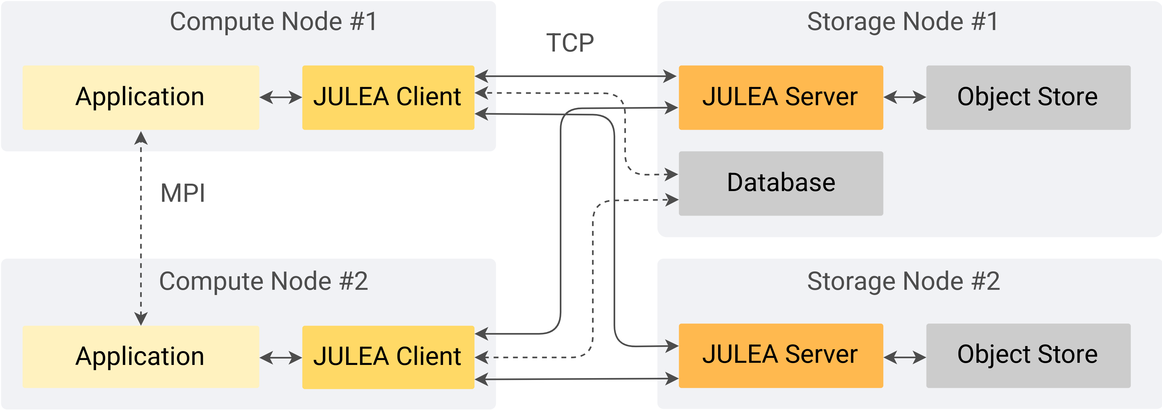
Why JULEA?
Flexible storage framework for rapid prototyping of new approaches
Object storages occur when working with SDF (ex. HDF5) in HPC

Slide 3
Writing object storage backend for JULEA
read, write, status – use built-in functions of API
open, create, close, delete – hash tables + BackendObject* handling.
Note: create is analog of writing 0 bytes
get_all, get_by_prefix, iterate – implementing BackendIterator struct and methods for handling it
create_namespace, clean_namespace, etc.

Slide 4
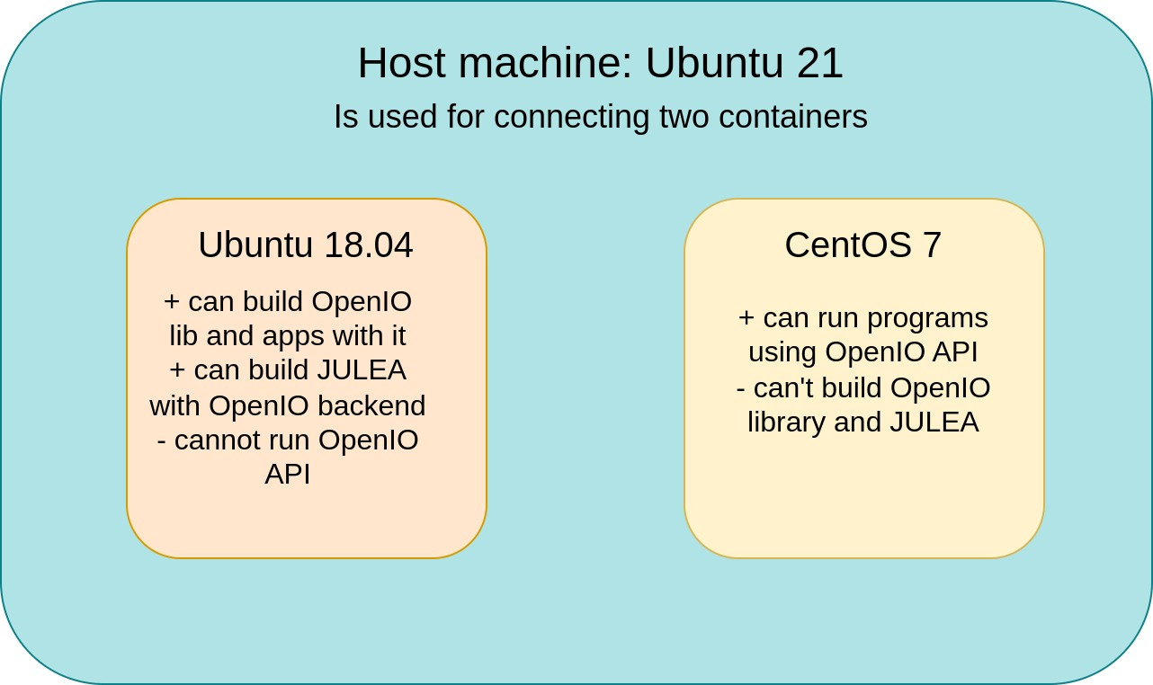
OpenIO C SDK

Slide 5
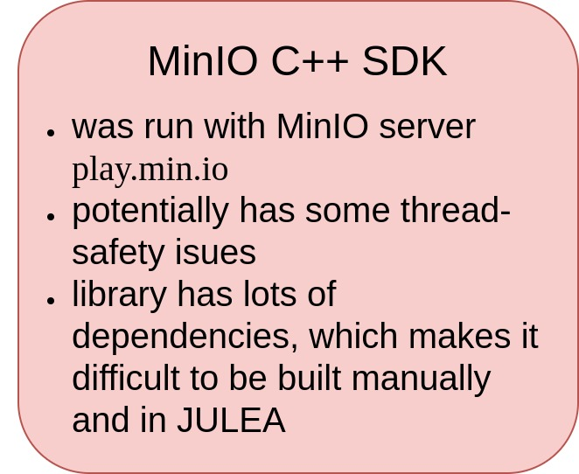
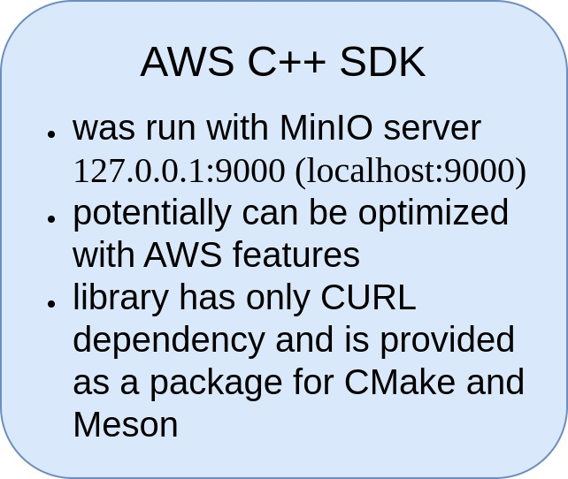
MinIO and AWS C++ SDKs
Are in C++, so building JULEA with them requires writing C wrappers
Are originally built with CMake

Slide 6
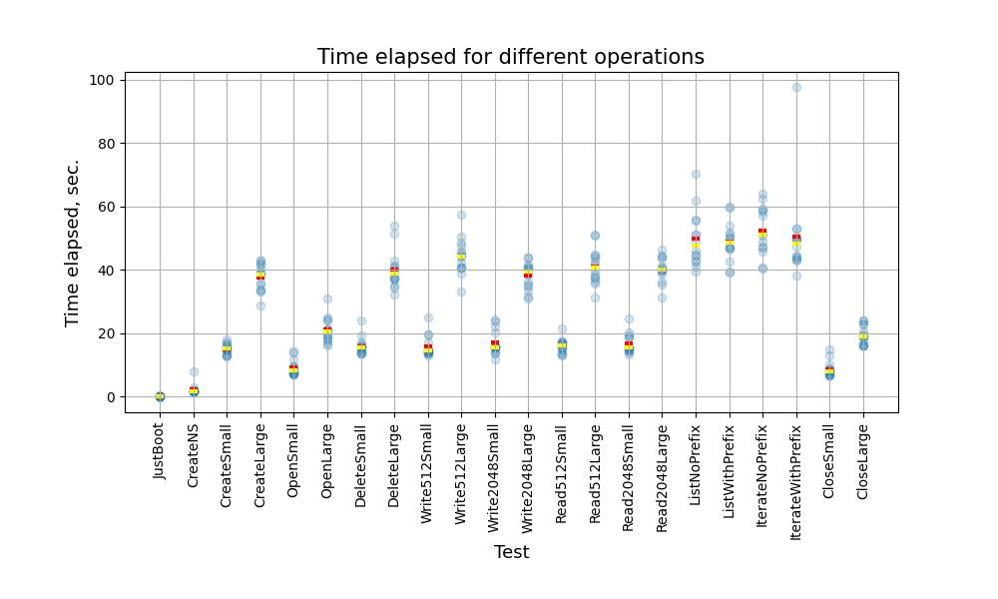
MinIO benchmarks: overall picture

Slide 7
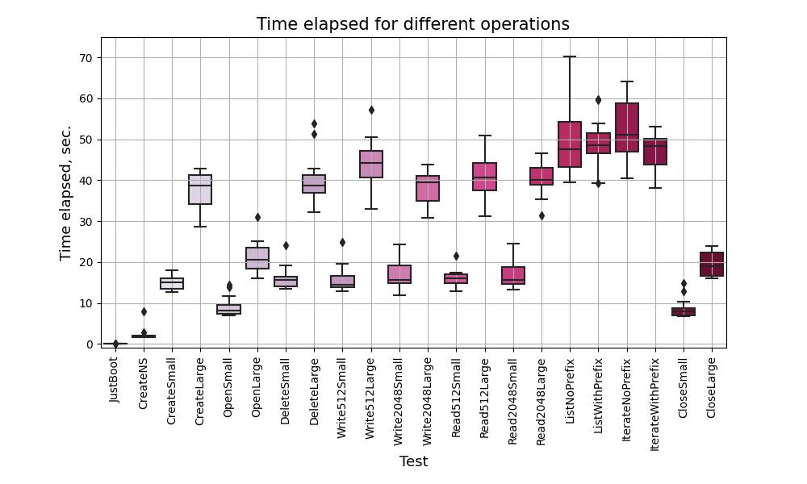
MinIO benchmarks: dispersion

