Slide 1



Garbage Classification Model using Transfer Learning
- Kshetrimayum Paresh Singh

Slide 2

Learning Objectives
To understand how green technology development takes place
To train and deploy a properly working machine learning model for real-life applications
To understand how CNN models work
To work with pre-trained deep learning models like EfficientNetV2B2
To learn how to handle an imbalanced dataset
To build a transfer learning model and fine-tune it with proper hyperparameters
GOAL
Source :
www.freepik.com/

Slide 3
Tools and Technology used
Python version 3.9.6
Jupyter Notebook
Kaggle garbage image dataset for six different classes
(https://www.kaggle.com/datasets/farzadnekouei/trash-type-image-dataset)
Important Python libraries used:
numpy 1.26.0
tensorflow 2.19.0
scikit-learn 1.5.1
matplotlib 3.6.2
seaborn 0.13.2
gradio/ streamlit

Slide 4
Methodology
Data Visualisation and Preprocessing
Data imbalance handling with data augmentation and class weight computation
Pre-trained model
(EfficientNetV2B2, EfficientNetV2B0, MobileNetV2)
Fine-tuning additional layers for transfer learning
Model performance evaluation
Model deployment

Slide 5
Problem Statement
To develop a sophisticated garbage classification system leveraging the EfficientNetV2B2 architecture. Our primary dataset serves as a foundation for building models that can eventually automate waste segregation, a critical step in optimizing recycling and waste management, ultimately aiding in environmental conservation.
Goal: To develop an accurate and efficient garbage classification model using EfficientNetV2B2 and transfer learning for automated waste sorting.

Slide 6
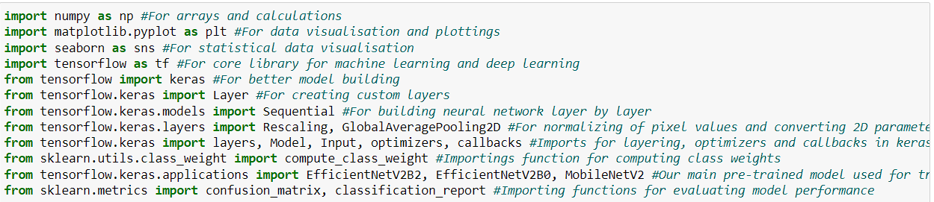
Solution
1) Importing libraries: Install all the important libraries with the correct version to avoid mismatch and import them in your jupyter notebook.

Slide 7
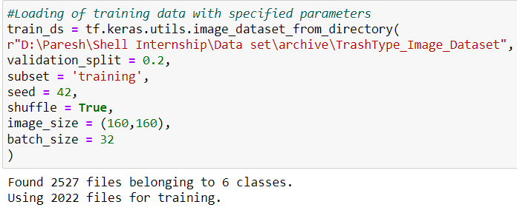
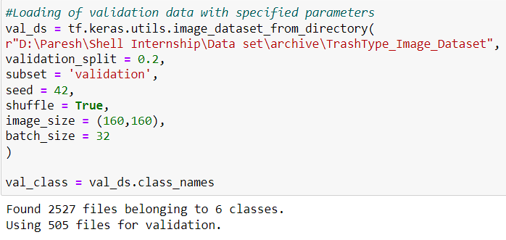
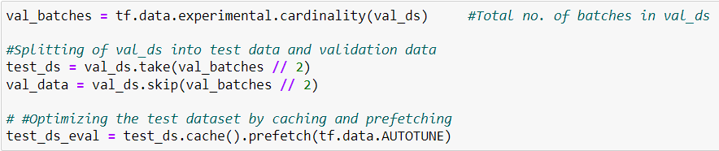
2) Load Dataset: Load your training, validation, and test datasets with proper preprocessing.

Slide 8
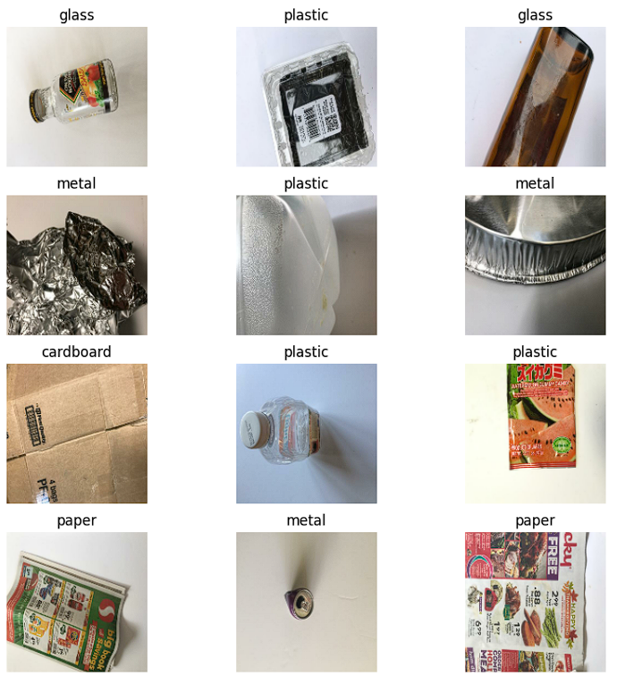
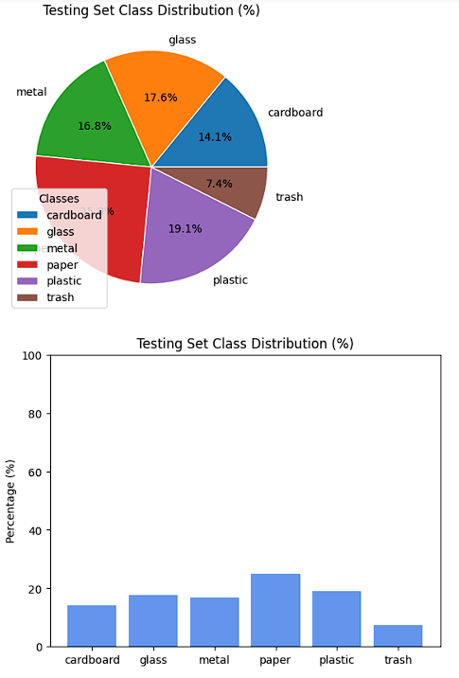
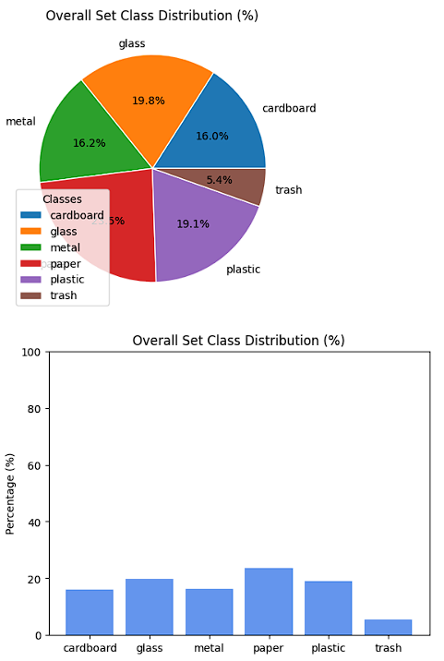
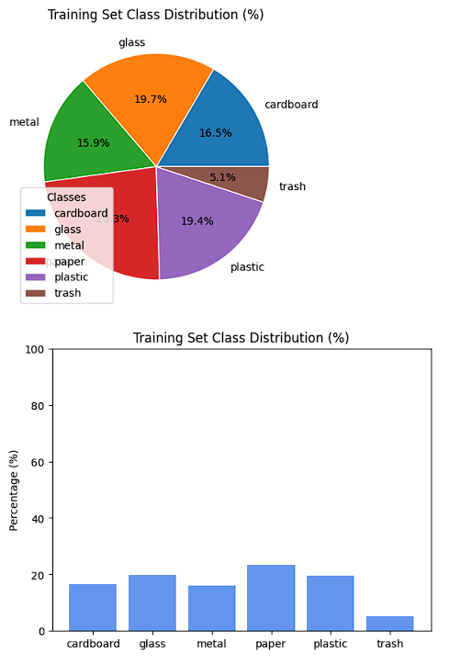
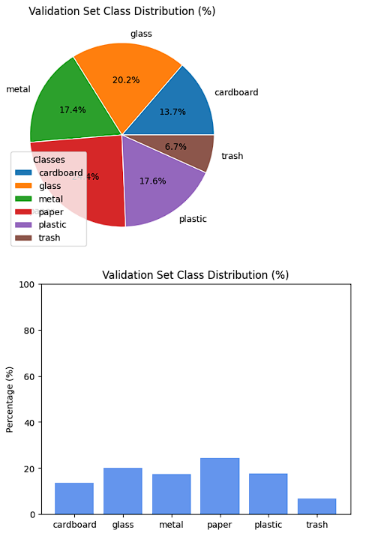
3) Data Visualisation: Go through your data and check the shape, image distribution, and proper class labels.

Slide 9
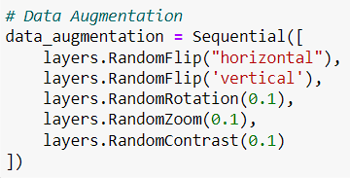
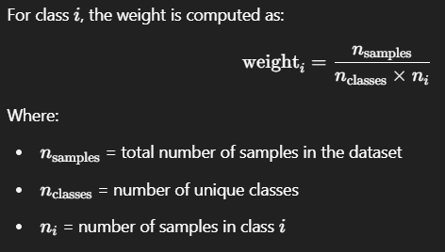
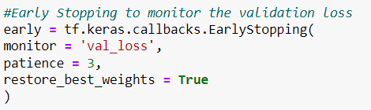
4) Handling imbalanced dataset: Perform data augmentation, compute class weights to train your model

Slide 10
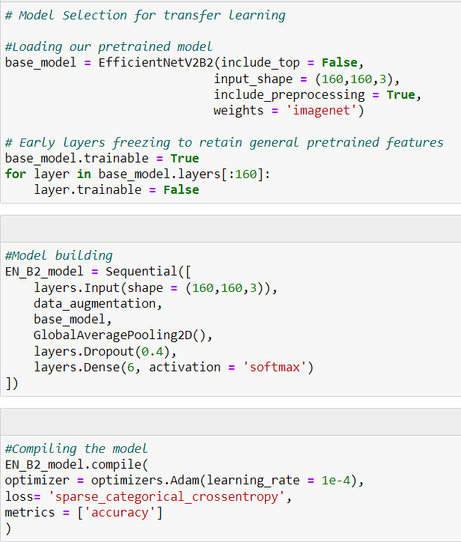
5) Model building: Load a pre-trained model, in our case EfficientNetV2B2, and freeze some early layers.
6) Fine-tuning the model: Add additional layers for regularisation, pooling, and final classification using softmax regression and compile your model.
Hyper-parameters that we have set for our model are:
We have used input size of (160,160,3) for better performance.
Frozen the first 160 layers of our pre-trained model and set the dropout rate to 0.4.
We have set the learning rate for our Adam optimizers at 0.0001.

Slide 11
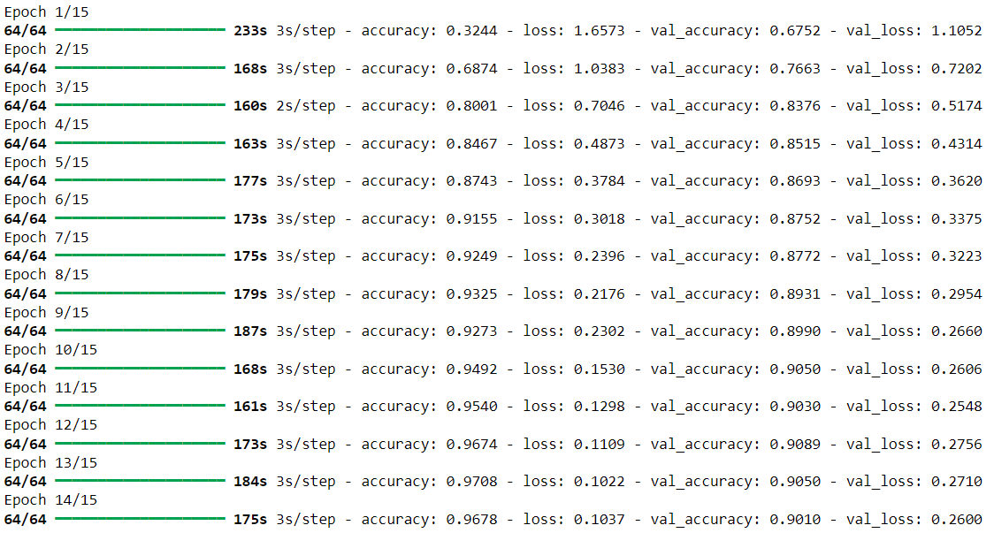
7) Fitting and testing: Fit your model with the training dataset and validation dataset and check its performance and evaluate it on the basis of the test dataset
8) Model Performance Evaluation: Plot accuracy and loss graphs for training and validation data, classification report with F1_score, accuracy, support, and Confusion matrix to evaluate how your model performs and predict some images and show them with their true classes.

Slide 12
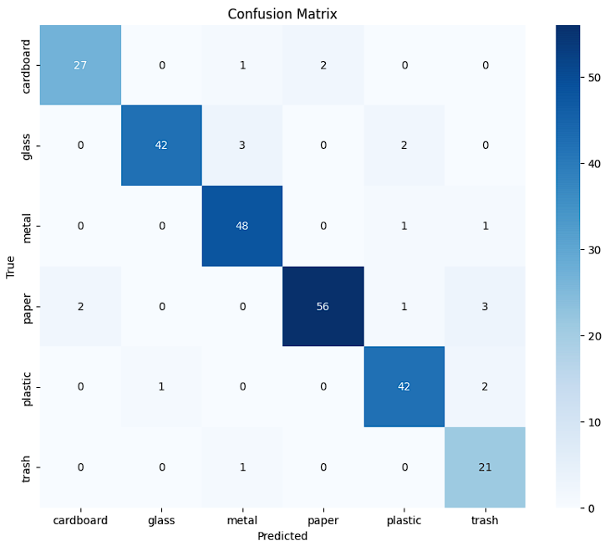
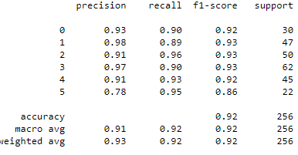
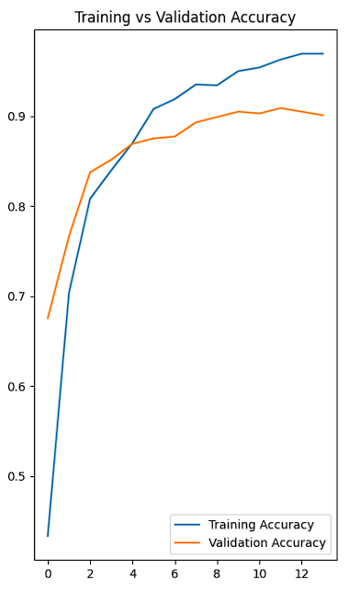
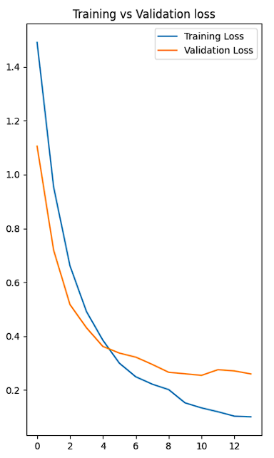

Slide 13

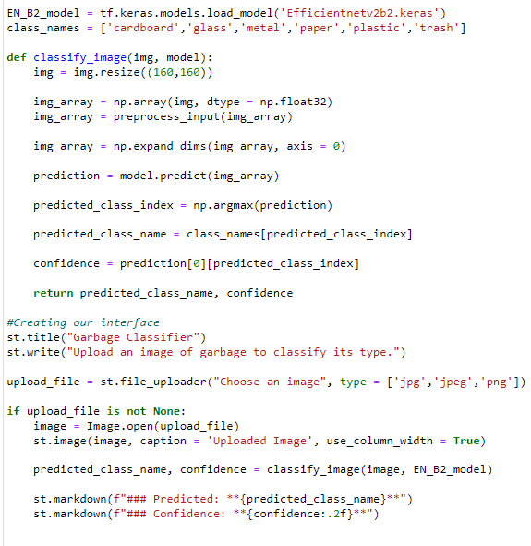
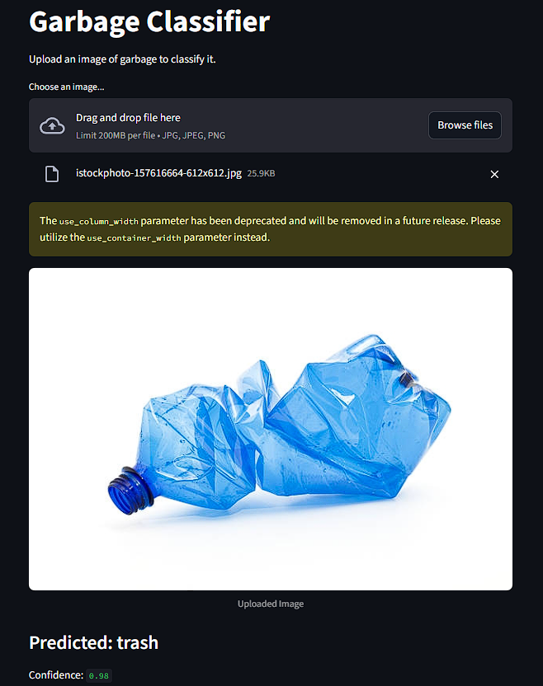
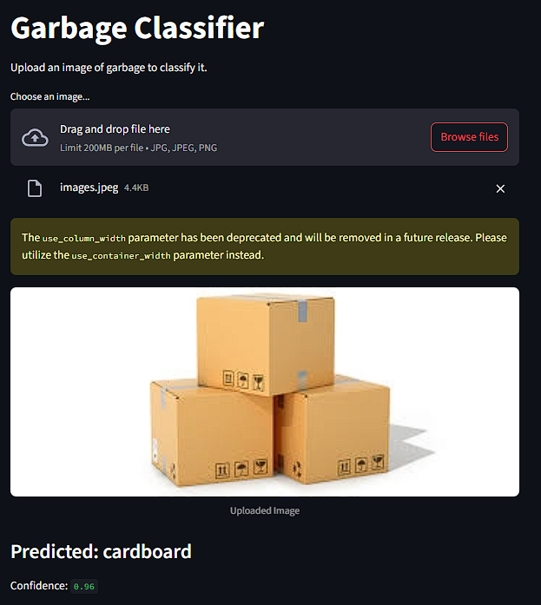
9) Model Deployment: To deploy our model using Streamlit library of Python.

Slide 14
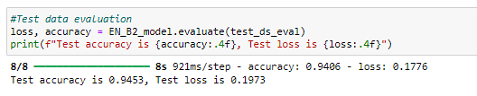


10) Model Comparison:
EfficientNetV2B2 has the highest accuracy and the lowest loss among all the three models.
EfficientNetV2B0 performs slightly worse than EfficientNetV2B2 but has faster training time.
MobileNetV2 performs the worst with the lowest accuracy on test_ds, but has a faster training time.

Slide 15
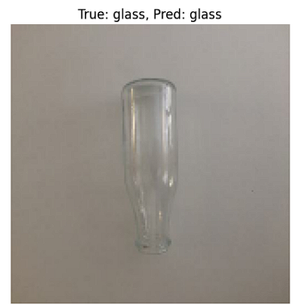
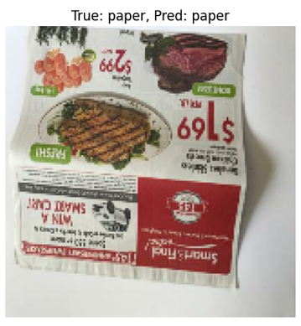
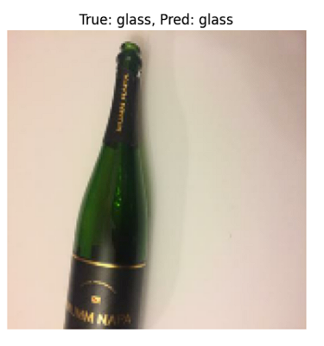
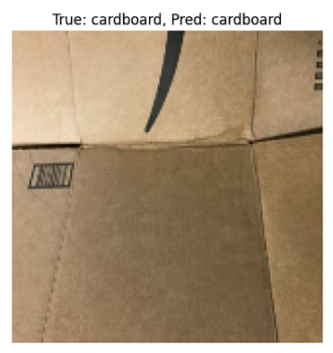
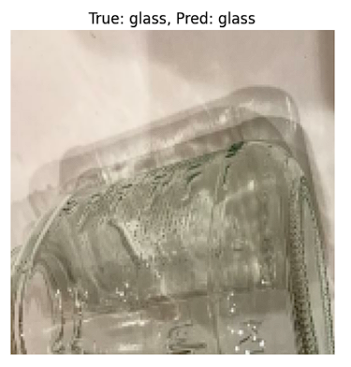
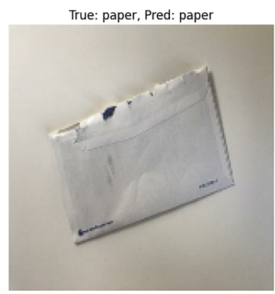
Screenshot of Output
The EfficientNetV2B2 model performs well in classifying these images to their correct classes.

Slide 16
Conclusion
We have implemented our garbage classification model using three pre-trained models:
EfficientNetV2B2, EfficientNetV2B0, MobileNetV2
All the models struggled to classify plastic and glass, metal and glass, & cardboard and paper.
EfficientNetV2B2 had the highest performance but took the longest time to train the model.
EfficientNetV2B0, which is a lightweight model, was faster and had only slightly less accuracy on the test data.
MobileNetV2 performed the worst for the given hyperparameters. The one thing that stood out about this model is that it is the fastest out of all the model, so if given higher epochs, the performance will be higher but for only 15 epochs, it couldn’t learn as fast as other models since it has the least number of layers, therefore had the worst performance out of all.
The two graphs for EfficientNet model showed divergence for training and validation accuracy and loss, indicating there was slight overfit present but not high enough to effect our model in a negative way.
For the given dataset, out the three, EfficientNetV2B2 will be the best option for garbage classification.

