Slide 1
PARALLEL COMPUTING • CCA-1
RGB TO GRAYSCALE
USING CUDA
GPU-parallel image-processing case study
INPUT
GPU
OUTPUT
RGB pixels
CUDA threads
Grayscale
Kshama Shrikantayya Hiremath | USN: 1BY23IS097
BMS Institute of Technology and Management

Slide 2
01 • OVERVIEW
Problem & motivation
• A colour pixel stores three channels: Red, Green and Blue (RGB).
• Grayscale conversion replaces each RGB triplet with one intensity value.
• A CPU loop processes pixels sequentially; independent pixels can be handled in parallel.
• CUDA lets many GPU threads perform the same operation on different pixels.
PARALLEL COMPUTING • CCA-1
02

Slide 3
02 • GOALS
Objectives
• Implement RGB-to-grayscale conversion with a CUDA C++ kernel.
• Map one CUDA thread to one pixel using a global thread index.
• Use host/device memory transfers and a GPU kernel launch.
• Compare GPU output against a CPU reference implementation.
• Measure end-to-end time across multiple input sizes.
PARALLEL COMPUTING • CCA-1
03

Slide 4
03 • CORE IDEA
Grayscale conversion formula
Gray = 0.299R + 0.587G + 0.114B
• R, G and B are channel values in the range 0–255.
• The weighted formula gives more contribution to green than blue.
• The computed value is rounded and stored as an 8-bit intensity.
• Example: pure red (255, 0, 0) produces approximately 76.
PARALLEL COMPUTING • CCA-1
04

Slide 5
04 • PARALLEL COMPUTING
Why CUDA for this problem?
• Each output pixel depends only on its corresponding input RGB values.
• This independence makes the workload suitable for data parallelism.
• One thread computes one pixel; blocks collectively cover the input.
• GPU performance depends on workload size, launch overhead and data transfer.
PARALLEL COMPUTING • CCA-1
05

Slide 6
05 • MAPPING WORK TO THREADS
CUDA execution model
HOST / CPU
COPY TO DEVICE
KERNEL
COPY BACK
Creates input and allocates host arrays
→
Transfers RGB pixels to GPU memory
→
CUDA threads compute grayscale values
→
Returns output to host for checking
Global index: i = blockIdx.x × blockDim.x + threadIdx.x
Boundary check: process only when i < N
PARALLEL COMPUTING • CCA-1
06

Slide 7
06 • CUDA C++
Algorithm & implementation
• Prepare RGB input on the CPU.
• Allocate input and output buffers on the GPU; copy RGB data to device memory.
• Launch rgbToGrayscale with 256 threads per block.
• Each valid thread applies the weighted formula and writes one output value.
• Copy output back, compare with CPU reference, then free GPU memory.
PARALLEL COMPUTING • CCA-1
07

Slide 8
07 • IMPLEMENTATION
Core CUDA kernel
__global__ void rgbToGrayscale(RGB *input,
unsigned char *output, int n) {
int i = blockIdx.x * blockDim.x + threadIdx.x;
if (i < n) {
float gray = 0.299f * input[i].r
+ 0.587f * input[i].g
+ 0.114f * input[i].b;
output[i] = (unsigned char)(gray + 0.5f);
}
}
The guard i < n prevents out-of-range threads from accessing invalid pixels.
PARALLEL COMPUTING • CCA-1
08

Slide 9
08 • EVALUATION
Experimental setup
• Platform: Google Colab with NVIDIA Tesla T4 GPU.
• CUDA compiler reported by nvcc: release 13.0, V13.0.88.
• Input sizes tested: 10,000; 100,000; 1,000,000; and 10,000,000 pixels.
• Threads per block: 256; grid size: ceil(N / 256).
• GPU total time includes host-to-device transfer, kernel execution and device-to-host transfer.
PARALLEL COMPUTING • CCA-1
09

Slide 10
09 • RESULTS
Measured performance results
Pixels | CPU time (ms) | GPU total (ms) | Speedup
10,000 | 0.0569 | 0.2060 | 0.28×
100,000 | 0.3690 | 0.2869 | 1.29×
1,000,000 | 2.7814 | 1.6536 | 1.68×
10,000,000 | 25.2972 | 13.5599 | 1.87×
Correctness: 0 mismatched pixels in all four benchmark runs (PASS).
Speedup = CPU time ÷ GPU end-to-end time.
PARALLEL COMPUTING • CCA-1
10

Slide 11
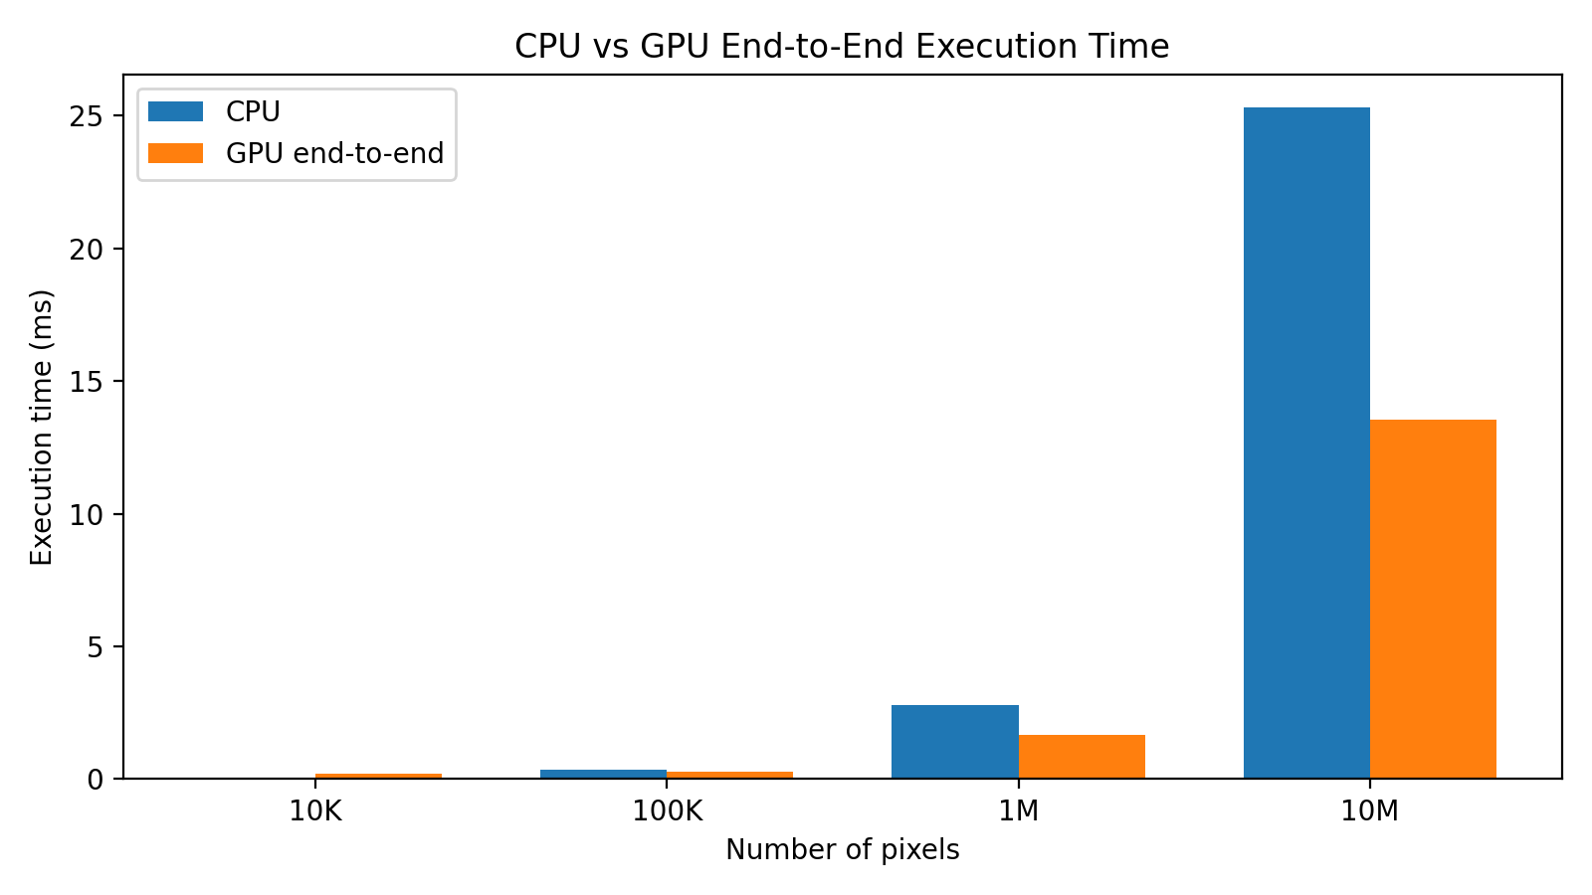
10 • PERFORMANCE ANALYSIS
CPU vs GPU execution time
Key finding
At 10K pixels, GPU overhead dominates. Larger workloads benefit more from parallel processing.
Times are from your Colab runs.
PARALLEL COMPUTING • CCA-1
11

Slide 12
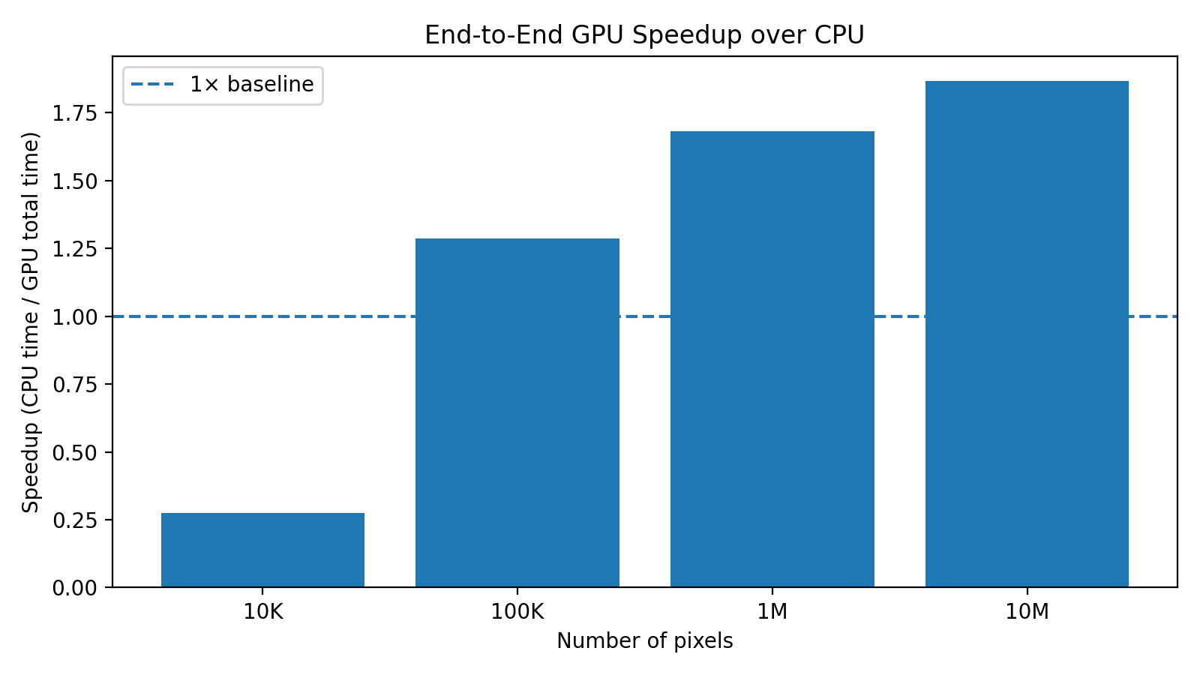
11 • PERFORMANCE ANALYSIS
How workload size affects speedup
Interpretation
The measured end-to-end speedup rises to 1.87× at 10M pixels. GPU benefit depends on input size and overhead.
Repeated runs may vary.
PARALLEL COMPUTING • CCA-1
12

Slide 13
12 • WRAP-UP
Conclusion & future work
• Implemented RGB-to-grayscale conversion using CUDA C++.
• Verified GPU output against CPU output: zero mismatches in all tested sizes.
• Observed 1.87× end-to-end speedup for 10 million pixels in the recorded run.
• Future work: process actual image files, repeat trials and report medians, and test more block sizes.
PARALLEL COMPUTING • CCA-1
13

Slide 14
13 • SOURCES
References
• NVIDIA, “CUDA C++ Programming Guide.” https://docs.nvidia.com/cuda/cuda-c-programming-guide/
• NVIDIA, “CUDA Runtime API.” https://docs.nvidia.com/cuda/cuda-runtime-api/
• NVIDIA, “CUDA Toolkit Documentation.” https://docs.nvidia.com/cuda/
• R. C. Gonzalez and R. E. Woods, Digital Image Processing, 4th ed., Pearson, 2018.
• Course-provided CUDA case-study handout: Case Study 2, RGB/colour-to-grayscale image processing.
PARALLEL COMPUTING • CCA-1
14

