Slide 1
🏥
ClaimSense
Agentic Clinical Claims Intelligence
Cotiviti AI / Healthcare Informatics Internship — Candidate Assessment
Kshamaa Suresh | Columbia University MS Data Science | June 2026
⚠️ Proof of Concept — All data is fully synthetic. Not for clinical or payment use.

Slide 2
THE PROBLEM
The Gap That Costs $31 Billion a Year
Current tools detect anomalies. They rarely explain them — or act on them.
What Exists Today
The Gap
What's Needed
Mention counts & keyword alerts
No explanation of why
Chain-of-reasoning analysis
Flag-and-review queues
No recommended action
Agentic action recommendations
Weekly analyst reports
No real-time signal
Continuous anomaly detection
Generic risk scores
No system-specific risk
Per-claim decision intelligence
CMS FY2023: $31B in improper Medicare payments — many detectable through systematic AI analysis

Slide 3
THE SOLUTION
ClaimSense — Three-Stage Agentic Pipeline
01
02
03
▶
▶
Anomaly Detection
Chain-of-Reasoning
Action Recommendation
Rule-based engine flags claims across 6 categories with confidence scores and risk levels
Groq LLM explains exactly why each claim was flagged, grounded in claim-specific data
Agent recommends next step: auto-deny, escalate, request docs, or approve
+ RAGAS-style faithfulness evaluation on every generated output
Every flagged claim is analyzed, explained, and actioned — not just flagged.

Slide 4
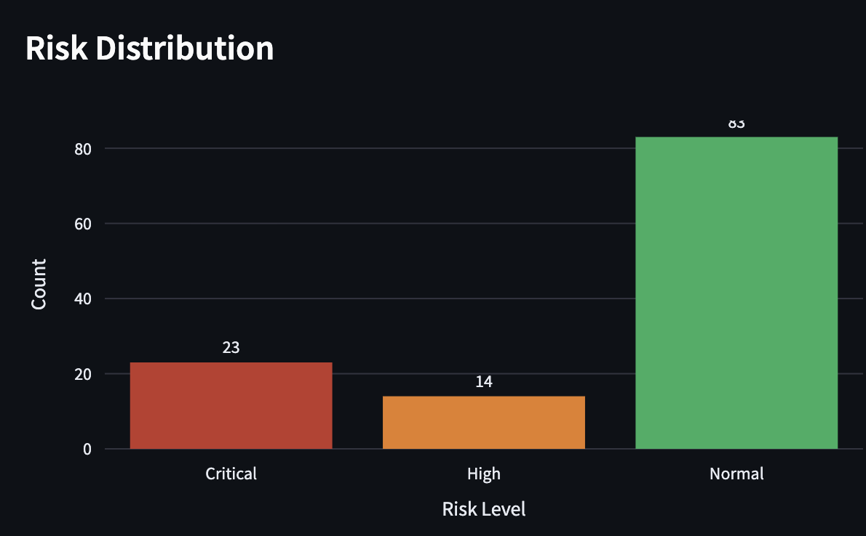
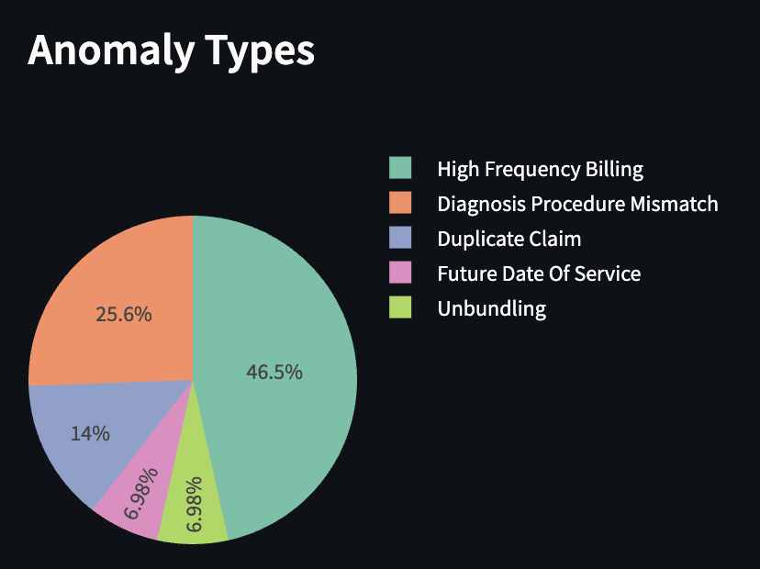
LIVE DEMO — TAB 1
Claims Dashboard
120
37
23
14
Total Claims
Flagged
Critical
High Risk
📌 Inserted screenshot of Claims Dashboard — Tab 1 of ClaimSense

Slide 5
LIVE DEMO — DETECTION ENGINE
Six Anomaly Categories Detected
Diagnosis-Procedure Mismatch
Amount Outliers
URI diagnosis + knee replacement
Conf: 90%
Billed > 2.5 SD above procedure mean
Conf: 72%
Duplicate Claims
Future Date of Service
Same patient, procedure & date
Conf: 88%
Date of service in 2026
Conf: 98%
High-Frequency Billing
Unbundling Patterns
Provider billing MRI 3× in 30 days
Conf: 80%
Separately billing bundled components
Conf: 85%

Slide 6
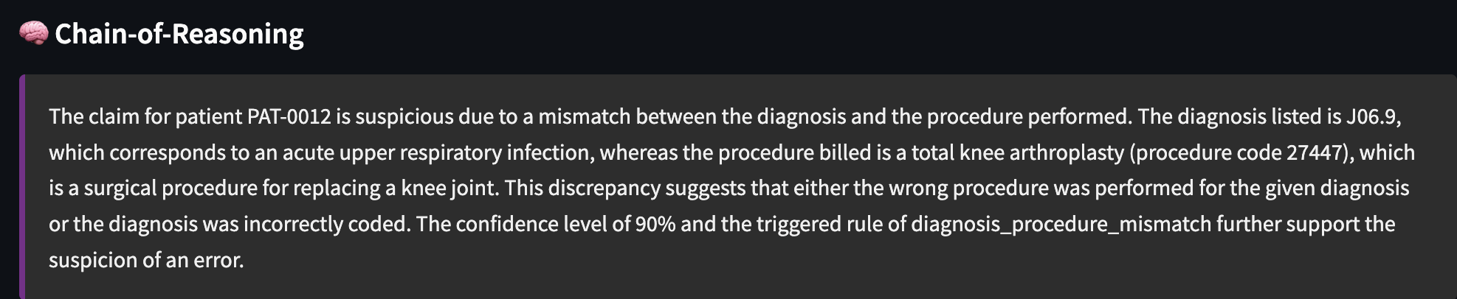
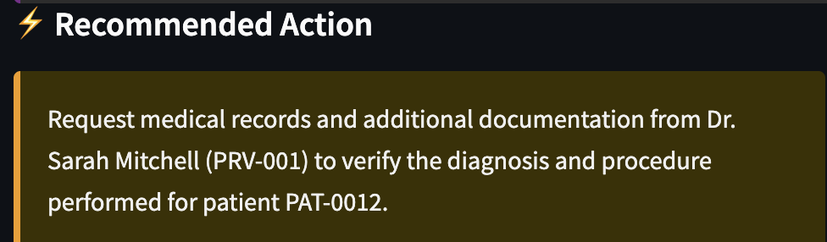

LIVE DEMO — TAB 2: ANOMALY DEEP DIVE
AI Chain-of-Reasoning Analysis
Claim Input
AI Agent Output
CLM-0013 | 2024-07-24
Patient: PAT-0017
Provider: Dr. Lisa Patel (Gastroenterology)
➜
Dx: J06.9 — Upper Respiratory Infection
Proc: 27447 — Total Knee Arthroplasty
Amount: $9,388.86
Risk: 🔴 Critical (90%)
Key innovation: Every claim explanation is verified by a RAGAS-style faithfulness check — ensuring the AI's reasoning is grounded in actual claim data, not hallucinated.
📌 Inserted screenshots of the Anomaly Deep Dive tab after running AI Analysis on a Critical claim

Slide 7
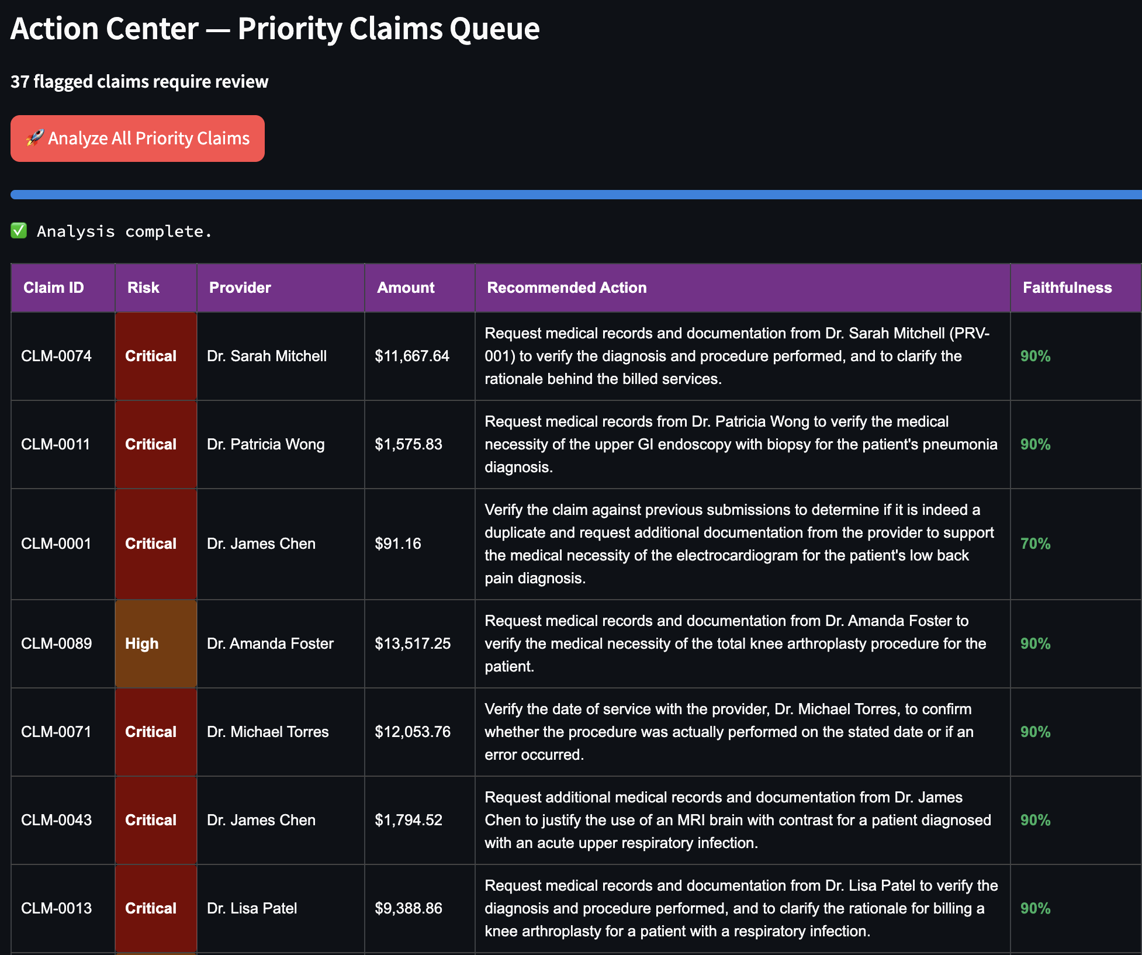
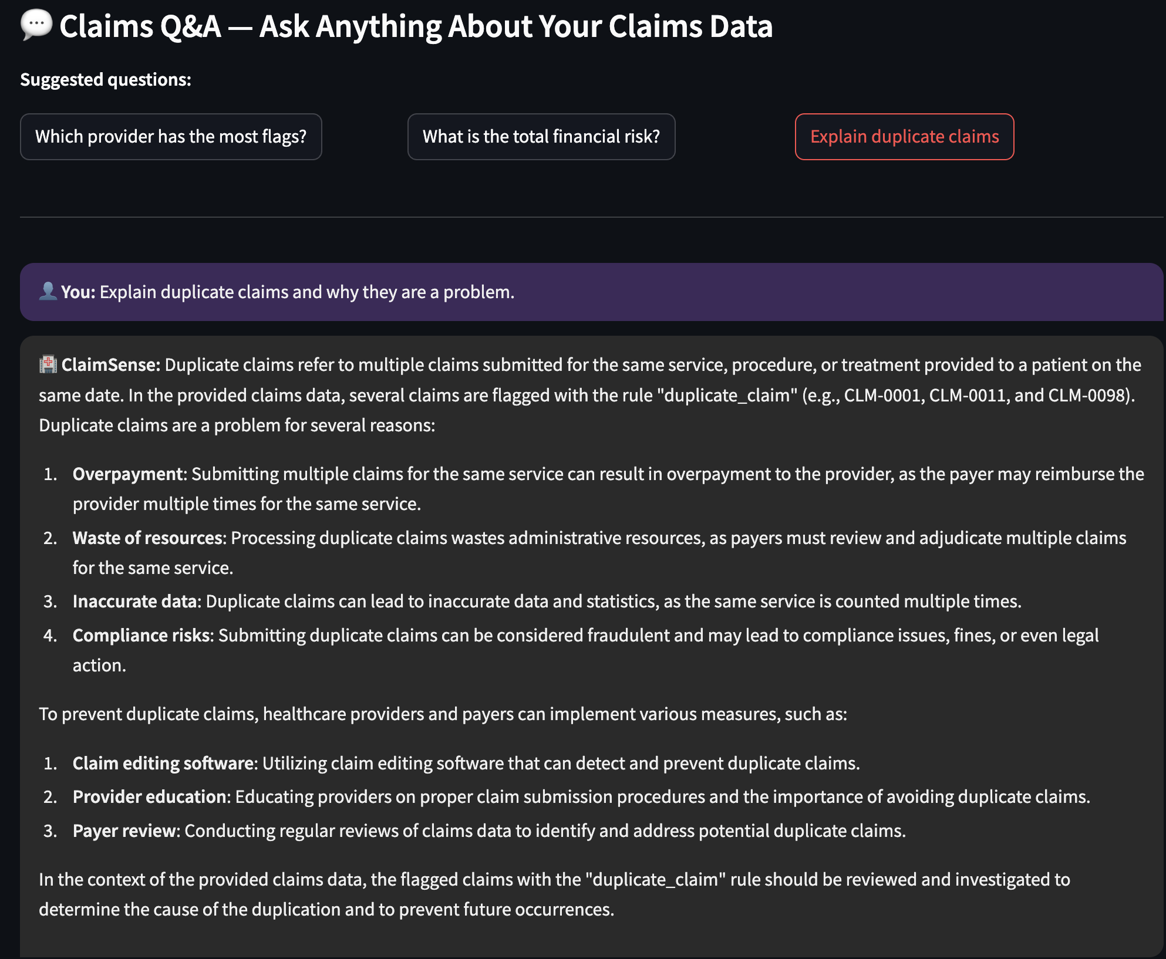
LIVE DEMO — TABS 3 & 4
Action Center & Claims Q&A
⚡ Action Center — Batch Analysis
💬 Claims Q&A Chatbot
📌 Inserted screenshots of Action Center batch results and Claims Q&A conversation

Slide 8
TECHNICAL ARCHITECTURE
How ClaimSense Is Built
Data Layer
Synthetic claims generator — 120 claims, 6 injected anomaly types, statistically realistic
Detection Engine
Rule-based Python engine — 6 detectors, confidence scoring, bootstrap-style risk levels
AI Reasoning
Groq API (llama-3.3-70b-versatile) — chain-of-reasoning, action recommendations, risk assessment
Faithfulness Eval
RAGAS-style claim-level verification — scores every AI output for grounding in claim data
Chatbot Q&A
Multi-turn conversational agent grounded in claims context — physician & reviewer facing
Frontend
Streamlit + Plotly — deployed on HuggingFace Spaces (free CPU tier, zero cost)

Slide 9
STRATEGIC RECOMMENDATIONS
Three Investments for Cotiviti
01
Agentic Payment Integrity Platform
Move beyond flag-and-review. Build agents that ingest claims, retrieve billing policy via RAG, detect anomalies, generate chain-of-reasoning explanations, and recommend action — with human oversight for complex cases.
02
Faithfulness-First Evaluation Standard
Establish a systematic faithfulness layer — RAGAS-style verification that every AI-generated claim explanation is grounded in retrieved policy rather than hallucinated. Market-differentiating commitment to trustworthy AI.
03
Clinical AI Governance Framework
Develop and publish an internal clinical AI governance standard covering model drift monitoring, bias auditing, human oversight thresholds, and regulatory compliance documentation before scaling agentic decisions.

Slide 10
🏥
The gap between clinical signal and clinical action has cost this system trillions of dollars and countless preventable harms.
Closing that gap — with systems that reason, explain, and act — is the most important engineering challenge in health care today.
Kshamaa Suresh · ks4423@columbia.edu · kshamaas.github.io/Portfolio
Live Demo: huggingface.co/spaces/kshamaasuresh/ClaimSense
⚠️ Proof of Concept — Synthetic data only. Not for clinical or payment use.

