Slide 1
WHITE WINE QUALITY PREDICTION
USING PYTHON AND MACHINE LEARNING
PRESENTED BY KSHAMIKA GHIYA 201900436

Slide 2
CONTENTS
1. ABSTRACT
2. LITERATURE SURVEY
3. PROBLEM DEFINITION
4. SOLUTION STRATEGY
5. SOFTWARE REQUIREMENTS
6. RESULTS WITH SCEENSHOTS
7. REFERENCES
Slide 3
Slide 4
Slide 5
Slide 6
Slide 7
Slide 8
Slide 10

Slide 3
INTRODUCTION / ABSTRACT
ABSTRACT
The aim of this case study is to predict wine quality based on physicochemical data.
In this study a large dataset was taken from the UC Irvine Machine Learning Repository which included 4898 instances of white wine with 11 physicochemical data.
In this, I learnt how to use different models of machine learning to classify the wines as well as figure out the importance of each chemical analysis parameters in the wine and which to ignore.
This case study helped me understand how to perform data analysis using machine learning and python programming language.

Slide 4
LITERATURE SURVEY
LITERATURE SURVEY
P. Appalasamy discussed about modeling the complex human taste is an important focus in wine industries. The main purpose of this study was to predict wine quality based on physicochemical data. This study was also conducted to identify outlier or anomaly in sample wine set in order to detect adulteration of wine.
Shen Yin evaluated that the quality prediction models are constructed based on multivariate statistical methods, including ordinary least squares regression(OLSR), principal component regression (PCR), partial least squares regression (PLSR), and modified partial least squares regression (MPLSR).
Dimitrija Angelkov introduced data mining technology for wine analysis. This paper made an analysis of data from the measurements in order to find hidden laws and relationships between the data.

Slide 5
PROBLEM DEFINITION
White wine consumption has been high in the past few years due to its correlation with heart and lung health. It has high antioxidant capacity.
In recent years, most of the industries are promoting their products based on the quality certification they receive on their products.
The tradition way of certification is time consuming, with machine learning techniques, the process of quality certification can be more efficient and less time consuming than before.

Slide 6
SOLUTION STRATEGY
Building such a model is valuable not only for certification entities but also wine producers and consumers.
It can be used to support the oenologist wine evaluations, potentially improving the quality and speed of their decisions.
Moreover, measuring the impact of physicochemical tests in the final wine quality is useful for improving the production process.
Furthermore, it can help in target marketing, i.e. by applying similar techniques to model the consumers preferences of niche and/or profitable markets.

Slide 7
SOFTWARE REQUIREMENTS
TOOLS REQUIRED:
Jupyter notebook
Python 3.9
Pandas
NumPy
Scikit-Learn
IMB-Learn
Matplotlib.pyplot
Seaborn

Slide 8
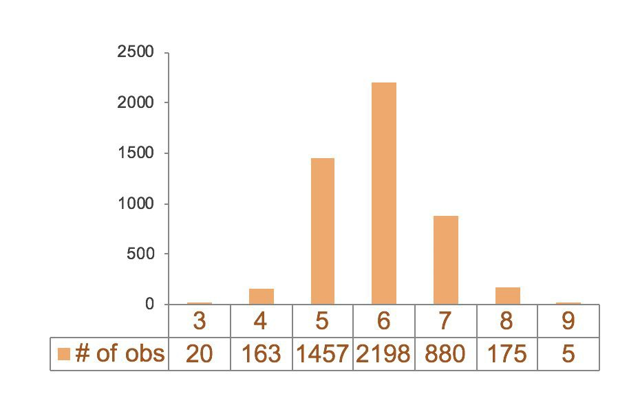
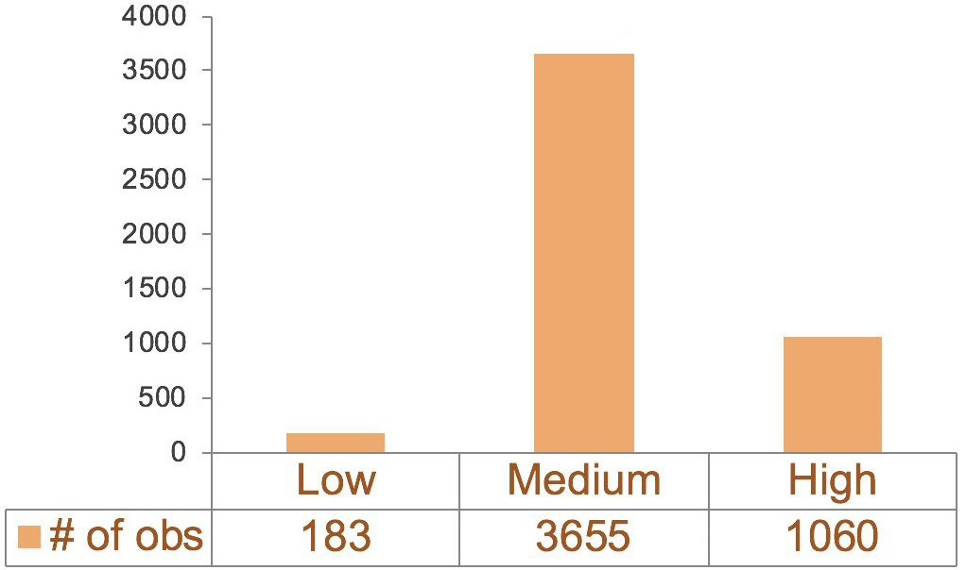
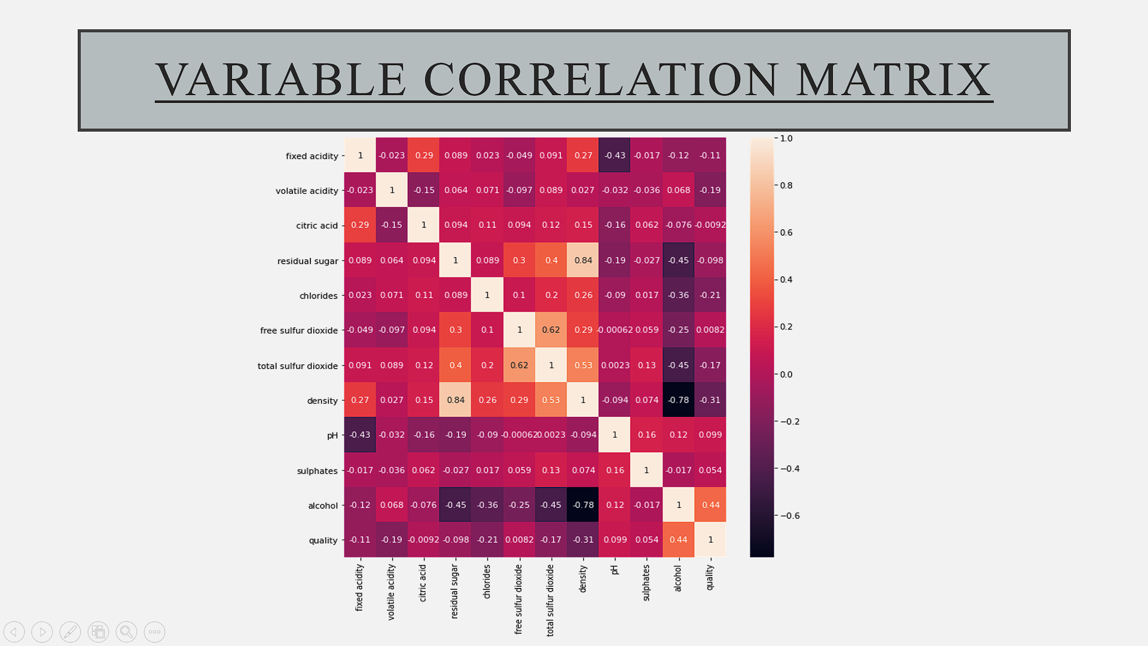
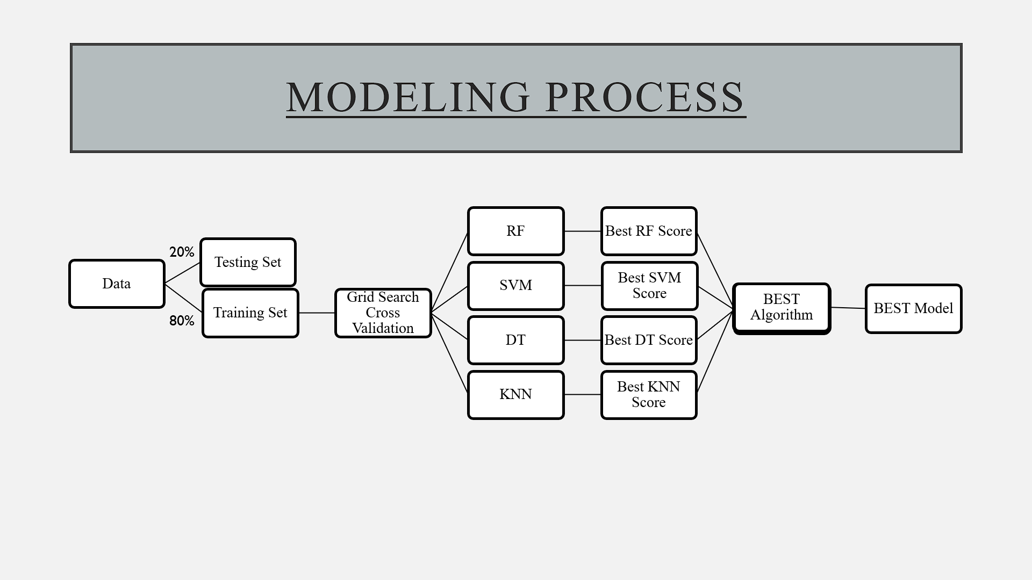
RESULTS
DATA TRANSFORMATION

Slide 9
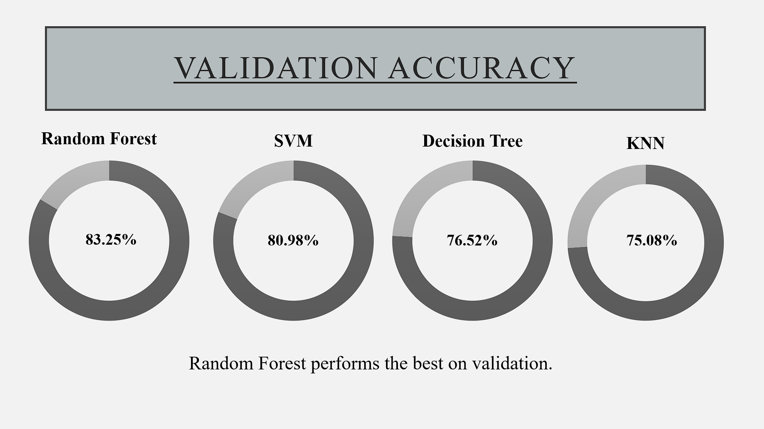
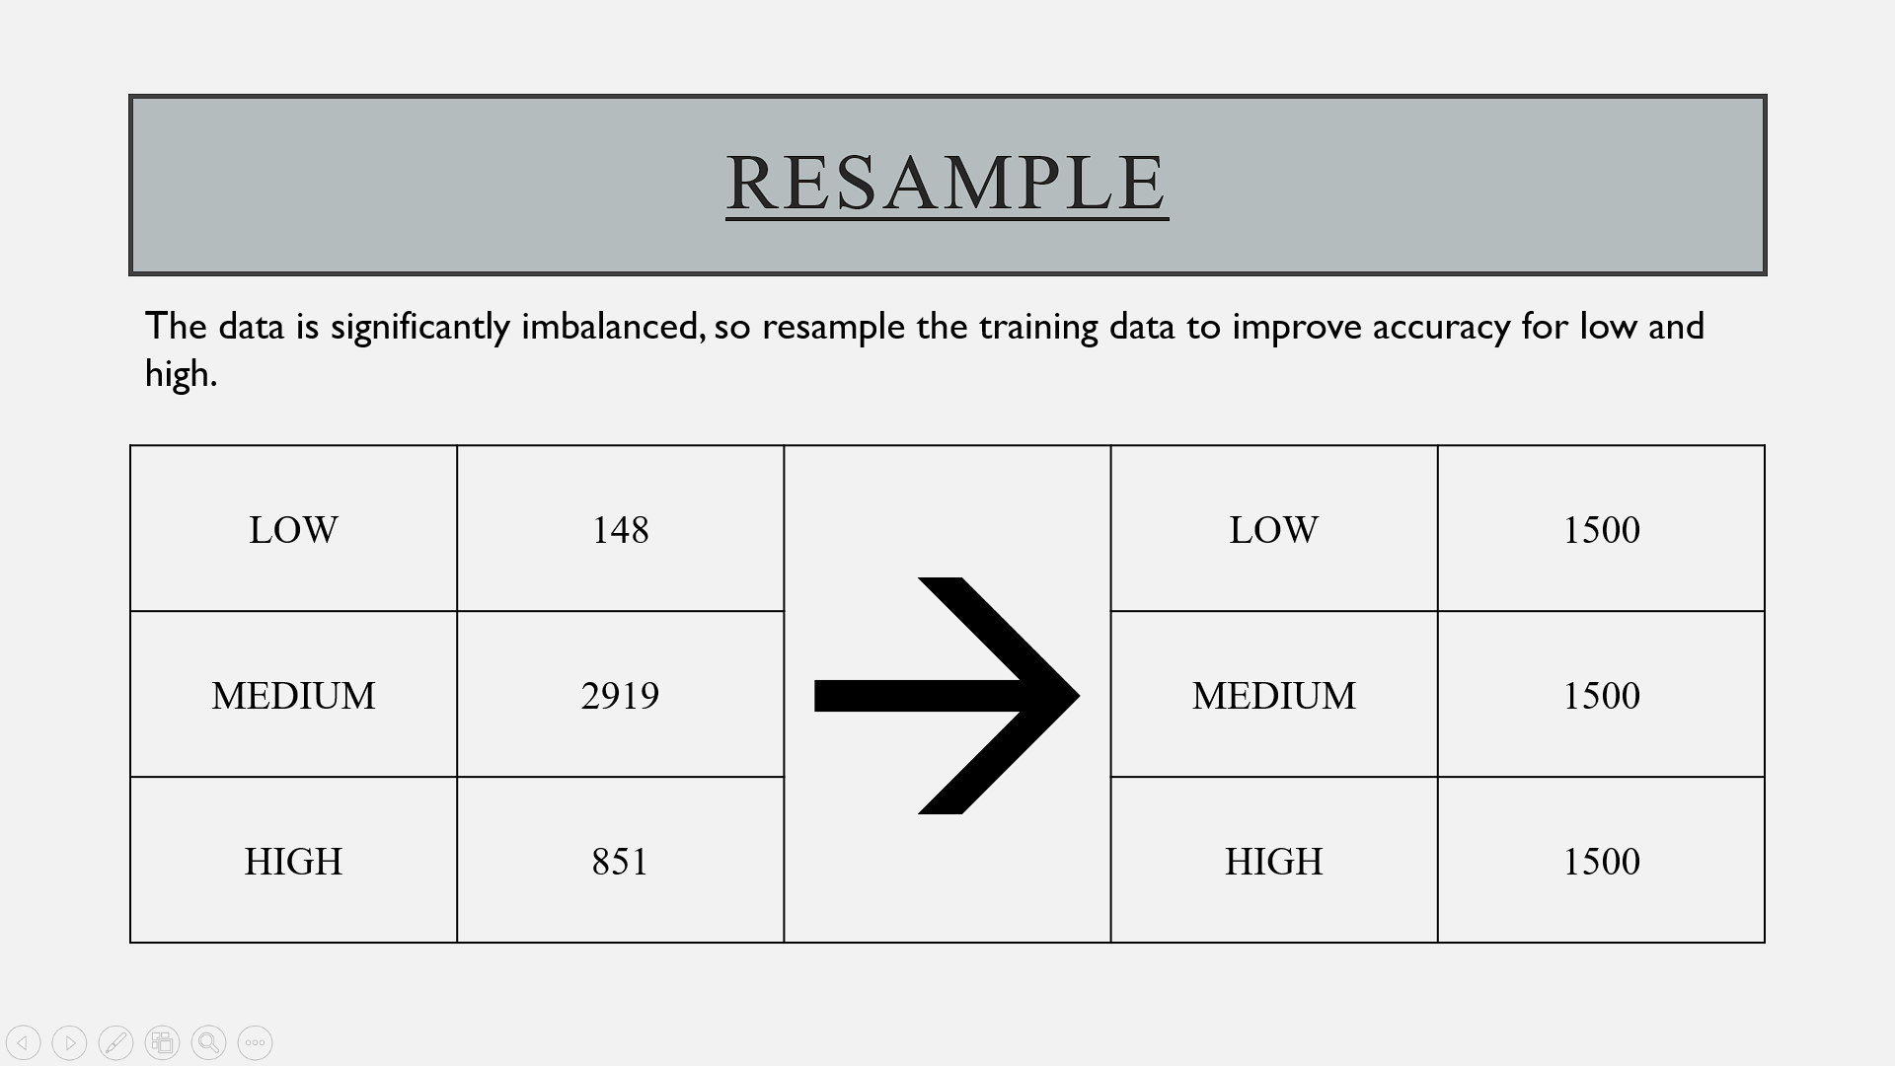
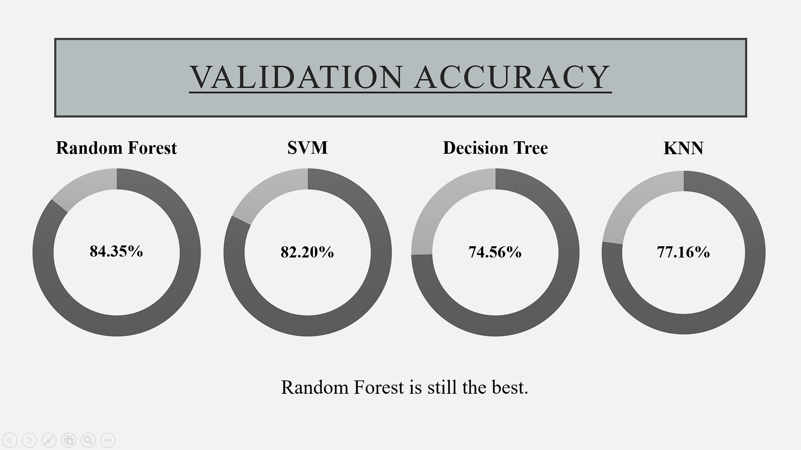
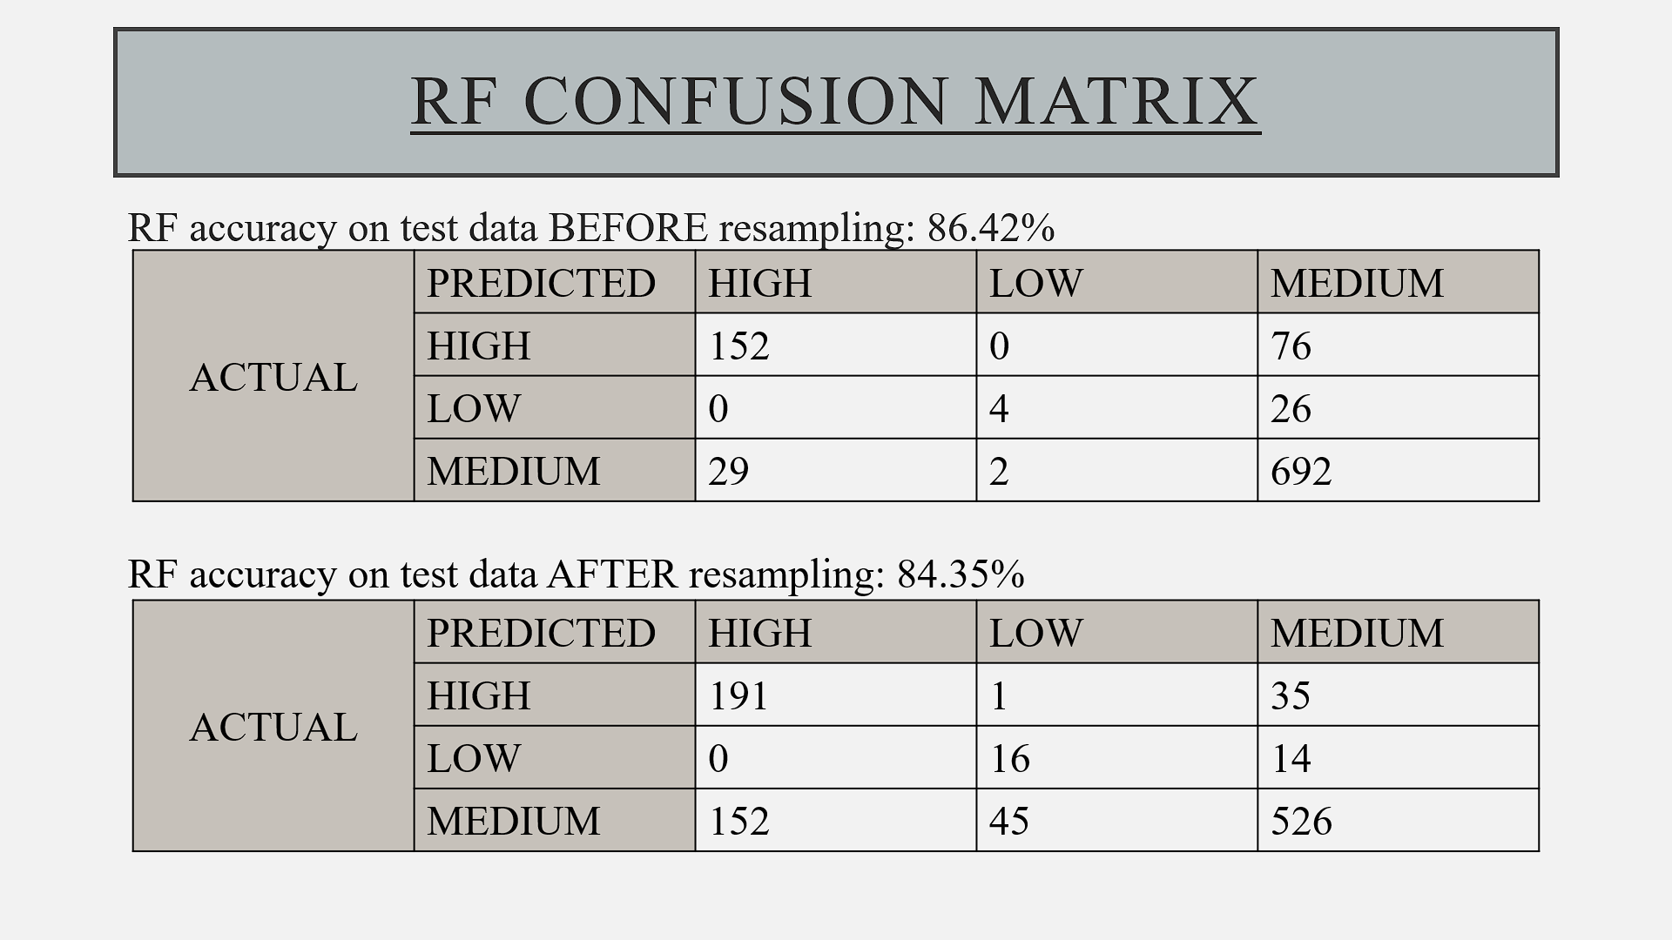
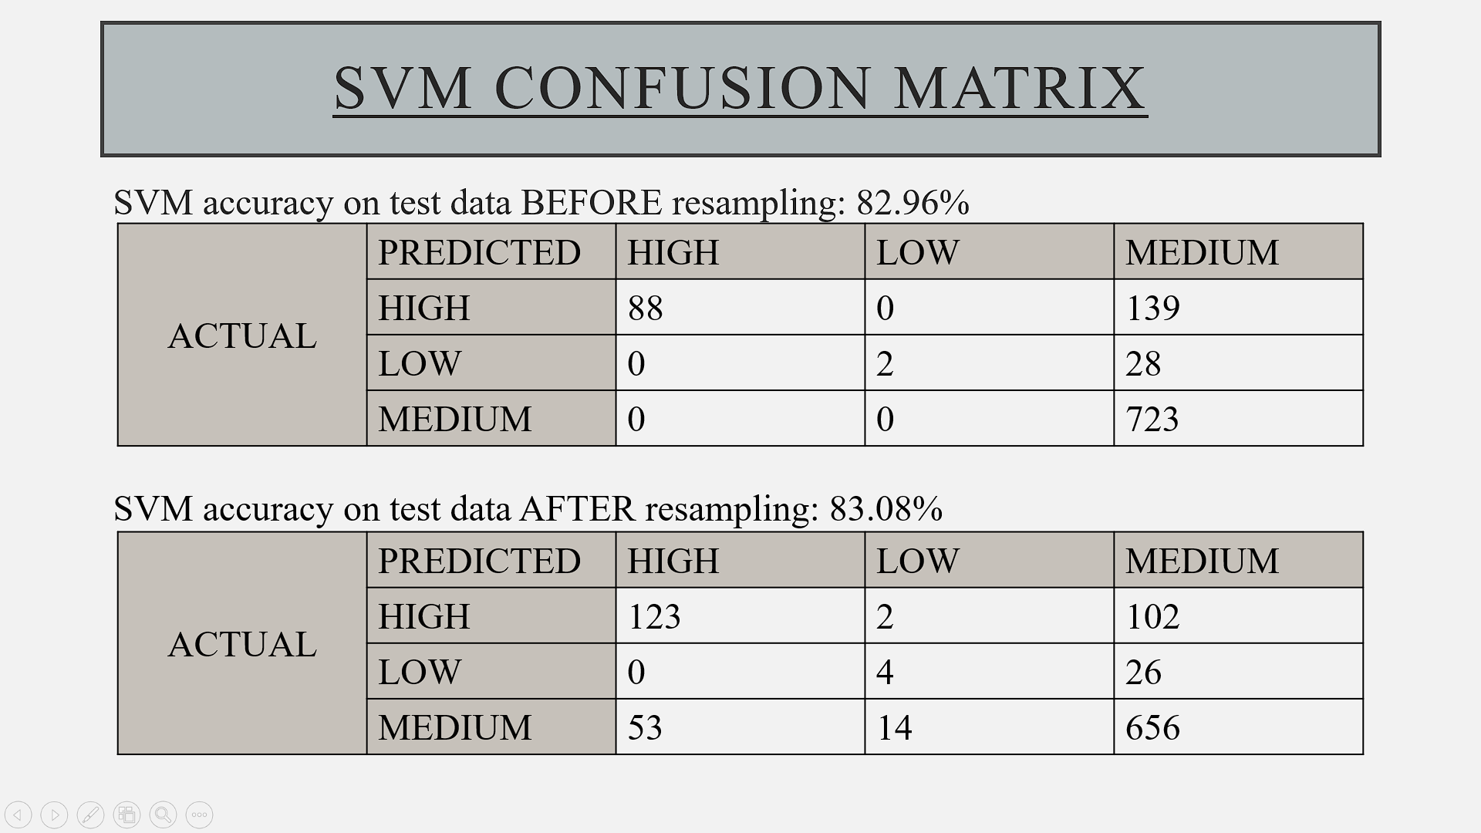
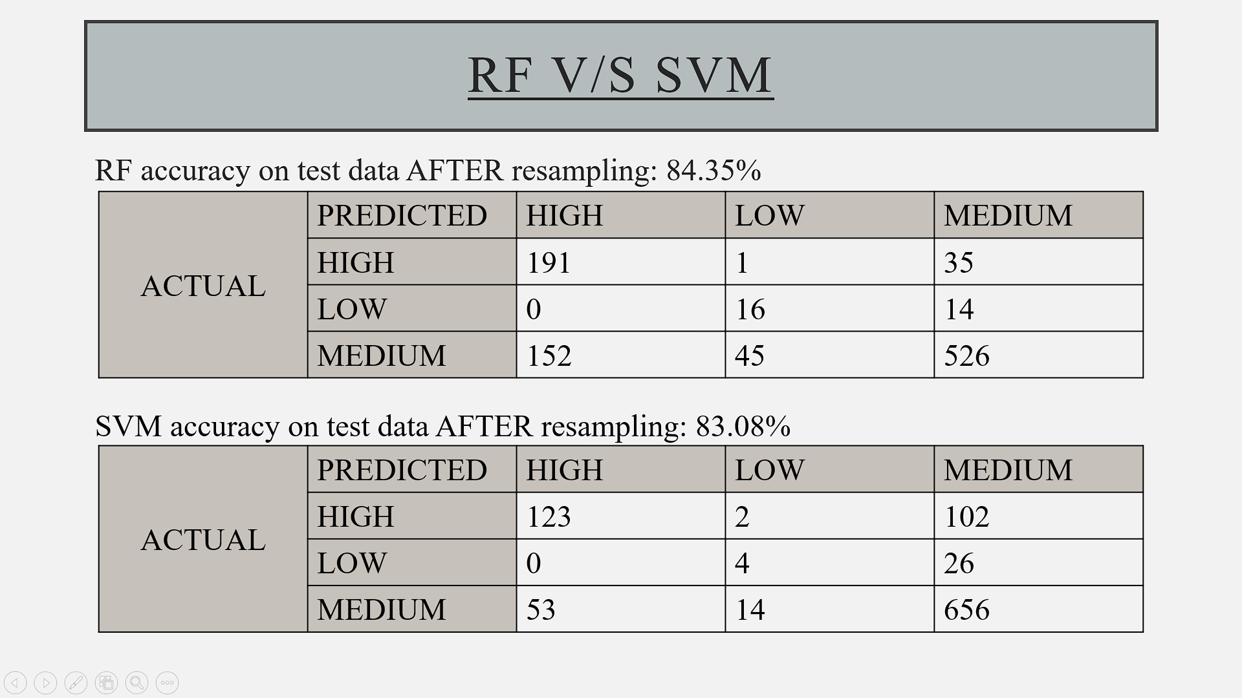
RESULTS (CONTINUED..)

Slide 10
REFERENCES
https://www.ijeast.com/papers/519-529,Tesma403,IJEAST.pdf
https://www.researchgate.net/publication/311919082_The_Classification_of_White_Wine_and_Red_Wine_According_to_Their_Physicochemical_Qualities
https://www.researchgate.net/publication/222430341_Modeling_wine_preferences_by_data_mining_from_physicochemical_properties
http://www3.dsi.uminho.pt/pcortez/wine5.pdf
Data from:
https://archive.ics.uci.edu/ml/datasets/wine+quality
Citation:
P. Cortez, A. Cerdeira, F. Almeida, T. Matos and J. Reis. Modelling wine preferences by data mining from physicochemical properties. In Decision Support Systems, Elsevier, 47(4):547-553, 2009

