Slide 1
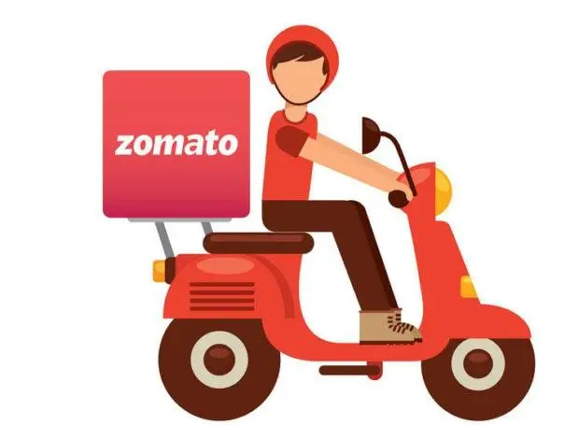
Zomato Restaurant Analysis
Zomato Restaurant Data Overview-Analysis of Restaurant Ratings and Costs

Slide 2

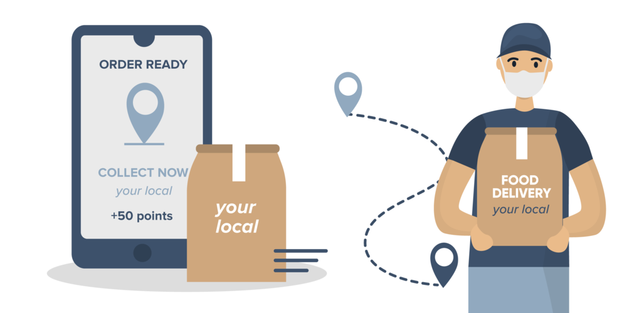
Zomato makes every meal special!.

Slide 3



Started In - July 2008, Delhi NCR. Founded By: Deepinder Goyal, Pankaj Chadha Initially named- “Foodie Bay” In November 2010 it was renamed as “ZOMATO” Parent Company - Info edge Category - Mobile Application Based Sector - Food & Restaurant guide

Slide 4
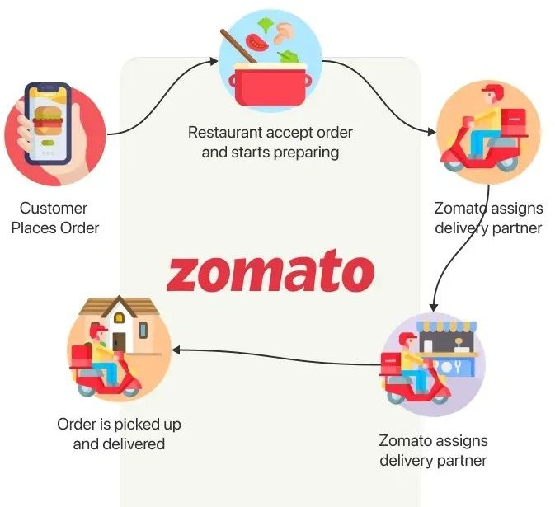
HOW ZOMATO WORKS

Slide 5
PROBLEM STATEMENT
You are hired as a consultant data analyst by Zomato where the team is looking for expansion and opening restaurants.
Your task is to come up with strategies/suggestions about opening newer restaurants.

Slide 6

Data Overview
This project involves analysis of Zomato restaurant data using
Excel function.
The given Data set includes information about all the restaurant which are listed on the Zomato
Restaurant name
Country & city
Cuisine
Currency
Table booking (yes/no)
Online delivery (yes/no)
Price range
Average Cost for Two people
Ratings (out of 5)

Slide 7
ANALYTICAL APPROACH AND TOOL
Cleaning process:- The given data contains inconsistent data and values so it has to be cleaned.
Categorical and Continuous Data :-Understanding the nature of your data is crucial for selecting the appropriate tools and techniques.
Visualization Techniques:- It helps in giving insights and make data driven decisions. Excel provides variety of charting and formatting options to help you create compelling and informative visualization.
Look Up Functions:- VlookUp function is used to combination with other data to achieve required information or table. It is considered in cleaning process.
Average Rating Calculation:- Using this we can easily calculate average ratings of restaurants based on price range, rating and availability of other aspects like online delivery and . Methods like IF functions, logical operators, and aggregation functions are used

Slide 8
TASKS ANALYSIS
Number of restaurants opened in each country.
Numbers of restaurants opened each year.
Places to open newer restaurants with lesser competition.
Total number of restaurants in India in the price range of 4.
Average number of voters for the restaurants in each country.
Highlighting suggested places to open restaurants.

Slide 9
Countries for new restaurants
Suggested States and Cities
Current Restaurants Ratings
Expenditure on Food
Competitor Analysis
Cuisine Selection
Online Delivery and Table Booking
Cuisine Rates and Feedback
Price Range Distribution

Slide 10
Restaurant Count Vs Country
As Per Research and analyzing the Data We have seen that the India is having the highest no of restaurant that is 8652 out 9551 restaurant where as the Canada is having the lowest no of restaurant.

Slide 11
Restaurant Count vs Year As per research we can see that Highest number of restaurants opened in 2018 (1,102) and Lowest number of restaurants opened in 2012 (1,022).

Slide 12
Average of Voter VS Country
The dataset shows the variations in average votes among countries, with Indonesia leading at 772.1 and Brazil at only 19.6.
Countries like the UAE and Turkey show high engagement, while Singapore and Brazil lag.
To improve participation, targeted outreach and engagement strategies could be developed for lower-performing nations. Fostering community initiatives may enhance overall voting activity

Slide 13
Expenditure Analysis
The average cost data shows significant disparities, with Singapore at the highest average cost of ₹10,047, while Turkey is the most affordable at ₹209.
India's average cost is relatively low at ₹624. To attract more international visitors, consider promoting affordable dining options in high-cost countries.
Conversely, countries like Turkey and India could market their culinary experiences as cost-effective alternatives, appealing to budget-conscious travelers.

Slide 14
Top Five Cuisines by Votes
The voting data indicates that "North Indian, Mughlai" cuisine received the highest engagement at 53,747 votes, while "Cafe" cuisine has a significant following with 30,657 votes.
The combination of "North Indian" and "Chinese" also shows strong interest.
To enhance participation, consider promoting fusion dishes and themed events that showcase popular combinations, especially those that resonate with North Indian flavors. This could help elevate lesser-voted cuisines and drive overall engagement.

Slide 15
Country Selection
Approach :Identification of countries with less number of restaurants, and Good Average.
Visualization tool :Stacked Column chart through pivot table construction.
Recommended countries :Indonesia, Canada ,Qatar, Singapore, Sri Lanka

Slide 16
Country Vs Average Rating
Quality of Dining Experience: Countries with ratings above 4.0 (Qatar and Indonesia) are likely providing exceptional dining experiences, possibly through diverse cuisines, better service, and innovative offerings.
Opportunities for Improvement: Canada and Singapore, with lower ratings, may need to focus on improving restaurant quality, customer service, and overall dining experiences to elevate their standings.

Slide 17
Selected Country -Expenditure Analysis
Singapore has the highest average cost at ₹10,047, while Sri Lanka offers the most affordable option at ₹665.
Canada and Qatar fall in the mid-range, with costs of ₹2,252.9 and ₹5,166.4, respectively. To attract more visitors, Singapore could highlight unique dining experiences that justify the higher costs, while Sri Lanka might focus on promoting its value-for-money offerings to appeal to budget travelers.
Encouraging culinary tourism could enhance engagement in both high- and low-cost regions.

Slide 18
ONLINE DELIVERY /TABLE BOOKING
As per data we can see we have 75%+ potential market available for serving through online delivery, and table booking. That clearly shows high scope for entering into online delivery and table booking sector. Also, from average rating it can be seen that restaurants offering online delivery and table booking have higher average ratings, so its a wise choice to go for online delivery and table booking.

Slide 19
INSIGHTS FROM ZOMATO
Created multiple pivot tables like :
Country and number of restaurant. Online delivery and table booking. average voting, ratings and votes.
Applied if, and, count if functions for necessity.
Used conditional formatting for representing the suggested countries.
Conducted market research for expansion in :
Indonesia
CANADA
QATAR
SINGAPORE
SRI LANKA

Slide 20
Recommendation
The analysis highlights Indonesia and Qatar as promising markets for new restaurants due to their strong average ratings and a healthy number of dining options.
Singapore's moderate ratings suggest potential for improvement through enhanced dining experiences.
Focusing on high-quality food and unique offerings will help differentiate from competitors and build customer loyalty.
Additionally, emphasizing online delivery and table booking services can significantly boost ratings and attract more customers.
Overall, these strategies can drive success in the competitive restaurant landscape.

Slide 21
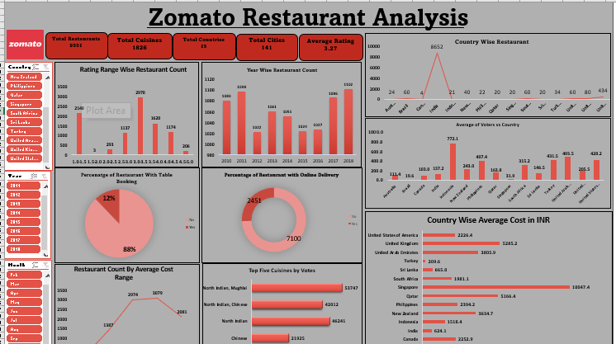
Zomato Restaurant Analysis -Dashboard

Slide 22
Contents of dashboard
Pivot charts :- For visualization & analysis of different trends and pattern.
Slicers :- Make data visualization interactive
Comparison of different aspects (like price range and rating)
Impacts of different set of entities on different entities (e.g. impact of online delivery on Restaurant Count)
Various analysis

Slide 23
Strategies
Customer preference & Quality of cuisines
Market Competition & Growth potential
Online/Offline Presence & services
Conduct Survey
Cost Benefit Analysis

Slide 24
Conclusion
As Zomato continues to expand its global footprint, it aims to revolutionize the food delivery industry and enhance the dining experience for customers world wide. With a focus on innovative technology and exceptional customer service, Zomato seeks to solidify its position as a leader in the food delivery and restaurant discovery sector. From above study we can conclude the cities where we can open new restaurants or food services for better growth of the overall company.

Slide 25


