Slide 1


Internet Programming Laboratory: Frontend Development project
Name: Kshatri Syam Sahil Singh | Roll No: 03 | Reg No: 12212269
Course: Internet Programming Laboratory | Course Code: CSE326
Showcasing key technologies and skills gained while developing a real website frontend.
Notes:
1

Slide 2
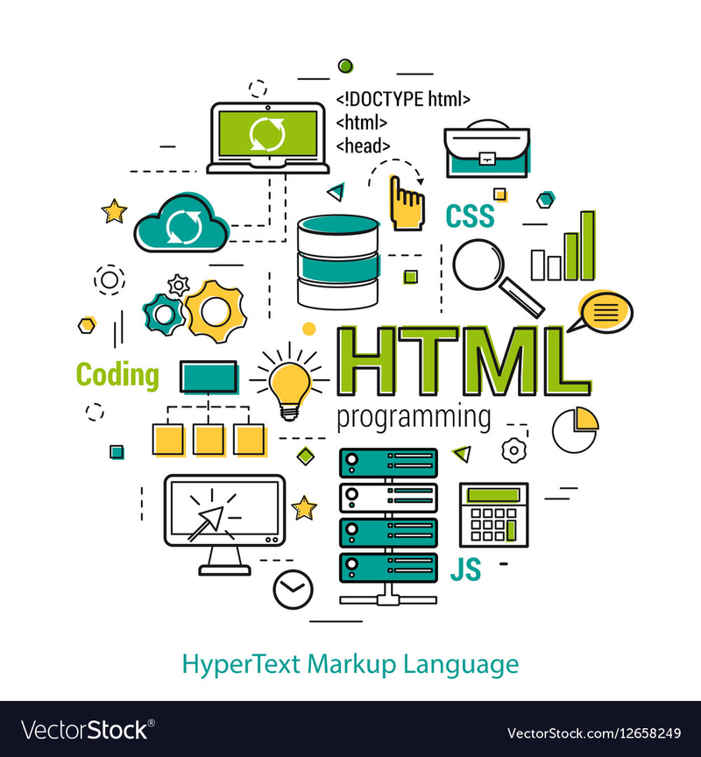
Project Overview: ShapesNGo Website Frontend
Project Scope
Technologies Used
Developed frontend of an active website: ShapesNGo
HTML, CSS, Bootstrap, JavaScript basics
Hosting & Management
Utilized cPanel and Plesk for site management
Notes:
2

Slide 3

HTML: Structure and Semantics
Learning Outcomes
Implementation Highlights
Created well-structured markup for pages
Organized content with headers and sections
Used semantic tags to enhance accessibility
Incorporated images and links properly
Linked pages to create seamless navigation
Maintained clean and readable code
Notes:
3

Slide 4
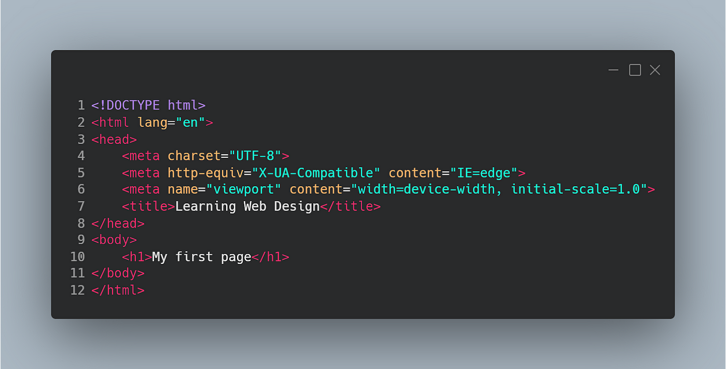
CSS: Styling and Responsive Design
Key Concepts Learned
Application in Project
Advanced selectors and properties
Styled consistent headers, footers, buttons
Flexbox and grid for layout control
Responsive design for mobile and desktop
Responsive media queries
Visual consistency using CSS classes
Notes:
4

Slide 5
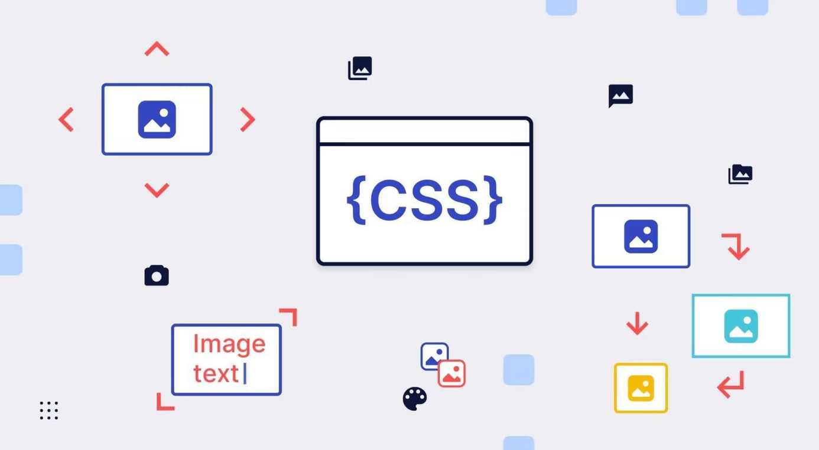



Bootstrap Framework: Rapid UI Development
Grid System
Responsive Utilities
Predefined Components
Used Bootstrap’s 12-column grid for layout
Implemented responsive visibility and alignment
Buttons, navbars, cards customized efficiently
Notes:
5

Slide 6

JavaScript Basics: Interactive Elements
Fundamental Concepts
Practical Usage
Implemented simple form validations and user interactions
Learned DOM manipulation and event handling
Limitations
Explored basics; in-depth scripting still to develop
Notes:
6

Slide 7

cPanel and Plesk: Web Hosting & Management
cPanel
Plesk
File management and site backups
User-friendly interface for hosting control
Email account setup and database management
SSL management and performance monitoring
Notes:
7

Slide 8


Summary & Future Learning Path
Master JavaScript
Advance to complex interactivity and frameworks
Deepen Backend Knowledge
Explore server-side programming and databases
Build Full-Stack Projects
Integrate frontend and backend for complete solutions
Enhance Deployment Skills
Learn CI/CD pipelines and cloud hosting
Notes:
8

