Slide 1
What I did since Tuesday
You asked for a concrete example of the structural uncertainty. This is it.
I used our own frozen network and our own NTSB data. Nothing new was built.
I changed one thing in how the network is constructed, then rebuilt it and asked the same question.
Everything else is held fixed: same 1,742 accidents, same CPT rules, same query.
No LLM is involved anywhere in this test.
Slide 12
Vanderbilt University
Notes:
Open with the frame: the model is fine for what it was built to do. The point is that its output should carry an interval and nothing currently computes one. Then: this is Zhang’s recipe on our data, no LLM, so it cannot be dismissed as the AI being unreliable.

Slide 2
What the structural uncertainty is
The structure is which parent nodes point into each node.
The data does decide a lot: which edges exist, and how strong each edge is. So the data ranks the candidate parents.
The data does not decide how many parents to keep.
That number is maxElements = 12, a constant in Zhang’s code. No threshold, no stopping rule, no test produces it.
The injury node therefore has 12 parents, which is 4,096 parent combinations. Only 59 of them ever appear in our 1,742 accidents.
Everything the model says about injury is estimated from those 59.
Slide 13
Vanderbilt University
Notes:
Be precise here. The ratios DO justify the ranking. They do not justify the cutoff. Analogy if he pushes: ranking 100 job candidates by score is justified by the scores; "hire the top 12" is not. If he says a developer would pick the cutoff by some criterion: they would have to state it, and they did not, and different reasonable criteria land in different places.

Slide 3
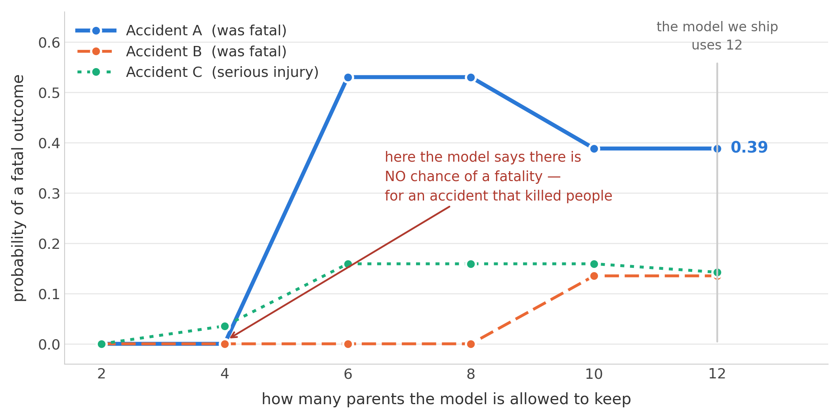
Same accident, same data, different answer
At a cap of 4
the model reports a 0% chance of a fatality, for an accident that killed people.
At a cap of 6
the same accident reads 53%.
Across all 1,742 accidents
44% at least double between the lowest and highest cap.
Rebuilt with our own CPT rules. It is also not monotonic — more parents is not better, it is sparser.
Slide 14
Vanderbilt University
Notes:
The mechanism, be ready for this: at a low cap none of the kept parents is active for that accident, so the rule puts ALL the mass on the default state "no injury". The model reports certainty and is certainly wrong. If you cannot explain that, the result looks borrowed.

Slide 4
Does the graph change every time?
No. Same data, same settings, run it twice and you get the identical network. Ours is deterministic.
It changes when a construction choice changes. The cap is one. The 0.95 ratio cap and the cycle-removal order are others.
Zhang’s original version would change run to run — he broke ties with random jitter. I replaced that with a fixed rule.
So this is not run-to-run noise. Several defensible builds give different answers, and we report only one of them.
Slide 15
Vanderbilt University
Notes:
This is the protective slide. Do NOT say "the network changes every time" — he will correct you. Say: it does not change if I re-run it, it changes if I change a choice nobody justified, and Zhang’s own version was random at the tie-break.

Slide 5
What I think this means
The network answers how likely the outcome is. It does not say how much to trust its own number.
I would like to report a range instead of a single number, and say where that range comes from.
This test only varied how the network is built. The next layer is how the narrative is read, which is where the agents come in.
Questions: is model form uncertainty the right frame? What would convince you this matters — a wider range, or a changed decision?
Slide 16
Vanderbilt University
Notes:
Keep it short. End on the questions. If he only has five minutes, show slide 3 and this one.

