Slide 1
WHAT THE STRUCTURAL UNCERTAINTY IS
The data ranks the parents. It does not say where to cut.
The structure is which parent nodes point into each node.
The data does decide a lot: which edges exist, and each edge’s ratio — so it ranks the candidate parents.
It does not decide how many to keep. The cap is maxElements = 12, a constant in Zhang’s code — no threshold, no stopping rule, no test produces it.
Same for the 0.95 ratio cap, the cycle-removal order, and the tie-break (Zhang’s was random jitter).
Every probability we report is conditional on those choices.
59
of 4,096 parent configurations
appear in the data
1.4%
coverage, from 1,742 accidents
Everything downstream is estimated from that.
Notes:
This answers his first question: what IS the structural uncertainty here. Be precise — the ratios DO justify the ranking; they do not justify the cutoff. Analogy: ranking 100 job candidates by score is justified by the scores; "hire the top 12" is not. If he says a developer would pick the cutoff by some criterion: they would have to state it and they did not, and different reasonable criteria land in different places. Say the frame first: the model is fine for what it was built to do; the point is that its output should carry an interval.

Slide 2
DIFFERENT ALTERNATIVES
Six alternatives, built the same way
Same 1,742 accidents. Same recipe. Same CPT rule. Only the cap changes.
parent cap | configurations seen | of possible | coverage
2 | 4 | 4 | 100%
4 | 11 | 16 | 69%
6 | 25 | 64 | 39%
8 | 35 | 256 | 14%
10 | 48 | 1,024 | 4.7%
12 (ships today) | 59 | 4,096 | 1.4%
More parents is not “better”.
Each extra parent doubles the table the CPT must fill, from the same 1,742 accidents. At the shipped setting almost every cell is estimated from nothing.
Notes:
This answers "I need to see different alternatives." The alternatives are not invented — they are the same recipe at a different value of one constant. Coverage collapse is the mechanism for everything on the next slide.

Slide 3
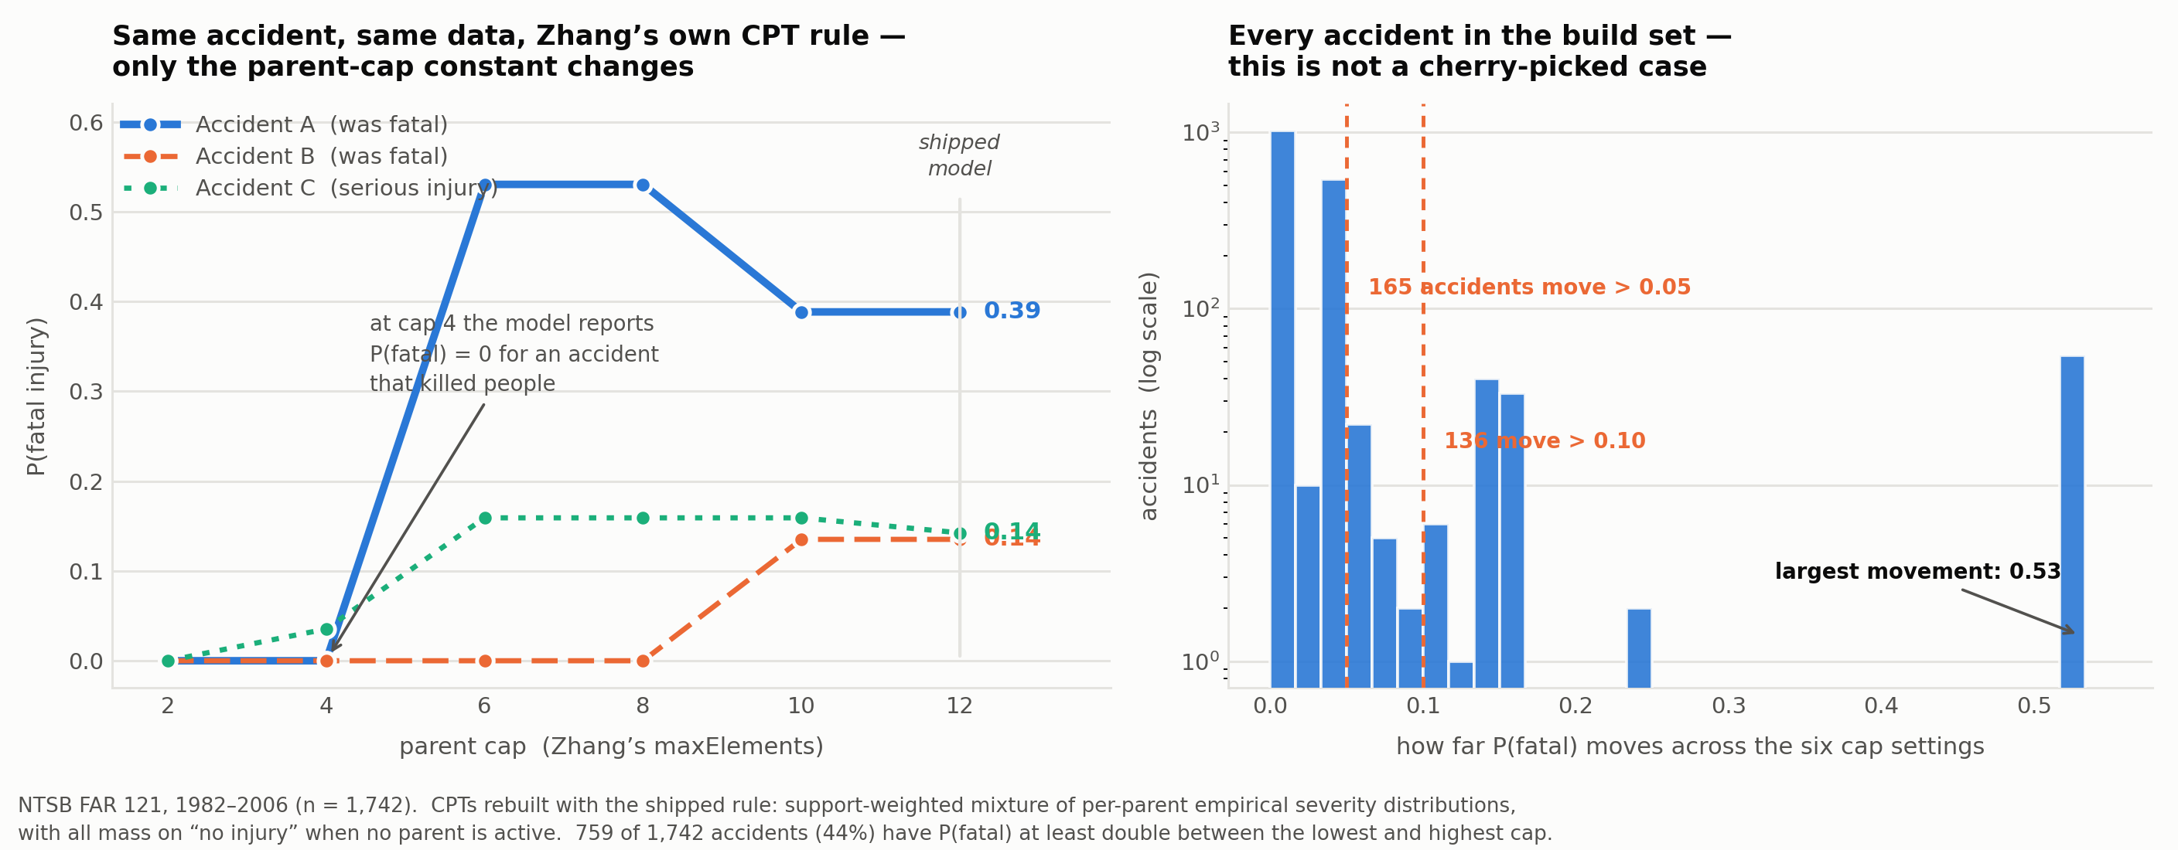
WHAT HAPPENS WHEN THE GRAPH CHANGES
Same accident. Same data. Different answer.
0.00
P(fatal) at cap 4 —
for an accident that was fatal
0.53
the same accident at cap 6
Rebuilt with the shipped CPT rules — support-weighted severity mixture, and Zhang’s Beta-CDF on the Boolean nodes, where mean P(Yes) moves 8× across the same cap range. No LLM involved.
44% of all 1,742 accidents have P(fatal) at least double between the lowest and highest cap.
Notes:
The money slide. At low caps no retained parent is active, so the rule puts ALL mass on the default state "no injury" — the model reports certainty, and is certainly wrong. Be ready to explain that mechanism; if you cannot, the result looks borrowed. Also note it is not monotonic: more parents is sparser, not better.

Slide 4
ON “A BAYESIAN NETWORK ALREADY HANDLES UNCERTAINTY”
Agreed — but that is a different uncertainty
What the CPTs do represent
Uncertainty about the outcome. Given this structure, P(fatal) = 0.39. That is the network doing its job.
What they do not represent
Uncertainty about the model form. Nothing in the network says how much to trust 0.39, or that it was 0.00 under a different cap.
“It is not possible to treat structural uncertainty within an individual BN. Instead, assessors must treat structural uncertainty by constructing alternative model structures and using separate BNs within the same assessment.”
Sahlin, Helle & Perepolkin (2021), Integrated Environmental Assessment and Management 17(1)
Model form uncertainty — Nannapaneni & Mahadevan, Reliability Engineering & System Safety 155 (2016)
Notes:
Concede first — he is right about what CPTs do. The distinction is aleatory vs model form. Use HIS term: model form uncertainty, from his own 2016 paper. The Sahlin quote answers the objection so you do not have to argue it yourself.

Slide 5
WHAT I WOULD DO NEXT
Report an interval, not a point
Construct the model every defensible way and report how far the answer moves — an interval on the risk number, not a single value.
Build the multi-agent system you described, with the agents configurable, so it generates the alternative structures rather than one.
Then the research question: is the interval reducible? Does it shrink with more accidents and better coding, or is there a floor?
What I need from you
1. Is model form uncertainty the right frame, or would you call it something else?
2. What would convince you this matters — a wider interval, or a changed decision?
3. You said look at ground transportation — this project, or the dissertation?
4. What should I work through to shore up the Bayesian network side?
Notes:
End on the questions. Question 4 matters — he told you the BN side was weak, and asking what to read is the right response to that. Keep the dissertation open, as he asked: this is method development, application later.

