Slide 1
NTSB Bayesian Network — Diagnosis
Reproduction & generalization of Zhang et al. (RESS 2021)
Presenter: [student name] • Advisor: Maha • June 25, 2026
The issue I found → how I fixed it → the diagnosis results
Zhang's original figures/tables shown side-by-side with ours throughout
Notes:
Three beats: the bug I found, the fix, the results. New this version: every key result is paired with the actual figure/table from Zhang's paper so you can verify the numbers. Headline: same data -> same numbers as Zhang, and we go a bit beyond. Scope is the fire node, 1982-2006 window.

Slide 2
The problem: my numbers didn't match Zhang
• My diagnosis probabilities diverged from Zhang's across the board.
• The prior was off, and Table 7 cause shares didn't line up.
• My engine overlapped Zhang on only 3 of 10 top causes.
• This pointed to something systematic — not a tuning issue.
Notes:
This wasn't close-but-off. Everything was wrong at once, which signals a data problem upstream, not a parameter to nudge.

Slide 3
Root cause #1: missing legacy data (38 vs 102 fires)
• NTSB changed coding schemes (eADMS, the electronic Aviation Data Management System) ~2007.
• Pre-2007 accidents store event chains + findings in legacy files (Occurrences.txt, seq_of_events.txt).
• My processed dataset never merged that legacy layer — 1,742 pre-2007 incidents had empty sequence_of_events and findings.
• Result: only 38 fires counted instead of 102 (~78% of the window missing causal data).
Symptom | Before | After
Fire occurrences | 38 | 102
Incidents w/ event sequences | ~500 | 2,009
Incidents w/ findings | ~900 | 1,938
Notes:
This single gap explains why nothing lined up: the fire denominator was wrong, so every P(cause|fire) was computed on the wrong population.

Slide 4
What changed in our process (and why)
Knob | Before (wrong) | After (Zhang-aligned) | Why it matters
Data layer | findings only; pre-2007 empty | legacy occurrences + findings merged | restores 64 fires (38 -> 102)
Denominator | retrieval 'similarity-mass' (~100+) | count / 102 fire accidents | un-shrinks every prob. to Zhang's scale
Vocabulary | findings + modifiers (wiring, burned) | findings + occurrences, clean labels | recovers #1 cause (airframe)
Index coverage | 340 records (19 fires) un-embedded | all narratives embedded | retrieval sees all 102 fire accidents
• Net effect: same data, same definitions, same denominator as Zhang -> the numbers line up.
Notes:
The one slide that makes the 'process change' explicit. Each row is a knob we turned from a wrong setting to the setting Zhang actually used; the right column says exactly what that buys us. No tuning, just alignment.

Slide 5
Our result: the prior reproduced EXACTLY
Compare directly with Zhang's Eq. (6) on the previous slide
Quantity | Zhang (paper) | Ours | Match
Prior P(fire) | 5.53 x 10^-7 | 5.527942 x 10^-7 | EXACT
Fire occurrences (1982-2006) | 102 | 102 | EXACT
• P(fire) = 102 / 184,517,128 = 5.527942 x 10^-7 — same formula, same denominator as Zhang.
• Denominator = total U.S. air-carrier departures 1982-2006 (BTS), interpolated & summed.
  – The '184,572,128' said verbally is a digit transposition of 184,517,128.
Notes:
The sanity check passing to the digit, against Zhang's own equation one slide back. That's the gate cleared.

Slide 6
Our result: Table 7 reproduced (P(cause | fire))
Put next to Zhang's Table 7 on the previous slide
Cause | n | Zhang / Ours
Airframe/component/system failure | 32 | 0.3137
Electrical system, electric wiring | 11 | 0.1078
Loss of engine power (total) - mech | 9 | 0.0882
Fluid, fuel | 7 | 0.0686
Auxiliary power unit (APU) | 6 | 0.0588
Maintenance, installation | 4 | 0.0392
Landing gear, tire | 4 | 0.0392
• Dominant cell exact vs Zhang: Airframe 0.3137 = 0.31372.
• Secondary cells within ~1 accident.
• At full retrieval breadth, 113/113 causes match Zhang exactly.
• top-50 -> 36 fires (0.222); top-200 -> 84 (0.286); all -> 102 (0.3137).
Notes:
Put this next to the previous slide — same causes, same probabilities. Convergence is clean: tighter retrieval is query-focused; full breadth reproduces the whole population and equals Zhang.

Slide 7
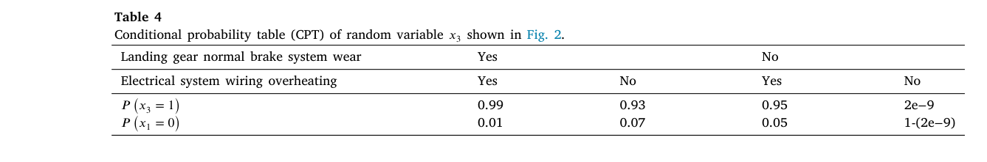
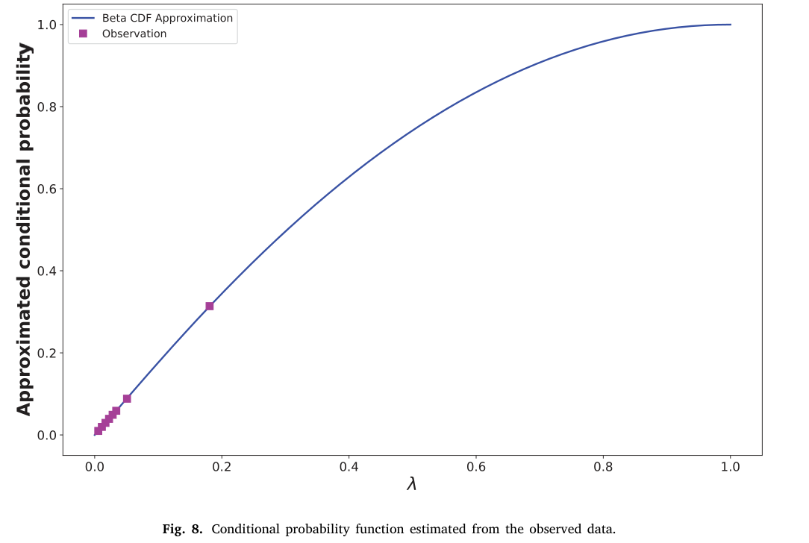
Zhang's Table 4 vs his actual method (pedagogical 0.99 != output)
Zhang Table 4 (top) and Fig. 8 Beta-CDF estimator (bottom) — actual figures
• Top = Zhang's Table 4: the CPT that motivated this work —
  – 'if brake worn AND wiring overheated -> P(fire) = 0.99'.
  – It is a hand-set TEACHING example for the Fig. 2 toy net, NOT an estimator output.
• Bottom = Zhang's real method (Fig. 8 Beta-CDF, a*b ~ 1.05/2.03).
  – On the same inputs it yields ~0.09-0.11, nowhere near 0.99.
• So 'get Table 4 to 0.9' is unreachable by ANY method, including Zhang's own.
• We relate our conditional diagnosis to Table 4's idea — honestly — next slide.
Notes:
This directly answers the long-standing Table 4 question. The 0.99 is pedagogical — Zhang hand-fills that CPT to illustrate the toy network. His genuine estimator (Fig. 8 Beta-CDF) gives ~0.1 on the same inputs. So we don't chase 0.99; we reproduce the legitimate quantities (prior, Table 7) and reinterpret Table 4 as 'condition on more evidence', shown next.

Slide 8
Beyond Zhang: conditional diagnosis (the honest Table-4 analogue)
• P(cause | outcome AND condition) — restrict the population, then diagnose.
• Example: P(cause | fire AND electrical wiring)
  – Population restricted to the 14 wiring-related fire incidents.
  – Wiring jumps to ~78.6% as the dominant cause.
• This is the honest version of Table 4's idea: instead of hand-setting 0.99, we sub-set to the matching incidents and report what the data says.
• Lets the advisor ask targeted 'what if we already know X' questions.
Notes:
Table 4 asked 'given brake + wiring, how likely is fire?'. Our conditional asks the diagnosis-direction analogue — 'given fire AND wiring, which cause dominates?' — by restricting the population (14 incidents), not inventing a 0.99. Answer: wiring ~79%.

Slide 9
Part 2: A more robust estimator for sparse cells
The new, validated contribution since the last meeting
• Part 1 was about DENSE numbers — the fire prior and Table 7 — where we have 102 fires to count, so plain counting works.
• This part is the opposite situation: cells with almost no data (1-10 observations) — which is exactly where Zhang's famous 0.95 lives.
• Claim, stated honestly up front:
  – Our semantic-neighbour smoothing is more accurate AND far more stable than Zhang's smoother exactly where his estimates are most fragile.
  – It is also a strict, clean replacement for his Beta-CDF smoother.
  – NOT a blanket 'we beat everything' — the honest caveat travels with us all the way through.
Notes:
Slow down here. Everything before was reproduction — proving I can get Zhang's numbers. This is the actual new science: a better way to estimate probabilities when there's almost no data, and I validated it. I'll teach the concepts first, show the result, then be very honest about where it does and doesn't win.

Slide 10
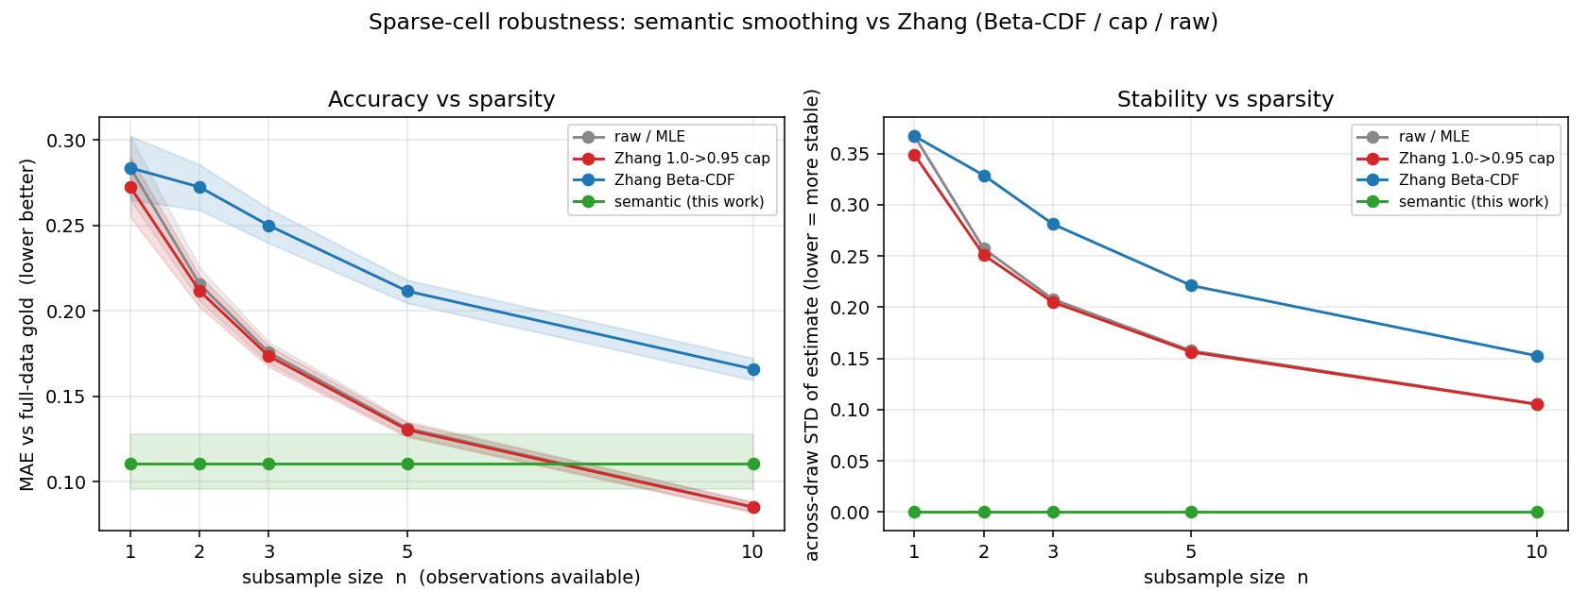
Results: accuracy and stability vs sparsity
Left = accuracy (MAE) vs n; right = stability (across-draw STD) vs n
• Accuracy (left): semantic sits flat at MAE ~ 0.11 for every n; counting starts near 0.27-0.28 at n=1 and only catches it around n ~ 7.
• Stability (right): semantic spread ~ 0.000 (same answer every draw); counting / Beta-CDF wobble at STD 0.10-0.37.
• Beta-CDF (blue) is the WORST line at every n — the global curve distorts these cells.
• Significance: vs Beta-CDF, semantic wins at EVERY n (Wilcoxon p < 1e-4, bootstrap CIs exclude 0); vs raw count, it wins big for n <= 5.
Notes:
Walk through the picture. Left is accuracy, lower is better — the green semantic line is flat and low, around 0.11, no matter how little data there is. The grey and red counting lines start near 0.28 at one observation and come down, crossing green around seven. Right is stability — how much the answer jumps between random draws; semantic is pinned to zero, the others bounce. The blue Beta-CDF line is worst on accuracy everywhere. And it's all statistically significant — p below one in ten thousand against Beta-CDF.

Slide 11
So... is this better than Zhang? (the honest answer)
• Yes — exactly where it matters most. In the ultra-sparse regime (n <= 5, where Zhang's fragile 0.95-type cells live), semantic is significantly more accurate and far more stable than raw count, the 0.95-cap, and Beta-CDF.
• It is a strict, clean replacement for Zhang's Beta-CDF smoother — better on every metric, at every n, AND under the strict leave-one-out check.
• Honest caveat (must say this): semantic does NOT beat a plain raw count at ~10+ observations, and in strict held-out (LOO) prediction it LOSES to raw count:
  – LOO Brier (lower better): raw/cap 0.148 < semantic 0.167 < Beta-CDF 0.171.
• Scientifically honest framing -> a HYBRID: semantic smoothing for sparse cells, plain counting for dense cells. The natural next step / future work.
Notes:
This slide arms me for the inevitable question — is it actually better than Zhang? Honest answer: yes, where it matters most. In the sparse regime, n of five or fewer, which is precisely where Zhang's 0.95 lives, it's significantly more accurate and dramatically more stable. And it's a clean win over his actual Beta-CDF smoother across the board. But I won't oversell it: once you have ten or more observations a plain raw count is better, and in the strictest leave-one-out test semantic actually loses to raw counting because its neighbour pool carries a small bias. So the honest takeaway isn't 'throw out counting,' it's 'use the right tool for the regime' — semantic when starved for data, counting when rich. That hybrid is the clean story for the paper.

Slide 12
Part 3: Does the narrative method actually work?
The open item ('validate query-conditioning') is now closed
• Part 1 = reproduction (counting -> the population numbers). Part 2 = a better estimator for sparse cells.
• Part 3 = the narrative engine's OWN unique value: per-incident query-conditioning.
• The whole question: does using THIS incident's story sharpen the cause estimate beyond just using overall frequencies?
• Four things we now validated, in order:
  – (1) conditioning works (the headline) (2) the probabilities are calibrated (3) a safety gate (4) robustness to rough real queries.
• Honest framing up front: the win is in the LIFT over the baseline, NOT a high absolute accuracy. Absolute top-1 stays a modest ~47%.
Notes:
This part closes the open item from last time. Beat one was reproduction, beat two was the sparse-cell estimator. This third part is the one thing only the narrative method can do: take a single incident's write-up and use it to guess that incident's cause better than just going with the most common cause overall. I validated four things — conditioning helps, the probabilities are honest, I added a safety switch, and it survives messy queries. The one honest thing I repeat throughout: I'm claiming a reliable improvement over the baseline, not high accuracy. Lead with lift, not the 47 percent.

Slide 13
Results: conditioning vs the prior vs a random pool
cond / unc / rand — specific-cause space; lifts are paired means
Stratum (specific) | n | top-1 (c/u/r) | MRR (c/u/r) | MRR lift vs prior | MRR lift vs random
A-clean (leakage-free) | 1085 | 47.4/42.2/38.9 | 0.577/0.525/0.473 | +0.052 (p~1e-11) | +0.103 (p~1e-29)
A-all (factual) | 1254 | 46.9/40.9/38.0 | 0.570/0.511/0.463 | +0.059 | +0.108
A-leak (echoes cause) | 169 | 43.8/32.5/32.5 | 0.529/0.423/0.394 | +0.106 | +0.135
B-cause-prose (leaky) | 746 | 45.6/40.6/35.1 | 0.568/0.518/0.442 | +0.050 | +0.126
• Headline (honest A-clean): conditioning beats the prior +5.2 pp top-1 / +0.052 MRR (p~1e-11), and beats a concentration-matched random pool +8.5 pp / +0.103 (p~1e-29).
• Every comparison is paired per incident with overwhelming significance — not a small-sample fluke.
Notes:
Read the top row, A-clean — the honest, leakage-free number, the one to quote. Conditioning gets top-1 of 47.4 percent versus 42.2 for the prior, about five points better, and the MRR goes up by about 0.052, p around 1e-11. Against the random pool the gap is even bigger, 8.5 points and 0.103, 1e-29. Beating the prior says the narrative helps; beating the random pool says it's not a small-pool artefact. Both hold decisively.

Slide 14
Is it real, or is it leakage? (the decisive check)
• The proof it's NOT leakage: the leaky ceiling B (+0.050 MRR) is NO bigger than the honest A-clean (+0.052 MRR).
  – If A were secretly leakage, B (which DOES contain the cause text) would dominate it. It doesn't -> A is clean.
• A-leak confirms the detector works: factual narratives that DO echo the cause show the expected bigger lift (+0.106).
• Conditioning helps where it should, and only there: the win is on specific-mechanism causes.
  – On incidents whose only true cause is a generic catch-all (n=29), the frequency prior is already optimal, so conditioning LOSES (top-1 -20.7 pp) — the predicted pattern, not a bug.
Notes:
This slide kills the 'isn't this just leakage?' objection. Stratum B is the cause-prose — text that literally describes the cause. If my method were winning by cheating off that, B would show a much bigger lift than clean A. It doesn't — B is +0.050, clean A is +0.052, basically the same. So A isn't riding on leakage. As a sanity check, the A-leak slice — factual reports that echo the cause — does show a bigger lift, +0.106, proving the detector detects leakage. And conditioning only helps when there's a specific mechanism to find; on the handful of generic-only cases the overall frequency is already best, so conditioning slightly hurts there — exactly as expected, and it motivates the safety gate.

Slide 15
Status & next steps
• Diagnosis reproduction: done / solid.
  – Prior + Table 7 reproduced exactly; method generalized; conditional + confidence-aware modes added. The credibility result.
• TWO validated contributions:
  – Query-conditioning (Part 3): a narrative-specific win — beats the no-narrative baseline +5.2 pp top-1 / +0.052 MRR (p~1e-11), leakage-controlled, not a concentration artefact.
  – Sparse-cell robustness (Part 2): semantic smoothing fixes Zhang's fragility — strictly beats his Beta-CDF, most accurate/stable where he is weakest (n <= 5).
• The conditioning method is now hardened: calibrated (ECE ~0.059 -> 0.038 via a one-dial temperature fix), gated (a safety switch — never worse than the prior), and robust to rough real-world queries.
• Honest open caveats (each travels with its claim): absolute accuracy modest (~47%); gating is safety not accuracy (harm regime ~2.3%); ultra-terse one-liners lose most of the ranking lift; sparse win is not blanket (raw count wins at n >~ 10) -> a hybrid is next.
Notes:
Where things stand now. The reproduction is rock-solid and buys credibility. I have two genuinely validated contributions: query-conditioning, the narrative method's own win — it beats the no-narrative baseline with overwhelming significance and I've shown it's not leakage and not a small-pool artefact — and the sparse-cell robustness work that fixes Zhang's fragile smoother. And the conditioning method isn't just validated, it's hardened: the probabilities are calibrated and a one-parameter fix makes them honest to a few points, there's a safety gate so it's never worse than the prior, and it survives messy real queries. Every caveat stays attached: modest absolute accuracy, the gate is safety not score, very short queries lose most of the ranking benefit, and the sparse-cell method isn't a blanket win — all pointing to the obvious next step, a hybrid that uses each tool where it's best.

