Slide 1
NTSB Bayesian Network — Friday Update
Your feedback → what we changed → the full pipeline, start to finish
Presenter: Kanu Shetkar • Advisor: Dr. Mahadevan
Notes:
Fifteen-minute plan: one slide on what you flagged last week, one slide on the whole process end to end, then for each thing we changed — the numbers we were getting before, why they weren't close to Zhang's, and what we changed to fix that. Then one complete worked example, and the live app if we have time.

Slide 2
Last week — what you flagged, and status
Every point from Tuesday's discussion has a closed fix
Your point (last week) | Status | Where it's fixed
“Evacuation is not a cause for fire — diagnosis and prognosis are mixed up” | FIXED | Response events excluded from diagnosis; trees fully separated
Sparse-data slide was hard to follow — “revise it with all the explanations” | REVISED | Every term (pair, n, subsamples, held-out) defined on the slide
Table 4: “we will only put the real example in the paper” | BUILT | Real CPT P(fire | wiring, fuel) from 1,742 accidents (slide 7)
Beta-CDF: “if it works fine, we can just go with that” | ADOPTED | Default for sparse forward cells (decision documented)
• Plus two things we found ourselves this week — both fixed and re-validated (slides 4–6).
Vanderbilt University • NTSB Bayesian-Network Reproduction (Zhang & Mahadevan, RESS 2021)
Notes:
Quick recap of Tuesday. You made three points: evacuation isn't a cause of fire — diagnosis and prognosis were mixed; the sparse slide needed clearer explanations; and for Table 4 we agreed to build a real example for the paper. All three are closed — and you approved Beta-CDF, which is now the default. While fixing those we found two more issues ourselves, which I'll show with before-and-after numbers.

Slide 3
The whole process — start to finish
Query in → diagnosis out. Zhang's counting is INSIDE every step.
Step | What happens | Example: “engine caught fire during takeoff”
1. Detect outcome | Parse the query for an NTSB occurrence | “fire” → 102 fire accidents (Zhang's Table 7 denominator)
2. Embed + retrieve | Embed query; rank all incidents by similarity | top-400 most similar incidents, with scores
3. Partition | Split the 102 fires into precomputed clusters | 15 clusters: Cabin Fire (32), Electrical (21), Engine Fire (16)…
4. P(cause | K) | Zhang's Table-7 counting INSIDE each cluster | same labels, same edge rules, same denominator convention
5. P(K | query) | Cluster weights — the ONLY place the query enters | neutral: N_K/102 • similarity: retrieval mass per cluster
6. Chain rule (LTP) | P(cause|Q) = Σ_K P(cause|K)·P(K|Q) | neutral → Table 7 EXACTLY; similarity → explainable tilt
7. Build tree | Recurse: causes of causes, path probabilities | diagnosis tree, upstream causes only (slide 8)
• “Clusters” = the 102 fires grouped into 15 sets of similar accidents (cabin fires, electrical fires, engine fires…); every fire is in exactly one group.
Vanderbilt University • NTSB Bayesian-Network Reproduction (Zhang & Mahadevan, RESS 2021)
Notes:
So this is the same process I've been showing you, start to finish, with one change in the middle. The user enters a query — 'engine caught fire during takeoff.' We detect the outcome — fire — and that's our root. And that root is the same 102 fire accidents as your Table 7. We embed the query and find the similar incidents, like before. Then we get our clusters — the 102 fires are grouped into fifteen clusters of similar accidents: cabin fires, electrical fires, engine fires. Every fire is in exactly one cluster. Then the law of total probability, same as I've shown you: probability of a cause given the query is the sum over clusters of probability of the cause given the cluster, times the probability of the cluster given the query. HERE'S THE ONE THING THAT CHANGED since last week: inside that formula, the probability of a cause given a cluster is now computed with exactly your Table 7 counting — same labels, same rules, same denominator. Before, we had our own counting in there, and that's why our numbers weren't close to yours. Now, when the query gives no information, the formula gives your Table 7 back exactly — and when the query does carry information, the difference from Table 7 is exactly what the narrative added. And then we build the tree from that, which I'll show you in a minute. [PAUSE HERE: 'Does this picture make sense before I go into what we changed?']

Slide 4
Everything we changed — before vs after
What we were getting, why it wasn't close to Zhang, what we changed
Part | BEFORE (our numbers) | Problem vs Zhang | AFTER (the fix)
Fire count | 38 fires | Zhang: 102 — pre-2006 occurrence files never merged | 102 exact (files merged)
Prior P(fire) | wrong denominator | Zhang: 5.53e-7 via BTS interpolation | 5.53e-7 exact (12 decimals)
Table 7 | partial / mismatched cells | Zhang: 85 causes, count/102 | 85/85 exact (±0.0006)
Diagnosis tree | “Evacuation”, “Emergency procedure” as causes | those are CONSEQUENCES (your point) | response events excluded; causes only
LTP layer | airframe 0.059; L1 to Table 7 = 1.96 (max 2.0) | own counting inside clusters ≠ Zhang's | Zhang counting inside clusters → L1 = 0 (exact)
Clusters | 19 of 102 fires had NO cluster | legacy records w/o narrative never embedded | backfilled from structured data → 102/102
• L1 = total absolute difference between two probability distributions: 0 = identical, 2 = as far apart as mathematically possible.
Vanderbilt University • NTSB Bayesian-Network Reproduction (Zhang & Mahadevan, RESS 2021)
Notes:
One table for everything we've changed, oldest to newest. The first three you've seen: the fire count was 38 because pre-2006 occurrence files were never merged — fixed, 102 exact; the prior and all 85 Table 7 cells now match to the digit. Row four is your point from Tuesday: evacuation and emergency procedure were showing up as causes — they're consequences — now excluded. Row five, highlighted, is the big one from this week: our chain-rule layer used its own counting inside clusters, so for a fire query it gave airframe zero-point-zero-five-nine when Zhang's table says zero-point-three-one — an L1 distance of 1.96 out of a max of 2. We changed the inside of the chain rule to Zhang's own Table 7 counting, and now it recovers his table exactly — provably, not approximately. Row six: nineteen fires had no cluster because they're legacy records with no narrative; we backfilled them from their structured findings. Everything re-validated after each fix.

Slide 5
The main fix — chain rule now provably matches Zhang
P(cause|Q) = Σ_K P(cause|K) · P(K|Q) with Zhang's counting inside each cluster
Top causes, query = “engine caught fire during takeoff” | OLD LTP | NEW neutral | Zhang T7 | NEW similarity
Airframe/component/system failure | 0.059 | 0.3137 | 0.3137 | 0.3012
Electrical system, electric wiring | — | 0.0882 | 0.0882 | 0.0789
Loss of engine power (total) — mech. | 0.036 | 0.0882 | 0.0882 | 0.1098
Fluid, fuel | — | 0.0588 | 0.0588 | 0.0559
“Evacuation” / “Emergency procedure” | ranked as causes | excluded | not in T7 | excluded
L1 distance to Zhang Table 7 | 1.96 (of max 2.0) | 0 (machine precision) | — | 0.33 = the query signal
• NEUTRAL = the query gives no information, so each cluster is weighted by its size (cabin fires: 32/102). SIMILARITY = clusters that resemble the query get more weight.
• Neutral → the clusters cancel algebraically → Table 7 EXACTLY, all 85 causes (not approximately — the algebra cancels; proven by an offline test).
• Similarity → engine query up-weights engine clusters (0.157→0.199) → LOEP rises 0.088→0.110. The deviation IS the narrative signal — auditable per cluster.
• Zhang's Table 7 is now the zero-information special case of our method.
Vanderbilt University • NTSB Bayesian-Network Reproduction (Zhang & Mahadevan, RESS 2021)
Notes:
This is the before-and-after on the chain-rule layer in detail, same query. Old LTP, first column: airframe at zero-point-zero-five-nine — five times too small — and consequences like evacuation ranked as causes. The fix: keep your chain rule, but compute probability of cause given cluster with Zhang's exact Table 7 estimator inside each cluster. With neutral weights — no query information — the decomposition provably collapses to Zhang's published table: L1 is ten to the minus sixteen, every one of the 85 causes. Then with similarity weights, the engine query pulls weight toward the engine-fire clusters, so loss of engine power rises from 0.088 to 0.110 — and we can show exactly which cluster did that. So his table is now the zero-information special case of our method — we're not near Zhang, we contain Zhang.

Slide 6
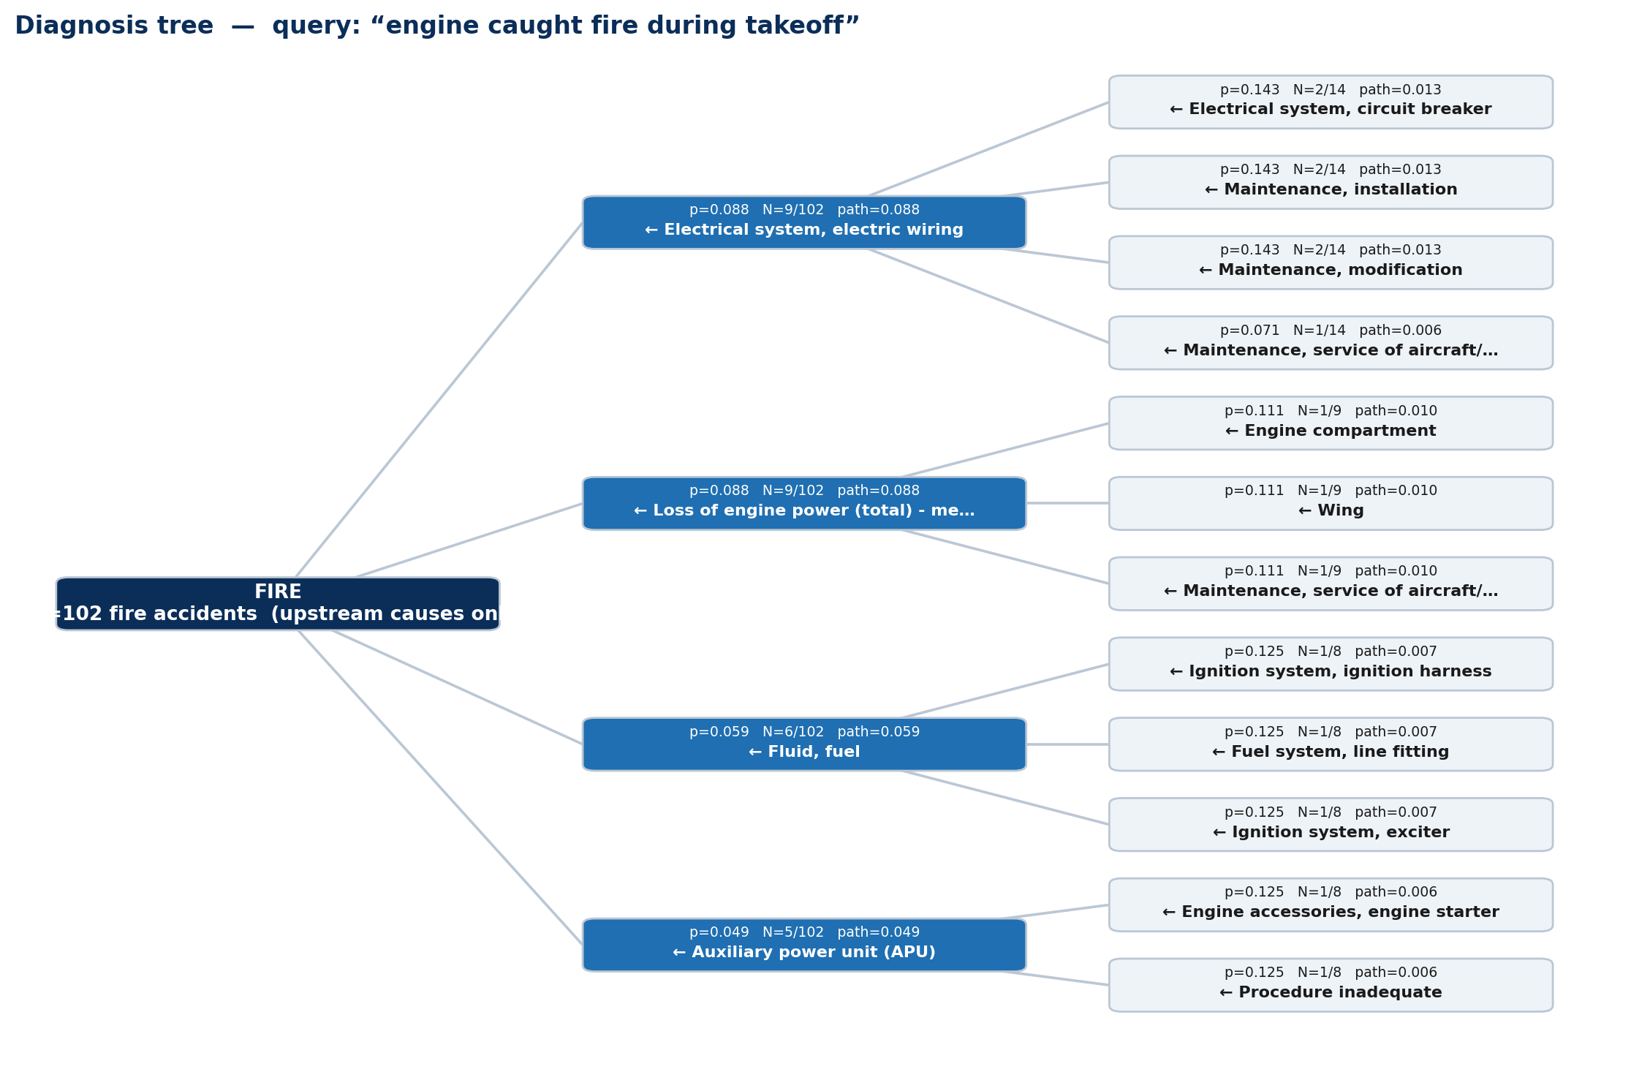
Full worked example — the diagnosis tree
Query: “engine caught fire during takeoff” — upstream causes only, N=102
• Root: fire, all 102 accidents (Table 7 denominator).
• Level 1 = Table 7 cells: wiring 9/102 = 0.088, LOEP 9/102 = 0.088, fluid/fuel 6/102 = 0.059, APU 5/102 = 0.049.
• Level 2 = causes of causes: e.g. wiring ← circuit breaker 2/14, maintenance/installation 2/14.
• Each edge: probability, support n/denom, cumulative path probability.
• No evacuation, no emergency procedure — responses excluded per your correction.
Vanderbilt University • NTSB Bayesian-Network Reproduction (Zhang & Mahadevan, RESS 2021)
Notes:
And here's the end of the pipeline for the same query — the tree. The root is fire over all 102 accidents. Level one is literally Table 7: wiring nine out of 102, loss of engine power nine out of 102, fluid-fuel six, APU five. Level two recurses — causes of causes, like circuit breaker behind wiring. Every edge shows its probability, its support, and the running path probability, so nothing is a black box. And per your correction: no evacuation, no emergency procedure — responses are excluded from diagnosis now.

Slide 7
Table 4 — the real data-derived example (as agreed)
Same format as Zhang's toy Table 4, populated from real NTSB counts
wiring | fuel | n / denom | raw | Beta-CDF | final (0.95 cap) | Zhang T4 (toy)
Yes | Yes | 1 / 1 | 1.000 | 1.000 | 0.950 (sparse) | 0.99
Yes | No | 10 / 21 | 0.476 | 0.717 | 0.476 | 0.93
No | Yes | 23 / 45 | 0.511 | 0.753 | 0.511 | 0.95
No | No | 68 / 1675 | 0.041 | 0.071 | 0.041 | 2e-9
• P(fire | electrical wiring, fuel system) — all four cells from the 1,742-accident window.
• The 1/1 sparse cell is where the 0.95 cap / Beta-CDF machinery engages — a live demonstration of the sparse-data problem.
• Toy values (0.99/0.93) are unreachable from real counts — confirming Table 4 was illustrative, as you said. THIS table is what goes in the paper.
Vanderbilt University • NTSB Bayesian-Network Reproduction (Zhang & Mahadevan, RESS 2021)
Notes:
The real Table 4 example we agreed on. Probability of fire given wiring and fuel — four cells, real counts. The both-present cell has exactly one incident, so you can see the 0.95 sparse cap engage right there. The neither cell is the four percent base rate — not two times ten to the minus nine. And the toy 0.99 and 0.93 are unreachable from real counts, which confirms the table in the paper was illustrative. This real one goes in our paper.

Slide 8
Validation scoreboard — and the ask
Every numeric target in Zhang's paper that CAN be reproduced, IS — plus a predictive win
Check | Result
Table 7 (85 causes, denom 102) | 85/85 exact
Prior P(fire), BTS denominator | 5.53e-7 exact (12 decimals)
Beta-CDF calibration (α, β, MSE) | 1.046 / 2.026 / 3.4e-7 exact
Table 9 forward edges | 0.95 / 0.50 / 0.95 / 0.1429 exact
Full parity suite (offline) | 13 PASS / 0 FAIL
Chain rule → Table 7 (neutral) | EXACT — proven, tested
Held-out diagnosis vs Zhang counting | BETTER on every metric: top-1 +5.6pp, log-loss −0.23 (p ≤ 1e-8)
• Held-out test in plain terms: hide each incident's answer, give both methods only the narrative, ask them to guess the cause — ours guesses right more often, with better-calibrated confidence, far beyond chance.
• Ask: the build phase is validated end to end — I'd like to start writing the paper (draft outline by next meeting).
• Live demo available: the Streamlit app shows every step of this pipeline interactively.
Vanderbilt University • NTSB Bayesian-Network Reproduction (Zhang & Mahadevan, RESS 2021)
Notes:
The scoreboard. Every quantity in Zhang's paper that comes from counting or curve-fitting, we reproduce exactly — thirteen out of thirteen numeric targets, zero failures. The two highlighted rows are the new ones: the chain rule provably recovers Table 7, and on the held-out prediction task — guess a hidden incident's cause from its narrative — our method beats the counting baseline on every metric with very strong significance. That's the 'actually better, with comparisons' evidence. So the ask: the build phase is done and validated — I'd like to start the paper, with a draft outline by our next meeting. And if we have time, I can show the live app — every number on these slides is a click away.

