Slide 1
NTSB Project Update
Diagnosis progress — Table 4, Table 7, conditional diagnosis, sparse data, trees
Kanu Shetkar • Meeting with Maha
Notes:
Quick update on what you asked me to check since last time.

Slide 2
Last meeting → Today's update
Last meeting (you asked) | Today's update
Recheck code & math | Fixed data merge + prior denominator
P(fire) = 5.52×10⁻⁷ should match | ✓ Matches after 102 fires + 184.5M flights
Test 5 causes from Table 7 | ✓ Full Table 7 — all 85 causes match
— | Table 4: illustrative vs our real analogue
— | Conditional diagnosis (LTP + exact filter)
— | Sparse data plan → Beta-CDF decision
— | Diagnosis tree preview
Vanderbilt University • NTSB Project • Kanu Shetkar
Notes:
Connect last meeting to today. You asked me to verify the fire prior and Table 7 — both done.

Slide 3
Table 4 — Zhang's example vs our similar real example
P(fire | electrical wiring, fuel system) — 2-parent CPT from NTSB data
• Zhang's Table 4 uses hand-picked teaching values (0.99, 0.93, 0.95) — not from counting.
• I rebuilt the same 2×2 layout with real causes: wiring + fuel (1982–2006 data).
• Our raw counts and Zhang's recreated estimator do NOT produce 0.99.
Wiring | Fuel | Count | Zhang T4 (paper) | Our count | Zhang estimator
Yes | Yes | 1/1 | 0.99 | 1.00 | 0.39
Yes | No | 10/21 | 0.93 | 0.48 | 0.39
No | Yes | 23/45 | 0.95 | 0.51 | 0.35
No | No | 68/1675 | ≈0 | 0.04 | 0.00
• Takeaway: Table 4 is illustrative. Real data gives ~0.35–0.51, not 0.99.
Vanderbilt University • NTSB Project • Kanu Shetkar
Notes:
Walk through the table. Both-present cell is literally 1 fire out of 1 incident.

Slide 4
Table 7 — all 85 causes match Zhang
P(cause | fire) = count / 102 fire accidents
• Question: given a fire, what contributory cause? Denominator = 102.
• After merging occurrences + Cause/Factor labeling: 85 / 85 match (±0.00001 rounding).
• Formula is simple counting: (# fires with that cause) ÷ 102.
• Top causes below — full 85-row table on next slides.
Cause | n/102 | Zhang P | Our P
Airframe/component/system failure/mal… | 32/102 | 0.31372 | 0.31373
Loss of engine power (total) - mechan… | 9/102 | 0.08823 | 0.08824
Electrical system, electric wiring | 9/102 | 0.08823 | 0.08824
Fluid, fuel | 6/102 | 0.05882 | 0.05882
Auxiliary power unit (APU) | 5/102 | 0.04901 | 0.04902
Maintenance, installation | 4/102 | 0.03921 | 0.03922
Procedure inadequate | 4/102 | 0.03921 | 0.03922
Loss of engine power (partial) - mech… | 4/102 | 0.03921 | 0.03922
Vanderbilt University • NTSB Project • Kanu Shetkar
Notes:
Airframe 32/102 = 31.4%. Every cause matches.

Slide 5
Table 7 — full comparison (rows 1–29)
Zhang P vs Our P — all rows match YES
# | Cause | n | Zhang | Ours
1 | Airframe/component/system f… | 32 | 0.3137 | 0.3137
2 | Loss of engine power (total… | 9 | 0.0882 | 0.0882
3 | Electrical system, electric… | 9 | 0.0882 | 0.0882
4 | Fluid, fuel | 6 | 0.0588 | 0.0588
5 | Auxiliary power unit (APU) | 5 | 0.0490 | 0.0490
6 | Maintenance, installation | 4 | 0.0392 | 0.0392
7 | Procedure inadequate | 4 | 0.0392 | 0.0392
8 | Loss of engine power (parti… | 4 | 0.0392 | 0.0392
9 | Maintenance, service bullet… | 3 | 0.0294 | 0.0294
10 | Engine compartment | 3 | 0.0294 | 0.0294
11 | Maintenance | 3 | 0.0294 | 0.0294
12 | Cargo/baggage | 3 | 0.0294 | 0.0294
13 | Fuel system, nozzle | 2 | 0.0196 | 0.0196
14 | Fuel system, drain | 2 | 0.0196 | 0.0196
15 | Fuel system, fuel control | 2 | 0.0196 | 0.0196
# | Cause | n | Zhang | Ours
16 | Maintenance, service of air… | 2 | 0.0196 | 0.0196
17 | Electrical system, circuit … | 2 | 0.0196 | 0.0196
18 | Engine accessories, engine … | 2 | 0.0196 | 0.0196
19 | Unknown quantity | 2 | 0.0196 | 0.0196
20 | Miscellaneous/other | 2 | 0.0196 | 0.0196
21 | Ignition system, ignition h… | 2 | 0.0196 | 0.0196
22 | Landing gear, tire | 2 | 0.0196 | 0.0196
23 | Fire extinguisher, powerpla… | 2 | 0.0196 | 0.0196
24 | Fire extinguisher, cargo | 2 | 0.0196 | 0.0196
25 | Fuel system, line fitting | 2 | 0.0196 | 0.0196
26 | Hazardous materials leak/sp… | 2 | 0.0196 | 0.0196
27 | Brakes (normal) | 2 | 0.0196 | 0.0196
28 | Reason for occurrence undet… | 2 | 0.0196 | 0.0196
29 | Maintenance, modification | 2 | 0.0196 | 0.0196
Vanderbilt University • NTSB Project • Kanu Shetkar

Slide 6
Table 7 — full comparison (rows 30–58)
Zhang P vs Our P — all rows match YES
# | Cause | n | Zhang | Ours
30 | Loss of engine power | 2 | 0.0196 | 0.0196
31 | Procedures/directives | 2 | 0.0196 | 0.0196
32 | Exhaust system, stack | 1 | 0.0098 | 0.0098
33 | Miscellaneous, bolt/nut/fas… | 1 | 0.0098 | 0.0098
34 | Electrical system, fuse | 1 | 0.0098 | 0.0098
35 | Evacuation | 1 | 0.0098 | 0.0098
36 | Ignition system, exciter | 1 | 0.0098 | 0.0098
37 | Aircraft/equipment, inadequ… | 1 | 0.0098 | 0.0098
38 | Aircraft/equipment inadequa… | 1 | 0.0098 | 0.0098
39 | Condition(s)/step(s) insuff… | 1 | 0.0098 | 0.0098
40 | Panic | 1 | 0.0098 | 0.0098
41 | Passenger compartment light… | 1 | 0.0098 | 0.0098
42 | Aircraft/equipment, inadequ… | 1 | 0.0098 | 0.0098
43 | Fluid, hydraulic | 1 | 0.0098 | 0.0098
44 | Overrun | 1 | 0.0098 | 0.0098
# | Cause | n | Zhang | Ours
45 | Anti-ice/deice system, wind… | 1 | 0.0098 | 0.0098
46 | Inadequate substantiation p… | 1 | 0.0098 | 0.0098
47 | Landing gear | 1 | 0.0098 | 0.0098
48 | Portable electrical equipme… | 1 | 0.0098 | 0.0098
49 | Hazardous material (HAZMAT) | 1 | 0.0098 | 0.0098
50 | Engine assembly, other | 1 | 0.0098 | 0.0098
51 | Smoke detector(s) | 1 | 0.0098 | 0.0098
52 | Fire extinguisher, portable | 1 | 0.0098 | 0.0098
53 | Emergency procedure | 1 | 0.0098 | 0.0098
54 | Fire warning system, lavato… | 1 | 0.0098 | 0.0098
55 | Electrical system, generator | 1 | 0.0098 | 0.0098
56 | Engine assembly | 1 | 0.0098 | 0.0098
57 | Starting procedure | 1 | 0.0098 | 0.0098
58 | Electrical system | 1 | 0.0098 | 0.0098
Vanderbilt University • NTSB Project • Kanu Shetkar

Slide 7
Table 7 — full comparison (rows 59–85)
Zhang P vs Our P — all rows match YES
# | Cause | n | Zhang | Ours
59 | Compressor assembly, blade | 1 | 0.0098 | 0.0098
60 | Fuselage, cabin | 1 | 0.0098 | 0.0098
61 | Overheat warning system | 1 | 0.0098 | 0.0098
62 | Miscellaneous equipment/fur… | 1 | 0.0098 | 0.0098
63 | Ignition system, igniter pl… | 1 | 0.0098 | 0.0098
64 | Maintenance, overhaul | 1 | 0.0098 | 0.0098
65 | Insufficient standards/requ… | 1 | 0.0098 | 0.0098
66 | Combustion assembly, combus… | 1 | 0.0098 | 0.0098
67 | Fire/explosion | 1 | 0.0098 | 0.0098
68 | Powerplant | 1 | 0.0098 | 0.0098
69 | Insufficient standards/requ… | 1 | 0.0098 | 0.0098
70 | Window, flight compartment … | 1 | 0.0098 | 0.0098
71 | Hydraulic system, line | 1 | 0.0098 | 0.0098
72 | Maintenance, approved airwo… | 1 | 0.0098 | 0.0098
# | Cause | n | Zhang | Ours
73 | Fuel system, tank | 1 | 0.0098 | 0.0098
74 | Maintenance, alignment | 1 | 0.0098 | 0.0098
75 | Miscellaneous | 1 | 0.0098 | 0.0098
76 | Wing | 1 | 0.0098 | 0.0098
77 | Maintenance, compliance wit… | 1 | 0.0098 | 0.0098
78 | On ground/water collision w… | 1 | 0.0098 | 0.0098
79 | Maintenance, inspection | 1 | 0.0098 | 0.0098
80 | Electrical system, auxiliar… | 1 | 0.0098 | 0.0098
81 | Lubricating system, oil line | 1 | 0.0098 | 0.0098
82 | Fuel system, fuel flow divi… | 1 | 0.0098 | 0.0098
83 | Loss of engine power (total… | 1 | 0.0098 | 0.0098
84 | Fuel system, primer system | 1 | 0.0098 | 0.0098
85 | Weather condition | 1 | 0.0098 | 0.0098
Vanderbilt University • NTSB Project • Kanu Shetkar

Slide 8
Conditional diagnosis — two ways to narrow the population
• Standard (Table 7): given fire → all 102 fires → e.g. wiring = 9/102 = 8.8%.
•
• My core method — similarity + LTP (what Maha asked for):
  – embed query → retrieve similar incidents → cluster by type
  – Law of Total Probability: P(cause|query) = Σ P(cause|cluster) × P(cluster|query)
•
• Exact filter mode (when we know structured facts):
  – fire + electric wiring → keep only 14 incidents with both in the record
  – count causes in that cohort → wiring = 11/14 = 78.6%
•
• Exact is better when facts are known (auditable cohort). LTP when user only has narrative.
Vanderbilt University • NTSB Project • Kanu Shetkar
Notes:
Do not say we dropped LTP. Exact filter is additive.

Slide 9
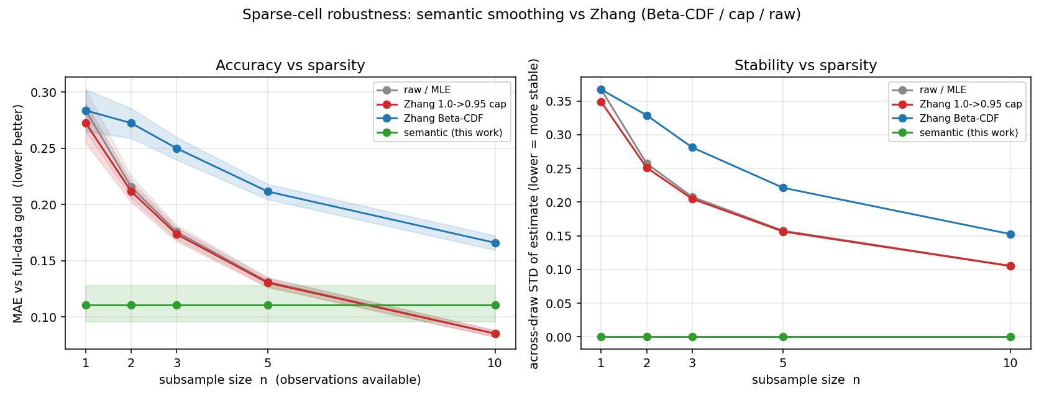
Sparse data — plan, test, decision (Beta-CDF)
When a probability rests on only 1–2 incidents
• Problem: some cells have almost no data → raw count jumps to 0% or 100%.
• Plan: test narrative smoothing (borrow from similar incident stories).
• Result: looked good on simulated sparse cells, but strict held-out test did not clearly beat Beta-CDF.
• Decision: use Zhang's Beta-CDF (you said yes) as default for sparse cells.
• Graph: green = our narrative method, blue = Beta-CDF. Lower error = better.
• Narrative wins at tiny n in simulation; Beta-CDF is our approved fallback.
Vanderbilt University • NTSB Project • Kanu Shetkar
Notes:
Appendix has Beta-CDF explainer if he asks.

Slide 10
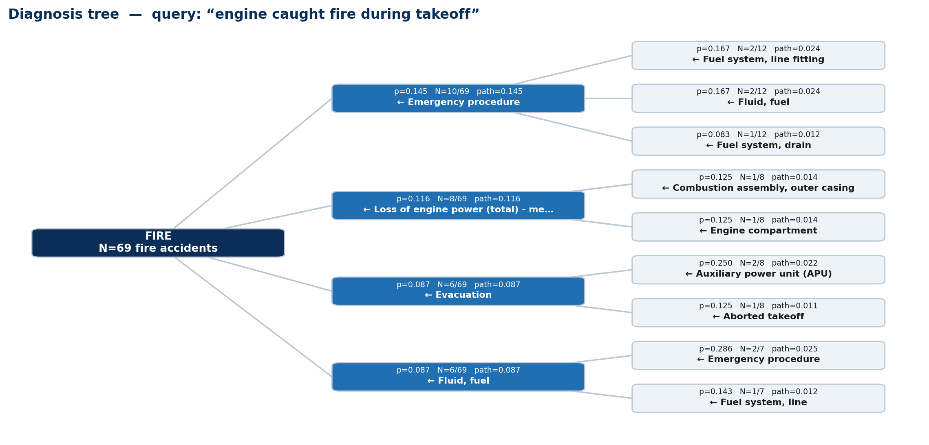
Diagnosis tree — progress preview
Branching causes, not a single ranked list
• Steps: query → embed → similar incidents → detect fire (root)
• Level 1: P(cause | fire) → top branches (airframe, wiring, fuel…)
• Level 2: filter to incidents with that cause → sub-causes
• Each edge shows probability + n/denom (support visible)
• Status: built + JSON export; Streamlit demo; validating vs Zhang examples next
Vanderbilt University • NTSB Project • Kanu Shetkar
Notes:
Tease only — full validation next meeting.

Slide 11
Summary
• Data + prior fixed; Table 7: 85/85 match.
• Table 4: illustrative — our real analogue shown.
• Conditional diagnosis: LTP (narrative) + exact filter (known facts).
• Sparse cells: tested narrative → using Beta-CDF.
• Diagnosis tree: preview built; more validation next.
Vanderbilt University • NTSB Project • Kanu Shetkar

