Slide 1
NTSB Bayesian Network — Tuesday Update
Reproducing & extending Zhang et al. (RESS 2021)
Presenter: Kanu Shetkar • Advisor: Maha • Tuesday
What you asked for → what I fixed → trees (the new direction)
Notes:
Open by reminding Maha what she asked me to do: reproduce Zhang's fire numbers exactly, settle the Table 4 question, validate the evidence-filtered diagnosis mode and the sparse-cell method, and move toward the tree picture of diagnosis and prognosis. This talk walks through each: two data bugs I found and fixed, a true cell-by-cell match of Table 7, the Table 4 clarification, the two validated add-ons, and then the headline new direction — trees. Keep it to fifteen minutes; the appendix has the full tables if she wants detail.

Slide 2
Two separate data bugs — found & fixed
Two different fixes for two different quantities (do not conflate them)
 | Fix #1 — the FIRE COUNT | Fix #2 — the PRIOR P(fire)
Bug | occurrences / seq-of-events never merged into findings | prior divided by 2,243 accidents (wrong denominator)
Effect of bug | only 38 fires counted | P(fire) far too large
Fix | merge legacy occurrences + seq_of_events with findings | divide by TOTAL flights 184.5M departures (1982–2006)
Result | 38 → 102 fires (matches Zhang) | P(fire) ≈ 5.5×10⁻⁷ (matches Zhang exactly)
• Two quantities, two fixes: the MERGE fixed the fire count (and therefore Table 7); the DENOMINATOR fixed the prior P(fire). They are independent.
Vanderbilt University • NTSB Bayesian-Network Reproduction (Zhang & Mahadevan, RESS 2021)
Notes:
This is the slide to be precise on. There were two different problems with two different fixes — don't let them blur together. Fix one: the dataset never merged the legacy occurrence and sequence-of-events records into the findings, so only 38 fires were counted; after merging, 102 fires, which is Zhang's number and which drives Table 7. Fix two is about a completely different quantity — the prior probability of fire. I had been dividing by the 2,243 accidents in the set, but Zhang's prior is per flight: divide the fire count by the total number of flights flown, about 184.5 million departures from 1982 to 2006. That gives P(fire) around 5.5 times ten-to-the-minus-seven, matching Zhang exactly. So: merge fixed the count, denominator fixed the prior — two separate things.

Slide 3
Table 7 — first TRUE cell-by-cell match: 85/85 exact
Denominator = 102 fires; anchor Airframe = 0.31372 (n=32); tol ±0.0005
Cause (excerpt) | Zhang P | n | Our P | Match
Airframe/component/system failure/malfunction | 0.31372 | 32 | 0.31373 | ✓
Loss of engine power (total) - mechanical | 0.08823 | 9 | 0.08824 | ✓
Electrical system, electric wiring | 0.08823 | 9 | 0.08824 | ✓
Fluid, fuel | 0.05882 | 6 | 0.05882 | ✓
Auxiliary power unit (APU) | 0.04901 | 5 | 0.04902 | ✓
Unknown quantity (code 92000 fallback) | 0.01960 | 2 | 0.01961 | ✓
• Be honest about what changed:
  – The earlier “all match” was a self-consistency check (our engine vs itself).
  – This is the FIRST true cell-by-cell match to the printed paper.
• Closed the last 18 gaps by counting only contributory findings — Cause_Factor ∈ {C, F}.
  – Plus the “Unknown quantity” fallback label for unresolved code 92000 (n=2).
• No dataset rows were edited — fix lives in the label/edge layer only.
Vanderbilt University • NTSB Bayesian-Network Reproduction (Zhang & Mahadevan, RESS 2021)
Notes:
Table 7 is now a genuine, cell-by-cell reproduction of the paper: all 85 causes match within Zhang's own rounding. The honesty point matters — last time the 'all match' was really our engine agreeing with itself, a self-consistency check. This time I'm comparing each cell against the numbers printed in Zhang's Table 7, and they line up, anchored by the dominant Airframe cell at 0.31372 with 32 of 102 fires. The last 18 gaps were not logic errors; they were label-mapping. Zhang counts only contributory findings — the ones flagged Cause or Factor — so I filtered to those, and I matched his fallback label 'Unknown quantity' for one unresolved code. Importantly I changed no data rows; the fix is purely in how labels are counted.

Slide 4
Table 4 — REAL data-derived example (per Maha)
Zhang's Table 4 is illustrative; here is the same format populated from real NTSB data
• Zhang's Table 4 (0.99 / 0.93 / 0.95 / 2e-9) is a TEACHING table — “for the sake of demonstration, assume…”. Agreed with Maha: we build a REAL one for the paper.
• Real CPT: P(fire | electrical wiring, fuel system) — two real contributory-factor parents, all four cells counted from the 1982–2006 window (1,742 accidents):
wiring | fuel | n / denom | raw | Beta-CDF | final (0.95 cap) | Zhang T4 (toy)
Yes | Yes | 1 / 1 | 1.000 | 1.000 | 0.950 (sparse) | 0.99
Yes | No | 10 / 21 | 0.476 | 0.717 | 0.476 | 0.93
No | Yes | 23 / 45 | 0.511 | 0.753 | 0.511 | 0.95
No | No | 68 / 1675 | 0.041 | 0.071 | 0.041 | 2e-9
• Sparse cell (both present, n=1) is exactly where Zhang's 0.95 cap / Beta-CDF smoothing engages — the real table demonstrates the sparse-data machinery.
• The toy 0.99 / 0.93 are unreachable from real counts (real single-cause rates ≈ 0.35–0.51) — confirming Table 4 was illustrative, as Maha said.
• Reproduce: tests/build_table4_analogue.py (offline, reads the corrected window).
Vanderbilt University • NTSB Bayesian-Network Reproduction (Zhang & Mahadevan, RESS 2021)
Notes:
This is the real Table 4 example Maha asked for. His Table 4 is a teaching table for a toy network, so instead of chasing its hand-picked numbers we built the same FORMAT from real data: probability of fire given two real parent causes, electrical wiring and the fuel system, all four present-absent combinations, counted over the corrected 1982 to 2006 window. Three things to point out. First, the both-present cell has exactly one incident — a live example of the sparse-cell problem, and you can see Zhang's 0.95 cap engage there. Second, the neither-present cell is about four percent, the base rate of fire without those causes — not two times ten to the minus nine. Third, the toy values 0.99 and 0.93 are unreachable from real counts, which confirms Table 4 was illustrative. This real table is what goes in the paper.

Slide 5
Evidence-Filtered Cohort Diagnosis (renamed per Maha)
Was “conditional diagnosis” — an ADD-ON to query-first similarity, not a replacement
• What it is: filter the corpus to incidents matching the outcome AND the known facts, then count causes over that cohort (no Bayesian-conditioning claim).
• Validated on multiple outcome+fact combinations, e.g.:
Outcome | Known fact(s) | Cohort n | Top cause (P)
fire | electric wiring | 14 | Electrical wiring (78.6%)
fire | fuel | 8 | Fluid, fuel (87.5%)
loss of engine power | fuel | 9 | Fluid, fuel (100%)
fire | wiring + maintenance | 0 | empty cohort (safe)
• Stays QUERY-FIRST: it's a targeted add-on to the narrative similarity mode.
• Degrades safely — narrowing the filter shrinks n; an impossible combo returns an empty cohort, no crash. Flag tiny-n (n<5) as low-confidence.
Vanderbilt University • NTSB Bayesian-Network Reproduction (Zhang & Mahadevan, RESS 2021)
Notes:
Per Maha's note I've renamed this 'evidence-filtered cohort diagnosis' instead of 'conditional diagnosis', because it doesn't claim Bayesian conditioning — it just filters to a cohort by the evidence and reports frequencies. Mechanically: given an outcome and some known facts, keep only incidents that contain all of them, then count causes. It reproduces the canonical example — fire plus electric wiring gives 14 incidents with wiring dominating at 78.6 percent — and it generalizes to other combinations. Two things to stress: it stays query-first, it's an add-on to the similarity search, not a replacement; and it degrades safely — narrow filters give small cohorts, impossible combinations give an empty cohort rather than an error, and I flag tiny cohorts as low-confidence.

Slide 6
Sparse cells: tested narrative smoothing, decided on Beta-CDF
Revised per Maha — every term on this slide defined
• Problem: some forward cells P(outcome | cause) have almost no data → raw counting gives 0% or 100%. Zhang's fix: Beta-CDF smoothing (we match it).
• Our test: can narrative smoothing (similar incident stories) beat Beta-CDF?
• How we tested — the terms:
  – a PAIR = one probability question, one cause + one outcome (e.g. P(fire | fuel)). 158 pairs where the full-data answer is trusted.
  – n = how many incidents we PRETEND to have for that question (1, 2, 3, 5, 10) after randomly hiding the rest.
  – 400 random subsamples per n, so no single lucky draw decides it. Methods compared: raw count, Zhang cap, Beta-CDF, narrative.
  – HELD-OUT: each scored incident hidden from the index so narrative cannot peek.
• Result: narrative did NOT clearly beat Beta-CDF on the fair held-out test.
• Decision (Maha approved): use Beta-CDF for sparse forward cells. Table 7 unchanged — still plain counting over 102 fires.
Vanderbilt University • NTSB Bayesian-Network Reproduction (Zhang & Mahadevan, RESS 2021)
Notes:
For sparse FORWARD probabilities — not Table 7 — some cells only have one or two incidents, so plain counting gives zero or one hundred percent. Zhang smooths those with a Beta-CDF curve. We wanted to see if narrative smoothing could do better. We couldn't score real one-incident cells without knowing the truth, so we used about 158 cause-and-outcome pairs where we DO trust the full-data rate. Then we pretended we only had one, two, three, five, or ten incidents — four hundred random subsamples each — and asked four methods to guess against that known answer. On a strict held-out test, hiding each incident so narrative can't peek, narrative did not clearly beat Beta-CDF. So we're using Beta-CDF to match Zhang, and Table 7 stays plain counting over 102 fires. If he asks what n is: n is how many incidents we pretend to have for that one question — not 158, not 400. 158 is how many questions; 400 is how many repeats per question.

Slide 7
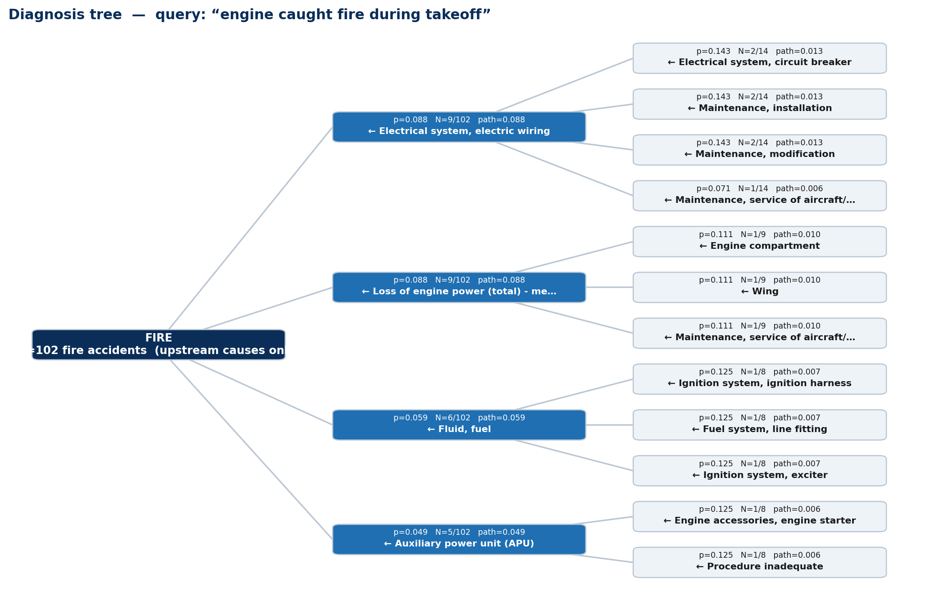
The new direction: diagnosis & prognosis are TREES
From one event, MULTIPLE outcomes branch — not a single linear chain
• Maha's point: from one event, many outcomes branch, each with its own probability — a TREE, not a chain.
• Query-first generation:
  – free-text query → embed → retrieve similar incidents → build tree over that pool.
• Diagnosis edge = P(cause | outcome AND ancestors) — Zhang's Table-7 counting, made recursive.
• Each edge shows p, support N=n/denom, and cumulative path probability.
  – Figure: real run, query “engine caught fire during takeoff”.
Vanderbilt University • NTSB Bayesian-Network Reproduction (Zhang & Mahadevan, RESS 2021)
Notes:
Here's the headline new direction. Maha clarified that diagnosis and prognosis aren't single linear chains — they're trees. From one event, several different things can branch out, each with a probability, and each of those can branch again. Two things to emphasize. First, it's query-first: I start from the user's plain-text query, embed it, retrieve similar incidents, and build the tree only over that relevant pool. Second, the math at each branch is exactly Zhang's Table 7 quantity — probability of a cause given the outcome — just made recursive: causes of the outcome, then sub-causes that co-occur with each cause. The figure is a real run for a fire query: the root is fire across all 102 fire accidents — the Table 7 denominator — and each branch shows the edge probability, the support like 32 out of 102, and the running path probability. Downstream responses like evacuation are excluded; only upstream causes appear, per Maha's diagnosis/prognosis separation.

Slide 8
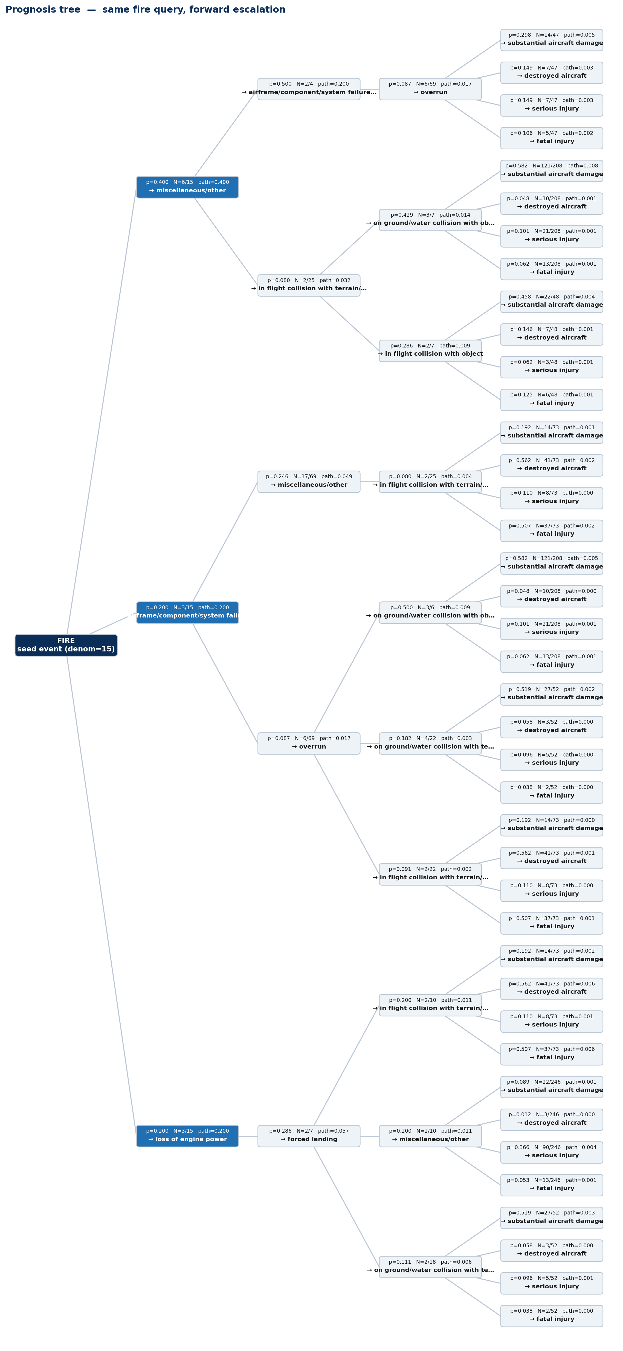
Prognosis tree + the publication gate
Same fire query, read forward: P(next event | current event) escalation
• Prognosis = the forward direction: from the seed event, where does it escalate?
• Edge = P(next event | current event), a Markov hop with visible support N.
• Same query-first generation; branches top-B next-events, prunes by prob & support.
• Both trees export to JSON — ready for the Streamlit demo.
• Publication gate:
  – a full diagnosis tree AND a full prognosis tree, validated against Zhang's paper examples.
Vanderbilt University • NTSB Bayesian-Network Reproduction (Zhang & Mahadevan, RESS 2021)
Notes:
The same idea run forward is prognosis: starting from an event, what does it escalate into? Each edge here is the probability of the next event given the current one — an honest Markov hop — and I keep the support N visible at every edge so you can see how thin the data gets deeper down. It's built the same query-first way and both trees already export to JSON, so they drop straight into the Streamlit demo. The bottom line for Maha is the publication gate: what we need to publish is a complete diagnosis tree and a complete prognosis tree, validated against Zhang's own paper examples. That's the target the rest of the work points at.

Slide 9
Next steps & timeline
Track | Status | Next step
Table 7 reproduction | Done — 85/85 exact | Lock as the reproduction anchor
Table 4 | Resolved (illustrative) | Optional: build data-derived CPT for a real node
Evidence-filtered cohort diagnosis | Validated, usable today | Surface cohort n + low-confidence flags
Sparse cells | Tested → default Beta-CDF | Keep semantic as experimental n≤3
Trees (diagnosis + prognosis) | Implemented + demo PASS | Finish, validate vs all Zhang examples
Streamlit demo | App exists | Wire trees JSON for live demo
• Headline next step: finish & validate the trees, build them against ALL of Zhang's paper examples, then demo live in Streamlit.
Vanderbilt University • NTSB Bayesian-Network Reproduction (Zhang & Mahadevan, RESS 2021)
Notes:
Where things go from here. The reproduction work is done and solid — Table 7 is the anchor, Table 4 is resolved, and both add-ons are validated with clear decisions. The real forward energy is on the trees: they're implemented and the demo passes, and the job now is to finish them and validate them against all of Zhang's paper examples, not just the fire case. In parallel, the Streamlit app already exists, so I can wire the tree JSON into it and show this live. If you want, the one optional extra is building a populated, data-derived CPT for a real node as the honest Table-4 analogue.

Slide 10
Appendix — Table 7 reproduction (top 14 of 85)
Full 85/85 in docs/TABLE7_FULL_REPRODUCTION.md and table7_full_reproduction.csv
# | Cause | Z P | n
1 | Airframe/component/system failure | 0.31372 | 32
2 | Loss of engine power (total) - mech | 0.08823 | 9
3 | Electrical system, electric wiring | 0.08823 | 9
4 | Fluid, fuel | 0.05882 | 6
5 | Auxiliary power unit (APU) | 0.04901 | 5
6 | Maintenance, installation | 0.03921 | 4
7 | Procedure inadequate | 0.03921 | 4
# | Cause | Z P | n
8 | Loss of engine power (partial) - mech | 0.03921 | 4
9 | Maintenance, service bulletin/letter | 0.02941 | 3
10 | Engine compartment | 0.02941 | 3
11 | Maintenance | 0.02941 | 3
12 | Cargo/baggage | 0.02941 | 3
13 | Fuel system, nozzle | 0.01960 | 2
14 | Fuel system, drain | 0.01960 | 2
• Our P matches Zhang P for all 85 causes within ±0.0005 (Zhang's 5-dp rounding); denominator = 102.
Vanderbilt University • NTSB Bayesian-Network Reproduction (Zhang & Mahadevan, RESS 2021)
Notes:
Backup detail if Maha wants to see more of the table. These are the top rows of Zhang's Table 7 with the cause, his probability and the count out of 102; ours matches every one within his own rounding, all 85 of them. The complete table and a CSV are in the docs folder if she wants to inspect any specific cell.

Slide 11
Appendix — methods & sources
• Data: data/processed/refined_dataset_1982_2006.json (1,742 incidents), legacy occurrences + seq_of_events merged with findings.
• Table 7: empirical_cause_distribution(“fire”, cause_factor_only=True), denominator = 102, contributory findings (Cause_Factor ∈ {C,F}); no rows mutated.
• Prior: P(fire) = 102 / 184,517,128 total departures (BTS, 1982–2006) = 5.53e-7.
• Evidence-filtered cohort diagnosis: hard set-intersection over outcome + facts, then Zhang count(cause & outcome)/count(outcome); validated in tests/exact_filter_validation.py.
• Sparse cells: leave-one-incident-out comparison (raw / cap / Beta-CDF / semantic); tests/sparse_robustness_validation.py.
• Trees: trees.py (imports zhang_diagnosis, prognosis, main_app unchanged); outputs/diagnosis_tree.json, outputs/prognosis_tree.json; tests/tree_demo.py.
• Source: Zhang & Mahadevan, Reliability Engineering and System Safety 209 (2021) 107371.
Vanderbilt University • NTSB Bayesian-Network Reproduction (Zhang & Mahadevan, RESS 2021)
Notes:
This is a reference slide so every claim is traceable. It lists the dataset, the exact function call and denominator behind Table 7, the prior formula and its 184.5-million-flight denominator, how the evidence-filtered diagnosis and the sparse-cell comparison were run and which test files reproduce them, and where the tree code and JSON exports live. It also cites the Zhang and Mahadevan paper. I can reproduce any number on request with framework Python 3.11.

