Slide 1

TCS AI Hackathon
Problem Statement
    Maintenance team needs concise summaries of daily logs to track issues & resolutions efficiently

Slide 2
TCS AI Hackathon
Infinity AI App Maintenance Log Summarizer
Team 8
    - Kaushal Ujjainkar
    - Kshitiz Parihar
    - Prakash Patel
    - Shriyash Lakhe
    - Sneha Lichade

Slide 3
TCS AI Hackathon
Strategy
Data Set
Code
Output
Scope of the Project
Build an AI agent which would read the Maintenance Log file
& create summaries highlighting key events
Model – GPT 4o
Multi-modal
Better Performance at Low Cost
Huge Context Window
Code – Python

Slide 4
Solution Approach

Slide 5
TCS AI Hackathon
Data Requirements
    Maintenance Log files
    Sample Entries
    Taken from ChatGPT

Slide 6
TCS AI Hackathon
Code
    Python Libraries
    UI based on
    Backend Code

Slide 7
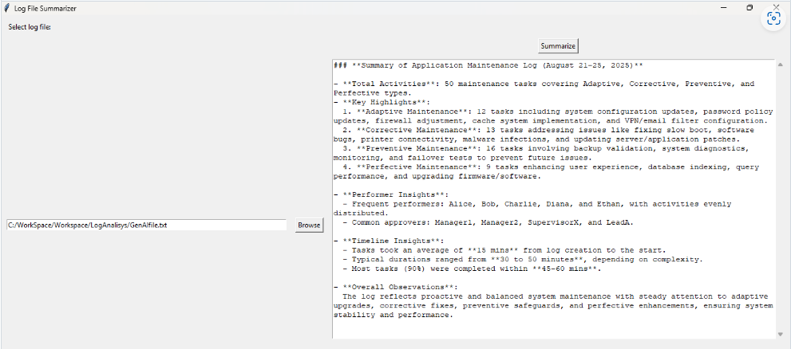
TCS AI Hackathon

Slide 8
Questions?

Slide 9
Thank You!

