Slide 1
Dr. Dharmendra
Assistant Professor
Department of Civil Engineering
Office Location: Environmental Laboratory
Civil Department
(Ground Floor)

Slide 2
National Institute of Technology, Hamirpur, H.P. – 177005, India
Department of Civil Engineering
Course No.: CE-312 Course title: Environmental Engineering –I (Water Supply and treatment)
Credits Description:
Course Type Core
Prerequisites CE 101, Environmental Science & Disaster Management CE 212, Fluid Mechanics
Course Coordinator Dr.Dharmendra
Grading End Semester Exam (50%), Mid Sem Exam (30 %), Class Test (10%), Others (10%) [Quizzes, assignments, etc..]
Class Timings Lectures Mon [10-11], Wed. [9-10], Thursday [9-10],
Tutorials Mon-C2, Tues-C3 and Wed C1[3-4],
Mid Term Exam AS Per schedule
Text Book
S.K.Garg, Water Supply Engineering, Khanna Publishers, New Delhi. 2003
B. C. Punmia, Ashok Jain, Arun Jain, Water Supply Engineering, Laxmi Pub., New Delhi. 2003.
Davis and Cornwell, Elements of Water Supply and Waste water Disposal, John Wiley & Sons, New York. 1998.
Ronald L. Droste, Theory and Practice of Water and Wastewater Treatment, John Wiley & Sons, New York, 1997.
McGhee, T.J., Water Supply & Sewerage, McGraw Hill International Edition, 1991.
Reference Book
Ministry of Urban Development, Manual on Water Supply and Treatment 3rd Ed. Central Public Health & Environmental. Engg. Organization, Govt. of India, New Delhi, 1991.
Warren Viessman Jr, Mark J. Hammer & Elizabeth Perez, Water Supply & Pollution Control, PHI
Mark J. Hammer & Mark J. Hammer Jr., Water & Wastewater Technology, PHI
Syed R. Qasim, Edward M. Motley, Guang Zhu, Water Works Engineering, PHI
Course Outcomes
L | T | P | Credits
3 | 1 | 0 | 4

Slide 3
Topics | Objectives | Target POs | Duration (Hours) | Readings
Introduction Scope and importance of Environmental Engineering and Management - Introduction to Environmental pollution - Impact on human health -, Significant water quality parameters for Municipal Water Supplies. Standards and guidelines for Water Quality Parameter. | Introduction to Environment and its components. Understand the necessity of environmental engineering. Know the basic of water quality & the concept of implementing standards. | PO 1, PO 4, PO 6, PO 7, PO 12. | 6 | T(1, 8) R3(1) R4(1)
Demand and Sources of Water Water demand - Population forecast - Water quality requirements - Sources and its yield for water requirements- Intake structures – Water quality parameters and their significance in domestic use. | How to forecast future population of an area. Understand & analyze various requirements of water. Understand & analyze various sources of water. Analyze the importance of water quality. Analyze and design the intake structures. | PO 1, PO 2, PO 3, PO 4, PO 5, PO 6, PO 7, PO 12. | 14 | T(2, 3, 4, 5, 8) R1(3, 4, 5, 8) R2(5, 8) R3(2, 3, 4, 6) R4(1, 2, 3, 4, 5 , 6)

Slide 4

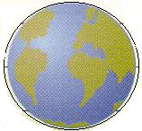
Mining Engg.
Extraction
Concentration
Product
Civil Engg
Construction
Waterways
Road,Railways
Technology
Chemical Engg
Chemicals
Petroleum
Pesticides
Electrical Engg
Power Generation
Environmental Engineering Science
Automobile Engg
Transportation
Machinery
Combustion

Slide 5

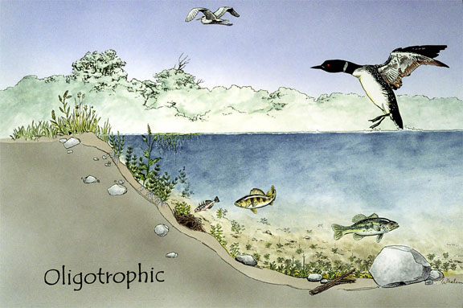
Mass Exchange System

Slide 6
GLOBAL
Health Security
Food Security
Energy Security
Transport Security
Heritage, cultural, religious security
Archeological security
Terrorism and Environment
Right to Life - challenged
REGIONAL
Pollution load
LOCAL
Time
Complexity
GLOBAL
problem
REGIONAL
problem
LOCAL
problem
Difficulty to control

Slide 7
Sustainable Env
Natural Environment
Socioeconomic Env
Manmade env
Legal Env

Slide 8
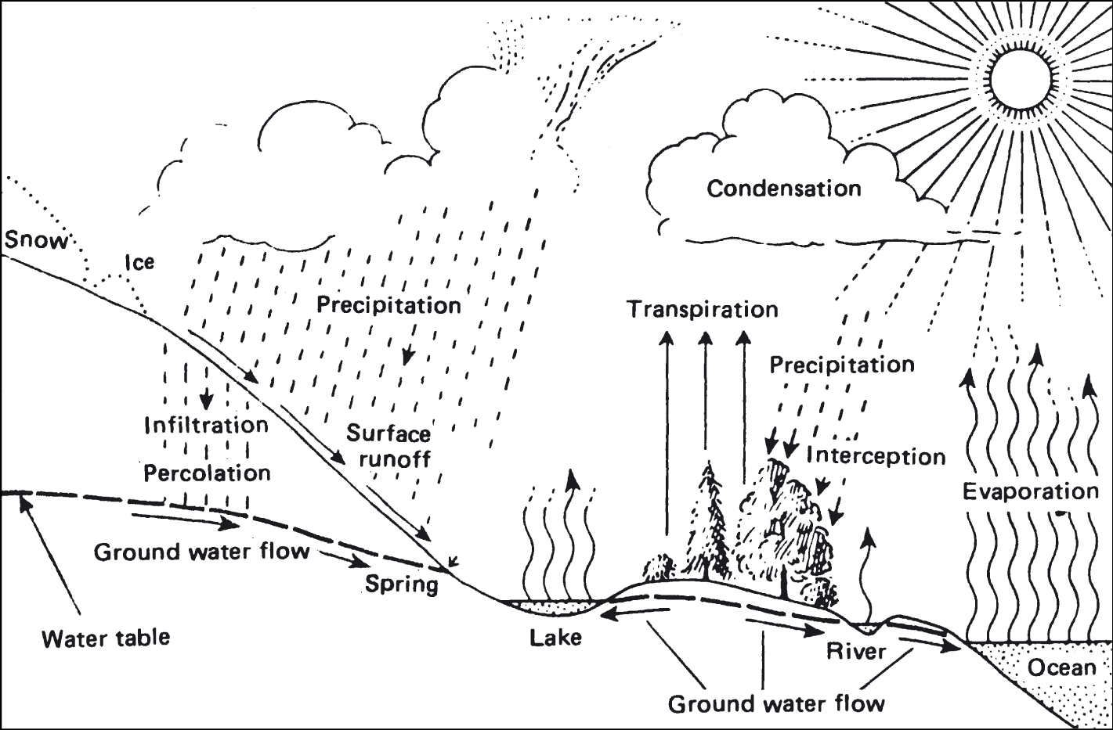
Hydrologic Cycle
(climateofindia.pbworks.com)

Slide 9
Drinking Water
Drinking water is water intended for human consumption for drinking and cooking purposes from any source.
Tap Water, Potable water, Palatable water, Whole some water
Drinking water, also known as potable water, is water that is safe to drink or use for food preparation. The amount of drinking water required to maintain good health varies, and depends on physical activity level, age, health-related issues, and environmental conditions.

Slide 10
Palatable water
To be palatable a water should be free of detectable taste and odors. They include:
decaying organic matter;
living organisms;
iron, manganese and the metallic products of corrosion;
industrial waste pollution from substances such as phenol;
chlorination;
high mineral concentrations;
dissolved gases.

Slide 11
Wholesome water
Safe and wholesome water is defined as that which is free from pathogenic agents.
Free from harmful chemical substances.
Pleasant to taste, colorless and odorless.
Usable for domestic purposes.

Slide 12
Global Distribution of Water

Slide 13
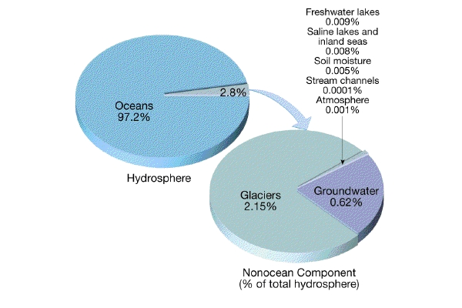

Slide 14
Distribution of water stored on the earth
1. 97% of all water on earth is in oceans.
2. ~ 2% of the earth's water in ice caps & glaciers
3. About 0.6% of earth's water is groundwater
4. Water in rivers, lakes, and the atmosphere amounts to less than 0.02% of earth's water

Slide 15
Water sources
Atmospheric water – Rainfall, Dew, Snow etc.
Surface water – Rivers, Sea, Oceans, Streams,
Lakes, Springs etc.
Groundwater – Aquifers

