Slide 1











PROBLEM STATEMENT
Stage fear and public speaking anxiety hinder individuals from effectively expressing themselves, limiting personal growth, professional opportunities, and societal impact.
Existing solutions are inadequate and fail to provide comprehensive support.
A transformative solution is needed to empower individuals and bridge the resource gap in public speaking.

Slide 2

SOLUTION
The project offers a comprehensive solution to stage fear and public speaking anxiety.
It includes generating PowerPoint presentations, describing slide content, and analyzing user-uploaded presentations.
Q&A sessions on specific topics are also generated. A supportive community/forum is created for users to connect, share experiences, seek advice, and find inspiration.
This solution aims to empower individuals, provide resources, and foster personal growth in public speaking within a supportive environment.

Slide 3
MARKET OPPURTUNITIES
Expansive Market: The project targets a large market of professionals, students, and individuals seeking to improve their public speaking skills by addressing stage fear and public speaking anxiety.
Inadequate Solutions: Current solutions in the market lack comprehensive support, but the project aims to fill this gap through innovative technology, personalized guidance, and a supportive community.
Growing Demand: The growing demand for effective communication skills creates an opportunity for the project to provide a platform for skill development and confidence building.

Slide 4




TECHNOLOGY USED

Slide 5

UNIQUENESS
Description
Q/N
Dedicated Community
Tips

Slide 6
BUSINESS MODEL
FearFall.Ai
User
Advertisement
Premium
Buy me a coffee
Referral
Community
Approved Templates

Slide 7

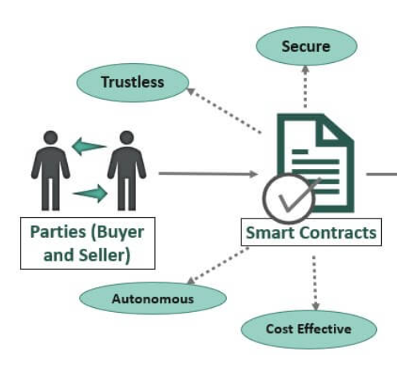
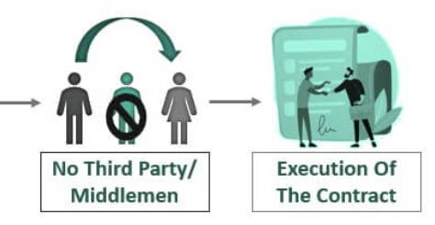

REVENUE MODEL
5ire API
Fig: Represent the Execution of Smart Contract using 5ire

Slide 8
User
FearFall.Ai
Premium
Advertisement
Buy me a coffee
Reference
Template
Community
Profit for FearFall.Ai
Points
Conventional
Blockchain

Slide 9
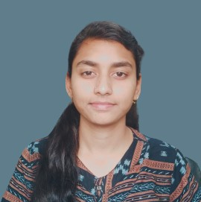

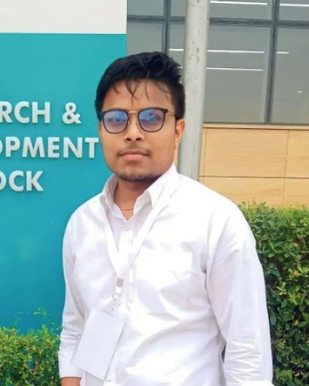

THE TEAM
Nikita Kumari
Kshitez Pratap Singh
Aniket Kumar
Rohit Raj

Slide 10

THANK YOU

