Slide 1
Slate Recommendation Methods
B.Tech Project Presentation
Kshitij Shah (CS19B027)

Slide 2
Motivation
Recommender Systems are growing in use.
Personalization is being brought in through extensive user data
Modern Recommender Systems provide users with a number of choices i.e a slate

Slide 3
Motivation
Slate Recommender Systems are far more difficult to model since we have a combinatorial action space
Reinforcement Learning has shown success when used for Recommender Systems
So the question that then follows is, can we effectively use RL to model Slate Recommender Systems?

Slide 4
Problem Statement
Set up a suitable environment to study slate recommendation systems.
Explore combinatorial action spaces and test traditional Reinforcement Learning Methods on them.
Implement the current state-of-the-art methods in Slate Recommendation and test them against traditional Reinforcement Learning Algorithms.
Explore the possibility of using alternative methods that could factor in combination data into item and slate values.
Conclude as to how progress could be made to factor in combination data, and what agents are the best fit for the slate recommender problem

Slide 5
Approach
We break the problem into 2 parts:
Learning
Evaluation
Learning involves being able to derive Q-vales for each slate from the data we have
Evaluation involves - Being able to evaluate all possible slates to show one of them to a user

Slide 6
Environment
We have worked with Google Recsim's Interest Evolution
It is a dynamic environment that allows for the algorithm to learn from any given combination instead of having to use partial slate matches.
IEE focuses on changes in user preferences and evolution in taste – similar to a movie or news recommendation agent.
IXE and LTS are the other 2 environments.

Slide 7
Environment
State Space –
A 30-dimensional vector that includes 20 interest features along with other general features like the probability the user will interact further, time user has left to watch videos, etc.
It also includes a history of previous interactions as well as open demographic features.
Action space -
There is a document corpus that we set up with each document having the same 20 interest features as well.
We set the size of the corpus to 10, and the slate size to 2.

Slide 8
Model 1: SlateQ
The first model we use is SlateQ
SlateQ has 2 components on the learning side:
User Choice Model
SlateQ Decomposition Model
It then uses one of three algorithms on the evaluation side:
Greedy
Top-k
Mixed Integer Programming
Neural Network (Added by us)

Slide 9
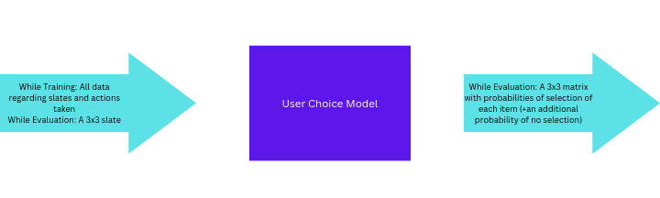
Model 1: SlateQ
We start with the first component – the User Choice Model.
The model used in the paper and in our implementation is a Multinomial Logit (MNL) Model.
This component takes in a slate of items and outputs the probability of each one being chosen

Slide 10
Model 1: SlateQ
The next component is the SlateQ Decomposition Model.
This is the part where the algorithm breaks down the Q values into the values associated with items.
This allows us to store all information in just |n| variables where n is the size of the document corpus
It makes two assumptions: SC and RTDS
We optimize this using Sarsa and Epsilon Greedy Algorithms.

Slide 11



Model 1: SlateQ

Slide 12
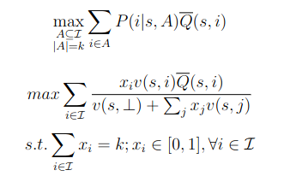
Model 1: SlateQ
Finally, we come to Slate Selection Methods
We have our 2 online methods:
Top K
Greedy
Mixed Integer Programming
Neural Network

Slide 13
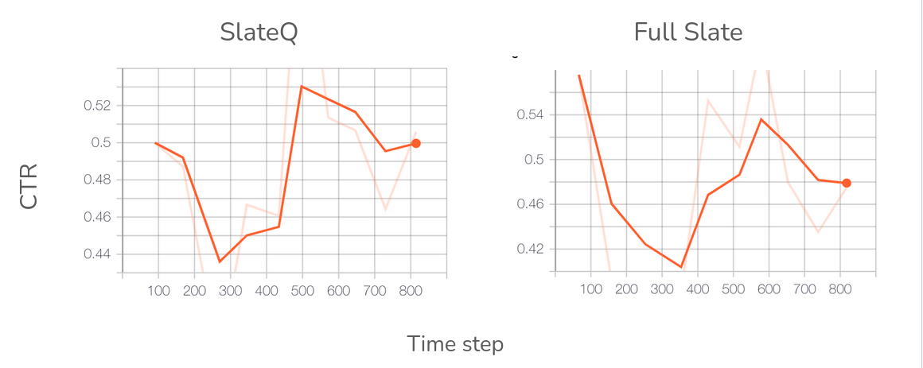
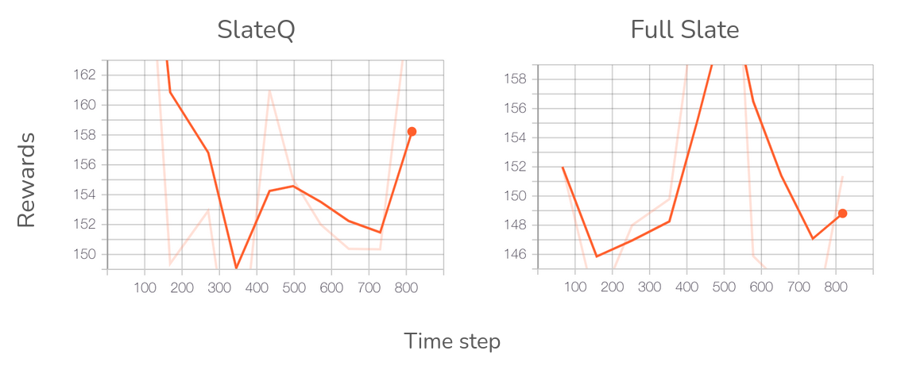
Results
Notes:
(a) As of now, the number of actions in Slate Q would be equivalent to 10, while for Full Slate Q Learning it would be 45.
f) Reward Space - The reward is a single scalar value that is directly proportional to how satisfied the user is with the item they chose. This means that an item on which the user spends more time, likes, or aligns more with their interests will get higher points than an item that is scrolled past quickly, not liked, or in opposition to user interests. It can receive a max reward of 200
(b) We see a significant reward increase when we move to the SlateQ decomposition Algorithm. The rewards are increasing by an average of 8 after 800 episodes of training and given the myopic nature of Full Slate Q versus calculating Long Term Values for SlateQ, there would be a widening gap if we process this further.
(c) The reward for Slate Q Decomposition settles on 158, while the Full SlateQ decomposition ends up at 149. We would also expect SlateQ to outperform Full Slate Q Learning significantly as we increase the size of the corpus of documents as well as the Slate Size.
d) CTR
e) Computational Speed

Slide 14
Model 2: LinUCB
Now we adapt a LinUCB algorithm to the Slate Recommendation Problem.
LinUCB is a computationally efficient Bandit, since it uses Matrix Operations and ergo seems like a better fit here.
We train our LinUCB model to directly treat the 10 documents as actions and maintain linear models for them.
These linear models would capture the context between the items in the slate as well.

Slide 15
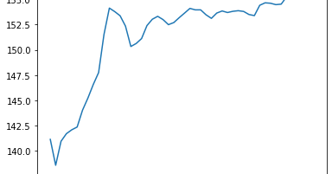
Results
Comparable to SlateQ results – Average reward of 155, higher than the original 148 for Full SlateQ
Faster Computation – Trained nearly 5000 episodes in over 10 minutes, on minimal computing resources.

Slide 16
Model 3: Twin Neural Networks
Finally, we attempted to nonlinearize the problem by using two neural networks – one for the evaluation purpose and one for the learning purpose.
The twin neural networks would be then used to ensure both processes take place much faster and also ensure that we can most effectively capture interactions between items into the model as well
We used a 3 layer NN, with Sigmoid activation functions for learning.
For evaluation, we started with the same NN that gave us good results with SlateQ. We used ReLu activation functions here.

Slide 17
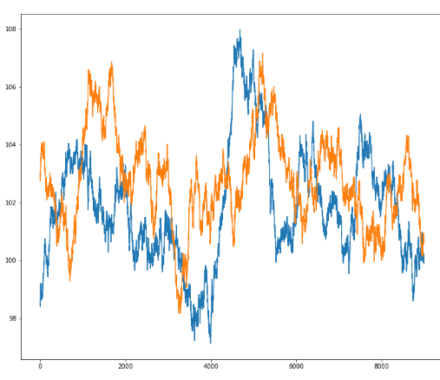
Results
Possible Reasons for failure:
Mismatched networks – High computational complexity
Limited Training Period
Blue curve – Random Agent
Orange Curve – Twin Neural Network

Slide 18
Conclusion and Future Work
We attempted to break the first of our two problems down using the current SoTA method - SlateQ, and a non-linear method, using a Neural Network.
For the Evaluation Mechanism as well, we used 4 methods - Top K, Greedy Step, Mixed Integer Programming, and Deep Neural Network
Beside these we also implemented LinUCB.
Notes:
Possible Future Work in the field could include - 1. Adding another layer of features in the LinUCB model to incorporate two item interactions into the model 2. Using SlateQ or LinUCB to select the top 3k items in the corpus for all users, fol- lowed by using a Neural Network to now pick the top k items from this shrunken set where it could easily factor in combinatorial interactions more easily. 3. Using alternate user choice models to change the learning problem at the first stage and then combining it with slateQ to improve results further.

