Slide 1
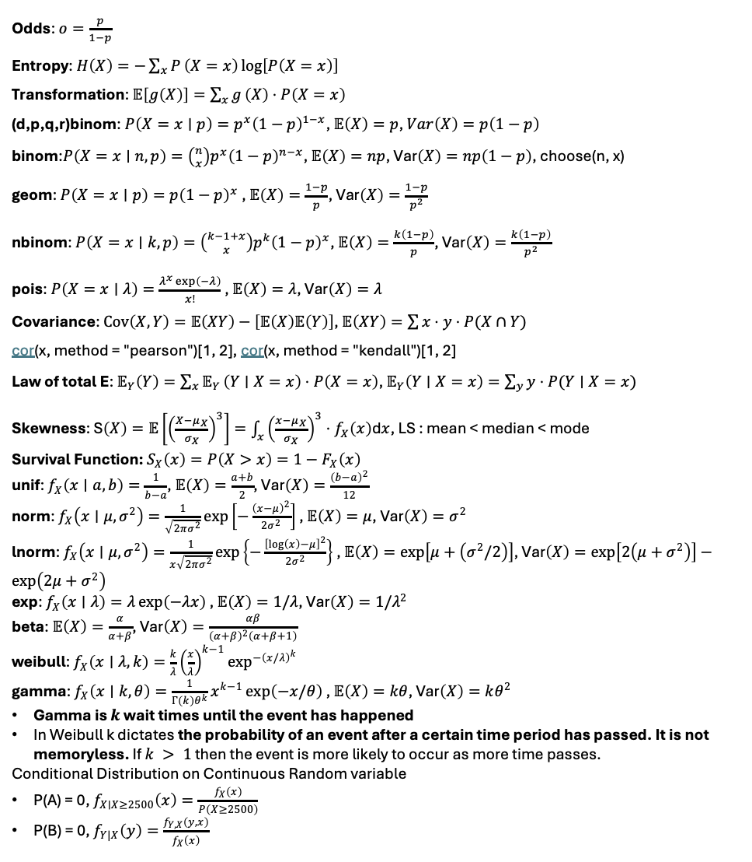
Odds: $o=\frac{p}{1−p}$
Entropy: $H\left(X\right)=−\sum_{x}{P}\left(X=x\right)\log\left[P\left(X=x\right)\right]$
Transformation: $𝔼\left[g\left(X\right)\right]=\sum_{x}{g}\left(X\right)⋅P\left(X=x\right)$
(d,p,q,r)binom: $P\left(X=x∣p\right)=p^{x}{\left(1−p\right)}^{1−x}$, $𝔼\left(X\right)=p$, $Var\left(X\right)=p\left(1−p\right)$
binom:$P\left(X=x∣n,p\right)=\left({n \atop x}\right)p^{x}{\left(1−p\right)}^{n−x}$, $𝔼\left(X\right)=np$, $\text{Var}\left(X\right)=np\left(1−p\right)$, choose(n, x)
geom: $P\left(X=x∣p\right)=p{\left(1−p\right)}^{x}$ , $𝔼\left(X\right)=\frac{1−p}{p}$, $\text{Var}\left(X\right)=\frac{1−p}{p^{2}}$
nbinom: $P\left(X=x∣k,p\right)=\left({k−1+x \atop x}\right)p^{k}{\left(1−p\right)}^{x}$, $𝔼\left(X\right)=\frac{k\left(1−p\right)}{p}$, $\text{Var}\left(X\right)=\frac{k\left(1−p\right)}{p^{2}}$
pois: $P\left(X=x∣λ\right)=\frac{λ^{x}\exp\left(−λ\right)}{x!}$ , $𝔼\left(X\right)=λ$, $\text{Var}\left(X\right)=λ$
Covariance: $\operatorname{Cov}\left(X,Y\right)=𝔼\left(XY\right)−\left[𝔼\left(X\right)𝔼\left(Y\right)\right]$, $𝔼\left(XY\right)=\sum{x}⋅y⋅P(X∩Y)$
cor(x, method = "pearson")[1, 2], cor(x, method = "kendall")[1, 2]
Law of total E: $𝔼_{Y}\left(Y\right)=\sum_{x}{𝔼_{Y}}\left(Y∣X=x\right)⋅P\left(X=x\right)$, $𝔼_{Y}\left(Y∣X=x\right)=\sum_{y}{y}⋅P(Y∣X=x)$
Skewness: $\text{S}\left(X\right)=𝔼\left[{\left(\frac{X−μ_{X}}{σ_{X}}\right)}^{3}\right]=\int_{x}{{\left(\frac{x−μ_{X}}{σ_{X}}\right)}^{3}}⋅f_{X}\left(x\right)\text{d}x$, LS : mean < median < mode
Survival Function: $S_{X}\left(x\right)=P\left(X>x\right)=1−F_{X}\left(x\right)$
unif: $f_{X}\left(x∣a,b\right)=\frac{1}{b−a}$, $𝔼\left(X\right)=\frac{a+b}{2}$, $\text{Var}\left(X\right)=\frac{{\left(b−a\right)}^{2}}{12}$
norm: $f_{X}\left(x∣μ,σ^{2}\right)=\frac{1}{\sqrt{2πσ^{2}}}\exp\left[−\frac{{\left(x−μ\right)}^{2}}{2σ^{2}}\right]$ , $𝔼\left(X\right)=μ$, $\text{Var}\left(X\right)=σ^{2}$
lnorm: $f_{X}\left(x∣μ,σ^{2}\right)=\frac{1}{x\sqrt{2πσ^{2}}}\exp\left\{−\frac{{\left[\log\left(x\right)−μ\right]}^{2}}{2σ^{2}}\right\}$ , $𝔼\left(X\right)=\exp\left[μ+\left(σ^{2}/2\right)\right]$, $\text{Var}\left(X\right)=\exp\left[2\left(μ+σ^{2}\right)\right]−\exp\left(2μ+σ^{2}\right)$
exp: $f_{X}\left(x∣λ\right)=λ\exp\left(−λx\right)$ , $𝔼\left(X\right)=1/λ$, $\text{Var}\left(X\right)=1/λ^{2}$
beta: $𝔼\left(X\right)=\frac{α}{α+β}$, $\text{Var}\left(X\right)=\frac{αβ}{{\left(α+β\right)}^{2}\left(α+β+1\right)}$
weibull: $f_{X}\left(x∣λ,k\right)=\frac{k}{λ}{\left(\frac{x}{λ}\right)}^{k−1}\exp^{−{\left(x/λ\right)}^{k}}{}$
gamma: $f_{X}\left(x∣k,θ\right)=\frac{1}{Γ\left(k\right)θ^{k}}x^{k−1}\exp\left(−x/θ\right)$ , $𝔼\left(X\right)=kθ$, $\text{Var}\left(X\right)=kθ^{2}$
Gamma is $k$ wait times until the event has happened
In Weibull k dictates the probability of an event after a certain time period has passed. It is not memoryless. If $k > 1$ then the event is more likely to occur as more time passes.
Conditional Distribution on Continuous Random variable
P(A) = 0, $f_{X∣X≥2500}\left(x\right)=\frac{f_{X}\left(x\right)}{P\left(X≥2500\right)}$
P(B) = 0, $f_{Y|X}\left(y\right)=\frac{f_{Y,X}\left(y,x\right)}{f_{X}\left(x\right)}$
MLE Steps:
Choose your fighter
Estimate likelihood
Perform log-likelihood transformation
Partially differentiate with respect to the parameter of interest
Make it equal to zero and estimate the parameter of interest
Make sure that it is local maximum by double differentiating the log-likelihood and checking if the value is negative.
For empirical estimates of parameter of interest, we choose a range of values for parameter and see which value corresponds to the maximum log-likelihood value.
Create Sequence in R: possible_betas = seq(5, 50, 0.5)
To apply log-likelihood: log_likelihood = map_dbl(1 / possible_betas, ~ log(prod(dexp(sample_n30$values, .))))
Discrete Sampling
To sample from Discrete distribution, we use sample() function in R.
set.seed(551)
outcomes <- c("banana", "bob-omb", "coin", "horn", "shell")
probs <- c(0.12, 0.05, 0.75, 0.03, 0.05)
n <- 10
R_mario_sample <- sample(outcomes, size = n, replace = TRUE, prob = probs)
R_mario_sample
Empirical Codes:
mean(), var(), sd(), quantile()

