Slide 1
Crop analysis and prediction
Name : Kshitij V Darwhekar
Roll No: TETB19
Seat No: T217149
PRN : 0120190215
Sub: Soft Computing

Slide 2
introduction
Agriculture is the most important supply of Indian Economy. For the better crop yield, the farmers always require a timely guidance to predict the future of crop productivity and also an analysis is to be made which will help the farmers to utilize full capacity in the crop production for their crops.
In this current situation due to rise in the population the production of crops and agricultural products needs to be increased simultaneously to meet the demands of the people. These problems could be solved using machine learning algorithms
Machine learning algorithm can analyze different soil parameters and weather conditions to give you accurate result.

Slide 3
implementation
The implementation is divided into following parts :
Data collection
Data Visualization
Data Preprocessing
Data split into train and test data.
Training the model
Parameter Tuning

Slide 4
The first step in implementation is data collection. The crop recommendation dataset is available on Kaggle. This dataset was build by augmenting datasets of rainfall, climate and fertilizer data available for India.
The next step is Data visualization, we used different heatmaps to visualize the data. Using Seaborn library we plotted distribution of temperature and ph. Then a count plot to visualize diagonal distribution of various plants.
The third step is data pre-processing, in this step we create target column and remove unnecessary columns from the dataset.
Then the data is split into training data and testing data.
This training data is then used to train the k-NN classifier model.
Using the test data we predict the crop and get accuracy of 97.81%

Slide 5
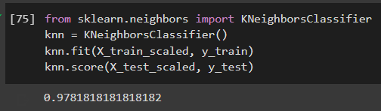
result
kNN Prediction Score:

Slide 6
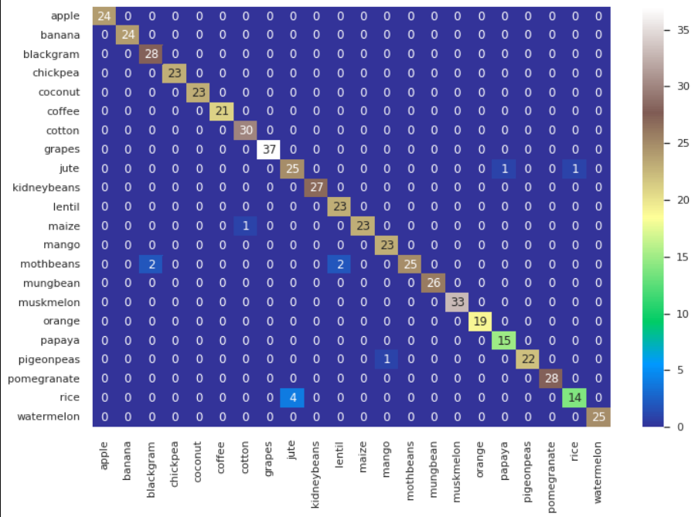
Confusion Matrix :

