Slide 1
Converter fails mid-section. The standby does not take over. What now?
NODE QUEST 2026 | TEAM LEMMACORE
AuxiCompass
TRIPPED
Auxiliary converter (SIV)
Motor blowers
Oil cooling and pump
Brake compressor
Battery charger
The loco pilot gets no guide: what to switch off, how many minutes are left, whether to stop.
Cab AC
Lights and fans
Sheds told RDSO the load did not shift from SIV1 to SIV2 (Siemens 2x130 kVA) or after an MCB trip (Medha 2x130 kVA). RDSO minutes, 29 May 2025.
Notes:
SAY: We are team LemmaCore, and this is AuxiCompass. A loco pilot is in the middle of a section. The auxiliary converter that runs the cooling blowers and the brake compressor trips. There is a standby, but sometimes it does not take over. Nobody tells the pilot what to switch off or how long they have before the motors overheat. That is our user and our problem.
TIME: 0:00 to 0:45. RUBRIC: Problem selection (20).
EVIDENCE: RDSO minutes, 29 May 2025: sheds report load not shifting from SIV1 to SIV2 (Siemens), and not shifting when the front-panel MCB trips (Medha).

Slide 2
Failures are frequent, and the evidence disappears
~27
The standby does not always take over
Siemens 2x130 kVA: load did not shift from SIV1 to SIV2 after a fault.
Medha 2x130 kVA: load did not shift when the front-panel MCB tripped.
failures per 100 converters a year
582 failures in 2,116 units, FY 2024-25, conventional electric locos. The total is our arithmetic from RDSO's table.
The fault log is gone before the shed reads it
20 days
60 days
of fault log kept
between scheduled shed visits
Source: RDSO minutes on 180 kVA SIV failures, meeting of 29 May 2025, Annexure-I. Conventional electric locos, not 3-phase locos.
Notes:
SAY: RDSO expressed serious concern about these failures. Their table gives 582 failures across 2,116 units, about 27 per 100 a year by our arithmetic. These are conventional electric locos, not the 3-phase locos BLW builds. Two root causes stand out: the changeover to the standby is not reliable, and the fault log keeps 20 days while the loco comes in every 60, so the evidence is gone before anyone reads it.
TIME: 0:45 to 1:30. RUBRIC: Understanding of the problem (15).
EVIDENCE: CONTEXT.md section 4, rows 1 to 4. The total and "per 100" are our reading of Annexure-I.

Slide 3
Monitoring exists. A crew advisor does not
What exists today
What the crew still lacks
REMMLOT remote monitoring
reports loco health to the shed
What do I switch off?
Loco thermal protection
derates or trips the motor
How many minutes do I have?
CLW analytics spec, 3-phase locos
April 2024, deployment unknown
Continue, or stop?
We searched and found no crew-side advisor. We say "we found none", not "none exists". Sources: IRIMEE slides, CLW documents (medium trust).
Notes:
SAY: Remote monitoring reports health to the shed. The loco's own protection derates or trips the motor. Neither tells the crew what to do next. We searched and found no crew advisor. We say "we found none", not "none exists".
TIME: 1:30 to 2:00. RUBRIC: Understanding of the problem.
EVIDENCE: CONTEXT.md section 4, rows 7 and 8 (trust: medium).

Slide 4
Our Solution
Two parts: an advisor, and the proof that it works
1 THE ADVISOR
Sensor readings
noisy, sometimes wrong
Diagnose (ML)
which faults are present?
Advisor (physics)
what to shed, minutes left
One decision
continue, stop at next, stop now
2 THE PROOF
Fault-injection harness
8 faults > 36 single and double combinations x 4 conditions x 2 policies = 288 runs
Four safety properties checked in every run. The results become the coverage map.
Physics first. ML names the fault; a learned estimate may lower the minutes left, never raise them. Sources: CONTRACT.md sections 1 and 4, docs/model.md.
Notes:
SAY: Two parts. First, the advisor: one screen that says what to switch off, at least how many minutes are left, what runs out first, and whether to continue, stop at the next safe place, or stop now. Second, the proof: we inject every single and double fault in four conditions, with and without the advisor, and check four safety properties in every run. ML names the fault from noisy sensors, so the pilot does not have to know which unit failed. The advisor is physics first; ML supports it and may never make it more optimistic.
TIME: 2:00 to 2:45. RUBRIC: Idea and innovation (20).
EVIDENCE: CONTRACT.md sections 1 and 4; docs/model.md "Advisor".

Slide 5
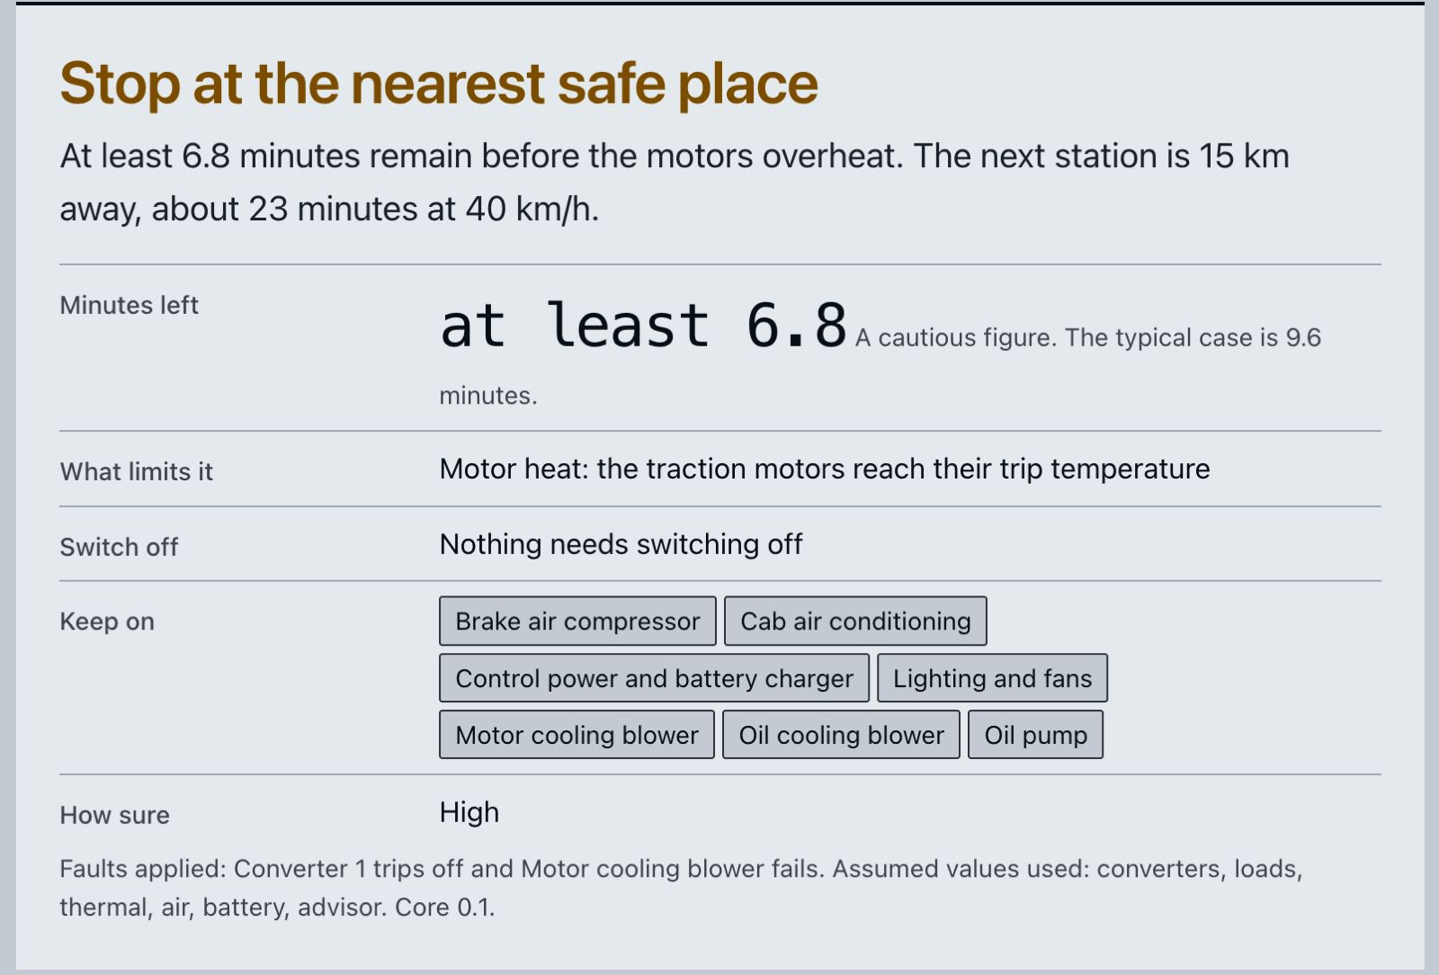
Model result: 44 unsafe without the advisor, 0 with it
What the pilot sees: the live app
LIVE DEMO
44 / 144
0 / 144
runs unsafe without the advisor
runs unsafe with the advisor
8
0
cautious stops the baseline did not need
safety properties failed
Model with assumed parameters; harness advisor told the true faults (coverage.json, core 0.1, seed 1). Auto-diagnose, held out and simulated: exact fault set 55%, stuck sensor 100% (models/metrics.json).
Notes:
SAY (headline): Across 144 cases, the baseline, which keeps running with only the loco's own protection, hits a limit while moving in 44. With the advisor, zero. All four safety properties held in every run. The price is 8 stops the baseline did not need, because we chose to be cautious.
SAY (screenshot, live app: converter 1 trips and the motor cooling blower fails, station 15 km away): The pilot gets one card. At least 6.8 minutes before the motors overheat, typically 9.6. The station is about 23 minutes away, so: stop at the nearest safe place. Nothing needs switching off; the stop decision is what keeps it safe.
SAY (harness hard case, hot climb, standby stuck, if asked): Without the advisor the motor reaches its trip limit about 12.6 minutes after the fault, while still moving. The advisor's cautious estimate is at least 6.3 minutes; the model's nominal value is 8.8. That is not enough for the station, so it says stop at the next safe place, and no limit is hit.
SAY (wrong data): Now we stick the temperature sensor. The reading goes flat while the model says the motor should be heating. The advisor flags the disagreement, lowers its confidence and assumes the motor is near the trip.
SAY (Auto-diagnose): The classifier names the fault from noisy sensors. On held-out simulated scenarios it gets the exact fault set right 55 percent of the time after a fault, and catches a stuck sensor every time. Below 60 percent confidence the advisor ignores it.
CLICKS: follow docs/presentation/demo-script.md. Read numbers off the screen; the app uses 15 km to the station, the harness 12 km.
TIME: 2:45 to 3:45. RUBRIC: Working prototype (10), Hard case (15).
EVIDENCE: demo_outputs/coverage.json summary and case STANDBY_STUCK__hot_climb.

Slide 6
What we left out, and what we assumed
Future Scope
Failure prediction (no data to learn it from)
Passenger features
Any safety-certification claim
ASSUMED
Every loco value in our model is a team assumption, and the app shows this tag. The 0 unsafe result is from our model, with the advisor told the true faults.
Most sensitive assumptions: the motor trip temperature (assumed 180 C) and the brake-air minimum (48.0 min swing for a failed compressor). Leak rate from PLW dispatch test sheets. Source: demo_outputs/sensitivity.json.
Notes:
SAY: We kept the scope narrow on purpose. Every loco number in our config is tagged assumed, and the app shows the badge. Our 0 unsafe is a model result with assumed values, and with the advisor told the true fault. We also measured which assumptions matter: in the hard case, moving the motor trip temperature by 20 percent changes minutes-left from about 5 to about 13. That is the most sensitive assumption in our model.
TIME: 3:45 to 4:15. RUBRIC: Idea and innovation.
EVIDENCE: config/loco.json (every block "status": "assumed"); coverage.json advisor_policy_note; demo_outputs/sensitivity.json (hot_climb_standby_stuck: trip temperature 4.91 to 13.31 min, swing 8.4).

Slide 7
From prototype to the loco cab
1
Replace simulated faults with the converter makers' real fault codes
2
Offer the harness to RDSO as an acceptance test for changeover software
3
Model BLW's 3-phase locos: 3 converters sharing load at about 37 Hz
4
Keep 60 days of fault log, not 20, so the shed sees the evidence
Who adopts it: RDSO for the test; zonal sheds and crews for the advisor.
What it needs: maker fault codes, shed data, confirmed loco values, an approval route.
AI disclosure: We used Claude, an AI assistant, to research sources and help write code. The running tool contains no language model. We wrote our own tests and marked every assumed value.
Notes:
SAY: Four steps to real use. One: replace our simulated faults with the converter makers' real fault codes. Two: offer the harness to RDSO as an acceptance test for converter changeover software. Three: model BLW's 3-phase locos, where three converters share the load and the frequency drops to about 37 Hz instead of loads going dark. Four: keep 60 days of fault log, not 20, so the shed sees the evidence. Who adopts it: RDSO for the test, the zonal sheds for the advisor. What it needs: maker fault codes, shed data and an approval route.
DISCLOSURE (say verbatim): We used Claude, an AI assistant, to research sources and help write code. The running tool contains no language model. We wrote our own tests and marked every assumed value.
TIME: 4:15 to 5:00. RUBRIC: Future scope and impact (10).
EVIDENCE: docs/AI_DISCLOSURE.md; 3-phase behaviour in docs/public_answers.md and docs/model.md "Known gap".

