Slide 1
Chapter Two National Income Accounting

Slide 2
SOME BASIC CONCEPTS
Potential and Actual GDP
Transfer Payment
Capital Gain
Second Hand Sale
Illegal Income
Closed and Open Economy
Residents of the Country
Depreciation
Economic Sectors

Slide 3
Circular Flow of Income and Expenditure
Flow of goods and services and factor payments among different sectors of the economy is called as Circular flow of income.
In other words, it is the flow of payments and receipts for goods and services between different sectors of the economy.
Production gives rise to income, income gives rise to expenditure and expenditure again gives rise to income. It is the main functional basis of the circular flow of income.
It consists of two flows: Real flow and Monetary flow.
It is the flow of Production, Income and Expenditure.

Slide 4
Circular Flow of Income and Expenditure in Two Sector Economy
Two sector economy is closed economy or Market Economy, where only two sectors i.e. Household sector and Business Sector are operating without the active role of the Government.
Business sector/Production sector hires factor services from household sector and for this household sector receive factor payments.
Household sector purchases goods and services from production sector and they pay price for them.
Financial sector only plays the role of intermediaries to convert savings of the household to investment.

Slide 5
It is the most simplified economic model and hypothetical economic system. It is not found in the real world.
It is based on the following assumptions.
There are only two sectors in the economy: HH and Business.
There is no government role in the economy.
There is no foreign trade.
All the goods and services are produced by business sector.
All factors of production are purchased from the household sectors.
On the basis of the assumptions, the circular flow of income and expenditure in two sector economy can be explained with the help of following figure.

Slide 6
Factor payments
Wages, Interest, Rent and Profit
Services of land Labor, Capital etc.
Household Sector
Financial Sector
Business Sector
Saving
Investment
Goods and Services
Price of Goods and Services
Circular Flow of Income and Expenditure
in Two Sector Economy

Slide 7
Circular Flow Of Income and expenditure in Three Sector Economy
Three sectors economy consists of Household Sector, Business Sector and Government Sector.
It is also the case of closed economy.
It is more realistic than two sector economy.
It includes the government sector which plays the important role in the economy.
The Government collects tax from both household and production sector.
Govt. provides subsidy and Govt. purchases to production sector and wages, transfer payments to household sector.

Slide 8
It is based on the following assumptions.
The economy consists of household, business and government sectors.
There is government intervention in the economy.
Government imposes taxes and provides subsidy.
There is perfectly competitive market.
The economy has no international trade.
Business sector pays both direct and indirect tax to the government.
Household sector pays only direct tax to the government.
On the basis of the assumptions, the circular flow of income and expenditure in three sector economy can be explained with the help of following figure.

Slide 9
Factor Payments
Factor Services
Wages salaries and
Transfer payments
Government Purchases
and Subsidies
Household Sector
Government Sector
Business Sector
Direct Income Tax
Direct and
Indirect Taxes
Goods and Services
Price of Goods and Services
Circular Flow of Income and Expenditure
in Three Sector Economy

Slide 10
Circular Flow Of Income and expenditure in Four Sector Economy
Four sectors economy consists of Household Sector, Production sector, Government Sector and Foreign Sector.
It is the case of open economy.
Economy receives from remittances and Exports.
Economy pays for foreign factors and Imports.

Slide 11
It is based on the following assumptions.
There are four sectors in the economy.
There is no restriction on import and export.
There is minimum government intervention.
Both internal and external markets are perfectly competitive.
There is well managed financial sector.
Households exports only labour and capital.
Business firms export and import only goods and services.
On the basis of the assumptions, the circular flow of income and expenditure in four sector economy can be explained with the help of following figure.

Slide 12
Factor Payments
Factor Services
Wages salaries and
Transfer payments
Government Purchases
and Subsidies
Household Sector
Government Sector
Business Sector
Direct Income Tax
Direct and
Indirect Taxes
Goods and Services
Price of Goods and Services
Foreign Remittance
Foreign Sector
Receipts from exports
Export of capital
and manpower
Payments to Imports
Circular Flow of Income and Expenditure in Four Sector Economy

Slide 13
Meaning of National Income
National income is the aggregate of income received by all the individuals and sectors of the economy during a given period of time specially one year.
NI = ΣY = Y₁+Y₂+…………………+Y_{n}
Where,
NI = National Income
Y₁ = Income received by the 1st individual or sector of the economy.
Y₂ =Income received by the 2nd individual or sector of the economy.
Y_{n} =Income received by the n^{th} individual or sector of the economy.
In other words, NI is money value of all final goods and services produced by the factors of production of the economy during a year

Slide 14
NI is the money value of all the final goods and services produced by a country during a period of one year.
NI consists of a collection of different types of goods and services.
Since these goods are measured in different physical units it is not possible to add them together.
Thus we cannot state NI in so many millions of meters of cloth.
Therefore, there is no way except to reduce them to a common measure i.e. money.

Slide 15
NI is also the sum total of factor payments made to all productive resources in terms of wage, interest, rent and profits.
NI = Wage +Rent +Interest +Profit
NI data reveals the aggregate economic performance of the National economy as a whole.

Slide 16
DIFFERENT CONCEPTS OF NI

Slide 17
In terms of Market Price (MP)
A. Gross Domestic Product (GDP)
GDP is the money value of all final goods and services produced within the domestic territory of a country during a specified time period, generally one year.
Therefore, it is the monetary measure of only final goods and services including the following components.
Value of final consumer goods and services consumed by household, ‘C’.
Value of new capital goods produced and addition to the inventories of goods but not sold during a year, ‘I’.

Slide 18
c. The value of purchases of goods and services by the government, ‘G’.
d. Difference between value of goods exported and value of goods imported, that is net export (X-M).
Therefore,
GDP_{mp} = C + I + G + (X-M)
Where,
C=Private Consumption expenditure
I = Private Investment Expenditure
G = Government Expenditure
X-M = Net exports (Exports-Imports)

Slide 19
According to product approach,
GDP_{mp} = P₁Q₁ + P₂Q₂ + …. + P_{n}Q_{n}
Where,
GDP_{mp} = Gross Domestic Product at market Price,
P = Price of the commodity,
Q = Qty of commodity.
_{Or,}
GDP_{mp} = Total Product of (Primary + Secondary +Tertiary) sectors

Slide 20
B. Net Domestic Product (NDP)
Net domestic product is the net value of final goods and services produced within a country during a year. It is the part of GDP after deducting the value of depreciation.
NDP_{mp} = GDP_{mp} – Depreciation

Slide 21
C. Gross National Product (GNP)
Gross National Product is the total market value of all final goods and services produced by the citizens of the country within or abroad during a specified time period.
Therefore, it is the sum of GDP_{mp} and net factor income from abroad (NFIA).
Net factor income from abroad is defined as the income earned by the citizens of any economy abroad minus the income earned by the foreign citizens in the economy.
GNP_{mp} = GDP_{mp} + NFIA
where,
NFIA = (Receipts from abroad – payments to abroad)

Slide 22
D. Net National Product (NNP)
Net National Product is the market value of all final goods and services after allowing for depreciation.
It is also known as the national income at market price.
When the charges of depreciation is deducted from the GNP, we can get the value of NNP.
That is,
NNP_{mp} = GNP_{mp} - Depreciation

Slide 23
E. National Income (NI)
National Income is the sum of the income earned by the domestically owned factors of production for their contribution on the production of goods and services.
It is also known as the national income at factor cost.
Therefore,
NI = Compensation of employees + Rent + Interest + Profit + Mixed Income from Self-Employment + NFIA
where,
Compensation to employees = Wages and salaries + other payments and services received by the employees

Slide 24
In terms of Factor Cost (FC)
All the value of market price may not be received by the factors of production used in the production of goods and services due to imposition of indirect tax.
Sometimes, the market price is less than the factor income due to the provision of subsidies.
Therefore, national income in factor cost can be calculated by subtracting the net indirect tax from the market price.
That is,
GDP_{FC}= GDP_{MP} – Net Indirect Tax (NIT)
NDP_{FC} = NDP_{MP} – NIT
GNP_{FC} = GNP_{MP} – NIT
NNP_{FC} = NNP_{MP} – NIT
NIT = Indirect Tax – Subsidy
NNP at factor cost is also known as the national income.

Slide 25
F. Personal Income (PI)
Personal Income is the total money income received by individuals and households of a country from all possible sources before direct taxes.
All part of national income may not be received by the citizens.
On the other, the government provides transfer payments in the form of old age allowance, unemployment allowance etc. which are not the part of NI.
Therefore, PI can be calculated from NI as following method.
PI= NI – Corporate Income Tax – Undistributed Corporate Profits – Social Security Contributions + Transfer Payments

Slide 26
G. Disposable Income (DI) / Disposable Personal Income (DPI)
The amount of personal income left after payment of direct taxes is called disposable income. It refers to the actual income which can be spent on consumption by individuals and families.
DI / DPI = PI – DT
On other concept, it is the sum total of consumption expenditure and saving:
DI = C +S
When the economy is in equilibrium , then, S = I. So,
DI = C + I

Slide 27
H. Personal Saving
Personal saving can be defined as the excess of disposable income over consumption expenditure. In other words, it is the difference between disposable income and consumption expenditure.
S = DI – C
I. Per Capita Income (PCI)
It is the average income of the people of a country in a particular year. It is derived by dividing the NI of the country by its total population.
PCI = NI/Total Population

Slide 28
Nominal and Real GDP
Nominal GDP measures the value of the economy’s total output at the prices prevailing in the period during which the output is produced i.e. current market prices.
Nominal GDP changes from year to year due to following two reasons:
The physical output of goods changes
Market prices changes
Real GDP measures changes in physical output in the economy between different time periods by valuing all goods produced in two periods at the same prices i.e. base year prices.

Slide 29
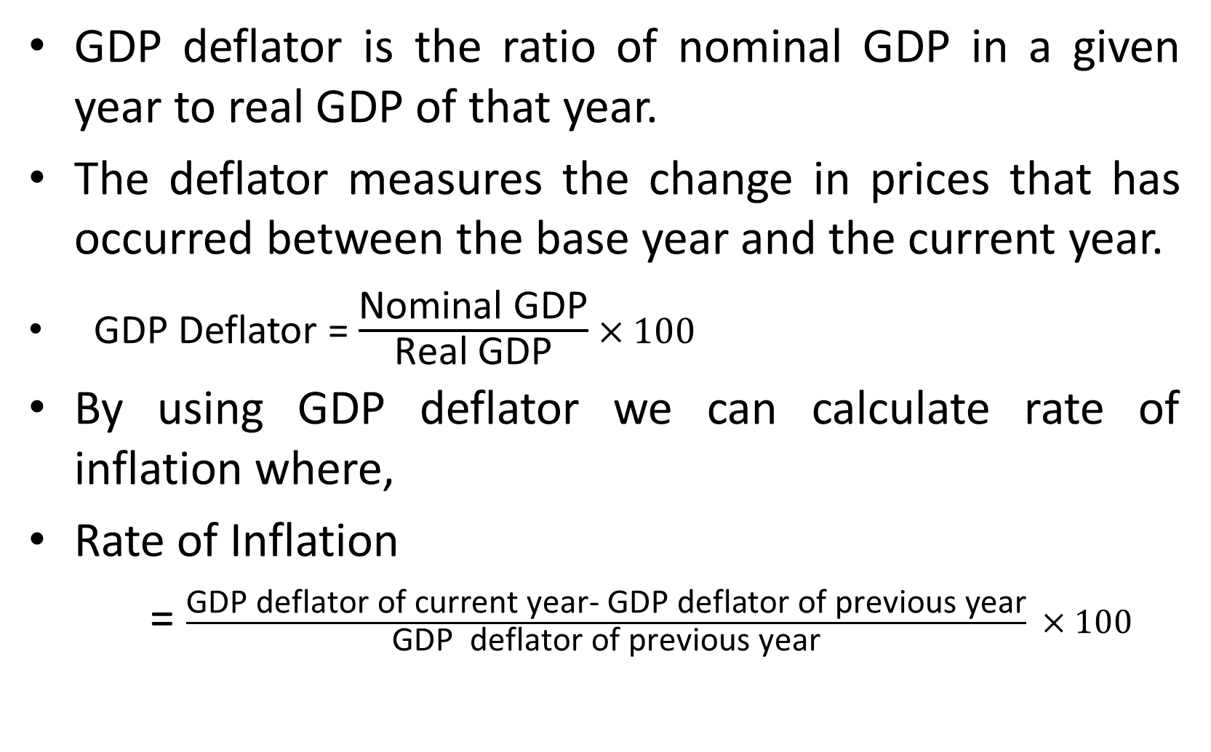
GDP Deflator and Rate of Inflation:
GDP deflator is the ratio of nominal GDP in a given year to real GDP of that year.
The deflator measures the change in prices that has occurred between the base year and the current year.
GDP Deflator =$\frac{\text{Nominal} \text{GDP}}{\text{Real} \text{GDP}}×100$
By using GDP deflator we can calculate rate of inflation where,
Rate of Inflation
= $\frac{\text{GDP} \text{deflator} \text{of} \text{current} \text{year}\text{− }\text{GDP} \text{deflator} \text{of} \text{previous} \text{year}}{\text{GDP} \text{deflator} \text{of} \text{previous} \text{year}} ×100$

Slide 30
MEASUREMENT OF NATIONAL INCOME

Slide 31
There are three methods of measuring NI
Expenditure Method:
This method measures NI as the aggregate of all the final expenditure on gross domestic product at market price in an economy during an accounting year.
In other words, if we add expenditure made by Household sector in consumption, expenditure made by manufacturing sector in investment, Expenditure made by government and expenditure made by foreign sector, it is NI.
It means if we calculate NI from market price, it is called as Expenditure method.

Slide 32
Process of calculating NI from expenditure method
GDP_{MP} = C +I +G + (X – M)
GNP_{MP} = GDP_{MP} + NFIA
Where,
NFIA = R – P
NNP_{MP} = GNP_{MP} – Depreciation
NNP_{FC} or NI = NNP_{MP} – NIT
Where,
NIT = Indirect Tax - Subsidy

Slide 33
Components of Expenditure Method
Private Final Consumption Expenditure (C):
Expenditure made on durable goods
Expenditure made on non-durable goods
Expenditure made on services of all kinds
Gross Private Domestic Investment / Gross Capital Formation (I):
Non-residential investment
Residential investment
Changes in business inventories
Or,
Net fixed capital formation
Depreciation
Change in inventories
Government Expenditure (G):
Government consumption expenditure
Government investment expenditure

Slide 34
4. Net Exports (X-M):
Export earnings (X)
Import expenses (M)
Net factor Income From Abroad (NFIA): R-P
Receipts from Abroad (R)
Payments made to Abroad (P)
Depreciation:
It is the consumption cost of fixed capital or Capital Consumption Allowances. It can also be defined as the wear and tear cost of fixed capital.
Net Indirect Taxes(NIT):
Indirect taxes (IT)
Subsidies (S)

Slide 35
Income Method:
Income method measures the total value of income generated by production plus indirect taxes net of subsidies.
Also called as distributed share method or factor payment method.
This method measures NI from the side of payments made in the form of wages, rent, interest and profits to the primary factors of production.
Thus, income method consists in adding together all the incomes that accrue to the factors of production by way of wages, profits, rent, interest and other values.

Slide 36
Process
GDP_{MP} = Compensation to Employees + Rent + Interest + Profit + Mixed Income + Depreciation + NIT
GNP_{MP} = GDP_{MP} + NFIA
NNP_{MP} = GNP_{MP} – Depreciation
NI = NNP_{MP} – NIT
Where,
NIT = Indirect Tax – Subsidy

Slide 37
Components of Income Method
Compensation to employees
Wages and salaries
Social security contribution by employers
Other facilities and payments received by the employees
Operating Surplus
Rent
Interest
Profits
Corporate profit tax
Proprietors’ income
Undistributed profits
Dividends
But, corporate profit = Corporate profit tax + Undistributed profits + Dividends

Slide 38
Mixed Income of Self Employed
Depreciation
It is the consumption cost of fixed capital or Capital Consumption cost. It can also be defined as the wear and tear cost of fixed capital.
Net Factor Income from Abroad
Receipts from Abroad (R)
Payments made to Abroad (P)

Slide 39
Product method
This method measures the total value of the nation’s output by adding up the total value of final goods and services produced within the economy during one year.
Also called as inventory method or commodity-service method or value added method or net output method.
Sum total of value of final products produced by primary sector, secondary sector and tertiary sector.
The value of intermediary goods are excluded.

Slide 40
Process
GDP_{MP} = Total product of (primary +Secondary + Tertiary) sectors
GNP_{MP} = GDP_{MP} + NFIA
NNP_{MP} = GNP_{MP} – Depreciation
NI = NNP_{MP} - NIT

Slide 41
Components of Product Method
Production made by primary sector: agriculture sector including food crops, cash crops, fishery, forestry, animal husbandry, mining etc.
Production made by secondary sector: manufacturing, construction, electricity, gas, water supply etc.
Production made by tertiary sector: service sector including banking and insurance, transport and communication, health and education etc.
Net factor Income from Aboard( NFIA)
Depreciation:
Net Indirect Taxes (NIT)

Slide 42
Problem of Double Counting
While calculating NI from product method, the value of intermediate goods and services may be included two or more times, it is called as the problem of double counting.
If the value of intermediate goods is included in NI accounting , the problem of double counting will crop up.
Double counting leads to overestimation of National Income.
There are two methods of avoiding the problem of double counting.

Slide 43
1) Final Product Method
Only the value of final consumption goods should be calculated in NI.
The value of intermediate goods are neglected while calculating NI.
2) Value Added Method
Value added is the value of output of a firm minus all inputs that it buys from other firms.
NI is the sum total of the value added by different producing units in their production process.
Net value added = value of output – Cost of intermediate goods

Slide 44
Producer | Output Produced | Value of Output | Cost of Intermediate Goods | Gross Value Added
Farmer | Wheat | 10,000 | --- | 10,000
Flour Mill | Flour | 30,000 | 10,000 | 20,000
Bread Industry | Bread | 40,000 | 30,000 | 10,000
Total |  | 80,000 | 40,000 | 40,000
From the above Table
The final product produced is Bread worth 40,000. i.e.
NI from final product method = 40,000.
Total value of Output = 80,000
Cost of Intermediate Goods = 40, 000
Hence, Gross Value Added = 80,000 - 40,000 = 40,000
Or, NI from value added method = 40,000
NI from Product method with double counting = 80,000
NI after avoiding double counting/ Actual NI = 40,000

Slide 45
Difficulties of Measuring National Income

Slide 46
NI accounting is very difficult task.
It involves various problems in each and every step of it.
The difficulties of NI accounting can be broadly classified into the following two types.

Slide 47
Conceptual Difficulties:
These are the general nature difficulties and found in all types of economies. The main conceptual difficulties are :
Inclusion of Services
Identifying intermediate Goods
Identifying Factor Income
Service of Housewife and Other Similar Services
Imputing Unpaid Service
Income from Foreign Companies
Valuation of Inventory Change
Estimation of Depreciation

Slide 48
Practical Difficulties:
They are mostly statistical difficulties and found in developing /under-developed countries like Nepal.
The main practical problems of NI accounting are:
Lack of occupational specialization
Non-monetized economy
Inadequate information
Illegal income
Non-availability of reliable data

Slide 49
Importance of NI accounting
Helpful to Formulation of economic policy
Basis of Budgetary Policies
Formulation of economic planning
To study the economy’s structure
To study economic growth situation
International Comparison
To study the distribution of Income
Basis of Social Accounting
Important to Defense and Development

Slide 50
THANK YOU

