Slide 1
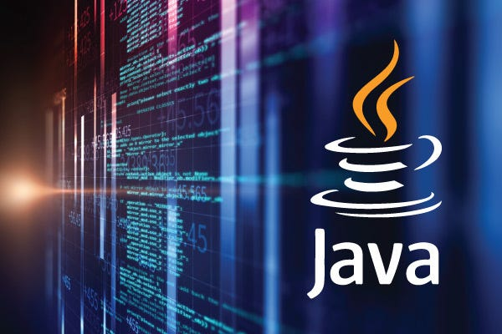
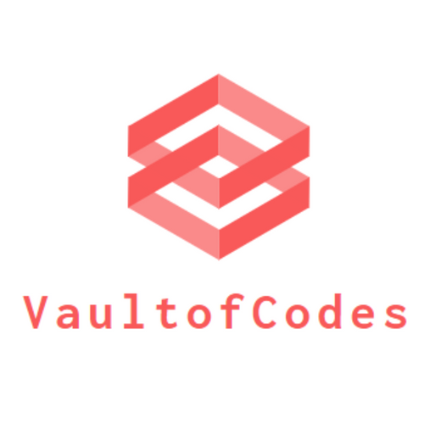
Exploring the World of Java
Welcome to an adventure where we will explore the world of Java.
Join me as we delve into its history and the beauty of object-oriented programming.
Kshitij Sharma, JAVA Programming Intern,
Vault of Codes

Slide 2
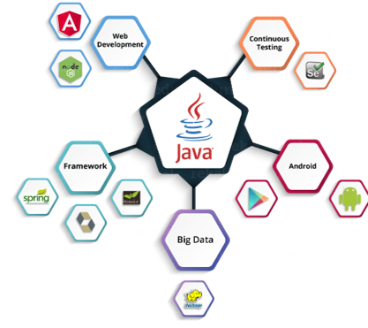
Introduction to Java
What is Java?
Java is a high-level, object-oriented programming language that runs on various platforms, including Windows and Linux.
Why use Java?
Java is highly portable and can run on any platform, making it a popular choice for developing dynamic web applications and enterprise software.
Who uses Java?
Java is used in a wide range of spheres, from mobile development to game design and finance.

Slide 3

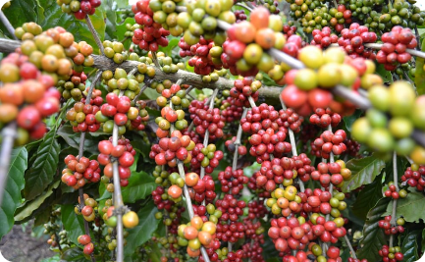
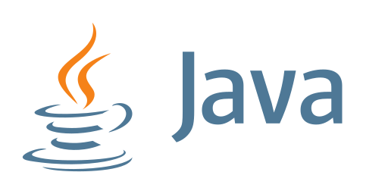
History of Java
Development of Java
Naming Java
Java Today
Java was developed by James Gosling at Sun Microsystems in 1995. Gosling wanted to create a language to control consumer electronics.
Initially called Oak after the oak tree outside Gosling's office, it was later renamed Java after coffee and island traditions.
Today, Java is still one of the most widely used programming languages, powering billions of devices and applications around the globe.

Slide 4
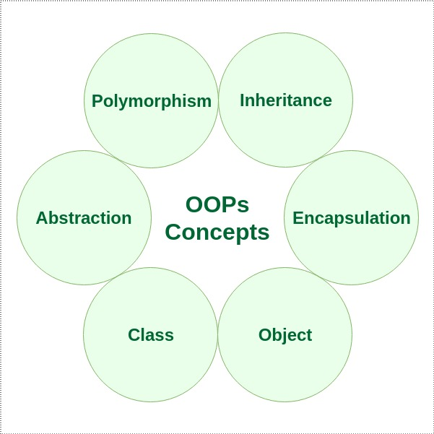
OOPs in Java
1
Polymorphism
Polymorphism allows objects to take on many forms, and in Java, it is achieved through overriding and overloading.
2
Inheritance
Inheritance helps to reduce code redundancy by allowing subclasses to inherit the properties and methods of a superclass.
3
Encapsulation
Encapsulation helps to restrict access to an object's properties and methods, protecting it from unauthorized access or modification.

Slide 5
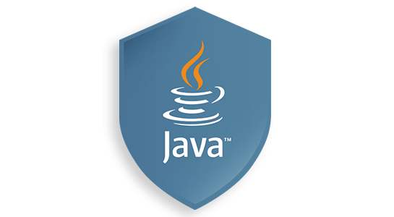
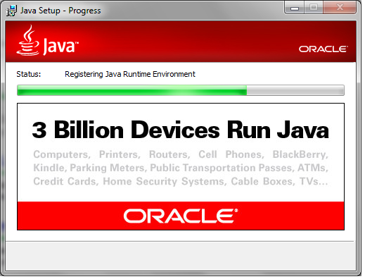
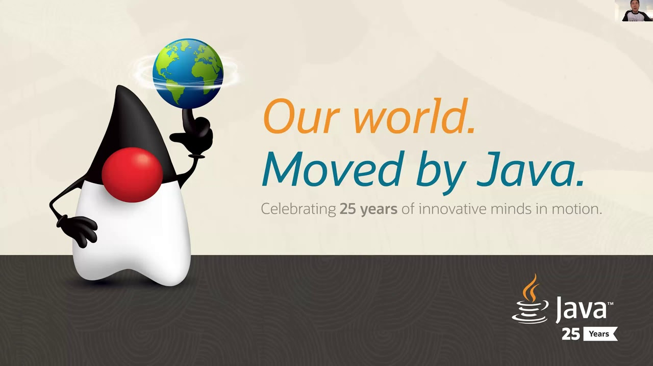
Conclusion
Java in Daily Life
Keep exploring the Java World!
Java is all around us, powering ATMs, medical devices, and even our morning coffee machine. Its versatility and reliability make it an essential language in today's world.
Java is an ever-evolving programming language, and there is always something new to learn or create. Get out there and discover what Java has to offer!

