Slide 1
PECATHON 2026 • TEAM PF-K96JPZ
Tsukuyomi Watch
The Samurai’s Celestial Guide
Plan the night.
Read the sky.
Inspect the image.
Weather + cosmic events + conservative local AI
in one Japanese-inspired observing workflow.
tsukuyomi-watch.vercel.app
LIVE DEMO + VERIFIED TEST EVIDENCE
TSUKUYOMI WATCH / PS-002
01
Notes:
Opening, 15 seconds. We built Tsukuyomi Watch for PS-002. A user should be able to choose a place and night, understand what is observable, then inspect a space image without pretending the AI knows missing details. Team PF-K96JPZ. Public URL: https://tsukuyomi-watch.vercel.app. Repo: https://github.com/PECathon-2026/Team-PF-K96JPZ. Readiness audit: 30 October 2026 IST, app source commit 8e07eb7. This deck distinguishes implemented behavior from estimates and deployment prerequisites.

Slide 2
PROBLEM UNDERSTANDING • 15 MARKS
A clear night is a decision problem
A beginner must combine fragmented information before an observing trip.
01 / WHERE
02 / WHEN
03 / WHAT
Will the sky be usable?
What can I observe?
Can I trust the image?
Clouds, humidity and visibility change by place and time. A map alone cannot rank an observing night.
Moon phases, launches, eclipses, meteor windows and visible ISS segments come from different sources.
Noise and blur hide faint structure. Cleanup must stay inspectable and avoid invented object identities.
Primary users: student astronomy clubs, first-time observers and hobby astrophotographers.
TSUKUYOMI WATCH / PS-002
02
Notes:
20 seconds. Explain the problem as three connected decisions, not just a feature checklist. Users currently assemble weather, event schedules and image tools themselves. The culturally themed interface is the narrative layer; the functional goal is more informed planning and inspectable restoration. Do not claim measured user research or adoption: these are intended user groups. PS-002 also asks for a before/after visualization and bonus analysis, archive retrieval and gamification.

Slide 3
SOLUTION WALKTHROUGH
One observing journey, four connected views
The core PS-002 modules are implemented; the interface also includes optional bonus tools.
01 / WATCHTOWER
02 / CELESTIAL SCROLL
03 / SPIRIT LENS
04 / DOJO / VIEWER
Choose a place
Choose a moment
Restore carefully
Inspect and record
→
→
→
Search the scroll map.
Compare nighttime forecasts.
Filter cosmic events.
Read the lunar calendar.
Run local AI denoising.
Inspect object candidates.
Compare, zoom and export.
Log an observation.
BONUS: archival SkyView import • CSV signal screening • local Honor Points
TSUKUYOMI WATCH / PS-002
03
Notes:
25 seconds. Walk the actual user flow. Watchtower and Scroll live on the main dashboard; event details stay inside the app. Spirit Lens contains the before/after Dojo visualization. /dojo is the separate device-local observation journal, not the name of the AI pipeline. /analysis contains light-curve and spectral CSV screening. The SkyView feature retrieves archival survey images on demand; it is not a live telescope feed.

Slide 4
INNOVATION • 15 MARKS
The contribution is the observing workflow
We combine established science and AI tools with explicit provenance and a distinctive interface.
CONNECTED PLANNING
INSPECTABLE AI
CULTURAL INTERACTION
Place → time → image
Local and bounded
A celestial scroll
Weather ranking, lunar navigation, event details, alerts and inspection are available in one application.
A browser worker runs DnCNN. Conservative edits, object overlays and downloadable measurements support review.
Ink Wash, Torii, Sakura and Katana palettes; light/dark mode; moon cues; English meanings for Japanese labels.
Originality claim: integration and experience. DnCNN, SGP4 and astronomical algorithms are established methods.
TSUKUYOMI WATCH / PS-002
04
Notes:
20 seconds. Be precise about novelty. We did not invent DnCNN, SGP4, a new astronomical catalogue or the Japanese lunar calendar. Our innovation is an integrated observing workflow, local and auditable processing, and a Japanese-inspired interaction system. Four palettes and shared light/dark mode are implemented across feature pages, with translations and reduced-motion styles. Code: apps/web/providers/palette.tsx, components/japanese-text.tsx, shared theme artwork and CSS.

Slide 5
SYSTEM DESIGN • 20 MARKS
Typed boundaries, separated responsibilities
Image pixels stay in the browser; planning data and alert jobs use the backend.
Next.js / React UI
Express + tRPC API
Drizzle → Neon PostgreSQL
Map • calendar • event pages
React Query + typed tRPC client
Zod validation • domain services
Provider adapters + bounded caches
Places • weather • event feeds
Device subscriptions + alert jobs
Browser worker / ONNX WASM
External provider adapters
Push delivery pipeline
Validate image → DnCNN → bounded blend
Optional deblur → metrics → overlays
Open-Meteo • USNO • Launch Library
CelesTrak • NASA SkyView¹
Minute scheduler → claimed DB jobs
Web Push → browser service worker
¹ SkyView uses a fixed-host Next.js server route. Vercel frontend • Render API • Neon database.
TSUKUYOMI WATCH / PS-002
05
Notes:
45 seconds. Follow one request: React Query calls the typed tRPC client through the web app’s same-origin API proxy, Express routes validate input with Zod, service functions own provider calls and business rules, and Drizzle accesses Neon PostgreSQL. Weather writes weather + score in a transaction; celestial feed membership supports caching and upserts by provider ID. Static type sharing reduces drift; runtime validation still handles untrusted inputs. NASA SkyView is a separate fixed-host server route in Next.js. Images selected from the user device are decoded and processed locally in an isolated worker using ONNX WASM, not sent to the API. Model assets are SHA-256 verified. VAPID private keys and database credentials are server-only. A configured recurring scheduler is necessary for push delivery. Files: apps/api/src/server.ts; packages/trpc/server/routes; packages/services; packages/database/models; apps/web/lib/spirit-lens/spirit-lens.worker.ts.

Slide 6
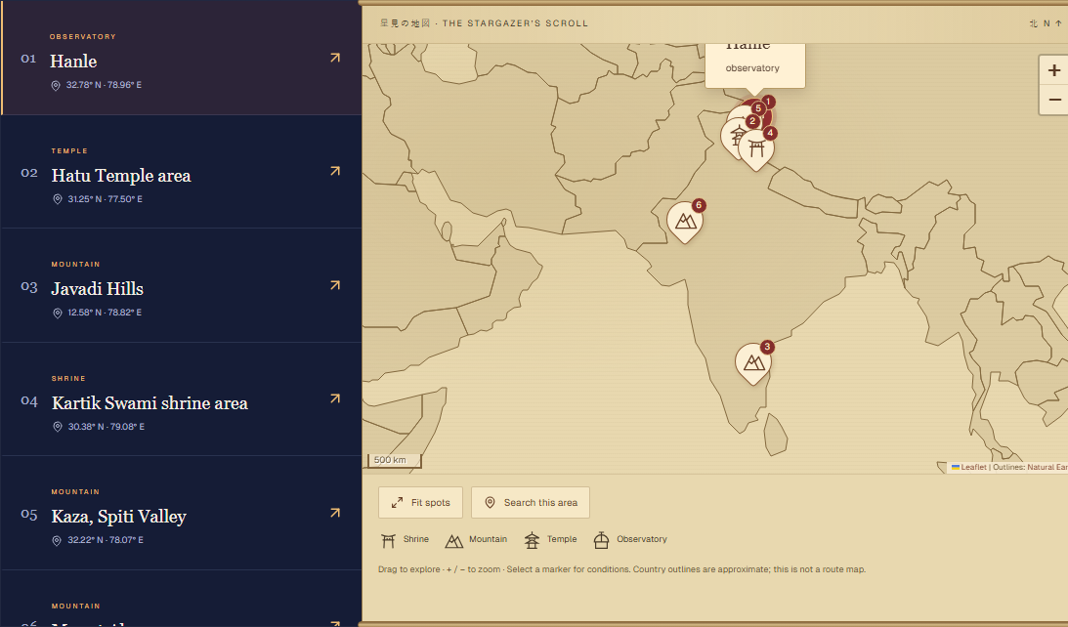
WATCHTOWER • LIVE APPLICATION SCREENSHOT
A scroll map backed by nighttime forecasts
Search a place or map area, select a marker and compare the next available nighttime conditions.
•
Open-Meteo cloud cover, humidity and visibility.
•
Night Honor Score: transparent weather-only ranking.
•
Shrine, mountain, temple and observatory markers.
•
Six curated Indian destinations today.
TSUKUYOMI WATCH / PS-002
06
Notes:
25 seconds. This screenshot was captured from production on 30 October 2026 IST, not a design mockup. The catalogue contains six curated Indian destinations. Search and map-area lookup do not mean a global destination discovery database. Nearby selection uses Haversine distance; conditions are ranked by the weather score. The forecast chooses the next future provider-night hour, not a past or daytime estimate. It is forecast data, not a real-time sensor feed. Score normalizes weights 40 cloud, 20 visibility, 15 humidity; visibility caps at 20 km. It currently excludes light pollution and moonlight. Explain these limits before claiming the best possible astronomical site. Code: packages/services/watchtower/weather.ts and index.ts.

Slide 7
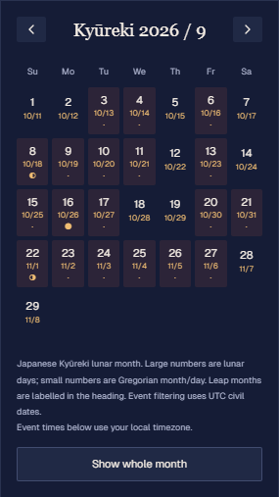
CELESTIAL SCROLL • LIVE APPLICATION SCREENSHOT
Time-aware events, with uncertainty visible
A Japanese Kyūreki month view includes lunar leap months and Gregorian dates.
•
Moon phases, launches, eclipses and meteor windows.
•
Visible ISS segments use fresh orbital elements.
•
Internal event details and calendar export.
•
Moonrise reminders and optional browser push.
TSUKUYOMI WATCH / PS-002
07
Notes:
25 seconds. Kyureki supports real 29/30-day Japanese lunisolar months and explicit leap months via himekuri; event filtering uses UTC dates. USNO phases retain UTC instants. Launch dates can change. Astronomy Engine eclipse events describe global maxima, not local visibility or contacts. Meteor events are approximate annual windows with ±1 day labels and a noon UTC placeholder, not a precision annual peak. ISS is a separate panel for the selected site: SGP4, fresh CelesTrak TLE, elevation at least 10 degrees, observer Sun below minus 6 degrees, fully sunlit segments, 20-second sampling over three days. Stale or malformed TLE does not generate fake passes. Push is implemented but needs credentials, HTTPS, permissions and a running minute scheduler.

Slide 8
SPIRIT LENS • AI RESTORATION
Conservative cleanup with an audit trail
DnCNN denoises a preview locally; users retain control over every result.
VALIDATE
NORMALIZE
RESTORE
CONSTRAIN
INSPECT
PNG / JPEG / WebP
12 MB • 24 MP cap
→
RGB preview
Longest edge ≤768px
→
Verified DnCNN
256px tiled inference
→
Bounded luminance
Protect source regions
→
Compare + zoom
PNG / JSON export
OPTIONAL DEBLUR
SCIENTIFIC LIMIT
Six Richardson–Lucy iterations
Bounded edits reduce risk. They cannot guarantee
that every faint feature remains unchanged.
User-selected Gaussian PSF; wrong settings can cause ringing.
TSUKUYOMI WATCH / PS-002
08
Notes:
35 seconds. The model is pretrained DnCNN sigma25, using luminance in a browser worker. Assets are hash-verified before inference. Tiles are 256 with a 17px halo. Gentle mode blends 25 percent with a max channel change of 6/255; Balanced uses 45 percent and 12/255. Detected source regions and color/alpha relationships are protected, with local extrema constraints. Optional deblur is conventional Richardson–Lucy, six iterations and an assumed Gaussian PSF 0.5–2px. Do not say no hallucination is mathematically guaranteed: the safeguards limit edits but faint source preservation needs a domain benchmark. Sixteen-bit PNG and FITS/RAW are not supported. The app restores bounded RGB previews, not full-resolution scientific data. Files: lib/spirit-lens/model.ts, image.ts, analysis.ts, deblur.ts and spirit-lens.worker.ts.

Slide 9
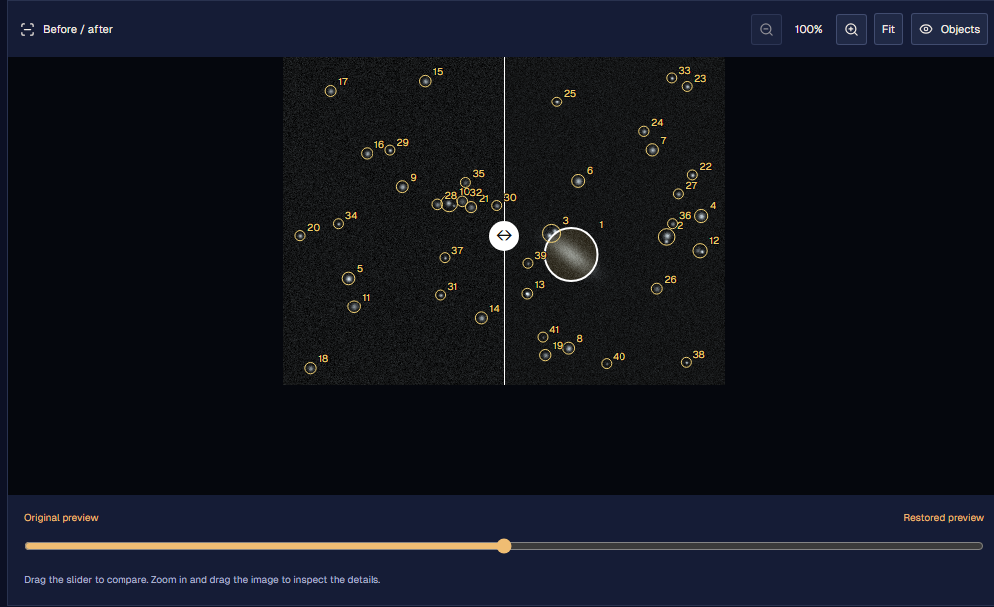
DOJO VISUALIZATION • ACTUAL BROWSER RESULT
Compare pixels, not promises
Synthetic demo fixture • 444 × 330 pixels • Gentle mode • one production browser run
15.8 s
41
This browser run
Object candidates
8.6 → 6.5
6 / 255
Estimated noise
Max channel edit
SSIM 0.975 compares output with noisy input. It does not prove clean-image accuracy.
TSUKUYOMI WATCH / PS-002
09
Notes:
25 seconds. Fresh production run captured 2026-10-29T23:39:26Z, which is 30 October IST. This source is explicitly synthetic, not a telescope photograph and not an independent science benchmark. Result: 15.8 seconds on this browser/device, 41 candidates, input similarity SSIM 0.975, PSNR 41.6 dB, estimated noise 8.6 to 6.5, max channel edit 6/255. The time is not a hardware-independent performance claim; SSIM and PSNR compare against the noisy input, not known clean ground truth. The interactive UI supports the slider, zoom, pan and candidate overlays. Objects are detected on the original preview. Galaxy labels are tentative morphology candidates; brightness is uncalibrated pixel data, not astronomical magnitude or catalogue identity. Evidence: assets/live-evidence.json.

Slide 10
TEST CASES • 20 MARKS
28 automated tests pass across 8 files
Fresh audit run: 30 October 2026 IST • 28 passed • 0 failed • no coverage percentage claimed
AREA
TESTS
EDGE CASE EVIDENCE
Weather + distance
4
Score bounds; missing night data; date-line crossing
Moon + reminders
3
Polar null rise/set; UTC and observer timezone
Event providers / export
4
Leap February; source IDs; ICS injection / Unicode
Eclipses / lunar / ISS
5
Known eclipse; leap lunar month; invalid orbital data
Push security
2
SSRF endpoint rejection; invalid scheduler credentials
Lens analysis / deblur
6
RGB/alpha bounds; flat sky; image limits; blur fixture
Signals + Honor
4
Zero scatter; bad CSV; duplicate / future observations
Production builds: Next.js frontend PASS • tsup API PASS
TSUKUYOMI WATCH / PS-002
10
Notes:
35 seconds. Tests and architecture carry 40 marks, so show evidence, not just a screenshot of a green check. The transcript is docs/presentation/test-results.txt. Node’s test runner executes 28 tests from eight TypeScript files using tsx. The seven displayed areas combine the five Lens analysis tests and one deblur test. Tests include boundary values, malformed external data, dates and timezones, injection and push credential rejection, scientific fixtures and invalid observations. The fresh frontend optimized build and API tsup build also pass. Existing PostgreSQL device-ownership integration had been run earlier; it is separate and was not rerun in this audit. No measured line coverage or load-test claim. See the appendix and READINESS.md for the exact command and remaining test gaps.

Slide 11
IMPACT AND FEASIBILITY • 15 MARKS
A useful student-scale platform, live today
Deployed on Vercel + Render + Neon, with public APIs and browser-side inference.
USER VALUE
PRACTICAL DELIVERY
VALIDATE NEXT
Fewer disconnected steps
A working public demo
Measure real benefit
Compare places, plan around events and inspect a restored image without switching between separate tools.
Local AI avoids an inference server. Provider adapters, caching and bounded inputs keep the prototype feasible.
Pilot with an astronomy club. Measure planning time, successful observing trips and faint-source preservation.
No fabricated adoption or accuracy claims. Free hosting can sleep; third-party APIs can be unavailable.
TSUKUYOMI WATCH / PS-002
11
Notes:
20 seconds. The live platform shows technical feasibility at prototype scale. Intended users are students, clubs and hobbyists. We have not measured improved observing success, scientific accuracy, retention, cost per user or load capacity. The browser model avoids a hosted GPU service, but execution time depends on hardware and image size. Current free demo hosting can sleep and external providers have quotas and outages; commercial production would require reliability and capacity planning. Geography is limited by the six-place catalogue. Validate with a club pilot and a labelled astronomy benchmark before broad claims. No need to quote current vendor pricing in the presentation.

Slide 12
READINESS AUDIT • 100-MARK RUBRIC
Ready for a controlled hackathon demonstration
The implementation is substantial; a maximum score or production-grade reliability is not established.
CRITERION
MARKS
ASSESSMENT / PREPARATION
Innovation
15
Strong integration story; distinguish it from new research.
System design / code
20
Clear layers and typed contracts; rehearse a request trace.
Problem understanding
15
All four core modules; explain estimates and source limits.
Test cases
20
28 passing tests; CI, device push and broader E2E remain.
Impact / feasibility
15
Live prototype; club pilot and scale evidence remain.
Presentation
15
Editable deck, demo script and screenshot fallback ready.
Before judging: warm the API, rehearse the demo, keep local image/CSV inputs and explain push honestly.
TSUKUYOMI WATCH / PS-002
12
Notes:
25 seconds. This is a candid internal readiness assessment, not a predicted judging score. All rubric categories have a concrete story, but code knowledge is demonstrated by the team answering questions and test marks depend on evidence beyond a count. The app is ready for a controlled demonstration with its known constraints. It is not certified for always-on production, confirmed astronomical classification or full-resolution science processing. The most material missing evidence is automated CI and broad E2E, a physical closed-app push receipt using a running production scheduler, a larger astronomy benchmark, and user impact validation.

Slide 13
PRESENTATION • 15 MARKS
A five-minute demo with a reliable fallback
Open the public URL before the pitch and keep the screenshot deck available.
0:00–0:30
Problem + promise
Choose a place, a moment and a trustworthy image workflow.
0:30–1:20
Watchtower + Scroll
Search / select a spot, inspect conditions, open an event.
1:20–2:30
Spirit Lens
Use the labelled demo, restore, drag slider, zoom and inspect.
2:30–3:10
Bonus tools
Show archive import, a synthetic CSV result and Honor journal.
3:10–4:20
Architecture + tests
Trace one request and show the 28-test evidence.
4:20–5:00
Impact + limits
Explain the pilot plan, provider uncertainty and push setup.
TSUKUYOMI WATCH / PS-002
13
Notes:
This slide is a presenter rehearsal plan; skip it during a short live pitch if it breaks the flow. A detailed script is in DEMO_GUIDE.md. Preload the homepage and Spirit Lens so free-tier startup and model downloads happen before judging. Start with a synthetic fixture that is visibly labelled, and keep a permitted local space image ready. Do not rely on NASA availability, device geolocation or a future moonrise happening during the demo. If a provider fails, show the actual error handling and the previously captured screenshot. Never claim a notification has arrived if you only scheduled it. Speaker division: one person handles user flow, one architecture/testing, one impact and Q&A; adapt to actual team size.

Slide 14
APPENDIX A • CODEBASE KNOWLEDGE
Know where every responsibility lives
Use these paths to move from a judge’s question to the implementation.
UI + feature pages
apps/web/app; apps/web/components
Typed API contracts
packages/trpc/server/routes; apps/api/src/server.ts
Weather / ranking / moon
packages/services/watchtower
Events / Kyūreki / ISS
packages/services/celestial
Persistent data / migrations
packages/database/models; packages/database/drizzle
AI / object analysis / deblur
apps/web/lib/spirit-lens
Signals + local Honor
apps/web/lib/transient-analysis.ts; honor-journal.ts
Push delivery / scheduler
packages/services/alerts; ops/push-cron.mjs
TSUKUYOMI WATCH / PS-002
14
Notes:
Appendix for questions. Request trace example: Watchtower client → packages/trpc/server/routes/watchtower/route.ts → packages/services/watchtower/index.ts → weather.ts provider adapter → packages/database/models/watchtower.ts. Event feed caching is in packages/services/celestial/index.ts; eclipse and meteor generation in calculated.ts; SGP4 passes in iss.ts. Push ownership and delivery are in services/alerts/index.ts and database/models/push.ts. AI worker validates requests, verifies model files, performs tiled inference, then produces metrics and candidates. There are database foundation tables for user accounts and Honor, but current journal behavior is local; do not imply the existence of full authentication or cloud sync.

Slide 15
APPENDIX B • DEFENSIBLE CALCULATIONS
Explain assumptions before giving a score
Night Honor Score is a weather heuristic, not a scientific observability guarantee.
Score = round{100 × [40(1 − C/100) + 20 min(V/20, 1) + 15(1 − H/100)] / 75}
C = cloud cover % V = visibility in km H = relative humidity %
•
Bounds: 0–100; visibility gets full credit at 20 km.
•
Forecast uses the next future provider-night hour; null values are rejected.
•
Moon illumination and light pollution are currently excluded.
•
Meteor windows are approximate; eclipse maxima are global; ISS passes are predictions.
TSUKUYOMI WATCH / PS-002
15
Notes:
Worked example: C=50, V=10 km, H=50 yields components 20 + 10 + 7.5 = 37.5. Divide by 75 and multiply by 100: 50. C=0, H=0 and V at least 20 gives 100; C=100, H=100 and V=0 gives 0. Inputs are validated before calculation. This is not a trained model and there is no measured prediction accuracy. Cloud/humidity/visibility do not account for seeing, atmospheric transparency, local obstructions, moonlight or light pollution. A future score should add calibrated darkness and moon effects with validation. Tests: packages/services/watchtower/weather.test.ts.

Slide 16
APPENDIX C • TEST DEPTH AND REMAINING WORK
What the evidence proves — and what remains
Passing tests establish selected behaviors; they do not establish exhaustive coverage.
VERIFIED IN THIS AUDIT
PRIORITY NEXT
Repeatable evidence
Close the evidence gaps
28 / 28 automated test cases pass.
Frontend and API builds pass.
Production map and calendar render.
Browser AI completes with exported metrics.
CI for tests and builds.
Permission / offline / mobile E2E.
Physical closed-app push receipt.
Real astronomy and load benchmarks.
Earlier PostgreSQL ownership integration is separate evidence; it was not rerun in this audit.
TSUKUYOMI WATCH / PS-002
16
Notes:
The 28 are test cases; many cases contain several assertions. The suite is mostly pure logic and provider parsing with fixtures, not a full live integration suite. Database ownership integration exists separately and had passed earlier using dummy subscriptions without delivery, but was not rerun here. Current browser proof covers map/calendar rendering and a synthetic AI restoration plus analysis screenshot. There is no measured line/branch coverage and no verified CI workflow. Follow-up E2E should cover provider outage, empty data, disabled geolocation, denied notification permission, offline state, concurrent alert claims, device deletion and download/export behavior. Scientific validation needs clean/noisy pairs and source photometry preservation, not just similarity to noisy input.

Slide 17
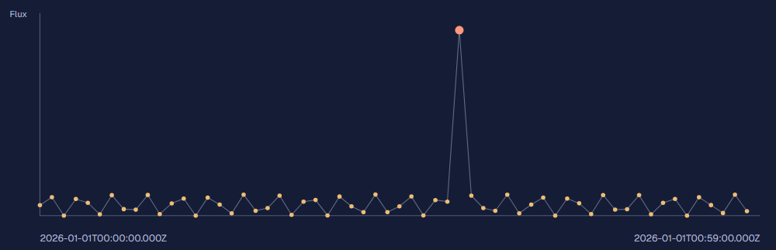
APPENDIX D • BONUS CHALLENGES AND HONEST SCOPE
Useful extras, with explicit boundaries
These features are implemented as prototype tools, not confirmed scientific discovery services.
•
SkyView: on-demand archival survey JPEGs, not live telescope video.
•
Signals: CSV median / MAD screening, not confirmed transient discovery.
•
Honor: 25 points per unique observation, stored on this device.
Synthetic light-curve screening output
•
Push: persistent jobs exist; closed-app delivery needs an active scheduler.
NEXT: more destinations • calibrated validation • authenticated sync • reliable scheduling
TSUKUYOMI WATCH / PS-002
17
Notes:
NASA SkyView accepts a validated target, DSS/2MASS-J/GALEX Near UV survey and bounded field width, retrieves a 512px archival display JPEG through a fixed-host server route, and preserves query provenance. It may return overload errors; the UI reports them. Signal Observatory accepts CSV up to 1 MB and 12–2000 rows. Time-domain median/MAD screening and spectral local-median residuals flag unusual values; uncertainties combine in quadrature. These are heuristic candidates, not formal discovery significance, and a spectrum alone cannot establish time variability. Honor is device-local, user-editable and self-reported, with no synced accounts or public leaderboard. Push uses hashed bearer ownership and endpoint allowlists, leases and up to three attempts, but browser power policy and a missing production scheduler can prevent timely delivery. Safari endpoint support is not enabled. Use calendar export as the demo fallback.

