Slide 1


SMART INDIA HACKATHON 2026
SMART INDIA
HACKATHON
2026
TITLE PAGE
Problem Statement ID – SIH26159
Problem Statement Title – SecureMailScope: AI-Assisted Cryptographic Security Posture Assessment for Secure Email Communications
Theme – Blockchain & Cybersecurity
PS Category – Software
Team ID – [Enter Team ID]
Team Name – [Enter Team Name]
Notes:
Title page in the official SIH idea-submission format. Replace [Enter Team ID] and [Enter Team Name] here, and the team name once in View > Slide Master (the oval at the top-left of every slide). Problem statement details are as published for SIH 2026 (NTRO, Blockchain & Cybersecurity, Software).

Slide 2
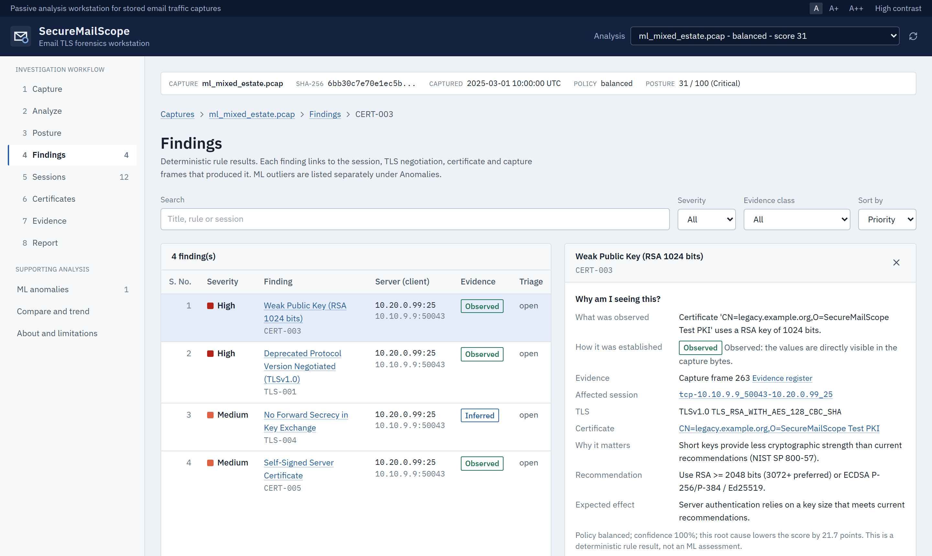
SecureMailScope
Passive email-security forensics workstation for SMTP · IMAP · POP3 captures
The Problem
Mail servers still negotiate obsolete TLS 1.0/1.1, weak ciphers and expired or self-signed certificates.
STARTTLS can be refused or stripped, so mail and passwords travel in plaintext.
Packet tools decode traffic but do not assess posture; active scanners must contact live servers and cannot analyse a capture.
Proposed Solution
Upload a PCAP: TCP streams reassembled, SMTP/IMAP/POP3 identified, STARTTLS/TLS and X.509 analysed.
19 deterministic rules grade each session with an evidence class and the exact capture frame.
Posture score 0-100 with prioritised remediation; Isolation Forest ranks sessions weaker than the capture norm.
14-section forensic report (JSON/HTML/PDF), redacted mode, evidence bundle and STIX 2.1.
Working prototype: finding with its evidence and remediation
Uniqueness & Innovation
PCAP
Sessions
TLS +
X.509
Rules
Score
Report
100% passive: never contacts a mail server and never decrypts traffic.
Evidence chain: every finding traced to session, TLS, certificate and packet frame.
Explainable & honest: 'Why am I seeing this?'; TLS 1.3 certificates marked NOT OBSERVABLE.
Analyst workflow: 8 steps, policy profiles, before/after compare, notes, trend.
WORKING PROTOTYPE BUILT AND TESTED
414 automated tests · 112/112 browser checks · 0 accessibility (axe) violations
Notes:
Problem: email TLS is often misconfigured, and existing tools either decode packets without judging security or actively scan live servers. Our idea: a passive, capture-based workstation that turns a PCAP into a prioritised, evidence-backed security assessment. The screenshot is the working prototype (finding CERT-003 on a lab capture).

Slide 3













TECHNICAL APPROACH
System Architecture (passive analysis pipeline)
Languages, Frameworks & Libraries
PCAP / PCAPNG
SHA-256, streamed, size-capped
TCP reassembly
order, gaps, overlaps
Protocol ID
SMTP · IMAP · POP3
STARTTLS / STLS
state machine
Python
FastAPI
SQLAlchemy
SQLite
Posture scoring
0-100, 5 dimensions
Rule engine
19 rules, evidence class, frames
X.509 analyser
validity, key, signature, chain
TLS handshake parser
version, suite, key exchange, PFS
scikit-learn
NumPy
Pydantic
Jinja2
React
TypeScript
Vite
Tailwind
Canonical evidence document
capture SHA-256 · frames · policy profile · timeline
ML: Isolation Forest v2
ranks sessions weaker than the capture norm (supplementary)
Packet & crypto: dpkt, cryptography (X.509), IANA cipher registry
Reports: ReportLab (PDF), STIX 2.1 (stix2)
Dashboard
React
REST API
FastAPI
Reports
JSON/HTML/PDF
Bundle + STIX
SHA-256 manifest
Testing & Validation Tools
Tests: pytest, Hypothesis fuzzing, Playwright browser checks
Real mail lab: Mailpit, aiosmtpd, pymap (IMAP) servers
Public captures: Wireshark wiki (Dovecot IMAP/POP3, SMTP)
Analyst workflow (8 connected steps)
1
Capture
2
Analyze
3
Posture
4
Findings
5
Sessions
6
Certificates
7
Evidence
8
Report
Notes:
Pipeline: capture ingestion and TCP reassembly, protocol identification, STARTTLS state tracking, TLS handshake and X.509 analysis, 19 deterministic rules, posture scoring, and a supplementary Isolation Forest. Everything is stored as one canonical evidence document that feeds the dashboard, the REST API, the three report formats, the evidence bundle and STIX. The analyst works through 8 connected steps.

Slide 4


FEASIBILITY AND VIABILITY
Technical Feasibility: built and verified
414
15 + 5
1,000,000
112 / 112
automated tests passing
(unit, fuzz, API, reports)
real lab captures (SMTP, IMAP, POP3)
+ public Wireshark captures
packets (198.7 MB) analysed
end-to-end in about 4 minutes
browser checks on every control;
0 accessibility violations
Potential Challenges and Risks
Strategies for Overcoming These Challenges
TLS 1.3 encrypts server certificates
Report them as NOT OBSERVABLE; analyse TLS 1.2 and earlier certificates; never guess.
Hostile or malformed captures
Bounded parsers and resource limits; 13 Hypothesis fuzz properties; clean errors, no crashes.
No labelled real-world data for ML
Unsupervised, supplementary ranking; evaluated on 80 labelled lab sessions; rules stay primary.
Sensitive traffic (credentials, addresses)
Credentials never stored; redacted outputs; API bound to 127.0.0.1.
Very large captures
Streamed ingestion, 100 MB upload limit, batched ML scoring, capped PDF tables.
Viability
Runs on one analyst laptop (Windows / Linux), offline and air-gapped; open-source stack with no licence cost; deployable by CERT / SOC teams without touching production mail servers.
Notes:
Feasibility is demonstrated, not assumed: the prototype exists and is tested. Numbers come from the repository test suite, the lab and public captures, the performance benchmark (1,000,000 packets in 240 s end-to-end on a laptop) and the scripted browser walkthrough. Each known risk has a concrete mitigation already implemented.

Slide 5










IMPACT AND BENEFITS
IMPACT
BENEFITS
Stronger national email security
Government, banks and enterprises find weak TLS before attackers do.
Zero risk to production
Fully passive: no scanning, no decryption, no traffic generated.
Faster audits
PCAP to prioritised report in minutes: 1M packets in about 4 min on a laptop.
Works offline / air-gapped
Single-laptop deployment for sensitive environments.
Forensically defensible
Each finding cites capture frames and the capture SHA-256.
Explainable results
'Why am I seeing this?' with evidence, recommendation and effect.
Measurable remediation
Before / after compare: same server scored 0, then 100, in our lab.
Fits each organisation
Balanced, strict and legacy-audit policy profiles.
Privacy-preserving sharing
Redacted reports and STIX 2.1 observations for CERT exchange.
Low cost
Open-source stack; no licences or cloud services required.
Notes:
Impact is on the organisations whose mail infrastructure is assessed; benefits are for the analysts who use the tool. The 0 to 100 before/after result is from our controlled lab pair (same server address, legacy configuration then remediated), not a field deployment.

Slide 6
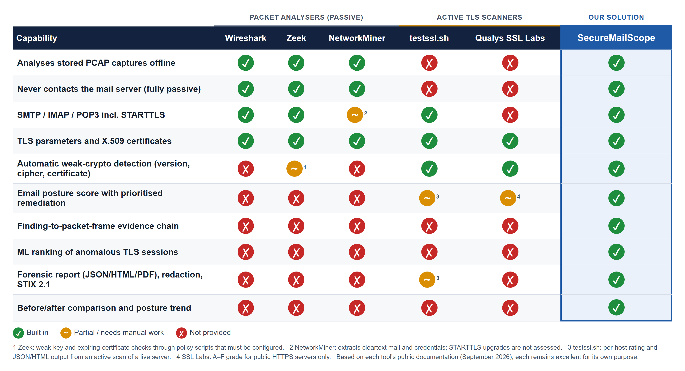



COMPARISON WITH EXISTING SOLUTIONS
Why SecureMailScope is better
Two worlds in one tool
Passive like packet analysers, judging posture like TLS scanners.
Evidence you can defend
Finding to session, certificate and packet frame, with capture hash.
Built for email
SMTP, IMAP, POP3 and STARTTLS end to end, incl. downgrade and plaintext login.
Honest, explainable ML
Ranks weaker-than-normal sessions; never claims attacks.
Existing tools either see the traffic or grade live servers. SecureMailScope does both from a stored capture, with evidence for every finding.
Notes:
Existing tools fall into two groups. Packet analysers (Wireshark, Zeek, NetworkMiner) are passive and decode mail protocols but do not grade cryptographic posture or produce evidence-linked findings. Active scanners (testssl.sh, Qualys SSL Labs) grade TLS but must connect to live servers and cannot analyse a stored capture; SSL Labs covers public HTTPS servers only. SecureMailScope combines passive capture analysis with posture assessment, evidence traceability and forensic reporting. Comparison based on each tool's public documentation; these tools remain excellent for their own purpose.

Slide 7

RESEARCH AND REFERENCES
Email and TLS standards
19
20
RFC 3207 - SMTP Service Extension for Secure SMTP over TLS (STARTTLS)
https://www.rfc-editor.org/rfc/rfc3207
RFC 2595 - Using TLS with IMAP, POP3 and ACAP
https://www.rfc-editor.org/rfc/rfc2595
RFC 8314 - Cleartext Considered Obsolete: TLS for Email Submission and Access
https://www.rfc-editor.org/rfc/rfc8314
RFC 8446 - TLS 1.3; RFC 8996 - Deprecating TLS 1.0 and TLS 1.1
https://www.rfc-editor.org/rfc/rfc8996
RFC 9325 (BCP 195) - Recommendations for Secure Use of TLS
https://www.rfc-editor.org/rfc/rfc9325
deterministic rules
real + public validation captures
414
14
Cryptographic guidance
automated tests
report sections
NIST SP 800-52 Rev. 2 - Guidelines for TLS Implementations
https://csrc.nist.gov/pubs/sp/800/52/r2/final
NIST SP 800-57 Part 1 Rev. 5 - Key Management (security strengths)
https://csrc.nist.gov/pubs/sp/800/57/pt1/r5/final
RFC 5280 - X.509 Certificate and CRL Profile
https://www.rfc-editor.org/rfc/rfc5280
Project resources
Source code & documentation
github.com/Kshitij1425/Secure-mail-protocol
ML, exchange formats and data
Liu, Ting & Zhou - Isolation Forest, IEEE ICDM 2008
https://doi.org/10.1109/ICDM.2008.17
OASIS STIX Version 2.1 (observations export)
https://docs.oasis-open.org/cti/stix/v2.1/stix-v2.1.html
Wireshark wiki Sample Captures (external validation)
https://wiki.wireshark.org/SampleCaptures
Problem statement: SIH26159 (NTRO), SIH 2026
Methodology, limitations and ML evaluation in the repository documentation
Notes:
Standards define what 'secure' means for email TLS (RFC 3207, 2595, 8314, 8996, 9325; NIST SP 800-52r2 and 800-57). The ML component follows the Isolation Forest paper. External validation uses public Wireshark sample captures. Stat tiles reflect the current repository state.

