Slide 1
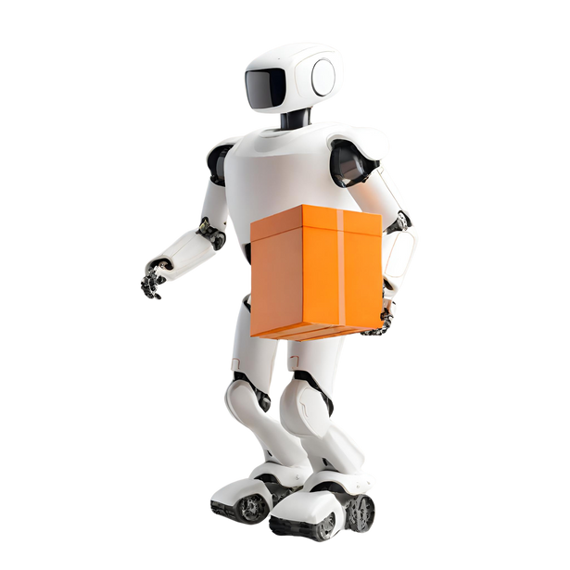


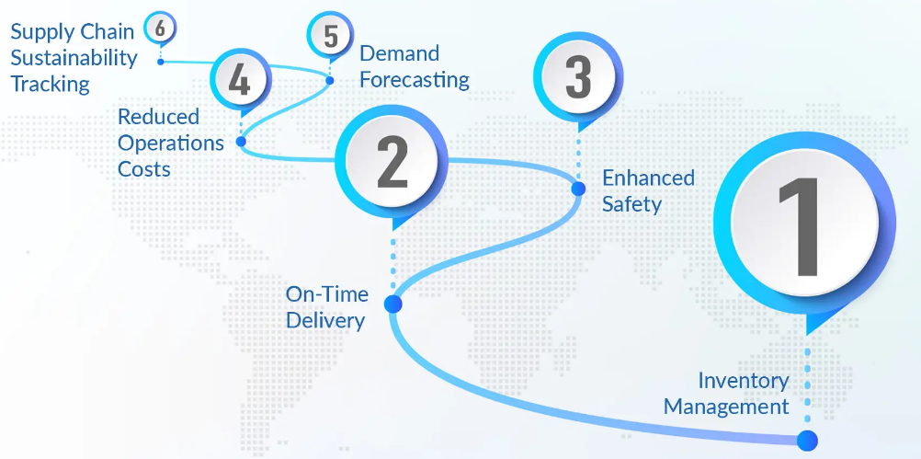

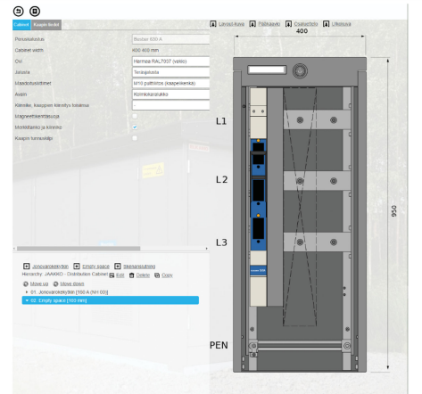

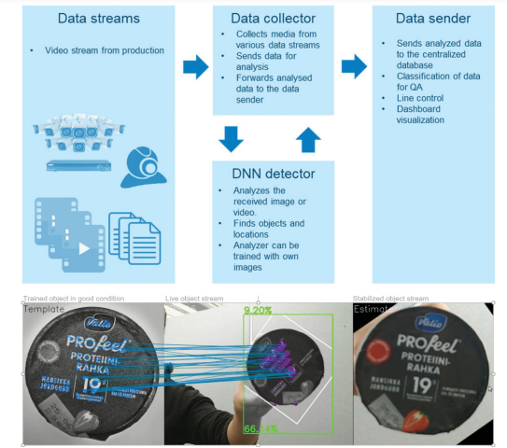

STUDENT NAME:KSHITIJ PANDEY
STUDENT ID:77324478
Impact of AI on supply chain integration
to accelerate innovation of new projects development
Overview
Literature Review
Research Outcome And Discussion
Conclusion
AI usage in supply chain management is transforming the procurement process of business corporations by utilising powerful data analysing tools, AI-driven technologies, and machine-learning algorithms that offer valuable insights to make smarter procurement decisions in organisations. The global spending on IIoT platforms predicted growth from $1.67 billion in 2018 to $12.44 billion in 2024, which is attaining a 40% compound annual growth rate in the last 7 years (Belhadi et al., 2024). Accelerating supply chain success with the generation of AI and logistics applications delivers powerful optimization capabilities required for the enhancement of accurate planning, capacity measurement, raising productivity, greater output, lower supply chain cost and improving demand forecasting for the new project development
With the advancement of technology there has been a revolution in different aspects of the supply chain management processes. Particularly in the case of the use of the artificial intelligence in the supply chain management that has been a transformation in which the procurement process, logistics and operations, warehouse management, relationship with the suppliers and customers and other aspects of SCM had been transformed suggestive of the innovation welcomed because of AI implementation. There has been growth in the investment on the IoT platform by artificial intelligence for the acceleration of the success and innovation in the supply chain with respect to the use of Advanced technology such as in logistic, warehouse and supply chain processes for the powerful optimisation of the existing capabilities, reducing the cause and increasing the overall efficiency.
Sales configuration is important part of the sales and distribution process and the sale configurated tools are used for maintaining fast communication between the production in the company and the customer interface (Toorajipour et al. 2021). The software packed is developed to store the key information of the products for which ERP is now being used for production, planning and scheduling (Helo and Hao, 2022). Based on the history of configuration there can be clustering of products and the information related to products is bundled to be used in the R&D process as noted in the configuration system shown below:
Kavadias and Ulrich (2020) state that effective innovation frameworks include the identification of needs and opportunities, the establishment of clear objectives, the promotion of cultural innovation, and the adoption of user-centric designs. Building upon this idea, Benitez et al. (2020) suggest that once an organization identifies its needs and opportunities, it is imperative to define clear objectives to maximize innovation outcomes in new project development.
This research had no ethical issues.
Ethical number - 127309
Ethical Considerations
Aim And Objectives
Aim The purpose of the research study is the investigate the impact of AI on supply chain integration to accelerate innovation of new project development. In the current era, Artificial Intelligence is becoming one revolutionary technology to make a huge impact on different sectors.
Critically investigate the mechanism through which AI impacts inventory management, warehouse management, supplier management and other key aspects
In-depth analysis of the different types of AI technologies which can accelerate innovation of new project development.
Examine the impact of AI on the Supply Chain Integration to accelerate different types of innovation in project development
The company in this case manufactures mobile machines used for construction sites. The machines have a planned system of schedule for maintenance and the basic maintenance service includes the activities that need to be completed by the authorized personal. Every service needs some spare parts and tools to complete the order. The company have invested in the IOT connecting the portal of manufacturing of the installed based in the initial phrase, raw information is collected and used in giving guidance to the customers and management of assets (Nahr et al. 2021). Later there is an addition of processing level capability to EDGE level to the machines. There is continuous monitoring of the machines by the IOT and because of that any signs of possible breakdown are alerted as early as possible. The anomaly events are characterized by local machine AI based on the training data. The machine AI sent messages to the centralized portal of manufacturers by identifying any possible area of failure (Patil et al. 2021). In case of condition based analysis service can also booked by the AI construction machines and the spare parts can be automatically delivered. In the case study by, Helo and Hao (2022), the figure below shows how local AI can be use video stream in the real time using trained data using machine vision:
Methodology
Acknowledgement
The researcher in this study employed an inductive approach, contrasting with deductive methods. Initially, data collection was conducted to gather relevant information for the study. Subsequently, a comprehensive analysis of the collected data was undertaken to identify patterns, with the aim of developing theory. This involved comparing the emerging patterns with existing research data to provide explanations (Okoli, 2023).
In terms of data collection strategy, qualitative research case studies were utilized. This method was chosen due to its suitability for social research, particularly in understanding the opinions and beliefs of individuals and companies involved in the implementation of AI, supply chain integration, and innovation projects. Through the case study approach, the researcher was able to leverage authoritative and relevant literature that pertains specifically to certain organizations and the research area (Priya, 2021).
I acknowledge my supervisor, Professor Mohammed Dulaimi.
Rationale
References
The rationale of the research paper highlights the need or essential to conduct research based on the topic development, here the researcher chose the impact of AI on supply chain integration to accelerate innovation of new projects development. As after the Covid-19 pandemic situation, people and companies are starting to be focusing more on the digital and innovative technological affections in every kind of projection. By learning regarding the measurement of the effectiveness of AI generative tools, adaptive in supply chain management helps the business corporations to select fair and accurate suppliers, hold the availability of projection by raising the networks in the supply chain that deliver multiple suppliers and reducing the cause of disruption in the logistics materials flow (Stute et al., 2021). V
Alharahsheh, H.H. and Pius, A., 2020. A review of key paradigms: Positivism VS interpretivism. Global Academic Journal of Humanities and Social Sciences, 2(3), pp.39-43. https://gajrc.com/media/articles/GAJHSS_23_39-43_VMGJbOK.pdf
Allal-Chérif, O., Simón-Moya, V. and Ballester, A.C.C., 2021. Intelligent purchasing: How artificial intelligence can redefine the purchasing function. Journal of Business Research, 124, pp.69-76. https://www.sciencedirect.com/science/rticle/abs/pii/S0148296320308031
Anica-Popa, I., Anica-Popa, L., Rădulescu, C. and Vrîncianu, M., 2021. The integration of artificial intelligence in retail: benefits, challenges and a dedicated conceptual framework. Amfiteatru Economic, 23(56), pp.120-136. https://www.econstor.eu/bitstream/10419/281563/1/1793800812.pdf
Annanth, V.K., Abinash, M. and Rao, L.B., 2021, July. Intelligent manufacturing in the context of industry 4.0: A case study of siemens industry. In Journal of Physics: Conference Series (Vol. 1969, No. 1, p. 012019). IOP Publishing. https://iopscience.iop.org/article/10.1088/1742-6596/1969/1/012019/pdf
Ashok, M., Madan, R., Joha, A. and Sivarajah, U., 2022. Ethical framework for Artificial Intelligence and Digital technologies. International Journal of Information Management, 62, p.102433. https://www.sciencedirect.com/science/article/abs/pii/S0268401221001262

