Slide 1
Chapter 13
Real-time Software Design

Slide 2
Real-time Software Design
Designing embedded software systems whose behaviour is subject to timing constraints

Slide 3
Objectives
To explain the concept of a real-time system and why these systems are usually implemented as concurrent processes
To describe a design process for real-time systems
To explain the role of a real-time executive
To introduce generic architectures for monitoring and control and data acquisition systems

Slide 4
Topics covered
Systems design
Real-time executives
Monitoring and control systems
Data acquisition systems

Slide 5
Real-time systems
Systems which monitor and control their
environment
Inevitably associated with hardware devices
  Sensors: Collect data from the system environment
  Actuators: Change (in some way) the system's
  environment
Time is critical. Real-time systems MUST
respond within specified times

Slide 6
Definition
A real-time system is a software system where the correct functioning of the system depends on the results produced by the system and the time at which these results are produced
A ‘soft’ real-time system is a system whose operation is degraded if results are not produced according to the specified timing requirements
A ‘hard’ real-time system is a system whose operation is incorrect if results are not produced according to the timing specification

Slide 7
Stimulus/Response Systems
Given a stimulus, the system must produce a
response within a specified time
Periodic stimuli. Stimuli which occur at
predictable time intervals
  For example, a temperature sensor may be polled 10 times
  per second
Aperiodic stimuli. Stimuli which occur at
unpredictable times
  For example, a system power failure may trigger an
  interrupt which must be processed by the system

Slide 8
Architectural considerations
Because of the need to respond to timing demands made by different stimuli/responses, the system architecture must allow for fast switching between stimulus handlers
Timing demands of different stimuli are different so a simple sequential loop is not usually adequate
Real-time systems are usually designed as cooperating processes with a real-time executive controlling these processes

Slide 9
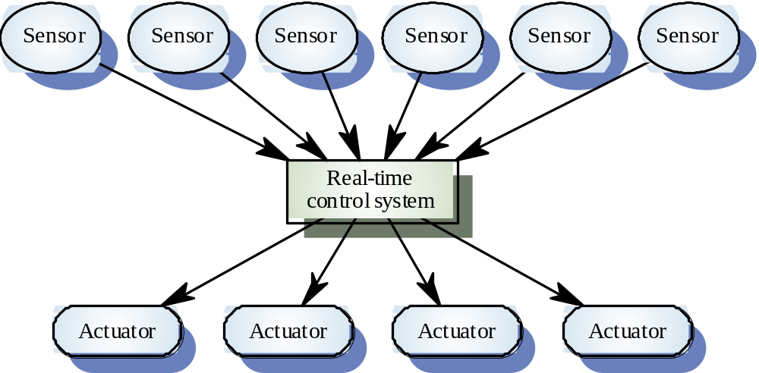
A real-time system model

Slide 10
System elements
Sensors control processes
  Collect information from sensors. May buffer information collected in response to a sensor stimulus
Data processor
  Carries out processing of collected information and computes the system response
Actuator control
  Generates control signals for the actuator

Slide 11
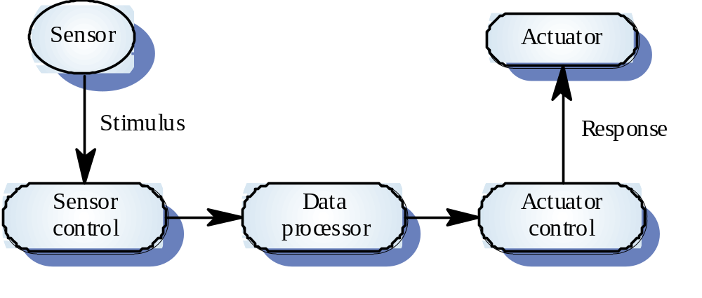
Sensor/actuator processes

Slide 12
System design
Design both the hardware and the software associated with system. Partition functions to either hardware or software
Design decisions should be made on the basis on non-functional system requirements
Hardware delivers better performance but potentially longer development and less scope for change

Slide 13
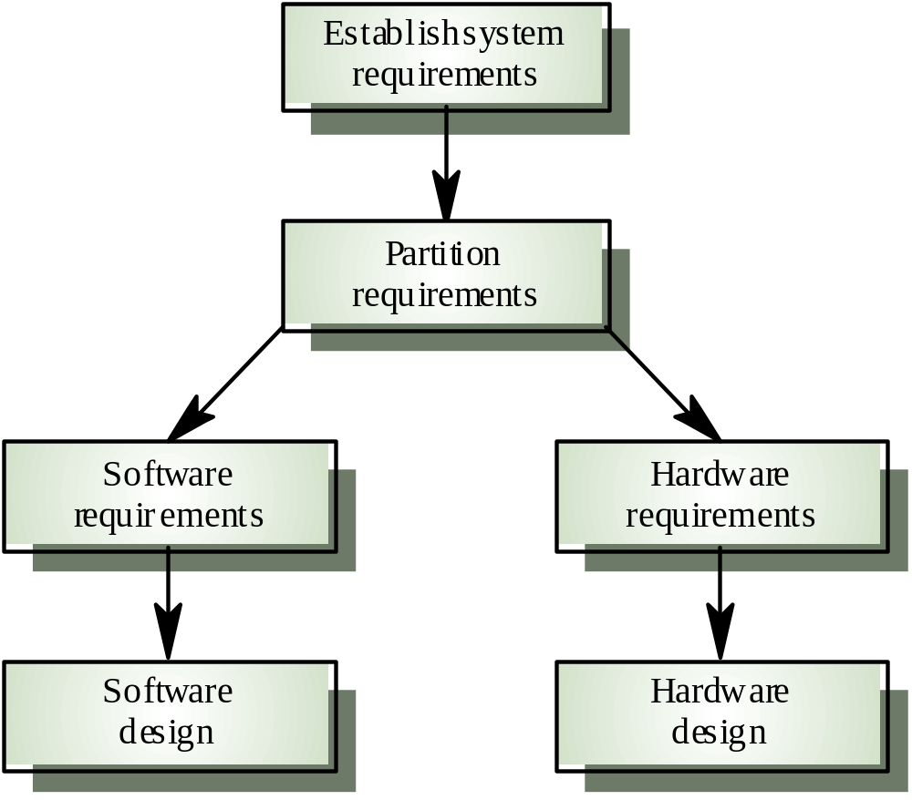
Hardware and software design

Slide 14
R-T systems design process
Identify the stimuli to be processed and the required responses to these stimuli
For each stimulus and response, identify the timing constraints
Aggregate the stimulus and response processing into concurrent processes. A process may be associated with each class of stimulus and response

Slide 15
R-T systems design process
Design algorithms to process each class of stimulus and response. These must meet the given timing requirements
Design a scheduling system which will ensure that processes are started in time to meet their deadlines
Integrate using a real-time executive or operating system

Slide 16
Timing constraints
May require extensive simulation and experiment to ensure that these are met by the system
May mean that certain design strategies such as object-oriented design cannot be used because of the additional overhead involved
May mean that low-level programming language features have to be used for performance reasons

Slide 17
State machine modelling
The effect of a stimulus in a real-time system may trigger a transition from one state to another.
Finite state machines can be used for modelling real-time systems.
However, FSM models lack structure. Even simple systems can have a complex model.
The UML includes notations for defining state machine models
See also Chapter 7.

Slide 18
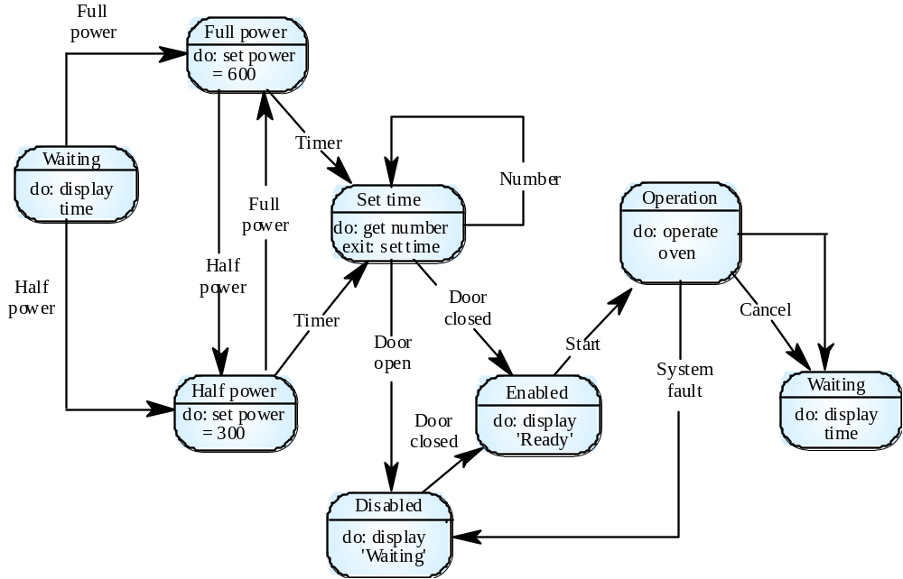
Microwave oven state machine

Slide 19
Real-time programming
Hard-real time systems may have to programmed in assembly language to ensure that deadlines are met
Languages such as C allow efficient programs to be written but do not have constructs to support concurrency or shared resource management
Ada as a language designed to support real-time systems design so includes a general purpose concurrency mechanism

Slide 20
Java as a real-time language
Java supports lightweight concurrency (threads and synchonized methods) and can be used for some soft real-time systems
Java 2.0 is not suitable for hard RT programming or programming where precise control of timing is required
  Not possible to specify thread execution time
  Uncontrollable garbage collection
  Not possible to discover queue sizes for shared resources
  Variable virtual machine implementation
  Not possible to do space or timing analysis

Slide 21
Real-time executives
Real-time executives are specialised operating systems which manage the processes in the RTS
Responsible for process management and
resource (processor and memory) allocation
May be based on a standard RTE kernel which
is used unchanged or modified for a particular
application
Does not include facilities such as file management
14

Slide 22
Executive components
Real-time clock
  Provides information for process scheduling.
Interrupt handler
  Manages aperiodic requests for service.
Scheduler
  Chooses the next process to be run.
Resource manager
  Allocates memory and processor resources.
Despatcher
  Starts process execution.

Slide 23
Non-stop system components
Configuration manager
  Responsible for the dynamic reconfiguration of the system
  software and hardware. Hardware modules may be replaced and software upgraded without stopping the systems
Fault manager
  Responsible for detecting software and hardware faults and
  taking appropriate actions (e.g. switching to backup disks) to ensure that the system continues in operation

Slide 24
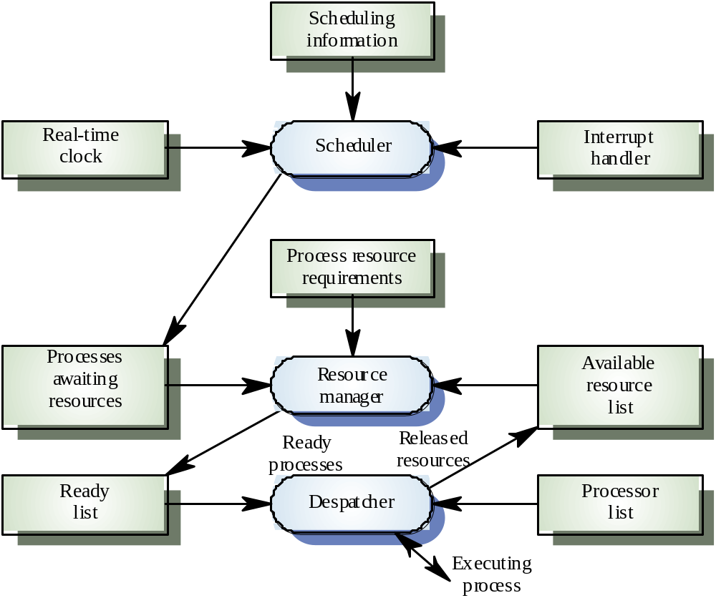
Real-time executive components

Slide 25
Process priority
The processing of some types of stimuli must
sometimes take priority
Interrupt level priority. Highest priority which is
allocated to processes requiring a very fast
response
Clock level priority. Allocated to periodic
processes
Within these, further levels of priority may be
assigned

Slide 26
Interrupt servicing
Control is transferred automatically to a
pre-determined memory location
This location contains an instruction to jump to
an interrupt service routine
Further interrupts are disabled, the interrupt
serviced and control returned to the interrupted
process
Interrupt service routines MUST be short,
simple and fast

Slide 27
Periodic process servicing
In most real-time systems, there will be several
classes of periodic process, each with different
periods (the time between executions),
execution times and deadlines (the time by
which processing must be completed)
The real-time clock ticks periodically and each
tick causes an interrupt which schedules the
process manager for periodic processes
The process manager selects a process which
is ready for execution

Slide 28
Process management
Concerned with managing the set of concurrent processes
Periodic processes are executed at pre-specified time intervals
The executive uses the real-time clock to determine when to execute a process
Process period - time between executions
Process deadline - the time by which processing must be complete

Slide 29
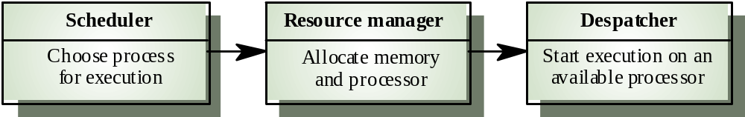
RTE process management

Slide 30
Process switching
The scheduler chooses the next process to be executed by the processor. This depends on a scheduling strategy which may take the process priority into account
The resource manager allocates memory and a processor for the process to be executed
The despatcher takes the process from ready list, loads it onto a processor and starts execution

Slide 31
Scheduling strategies
Non pre-emptive scheduling
  Once a process has been scheduled for execution, it runs to completion or until it is blocked for some reason (e.g. waiting for I/O)
Pre-emptive scheduling
  The execution of an executing processes may be stopped if a higher priority process requires service
Scheduling algorithms
  Round-robin
  Rate monotonic
  Shortest deadline first

Slide 32
Monitoring and control systems
Important class of real-time systems
Continuously check sensors and take actions
depending on sensor values
Monitoring systems examine sensors and
report their results
Control systems take sensor values and control
hardware actuators

Slide 33
Burglar alarm system
A system is required to monitor sensors on doors and windows to detect the presence of intruders in a building
When a sensor indicates a break-in, the system switches on lights around the area and calls police automatically
The system should include provision for operation without a mains power supply

Slide 34
Burglar alarm system
Sensors
  Movement detectors, window sensors, door sensors.
  50 window sensors, 30 door sensors and 200 movement
  detectors
  Voltage drop sensor
Actions
  When an intruder is detected, police are called
  automatically.
  Lights are switched on in rooms with active sensors.
  An audible alarm is switched on.
  The system switches automatically to backup power when a voltage drop is detected.

Slide 35
The R-T system design process
Identify stimuli and associated responses
Define the timing constraints associated with
each stimulus and response
Allocate system functions to concurrent
processes
Design algorithms for stimulus processing and
response generation
Design a scheduling system which ensures that
processes will always be scheduled to meet
their deadlines

Slide 36
Stimuli to be processed
Power failure
  Generated aperiodically by a circuit monitor. When
  received, the system must switch to backup power within 50
  ms
Intruder alarm
  Stimulus generated by system sensors. Response is to call
  the police, switch on building lights and the audible alarm

Slide 37
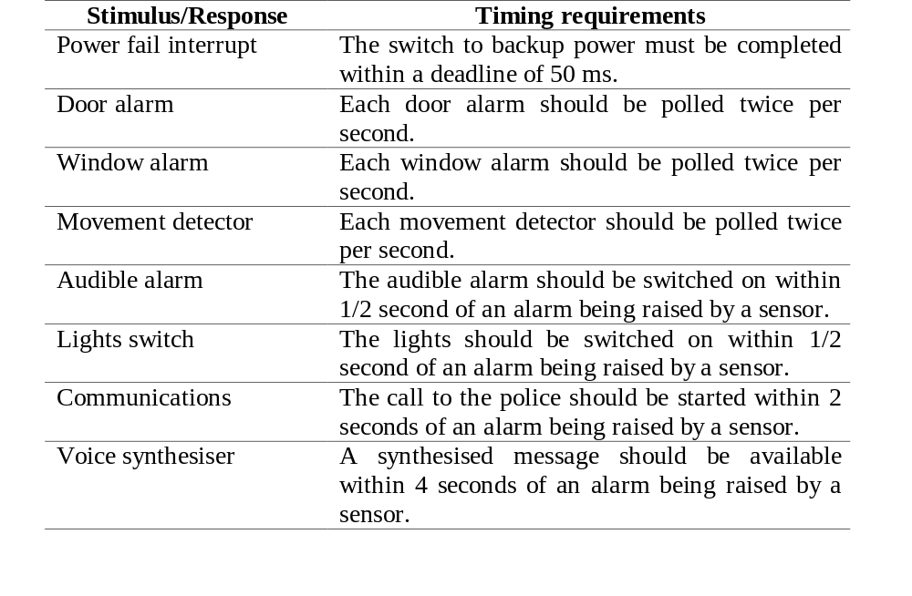
Timing requirements

Slide 38
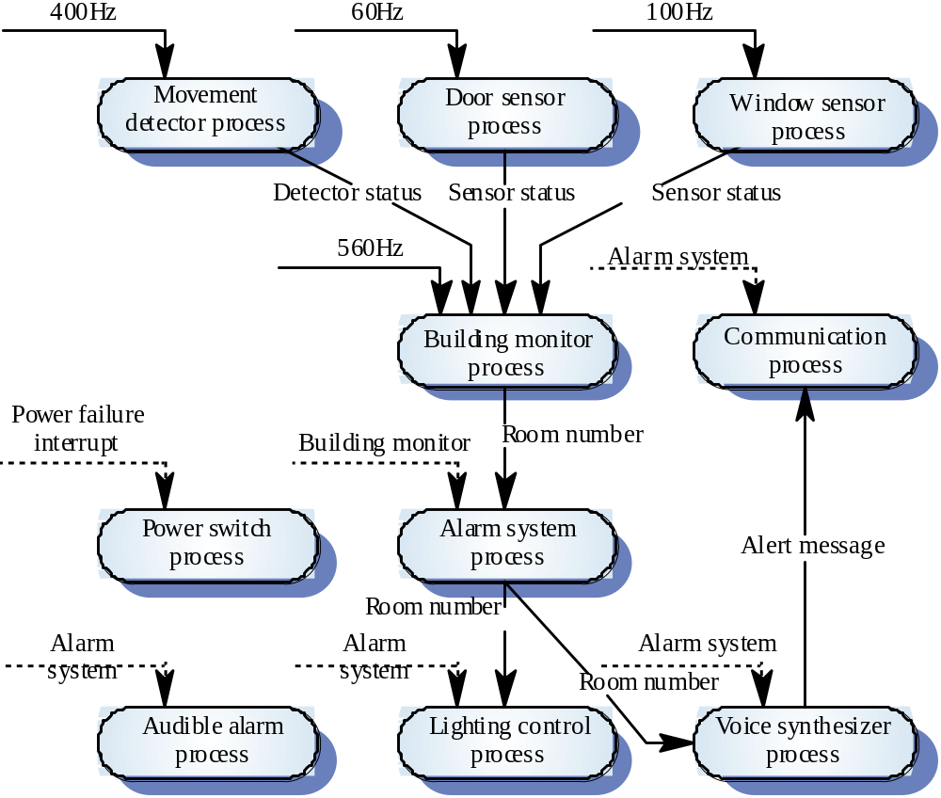
Process architecture

Slide 39
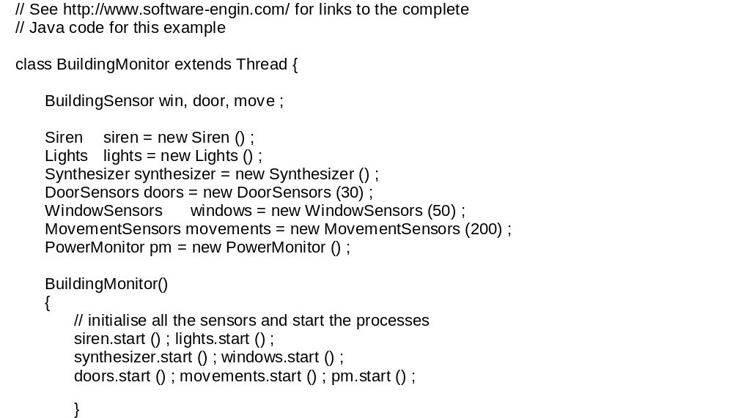
Building_monitor process 1

Slide 40
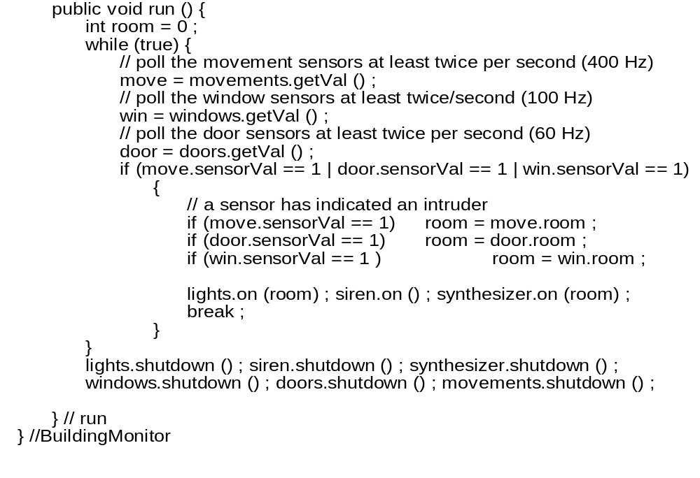
Building_monitor process 2

Slide 41
Control systems
A burglar alarm system is primarily a monitoring system. It collects data from sensors but no real-time actuator control
Control systems are similar but, in response to sensor values, the system sends control signals to actuators
An example of a monitoring and control system is a system which monitors temperature and switches heaters on and off

Slide 42
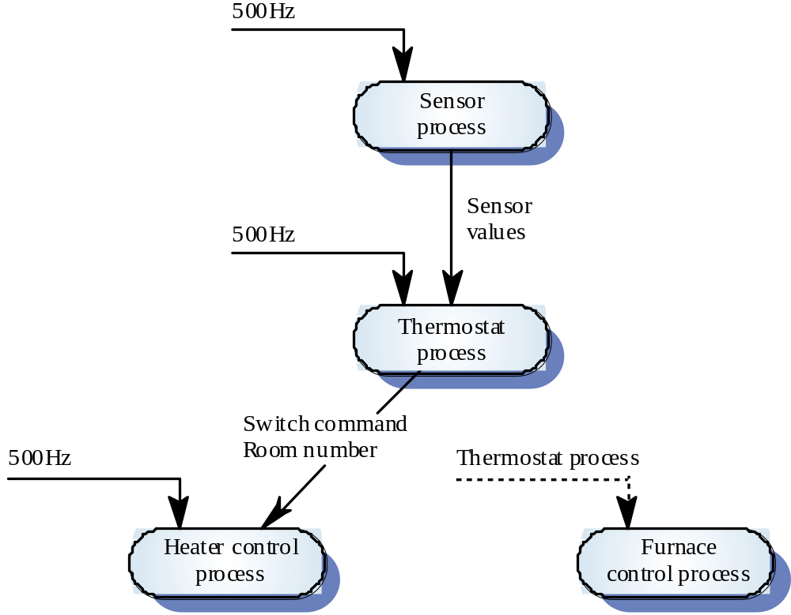
A temperature control system

Slide 43
Data acquisition systems
Collect data from sensors for subsequent
processing and analysis.
Data collection processes and processing
processes may have different periods and
deadlines.
Data collection may be faster than processing
e.g. collecting information about an explosion.
Circular or ring buffers are a mechanism for
smoothing speed differences.

Slide 44
Reactor data collection
A system collects data from a set of sensors
monitoring the neutron flux from a nuclear
reactor.
Flux data is placed in a ring buffer for later
processing.
The ring buffer is itself implemented as a
concurrent process so that the collection and
processing processes may be synchronized.

Slide 45
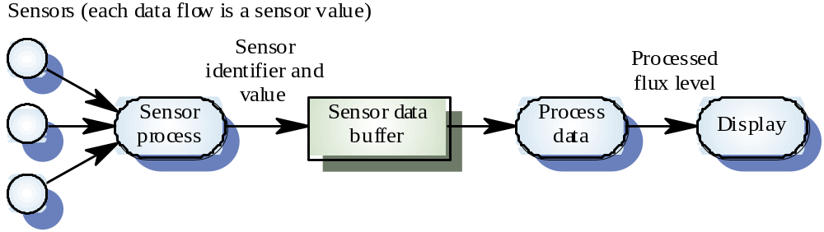
Reactor flux monitoring

Slide 46
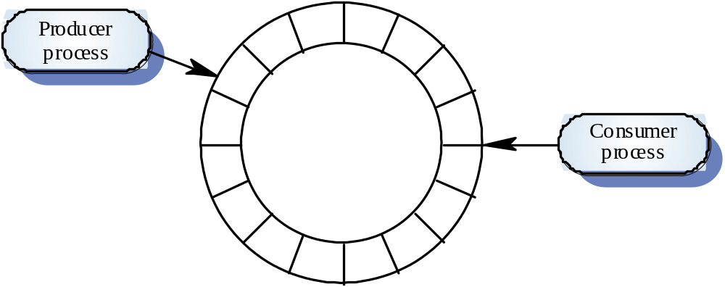
A ring buffer

Slide 47
Mutual exclusion
Producer processes collect data and add it to
the buffer. Consumer processes take data from the buffer and make elements available
Producer and consumer processes must be
mutually excluded from accessing the same
element.
The buffer must stop producer processes
adding information to a full buffer and consumer processes trying to take information from an empty buffer.

Slide 48
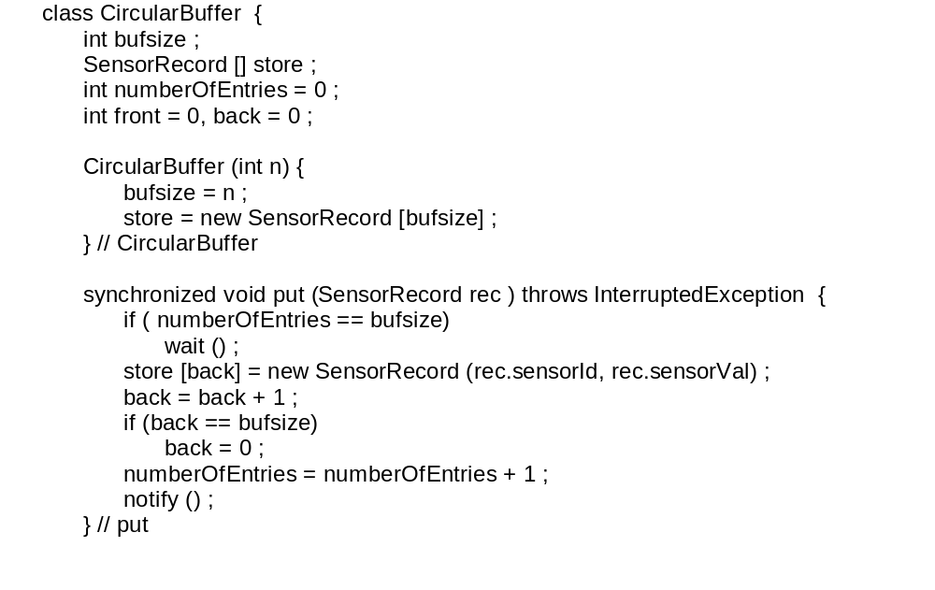
Java implementation of a ring buffer 1

Slide 49
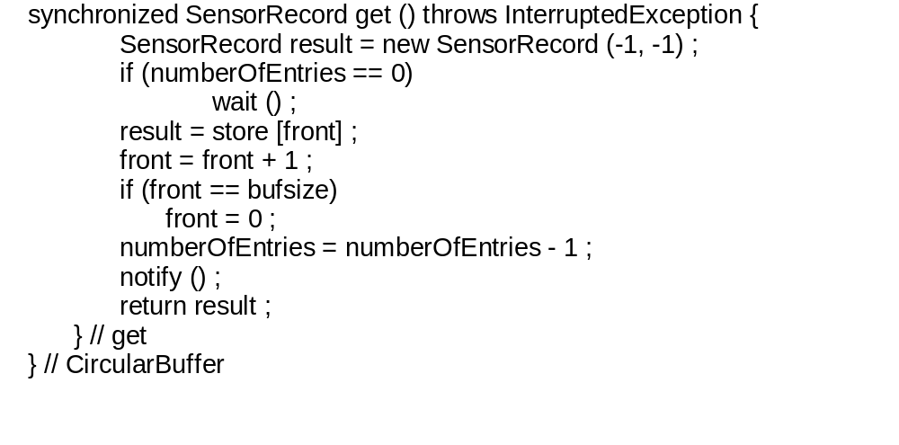
Java implementation of a ring buffer 2

Slide 50
Key points
Real-time system correctness depends not just
on what the system does but also on how fast it
reacts
A general RT system model involves associating processes with sensors and actuators
Real-time systems architectures are usually designed as a number of concurrent processes

Slide 51
Key points
Real-time executives are responsible for
process and resource management.
Monitoring and control systems poll sensors and send control signal to actuators
Data acquisition systems are usually organised according to a producer consumer model
Java has facilities for supporting concurrency but is not suitable for the development of time-critical systems

