Slide 1
ENERGY DISAGGREGATION

Slide 2

TEAM
TEAM MEMBERS: 1
NAME:- KSHITIJ GARG

Slide 3
ROLE OF TEAM MEMBER
WHOLE PROJECT DONE BY THE LONE MEMBER
EXPERTISE:- CURRENTLY THIRD YEAR,EE,B.TECH,IIT JAMMU
EXPERIENCE IN COMPUTER VISION,REINFORCEMENT LEARNING, NEURAL NETWORKS

Slide 4
TECHNOLOGIES/APIs USED
Keras,numpy and pandas libraries were used.
User interface like app or web were not made as the code takes as input a sequence of mains reading at 3Hz frequency to provide accurate results. Appliances reading can be accounted as noise in the mains reading. So to find the noise, a series of mains reading must be inputed to provide it with accurate results. User will not be able to such values. A need of portable machine that reads the value at 3Hz and directly calculates the result value using the model trained.

Slide 5
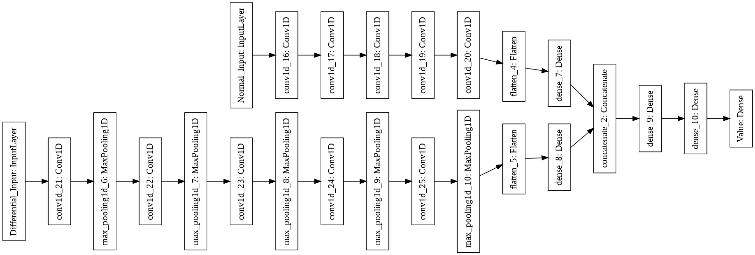
Architecture Diagram

Slide 6
Network explanation
The above network takes two input- Differential input and auxillary input
Differential input(Mains reading at time t+1-Mains reading at t)
Auxillary input(Mains reading at t)
Each input is a sequence of above readings taken over a duration of 1500s at 3Hz frequency i.e each sequence length is 500
Mains reading at a single time t can also be given but the result won’t be that accurate. 2 Houses at any instant can have same mains reading ,but if taken as a sequence they would really be equal.
So better solution is to take a sequence of input and for that reason no framework was created as user will unable to enter the sequence. A device at the main house meter will do the job for him/her.

Slide 7
Thank you

