Slide 1
Project : data cleaning in mysql

Slide 2
Objective :
The Goal of this project is to clean the dataset and perform exploratory data analysis (EDA)

Slide 3
Understanding the dataset
Column Name | Description
Company | The name of Company where layoffs occurred.
Location | The location or headquarters of the company
Industry | The industry sector to which the company belongs (eg.tech,finance,Healthcare)
Total_laid_off | The total number of employees laid off
Percentage_laid_off | The percentage of Workforce affected by layoffs.
Date | The date when the layoffs were reported.
Stage | The Business stage of the Company Operates.(eg.startup,Post-IPO)
Country | The country where the company Operates.
Funds_Raised_Millions | The total funding Raised by the Company in Millions of doll

Slide 4
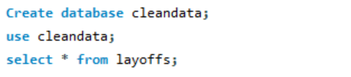
Setting Up the Project:
First I created a new database named “Cleandata” and imported the raw LAYOFFS TABLE into it . This ensured that all data cleaning steps would be carried out in separate environment without altering the original dataset.

Slide 5
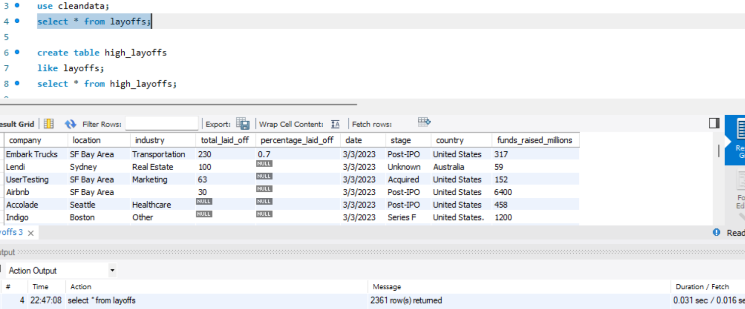
When I inspecting table I noticed several issues:
Duplicate rows
Null and blank values
Standardize the data
Null Values or Blank Values
Some columns are not stored a valid data type (eg.date column stored as is string datatype instead of date datatype)

Slide 6


To avoid affecting the original Table I create a dummy table Called “High layoffs
Where I Performed all Cleaning Task

Slide 7
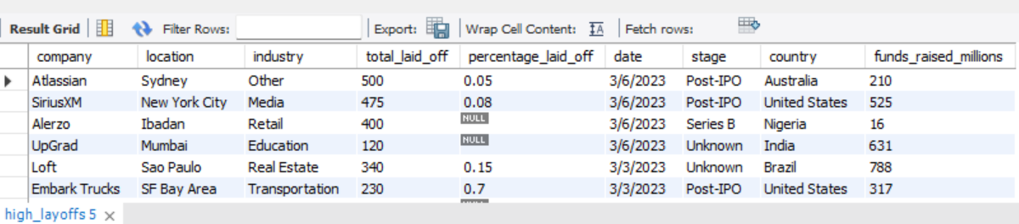
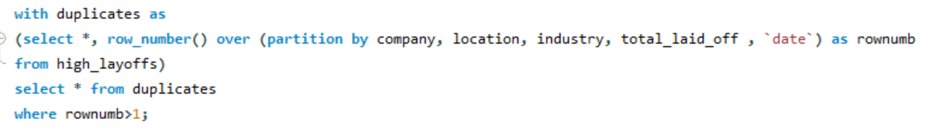
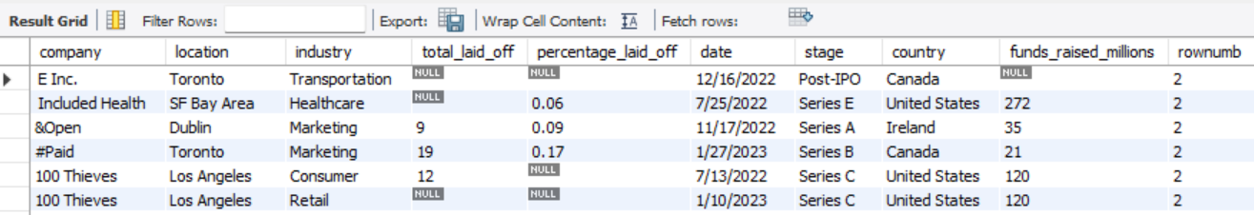
How I handle duplicate Records ?
Since There was no Unique Identifier for rows I used Row_number() with Partition by To Identify duplicate entries based on key Columns like Company, location, industry, layoffs, date and stage.

Slide 8
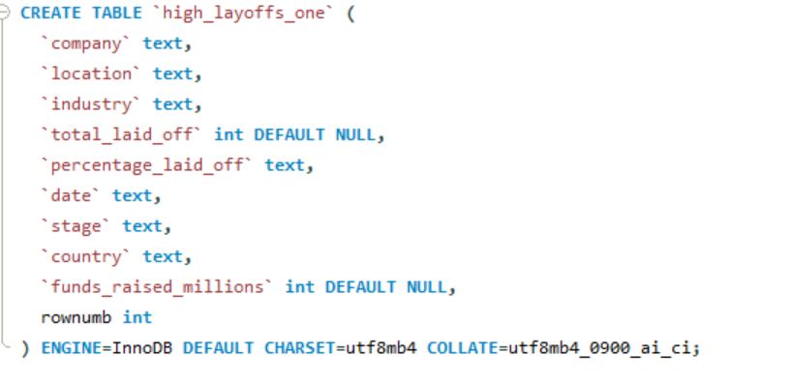

I found 5 duplicate Rows.
To safely Removed them I created another table called “High_layoffs_one”
Then I deleted the duplicate entries
Where Row_num > 1.

Slide 9
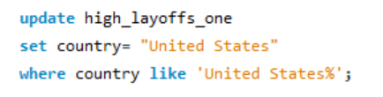


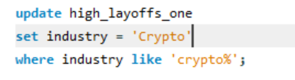
Standardizing Data
Trimming White Spaces. Company
Names had Extra spaces, so I used the
Trim() function to clean them.
Handling Country Values Similarly the Country United States appeared as United States of America I Standardized this as well
Handling Industry values I Found inconsistent values like Crypto written as Crypto.com
I replace them with Standard term.

Slide 10
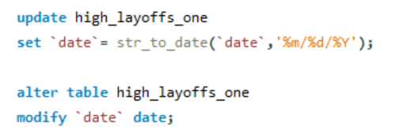
Date Column Standardization
Date column was stored in string I Converted into proper date format using string_to_date() and modify column datatype

Slide 11
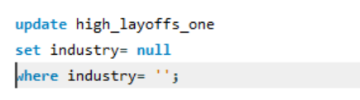
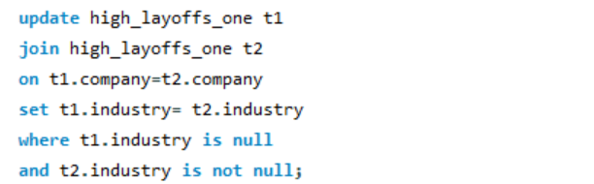
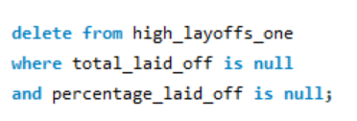
Handling Null and
Blank Values
Industry Column I first Converted blank values to Null.
Then, I filled The Null values using the Industry
Of the same company from other rows
Total laid off and Percentage Laid off Rows
With both values as Null were not useful, so
I delete them.

Slide 12
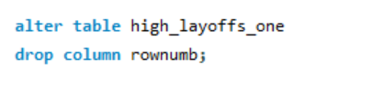
Final CleanUp
After Cleaning, The Row_num column was no longer needed, so I Dropped it.

Slide 13
Conclusion:
Ready for Analysis
The dataset is now fully cleaned—no duplicates, errors, or unnecessary data. Every column is properly formatted, missing values are taken care of, and dates are in the correct format. With this clean data, we're ready to explore patterns, trends, and insights through Exploratory Data Analysis (EDA).

