Slide 1
Project Presentation of Exploratory Project (EP)
On
Orbix
Kshtij Bhardwaj(2210991819)
Kumar garg(2210991820)
Lakshay Kumar (2210991841)
Supervised By
Dr. Shyam Goyal
Department of Computer Science and Engineering,
Chitkara University, Punjab

Slide 2
Content
Abstract
Introduction
Methodology
Tools and Technologies
Implementation
Results and Outputs
Conclusion
Future scope
Acknowledgement

Slide 3
Slide 2 – Abstract
Objective:
To build a secure, high-performance centralized crypto exchange (CEX) enabling seamless digital asset trading.
Scope:
Covers user authentication, order matching, wallet management, and real-time market data using scalable backend infrastructure.
Method Used:
Developed using Go, PostgreSQL, and WebSockets for real-time order updates; deployed with Docker & Kubernetes for fault tolerance.
Major Expected Outcome:
A robust, low-latency exchange prototype demonstrating efficient trade execution and infrastructure reliability.
‹#›

Slide 4
Slide 3 – Introduction
Background of the Topic:
Centralized crypto exchanges (CEXs) enable secure trading and liquidity for digital assets.
They require highly optimized systems for matching trades, managing wallets, and ensuring user trust.
Problem Statement:
Building a reliable and scalable exchange remains technically complex and resource-intensive, often requiring deep expertise in systems engineering, security, and infrastructure.
Smaller teams struggle to achieve the performance, security, and compliance standards of major exchanges.
‹#›

Slide 5
Slide 4 - Introduction
Motivation / Real-World Need:
The crypto ecosystem needs transparent, developer-friendly, and efficient exchange infrastructure that can be deployed and scaled easily.
Key Objectives of the Project:
Develop a high-performance centralized exchange prototype.
Implement a real-time order matching engine and secure wallet management.
Focus on scalability, reliability, and modular architecture using Go, Docker, and Kubernetes.
Demonstrate a production-ready backend capable of handling live trading operations.
‹#›

Slide 6
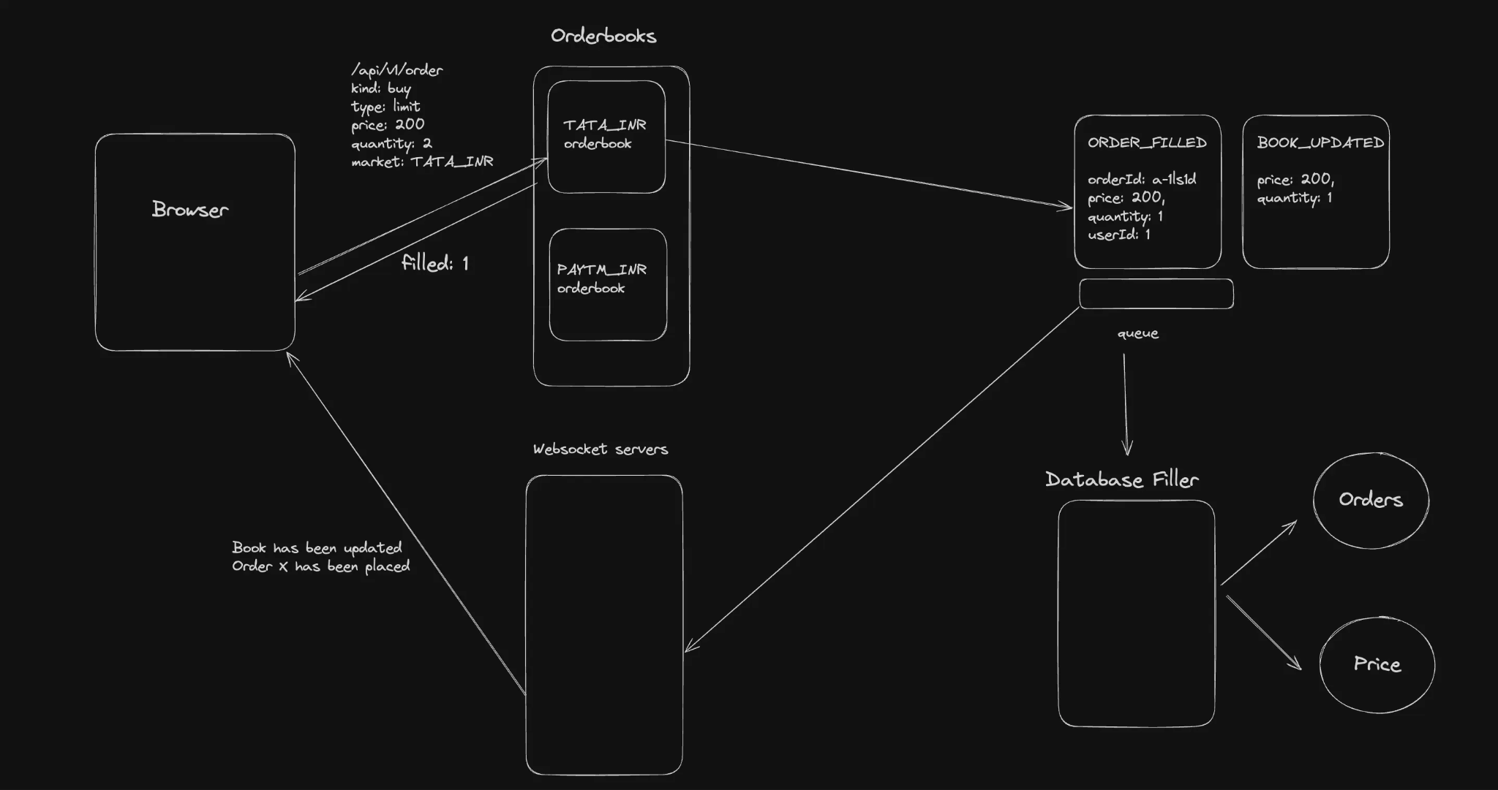
Slide 5 – Methodology
‹#›

Slide 7
Slide 6 – Tools and Technologies
Category | Tools/Technologies
Front-End | Next.js
Back-End | golang, kubernetes, docker
Database | posgresSQL
IDE/Cloud | VS Code /

Slide 8
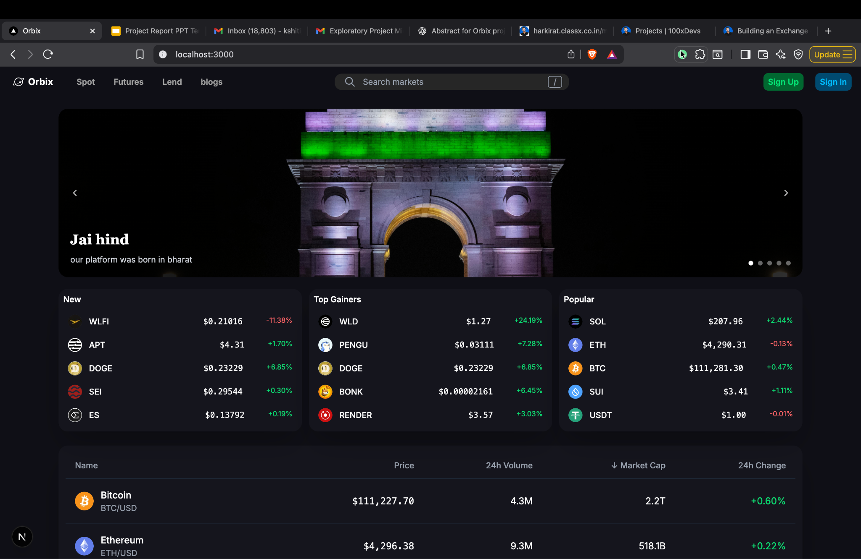
Slide 7 – Implementation
Key screenshots or code snippets (max 3–4)
Front-End interface
Database design
Module-wise description

Slide 9
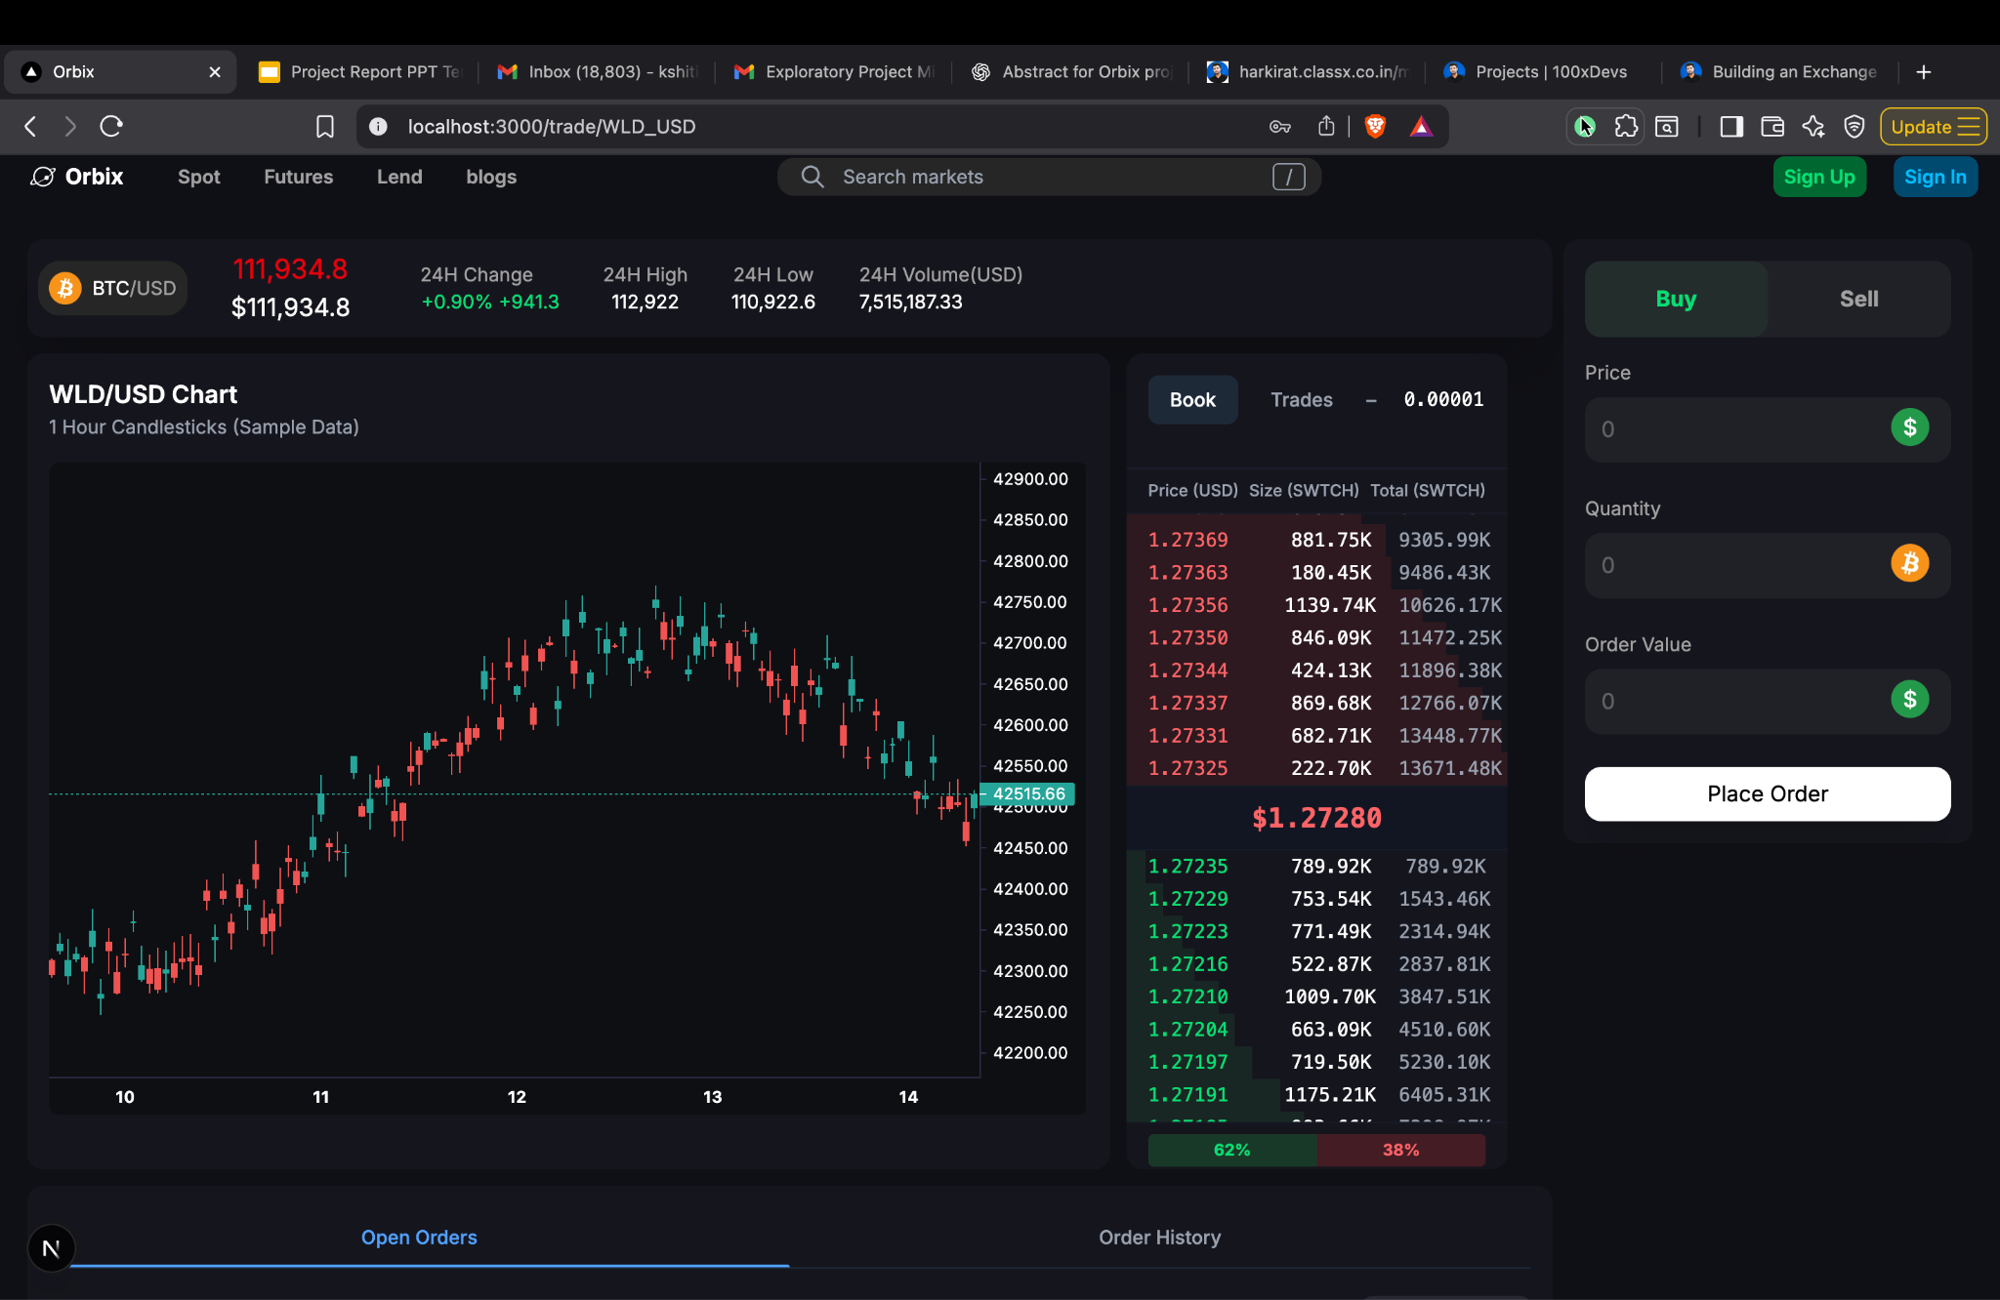
Slide 7 – Implementation
Key screenshots or code snippets (max 3–4)
Front-End interface
Database design
Module-wise description

Slide 10
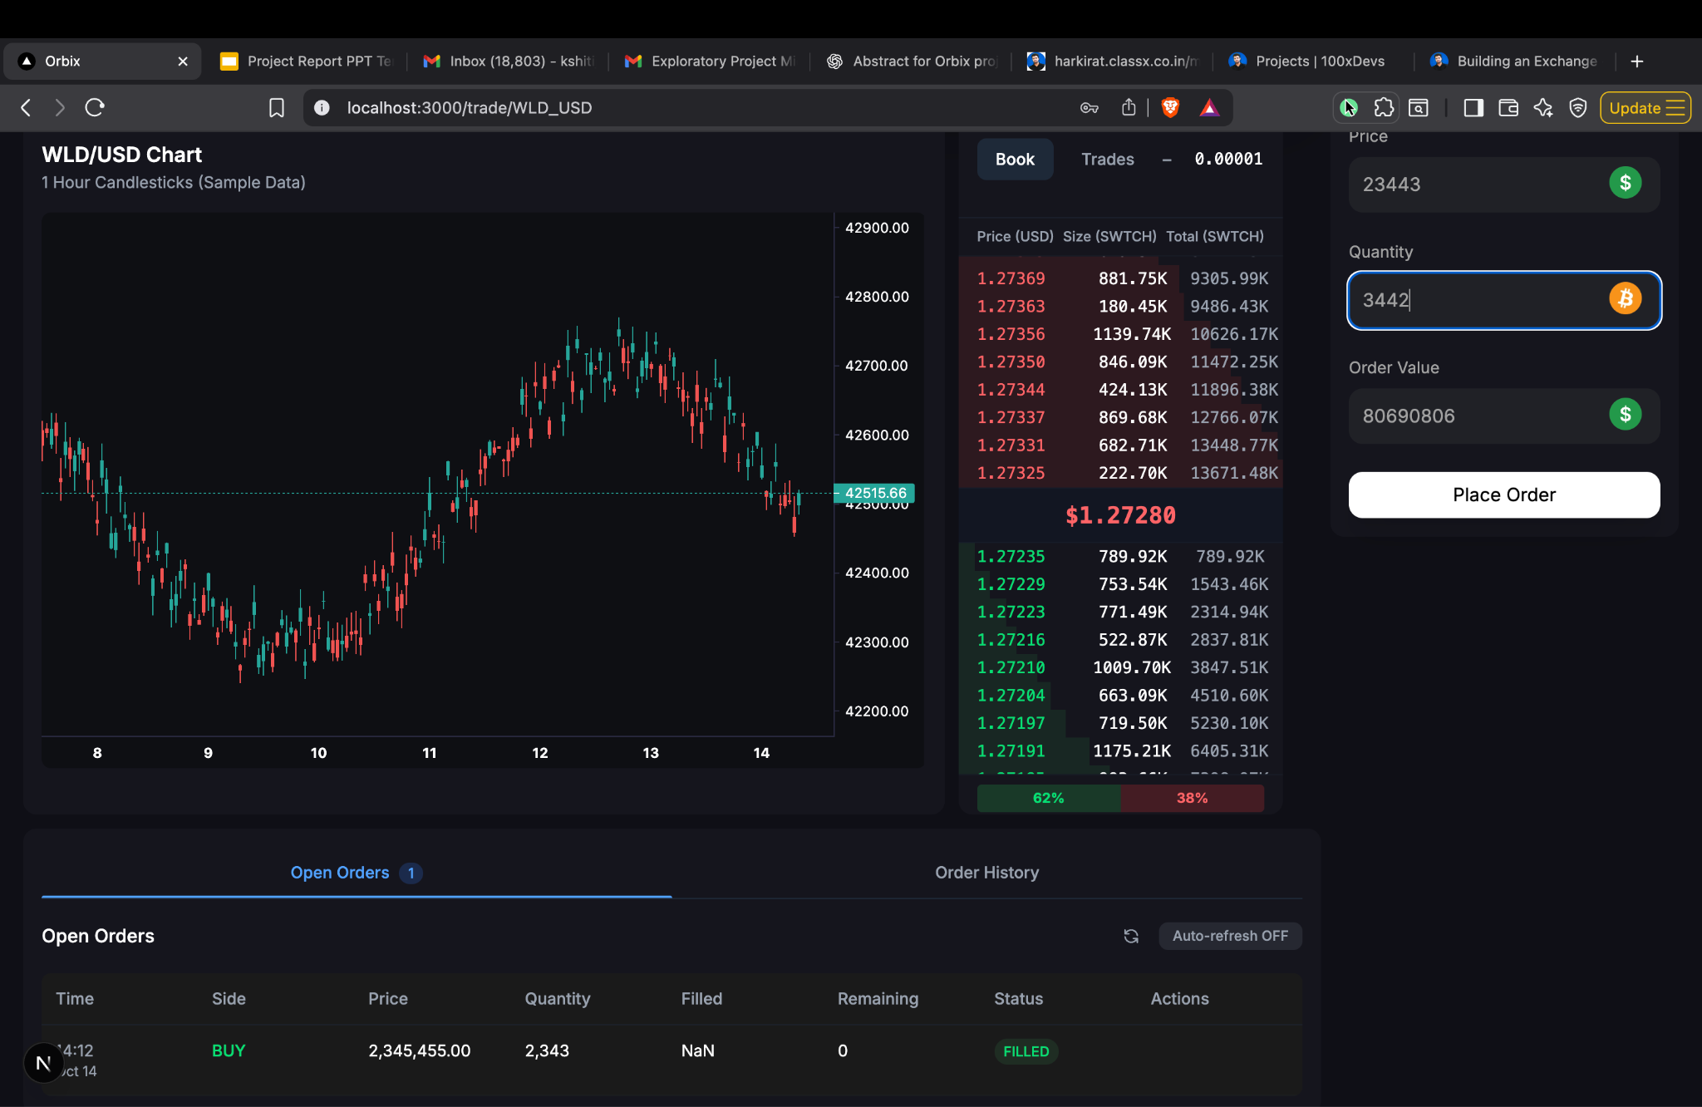
Slide 7 – Implementation
Key screenshots or code snippets (max 3–4)
Front-End interface
Database design
Module-wise description

Slide 11
Slide 7 – Implementation
Key screenshots or code snippets (max 3–4)
Front-End interface
Database design
Module-wise description

Slide 12
Slide 8 – Results / Output
Results and Output
Developed the core backend architecture for a centralized crypto exchange using Go and PostgreSQL.
Implemented user authentication, order placement, and basic order matching logic for trade simulation.
Designed a modular system structure to easily extend future components like wallets, real-time updates, and onramping.
Deployed initial backend prototype using Docker and Kubernetes, ensuring scalability and maintainability.
Verified system stability through API testing and mock trading workflows, confirming correct order execution and database consistency.

Slide 13
Slide 9 – Major Findings & Discussion
Achievements, Insights & Challenges
Achievements / Improvements Made:
Built the foundational backend of a centralized exchange with modular architecture.
Improved code scalability and maintainability through microservice-style design using Go.
Established secure authentication and structured API endpoints for core exchange operations.
Technical / Research Insights Gained:
Gained a deep understanding of order matching logic, trade lifecycle, and exchange architecture.

Slide 14
Slide 10 – Major Findings & Discussion
Learned to optimize database interactions and handle concurrent processes efficiently using goroutines.
Challenges Faced:
Designing a robust matching engine that balances speed with accuracy.
Managing complex data relationships between users, orders, and trades.

Slide 15
Slide 11 – Conclusion and Future Scope
Summary of Work Done:
Designed and implemented the core backend architecture for Orbix, a centralized crypto exchange.
Developed modules for user authentication, order creation, and basic order matching.
Deployed the system using Docker and Kubernetes, ensuring modularity and scalability.
Validated core functionalities through API testing and simulated trading workflows.

Slide 16
Slide 12 – Conclusion and Future Scope
What Can Be Added in the Next Version:
Real-time trading engine using WebSockets for instant order book updates.
Wallet and onramping integration for deposits, withdrawals, and fiat conversions.
AI-powered fraud detection and user behavior analytics.
Automated deployment and monitoring via CI/CD pipelines and observability tools (Prometheus, Grafana).
Cloud-based scaling using managed Kubernetes services (GKE/EKS) for production-grade performance.

Slide 17
Slide 12 – Acknowledgement
I express my sincere gratitude to my project mentor for their constant guidance, valuable feedback, and encouragement throughout the development of Orbix.
I am thankful to the Department of Computer Science & Engineering for providing the necessary resources and a supportive environment.
I would also like to extend heartfelt thanks to my university for offering this opportunity to explore and apply real-world system design concepts.

Slide 18
Slide 13 – Q & A
GitHub Repository: github.com/yourusername/orbix
Thank you for your time and attention!
We are happy to answer any questions.

