Slide 1
Predicting Online Shoppers' Purchasing Intention
A KDD-based classification study and a data-leakage test of the PageValues feature
Kshitij Bhele | Predictive Analytics | CA3 Individual Project
Notes:
Introduce yourself and the project in one sentence: I built a model that predicts whether an online shopping session ends in a purchase, and I tested how much of its accuracy depends on one suspicious feature called PageValues. Roadmap: problem, data, preparation, modelling, evaluation, results, conclusion.

Slide 2
Problem statement
Business problem
Most store visits end without a purchase. Spotting buying intent during the session lets a business act before the visitor leaves.
15.5%
of sessions end in a purchase
12,330
Research question
Can we predict whether a session will generate revenue from browsing behaviour, visitor attributes and timing?
Binary classification. Target: Revenue (True / False).
sessions in the dataset
2
feature sets tested: with and without PageValues
Notes:
Business framing: conversion is low, so targeted offers or live chat only pay off if we can find the right visitors in time. The class imbalance (15.5% buyers) is the first technical challenge. The second, and the focus of my project, is checking whether the model's skill is real or comes from a leaky feature.

Slide 3






Dataset overview
Page-visit counts
Time spent
Analytics metrics
Administrative, Informational, ProductRelated pages viewed
Seconds on each of the three page types
BounceRates, ExitRates, PageValues
Calendar
Technical and source
Visitor
Month, Weekend, SpecialDay
Operating system, browser, region, traffic type
New, returning or other visitor
Target: Revenue (True = purchase) | 12,330 rows x 18 columns | 0 missing values | 125 duplicates
Notes:
Source: UCI Machine Learning Repository, one row per browsing session. Features fall into six groups. Two of them need a comment: BounceRates and ExitRates are 0.91 correlated, and PageValues is derived from purchase value, which I come back to. The target Revenue is boolean.

Slide 4
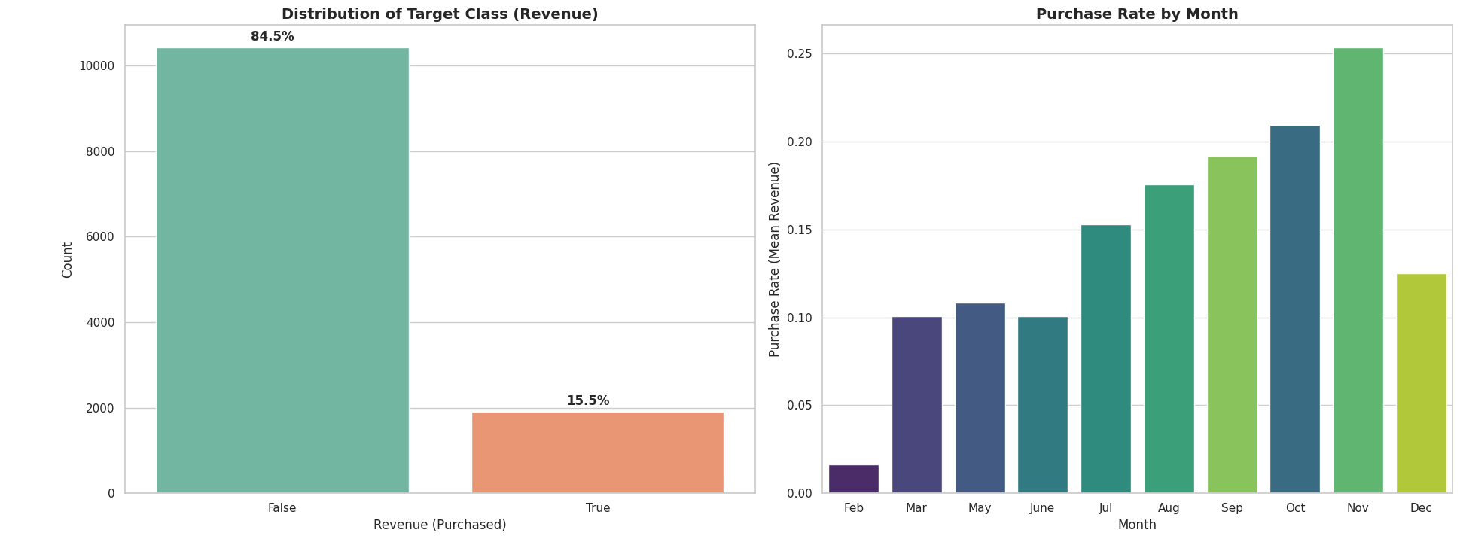
Data understanding: what EDA showed
Nov ~25%
24% vs 14%
r = 0.49
r = 0.91
purchase rate vs Feb ~2%
new vs returning visitors
PageValues with Revenue
BounceRates with ExitRates
Notes:
Left chart: severe imbalance, so accuracy would be misleading and I use ROC-AUC, PR-AUC and F1. Right chart: strong seasonality, with November highest. New visitors convert more than returning ones. PageValues has by far the strongest correlation with the target, which is a warning sign rather than good news, because it is computed from purchase value.

Slide 5
Preprocessing without leakage
1
2
3
4
Remove duplicates
Stratified split first
Fit on train only
Model-ready features
12,330 to 12,205 sessions
9,764 train, 2,441 test, 15.6% buyers in both
StandardScaler on 14 numeric columns; one-hot on Month, VisitorType, Weekend
29 features, or 28 without PageValues
Rule: split before transforming, and fit every scaler and encoder on the training rows only, so no test information reaches the model.
Notes:
There were no missing values, so no imputation. Duplicates were dropped because identical rows could land in both train and test. Imbalance is handled in the models through class weights, not by resampling, so the test set keeps its real distribution.

Slide 6
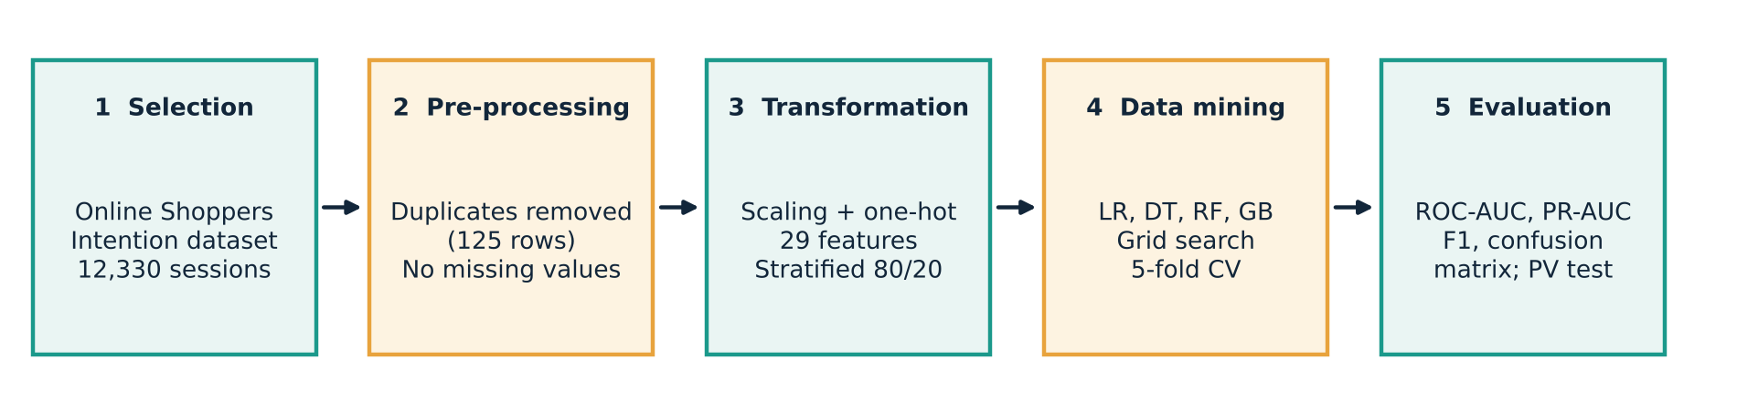
Predictive modelling approach
Configuration A: with PageValues
29 features. Best case on historical data.
Configuration B: without PageValues
28 features. PageValues is built from purchase value, so it may leak the answer.
Same splits, folds and seeds in both, so any gap is due to PageValues.
Notes:
The project follows KDD: selection, pre-processing, transformation, mining, evaluation. The distinctive part is the two-configuration experiment. Same splits, same folds, same seeds; only PageValues differs, so any gap is attributable to that feature.

Slide 7
Model development and tuning
Model | Grid searched | Imbalance | CV AUC with PV | CV AUC without
Logistic Regression | C: 0.01, 0.1, 1, 10 | balanced weights | 0.8999 | 0.7375
Decision Tree | depth 3/5/8/12; min split 2/10 | balanced weights | 0.9125 | 0.7437
Random Forest | trees 50/100; depth 5/10/15 | balanced weights | 0.9275 | 0.7688
Gradient Boosting | trees 50/100; learning rate 0.01/0.1/0.2 | none available | 0.9296 | 0.7698
Dummy baseline | stratified random | n/a | 0.50 | 0.50
GridSearchCV | 5-fold stratified cross-validation | scored on ROC-AUC | random_state = 42
Notes:
Four model families from interpretable to powerful. Hyperparameters chosen by cross-validated ROC-AUC on the training set only. Note the big drop in CV AUC for every model when PageValues is removed, which already hints at the result. Gradient Boosting in scikit-learn has no class_weight option, which matters for recall later.

Slide 8
Evaluation on the held-out test set
Dummy baseline: ROC-AUC 0.504, PR-AUC 0.230. Accuracy is avoided: 84.5% of sessions are non-buyers.
Notes:
I use ROC-AUC for ranking quality and PR-AUC for how well the rare positive class is found, plus F1 at the default threshold. All models beat the dummy baseline. With PageValues the ranking among models is Gradient Boosting, Random Forest, Decision Tree, Logistic Regression. Without it, every bar drops and PR-AUC falls hardest.

Slide 9
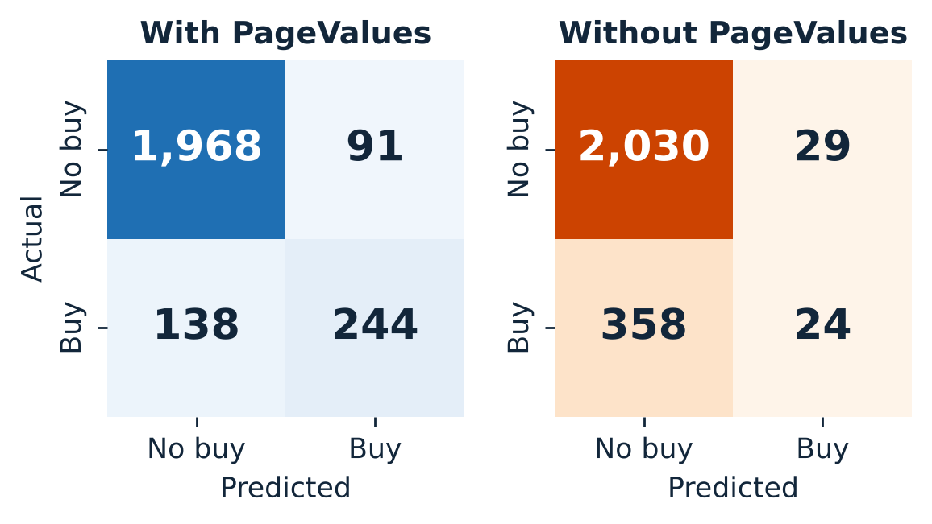
Results: PageValues carries the score
ROC-AUC
0.937 to 0.784
PR-AUC
0.744 to 0.356
F1-score
0.681 to 0.110
With PageValues: 244 of 382 buyers found.
Without: only 24 of 382 found at the default threshold.
Gradient Boosting, test set, with vs without PageValues
Notes:
Headline numbers for the best model. ROC-AUC falls 16 percent, PR-AUC 52 percent, F1 84 percent. The confusion matrices show why F1 collapses: without PageValues, Gradient Boosting at the 0.5 threshold almost never predicts a purchase. Class-weighted Random Forest and Logistic Regression keep F1 near 0.40 without PageValues, so threshold tuning is the obvious fix.

Slide 10
Interpretation: what drives purchases
Gradient Boosting, top-5 feature importance
PageValues holds 77.8% of importance. The model mostly reads the answer.
Exit rate leads, then time on product pages and November.
Notes:
Feature importance backs up the leakage story. With PageValues one feature dominates. Without it, behaviour signals take over: exit rate, time on product pages, number of administrative pages and the month. Logistic Regression agrees: exit rate has a negative coefficient of about minus 1.4, and November is positive.

Slide 11



Conclusion
Gradient Boosting is the strongest model: ROC-AUC 0.937 with PageValues, 0.784 without.
PageValues inflates results. Removing it cuts PR-AUC by 52% and F1 by 84%.
Next: tune the decision threshold, repeat the cross-validation, and score sessions as they unfold.
Notes:
Close with three points. One: the model works and beats the baseline. Two: much of the apparent skill comes from PageValues, so the leakage-free numbers are the honest expectation for live use. Three: the biggest improvement left is threshold tuning for recall. Invite questions.

