Slide 1
UNIT-5
Unit 5 : Memory Management

Slide 2
Background
Program must be brought (from disk) into memory and placed within a process for it to be run
Main memory and registers are only storage CPU can access directly
Memory unit only sees a stream of addresses + read requests, or address + data and write requests
Register access in one CPU clock (or less)
Main memory can take many cycles, causing a stall
Cache sits between main memory and CPU registers
Protection of memory required to ensure correct operation

Slide 3
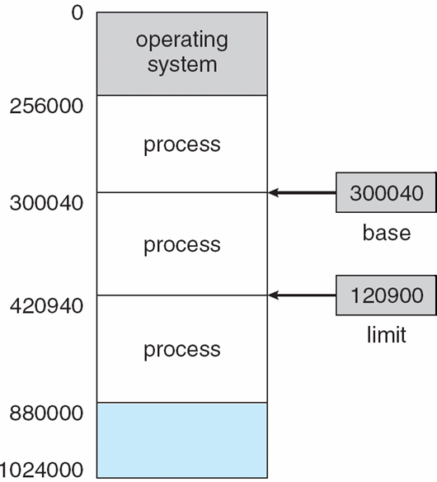
Base and Limit Registers
A pair of base and limit registers define the logical address space
CPU must check every memory access generated in user mode to be sure it is between base and limit for that user

Slide 4
Hardware Address Protection

Slide 5
Address Binding
Programs on disk, ready to be brought into memory to execute form an input queue
Without support, must be loaded into address 0000
Inconvenient to have first user process physical address always at 0000
How can it not be?
Further, addresses represented in different ways at different stages of a program’s life
Source code addresses usually symbolic
Compiled code addresses bind to relocatable addresses
i.e. “14 bytes from beginning of this module”
Linker or loader will bind relocatable addresses to absolute addresses
i.e. 74014
Each binding maps one address space to another

Slide 6
Binding of Instructions and Data to Memory
Address binding of instructions and data to memory addresses can happen at three different stages
Compile time: If memory location known a priori, absolute code can be generated; must recompile code if starting location changes
Load time: Must generate relocatable code if memory location is not known at compile time
Execution time: Binding delayed until run time if the process can be moved during its execution from one memory segment to another
Need hardware support for address maps (e.g., base and limit registers)

Slide 7
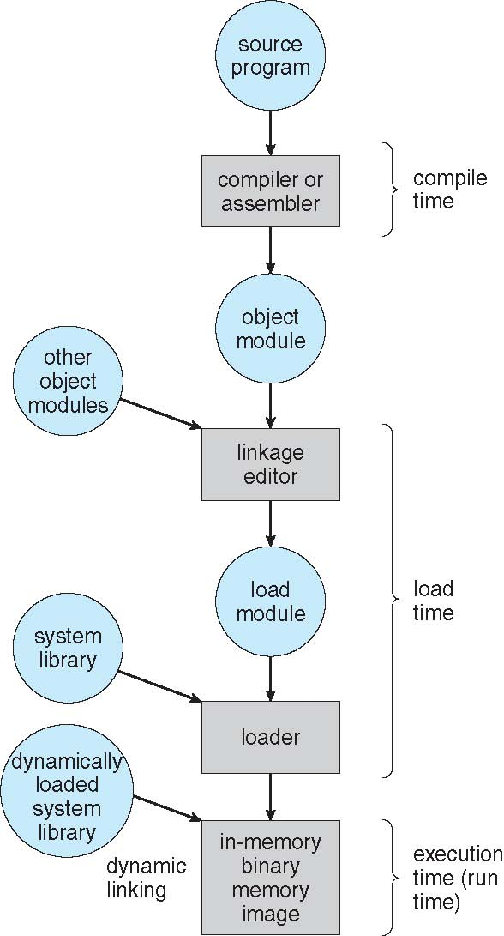
Multistep Processing of a User Program

Slide 8
Logical vs. Physical Address Space
The concept of a logical address space that is bound to a separate physical address space is central to proper memory management
Logical address – generated by the CPU; also referred to as virtual address
Physical address – address seen by the memory unit
Logical and physical addresses are the same in compile-time and load-time address-binding schemes; logical (virtual) and physical addresses differ in execution-time address-binding scheme
Logical address space is the set of all logical addresses generated by a program
Physical address space is the set of all physical addresses generated by a program

Slide 9
Memory-Management Unit (MMU)
Hardware device that at run time maps virtual to physical address
Many methods possible, covered in the rest of this chapter
To start, consider simple scheme where the value in the relocation register is added to every address generated by a user process at the time it is sent to memory
Base register now called relocation register
MS-DOS on Intel 80x86 used 4 relocation registers
The user program deals with logical addresses; it never sees the real physical addresses
Execution-time binding occurs when reference is made to location in memory
Logical address bound to physical addresses

Slide 10
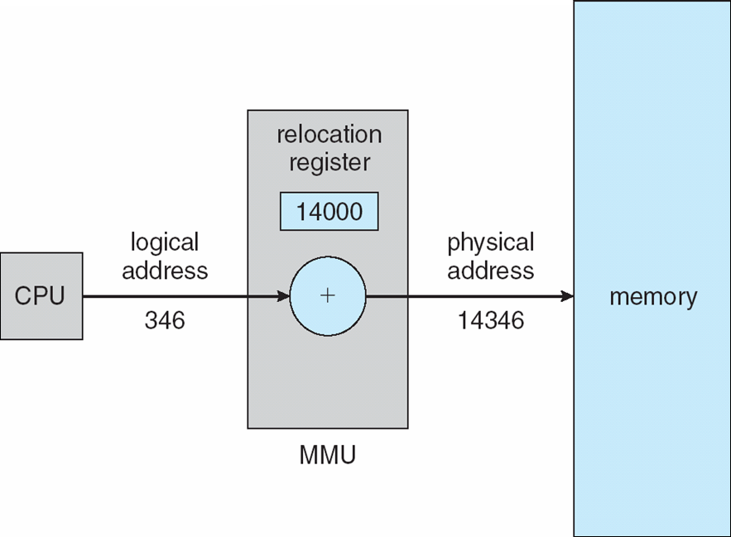
Dynamic relocation using a relocation register
Routine is not loaded until it is called
Better memory-space utilization; unused routine is never loaded
All routines kept on disk in relocatable load format
Useful when large amounts of code are needed to handle infrequently occurring cases
No special support from the operating system is required
Implemented through program design
OS can help by providing libraries to implement dynamic loading

Slide 11
Dynamic Linking
Static linking – system libraries and program code combined by the loader into the binary program image
Dynamic linking –linking postponed until execution time
Small piece of code, stub, used to locate the appropriate memory-resident library routine
Stub replaces itself with the address of the routine, and executes the routine
Operating system checks if routine is in processes’ memory address
If not in address space, add to address space
Dynamic linking is particularly useful for libraries
System also known as shared libraries
Consider applicability to patching system libraries
Versioning may be needed

Slide 12
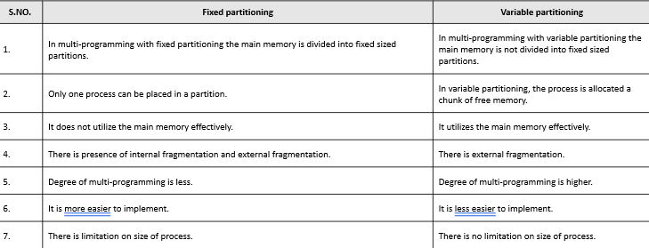
Multiprogramming with fixed partition. Multiprogramming with variable partition.
Difference between Fixed Partitioning and Variable Partitioning :

Slide 13
Buddy system- allocation of swap space
The buddy system is a memory allocation and management algorithm that manages memory in power of two increments. Assume the memory size is 2U, suppose a size of S is required.
The Buddy System is a memory allocation technique used in computer operating systems to efficiently allocate and manage memory.
The technique is based on dividing the memory into fixed-size blocks, and whenever a process requests memory, the system finds the smallest available block that can accommodate the requested memory size.

Slide 14
Cont..
Here are the basic steps in the Buddy System memory allocation technique:
The memory is divided into fixed-size blocks that are a power of 2 in size (such as 2, 4, 8, 16, 32, etc. bytes).
Each block is labeled with its size and a unique identifier, such as a binary number.
Initially, all the memory blocks are free and are linked together in a binary tree structure, with each node representing a block and the tree’s leaves representing the smallest available blocks.
When a process requests memory, the system finds the smallest available block that can accommodate the requested size. If the block is larger than the requested size, the system splits the block into two equal-sized “buddy” blocks.

Slide 15
Cont..
Here are the basic steps in the Buddy System memory allocation technique:
The system marks one of the buddy blocks as allocated and adds it to the process’s memory allocation table, while the other buddy block is returned to the free memory pool and linked back into the binary tree structure.
When a process releases memory, the system marks the corresponding block as free and looks for its buddy block. If the buddy block is also free, the system merges the two blocks into a larger block and links it back into the binary tree structure.

Slide 16
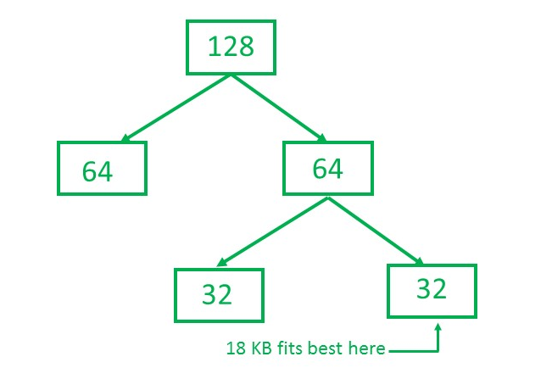
Buddy system- Numerical
Example – Consider a system having buddy system with physical address space 128 KB.Calculate the size of partition for 18 KB process.
Solution – So, size of partition for 18 KB process = 32 KB. It divides by 2, till possible to get minimum block to fit 18 KB.

Slide 17
Memory management with bit maps
Free space management is a critical aspect of operating systems as it involves managing the available storage space on the hard disk or other secondary storage devices.
The operating system uses various techniques to manage free space and optimize the use of storage devices.
Overall, free space management is a crucial function of operating systems, as it ensures that storage devices are utilized efficiently and effectively.

Slide 18
Memory management with bit maps
The system keeps tracks of the free disk blocks for allocating space to files when they are created.
Also, to reuse the space released from deleting the files, free space management becomes crucial.
The system maintains a free space list which keeps track of the disk blocks that are not allocated to some file or directory.
The free space list can be implemented mainly as:

Slide 19
Memory management with bit maps
Bitmap or Bit vector –
A Bitmap or Bit Vector is series or collection of bits where each bit corresponds to a disk block.
The bit can take two values: 0 and 1: 0 indicates that the block is allocated and 1 indicates a free block.
The given instance of disk blocks on the disk in Figure 1 (where green blocks are allocated) can be represented by a bitmap of 16 bits as: 0000111000000110.

Slide 20
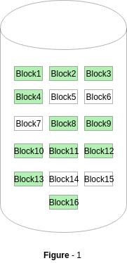
Memory management with bit maps
Bitmap or Bit vector (0000111000000110) –
Advantages –
Simple to understand.
Finding the first free block is efficient. It requires scanning the words (a group of 8 bits) in a bitmap for a non-zero word. (A 0-valued word has all bits 0). The first free block is then found by scanning for the first 1 bit in the non-zero word.

Slide 21
Dynamic Storage-Allocation Problem
First-fit: Allocate the first hole that is big enough
Best-fit: Allocate the smallest hole that is big enough; must search entire list, unless ordered by size
Produces the smallest leftover hole
Worst-fit: Allocate the largest hole; must also search entire list
Produces the largest leftover hole
First-fit and best-fit better than worst-fit in terms of speed and storage utilization

Slide 22
Paging
Physical address space of a process can be noncontiguous; process is allocated physical memory whenever the latter is available
Avoids external fragmentation
Avoids problem of varying sized memory chunks
Divide physical memory into fixed-sized blocks called frames
Size is power of 2, between 512 bytes and 16 Mbytes
Divide logical memory into blocks of same size called pages
Keep track of all free frames
To run a program of size N pages, need to find N free frames and load program
Set up a page table to translate logical to physical addresses
Backing store likewise split into pages
Still have Internal fragmentation

Slide 23
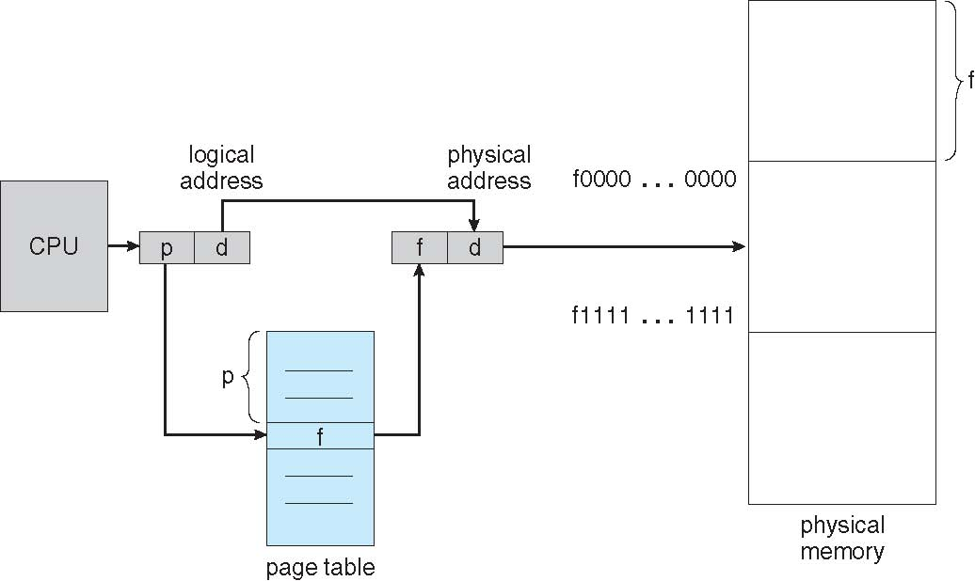
Paging Hardware

Slide 24
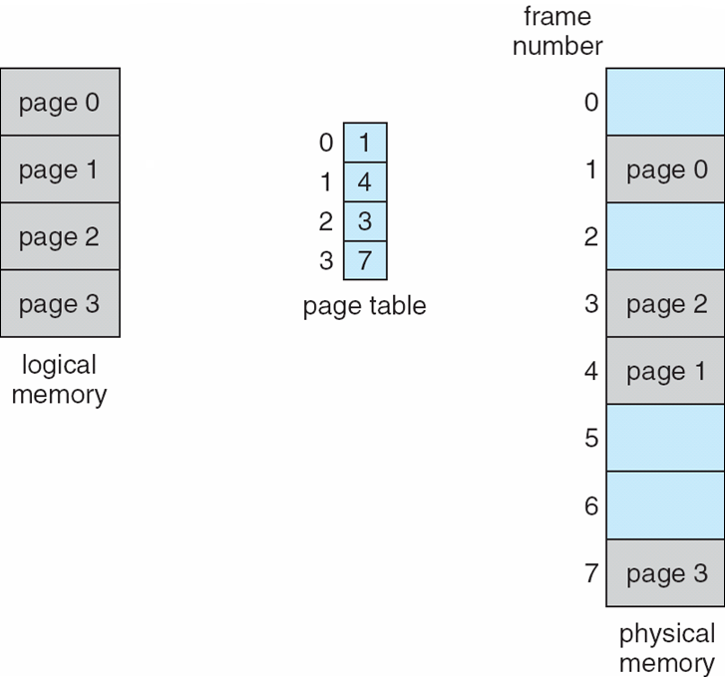
Paging Model of Logical and Physical Memory

Slide 25
Address Translation Scheme
Address generated by CPU is divided into:
Page number (p) – used as an index into a page table which contains base address of each page in physical memory
Page offset (d) – combined with base address to define the physical memory address that is sent to the memory unit
For given logical address space 2^{m} and page size 2^{n}

Slide 26
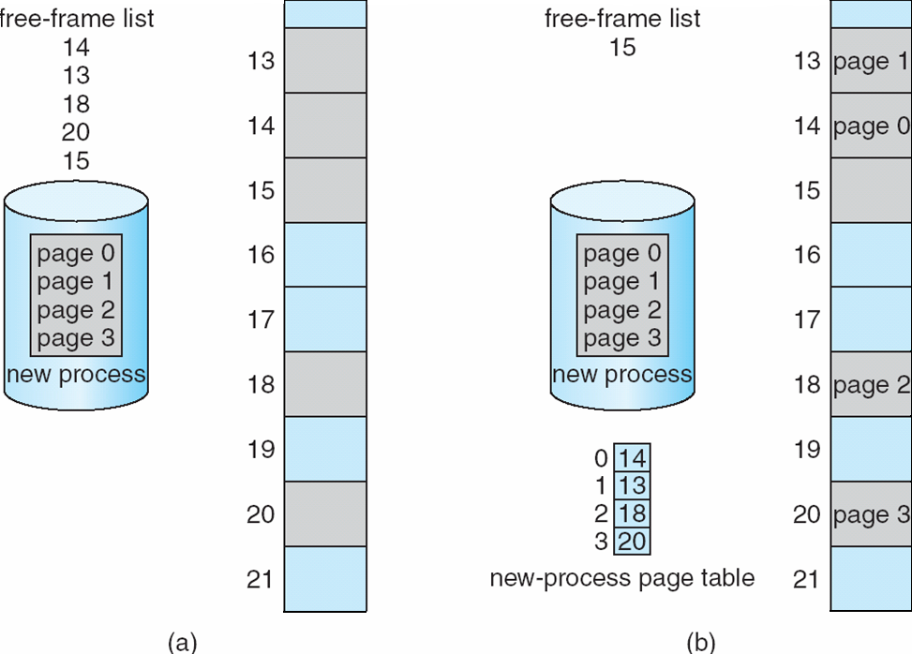
Free Frames

Slide 27
Implementation of Page Table
Page table is kept in main memory
Page-table base register (PTBR) points to the page table
Page-table length register (PTLR) indicates size of the page table
In this scheme every data/instruction access requires two memory accesses
One for the page table and one for the data / instruction
The two memory access problem can be solved by the use of a special fast-lookup hardware cache called associative memory or translation look-aside buffers (TLBs)

Slide 28
Implementation of Page Table (Cont.)
Some TLBs store address-space identifiers (ASIDs) in each TLB entry – uniquely identifies each process to provide address-space protection for that process
Otherwise need to flush at every context switch
TLBs typically small (64 to 1,024 entries)
On a TLB miss, value is loaded into the TLB for faster access next time
Replacement policies must be considered
Some entries can be wired down for permanent fast access

Slide 29
Associative Memory
Associative memory – parallel search
Address translation (p, d)
If p is in associative register, get frame # out
Otherwise get frame # from page table in memory

Slide 30
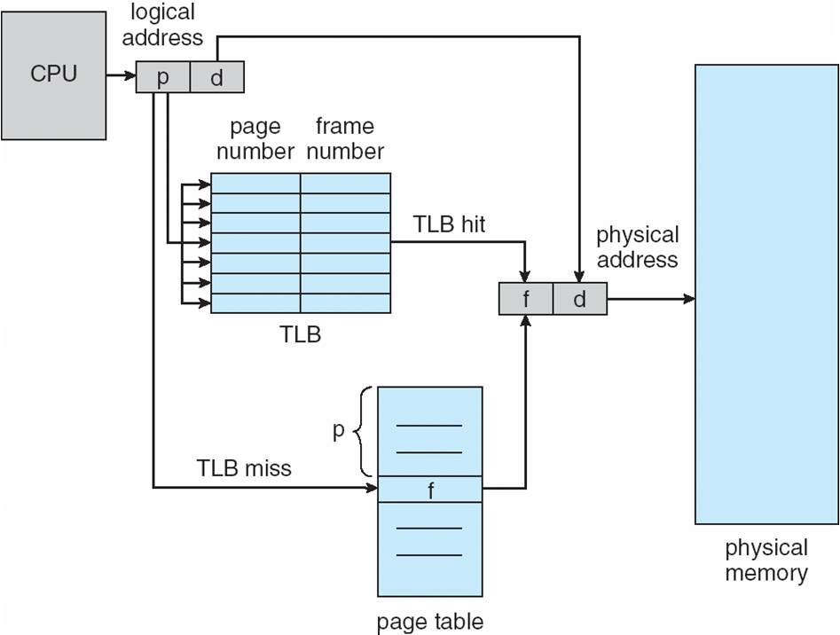
Paging Hardware With TLB

Slide 31
Effective Access Time
Associative Lookup = ε time unit
Can be < 10% of memory access time
Hit ratio = α
Hit ratio – percentage of times that a page number is found in the associative registers; ratio related to number of associative registers
Consider α = 80%, ε = 20ns for TLB search, 100ns for memory access
Effective Access Time (EAT)
EAT = (1 + ε) α + (2 + ε)(1 – α)
= 2 + ε – α
Consider α = 80%, ε = 20ns for TLB search, 100ns for memory access
EAT = 0.80 x 100 + 0.20 x 200 = 120ns
Consider more realistic hit ratio -> α = 99%, ε = 20ns for TLB search, 100ns for memory access
EAT = 0.99 x 100 + 0.01 x 200 = 101ns

Slide 32
Memory Protection
Memory protection implemented by associating protection bit with each frame to indicate if read-only or read-write access is allowed
Can also add more bits to indicate page execute-only, and so on
Valid-invalid bit attached to each entry in the page table:
“valid” indicates that the associated page is in the process’ logical address space, and is thus a legal page
“invalid” indicates that the page is not in the process’ logical address space
Or use page-table length register (PTLR)
Any violations result in a trap to the kernel

Slide 33
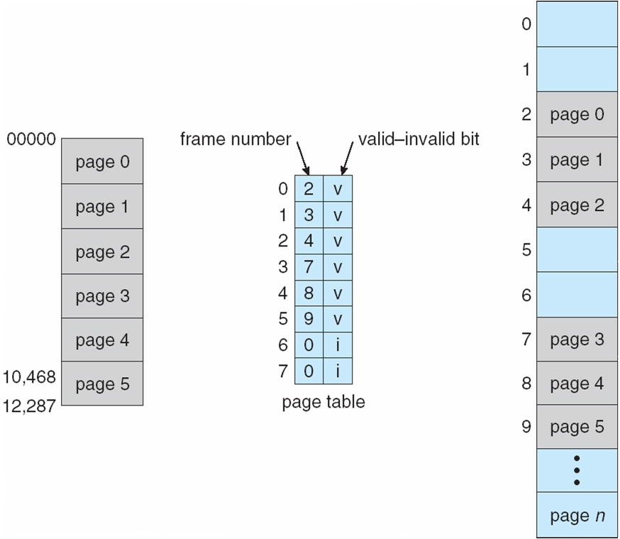
Valid (v) or Invalid (i) Bit In A Page Table

Slide 34
Shared Pages
Shared code
One copy of read-only (reentrant) code shared among processes (i.e., text editors, compilers, window systems)
Similar to multiple threads sharing the same process space
Also useful for interprocess communication if sharing of read-write pages is allowed
Private code and data
Each process keeps a separate copy of the code and data
The pages for the private code and data can appear anywhere in the logical address space

Slide 35
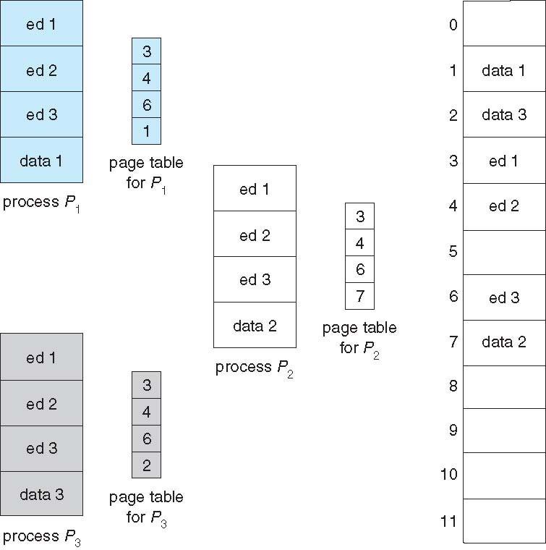
Shared Pages Example

Slide 36
Structure of the Page Table
Memory structures for paging can get huge using straight-forward methods
Consider a 32-bit logical address space as on modern computers
Page size of 4 KB (2¹²)
Page table would have 1 million entries (2³² / 2¹²)
If each entry is 4 bytes -> 4 MB of physical address space / memory for page table alone
That amount of memory used to cost a lot
Don’t want to allocate that contiguously in main memory
Hierarchical Paging
Hashed Page Tables
Inverted Page Tables

Slide 37
Hierarchical Page Tables
Break up the logical address space into multiple page tables
A simple technique is a two-level page table
We then page the page table

Slide 38
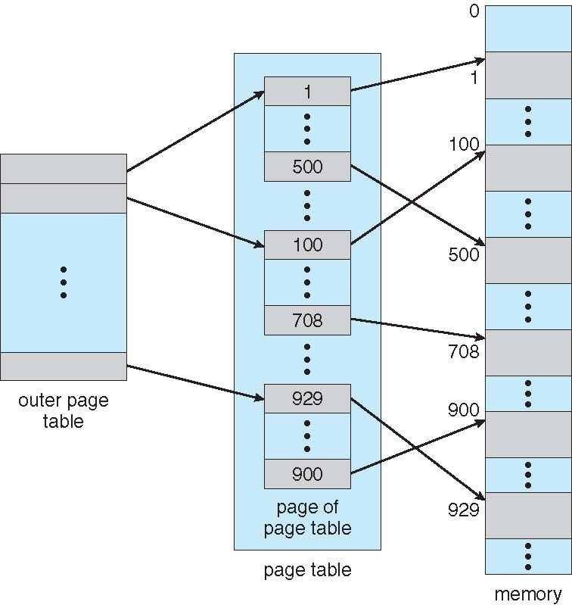
Two-Level Page-Table Scheme

Slide 39
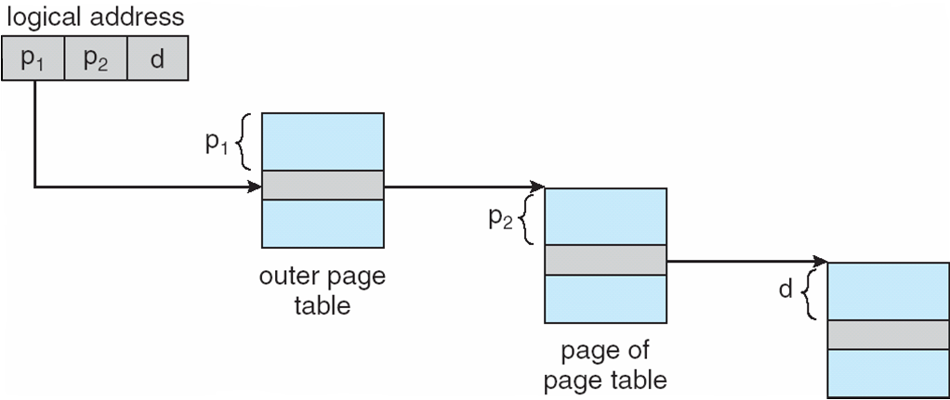
Address-Translation Scheme

Slide 40
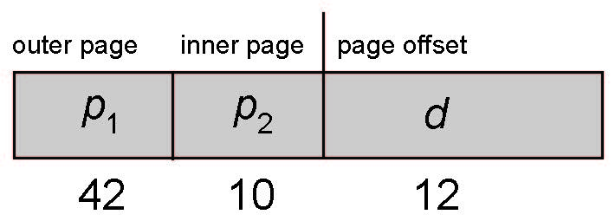
64-bit Logical Address Space
Even two-level paging scheme not sufficient
If page size is 4 KB (2¹²)
Then page table has 2⁵² entries
If two level scheme, inner page tables could be 2¹⁰ 4-byte entries
Address would look like
Outer page table has 2⁴² entries or 2⁴⁴ bytes
One solution is to add a 2nd outer page table
But in the following example the 2nd outer page table is still 2³⁴ bytes in size
And possibly 4 memory access to get to one physical memory location

Slide 41
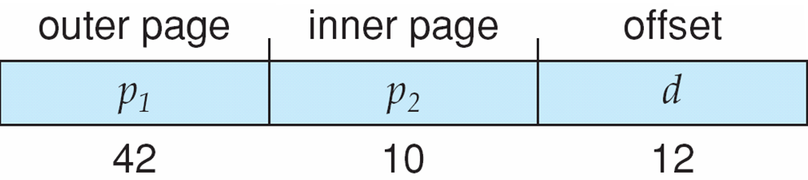
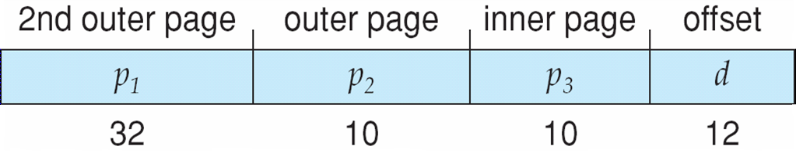
Three-level Paging Scheme

Slide 42
Hashed Page Tables
Common in address spaces > 32 bits
The virtual page number is hashed into a page table
This page table contains a chain of elements hashing to the same location
Each element contains (1) the virtual page number (2) the value of the mapped page frame (3) a pointer to the next element
Virtual page numbers are compared in this chain searching for a match
If a match is found, the corresponding physical frame is extracted
Variation for 64-bit addresses is clustered page tables
Similar to hashed but each entry refers to several pages (such as 16) rather than 1
Especially useful for sparse address spaces (where memory references are non-contiguous and scattered)

Slide 43
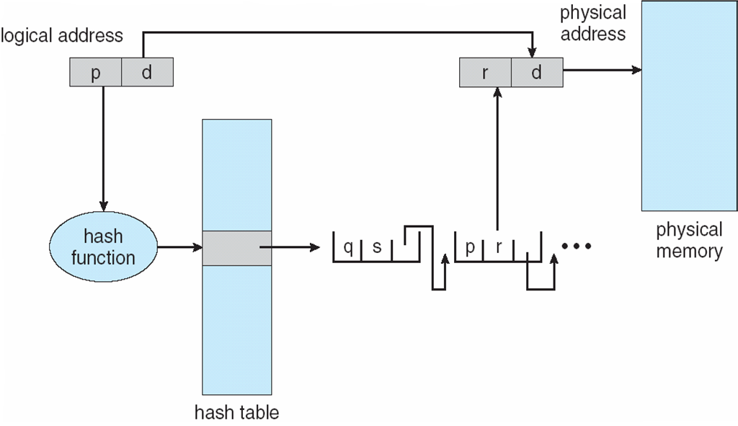
Hashed Page Table
Fig: Hashed Page Table

Slide 44
Inverted Page Table
Rather than each process having a page table and keeping track of all possible logical pages, track all physical pages
One entry for each real page of memory
Entry consists of the virtual address of the page stored in that real memory location, with information about the process that owns that page
Decreases memory needed to store each page table, but increases time needed to search the table when a page reference occurs
Use hash table to limit the search to one — or at most a few — page-table entries
TLB can accelerate access
But how to implement shared memory?
One mapping of a virtual address to the shared physical address

Slide 45
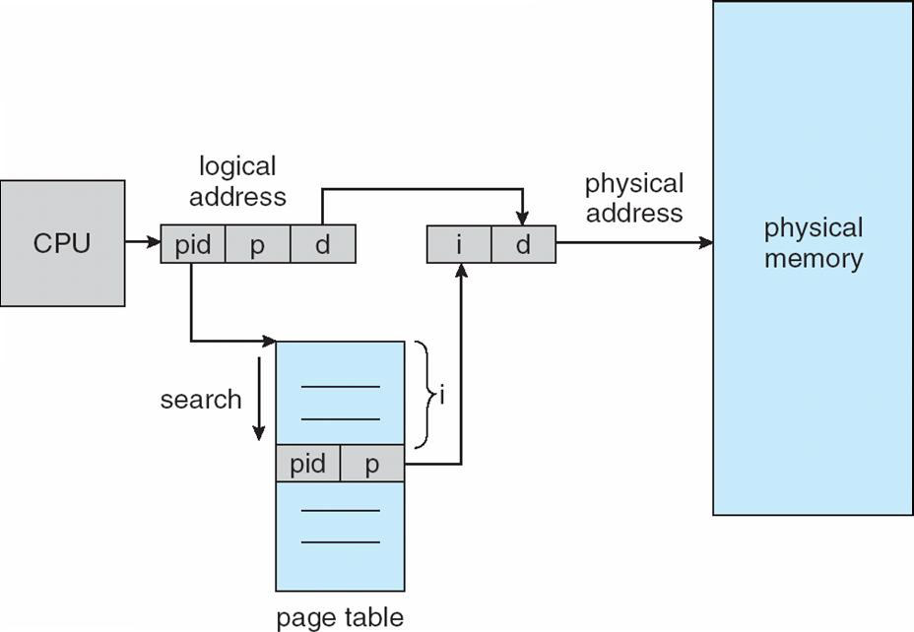
Inverted Page Table Architecture
Fig: Inverted Page Table Architecture

Slide 46
Virtual memory Demand Paging Page Fault Handling of Page Fault

Slide 47
Virtual memory-Introduction
Virtual memory – separation of user logical memory from physical memory.
Only part of the program needs to be in memory for execution
Logical address space can therefore be much larger than physical address space
Allows address spaces to be shared by several processes
Allows for more efficient process creation
Virtual memory can be implemented via:
Demand paging
Demand segmentation

Slide 48
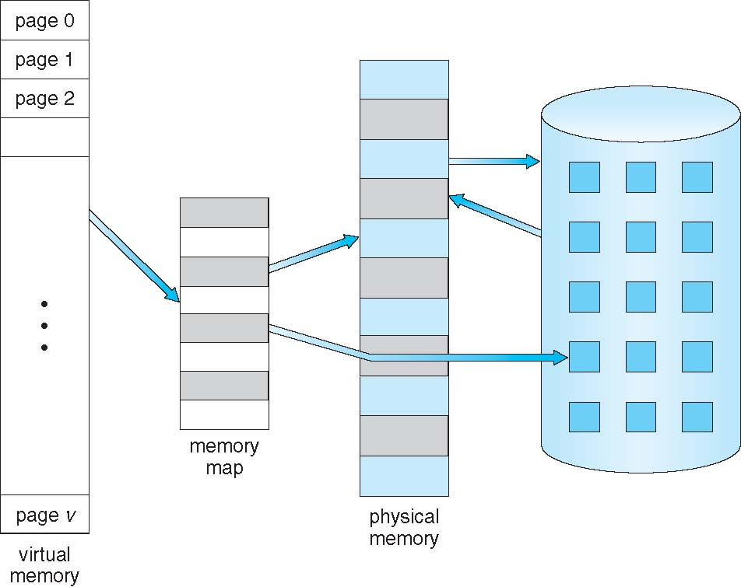
Virtual Memory That is Larger Than Physical Memory

Slide 49
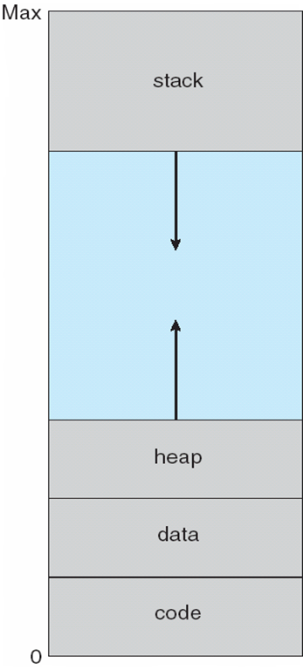
Virtual-address Space

Slide 50
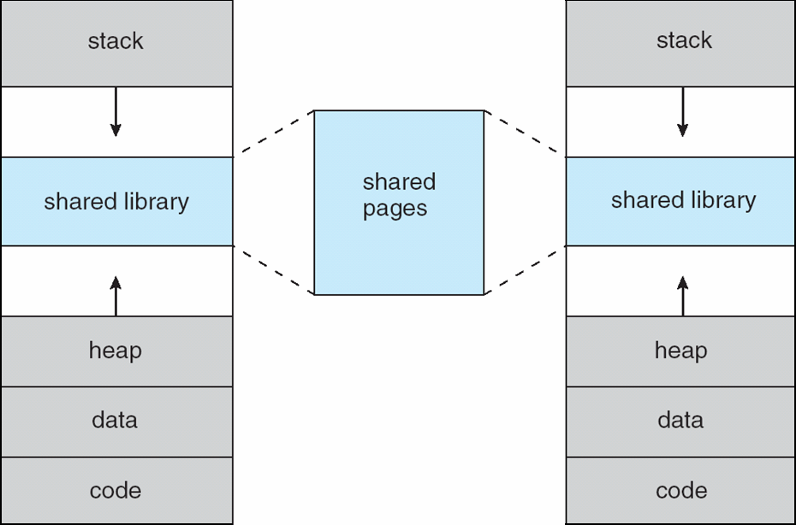
Shared Library Using Virtual Memory

Slide 51
Demand Paging
Bring a page into memory only when it is needed
Less I/O needed
Less memory needed
Faster response (no need to wait for all pages to load)
More users
Page is needed ⇒ reference to it
invalid reference ⇒ abort
not-in-memory ⇒ bring to memory
Lazy swapper – never swaps a page into memory unless page will be needed
Swapper that deals with pages is a pager

Slide 52
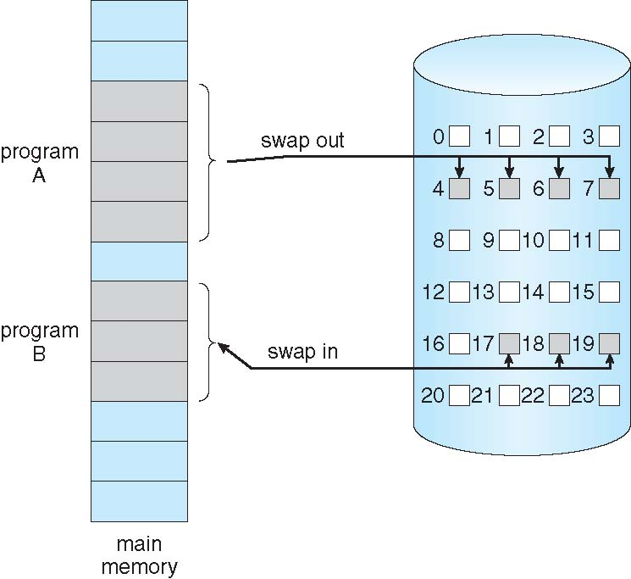
Transfer of a Paged Memory to Contiguous Disk Space

Slide 53
Background
With each page table entry a valid–invalid bit is associated (v ⇒ in-memory, i ⇒ not-in-memory)
Initially valid–invalid bit is set to i on all entries
Example of a page table snapshot:
During address translation, if valid–invalid bit in page table entry
is I ⇒ page fault
v
……….
v
v
v
i
i
i

Slide 54
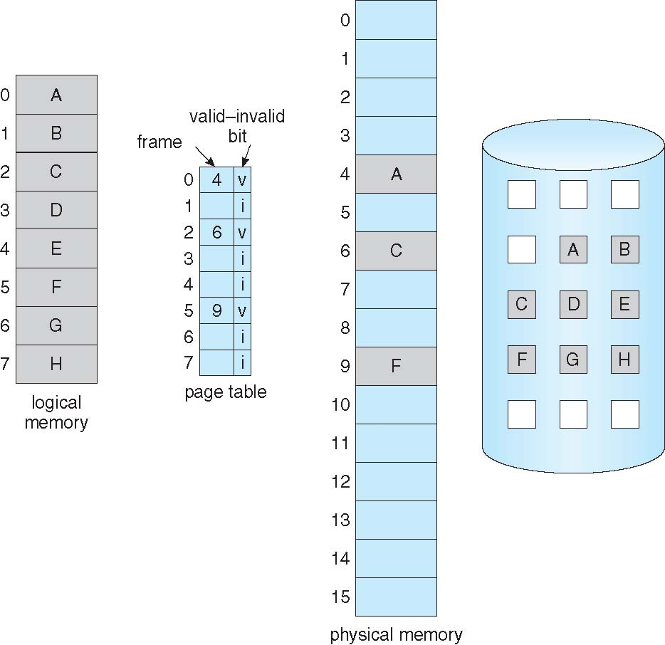
Page Table When Some Pages Are Not in Main Memory

Slide 55
Page Fault
If there is a reference to a page, first reference to that page will trap to operating system:
page fault
Operating system looks at another table to decide:
Invalid reference ⇒ abort
Just not in memory
Get empty frame
Swap page into frame
Reset tables
Set validation bit = v
Restart the instruction that caused the page fault

Slide 56
Page Fault
Restart instruction
block move
auto increment/decrement location

Slide 57
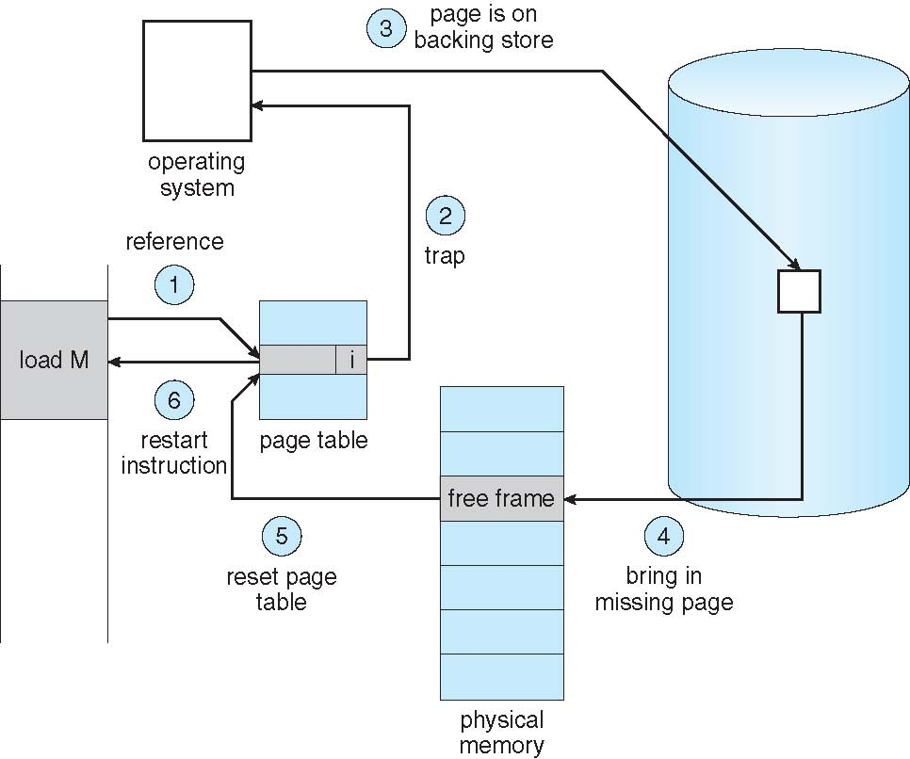
Steps in Handling a page Fault

Slide 58
Performance of Demand Paging
Page Fault Rate 0 ≤ p ≤ 1.0
if p = 0 no page faults
if p = 1, every reference is a fault
Effective Access Time (EAT)
EAT = (1 – p) x memory access
+ p (page fault overhead
+ swap page out
+ swap page in
+ restart overhead
)

Slide 59
Steps in Handling a page Fault
Memory access time = 200 nanoseconds
Average page-fault service time = 8 milliseconds
EAT = (1 – p) x 200 + p (8 milliseconds)
= (1 – p x 200 + p x 8,000,000
= 200 + p x 7,999,800
If one access out of 1,000 causes a page fault, then
EAT = 8.2 microseconds.
This is a slowdown by a factor of 40!!
To keep slowdown to 10% p < 0.0000025 (1 in ~400K)

Slide 60
Summary
Though we have discussed basics of memory management
Virtual memory
Demand Paging
Page Fault
Handling of Page Fault
next page replacement algorithms

Slide 61
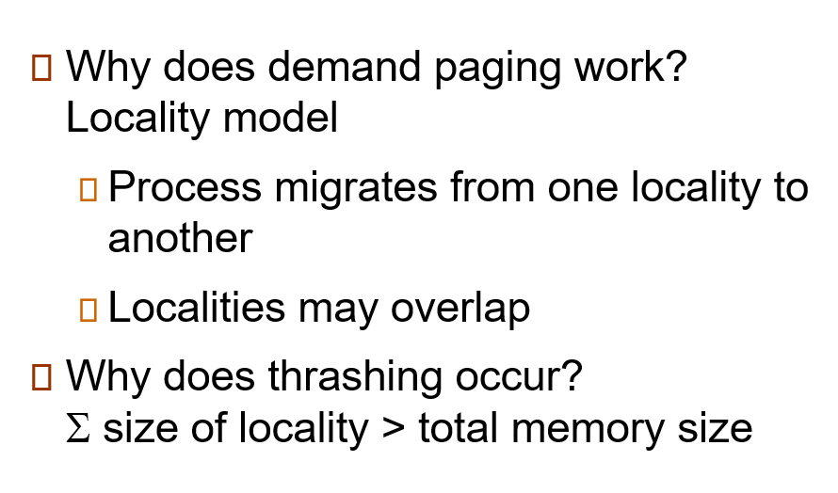
Demand Paging and Thrashing

Slide 62
Thrashing
It occurs when a system spends more time swapping pages in and out of memory than executing actual processes.
This typically happens when the working set (the set of pages currently needed by a process) exceeds the capacity of physical memory.

Slide 63
Locality of reference
In computer science, locality of reference, also known as the principle of locality is the tendency of a processor to access the same set of memory locations repetitively over a short period of time.
There are two basic types of reference locality –
temporal and spatial locality.
Temporal locality refers to the reuse of specific data and/or resources within a relatively small time duration.
Spatial locality (also termed data locality) refers to the use of data elements within relatively close storage locations. Sequential locality, a special case of spatial locality, occurs when data elements are arranged and accessed linearly, such as traversing the elements in a one-dimensional array.

Slide 64
Segmentation with Paging
• Most of the architecture support paging and segmentation. All the pages of segment
need not be in main memory.
• It simplify the memory allocation and speed increases.
It requires a high speed register to store the base address of the segment map table.
• For each segment, page table is created by OS. A pointer to the page table is kept in the segment's entry in the segment table.
• Segments are typically larger than pages.
• The base address get from the segment descriptor table is concatenated with the offset. This new address is referred to as a linear address. Linear address is generated by paging hardware.

Slide 65
Cont..
Advantage
Combines all advantages of paging and segmentation.
Disadvantages
1. It increases hardware cost.
2. It increases processor overheads.
3. Dangers of thrashing.

Slide 66
Segmentation vs Paging
Most architectures support segmentation and paging
Basic idea,
segments exist in virtual address space
base address in segment descriptor table is a virtual address
use paging mechanism to translate this virtual address into a physical address
Now an entire segment does not have to be in memory at one time
only the part of the segment that we need will be in memory

Slide 67
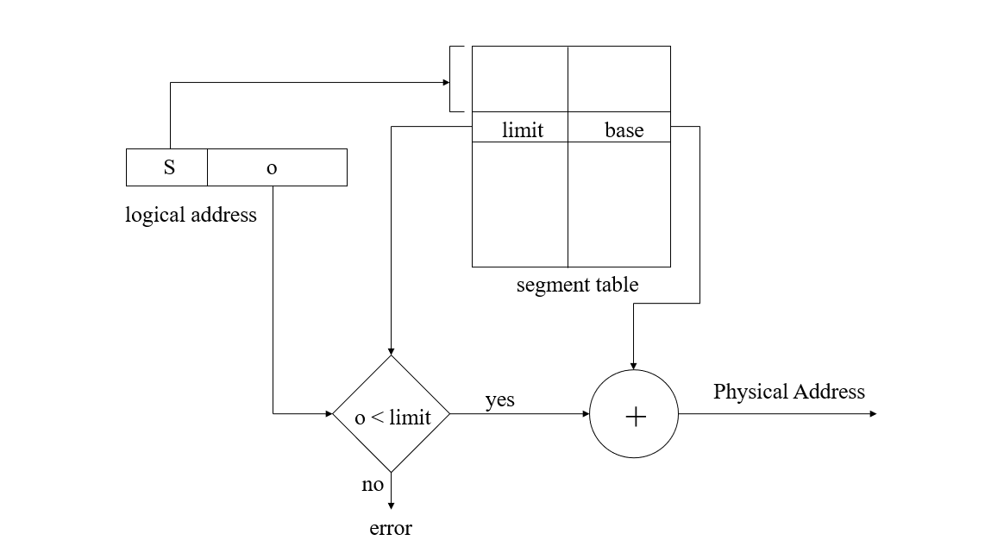
Addressing Segments

Slide 68
Segmentation Issues
Entire segment is either in memory or on disk
Variable sized segments leads to external fragmentation in memory
Must find a space big enough to place segment into
May need to swap out some segments to bring a new segment in

Slide 69
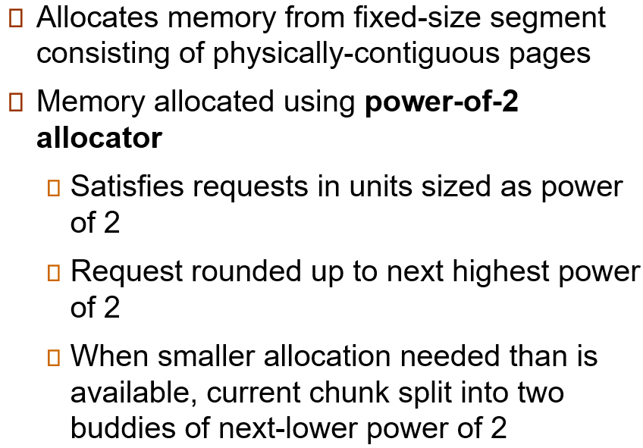
Buddy System

Slide 70
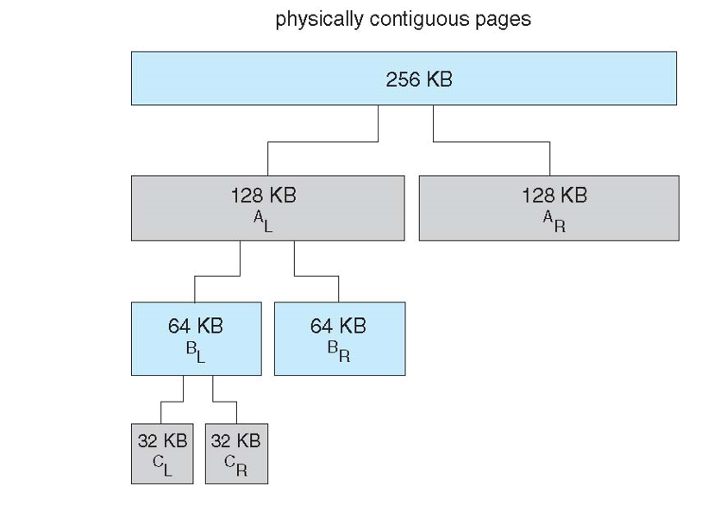
Buddy System Allocator

Slide 71
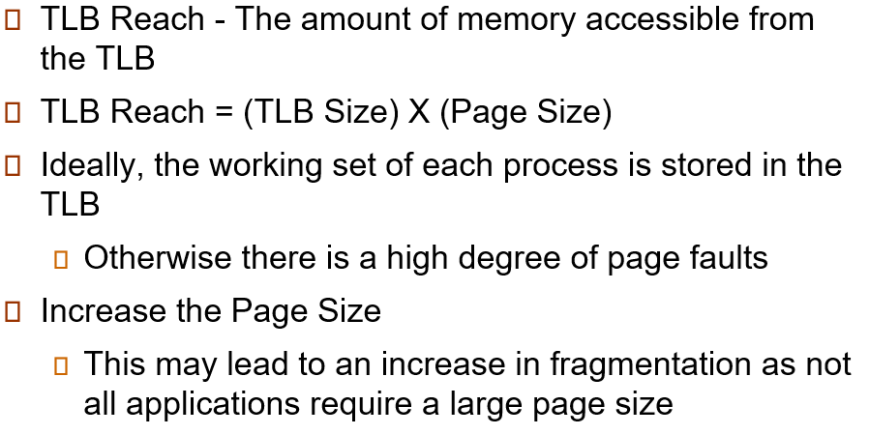
Other Issues: TLB Reach

Slide 72
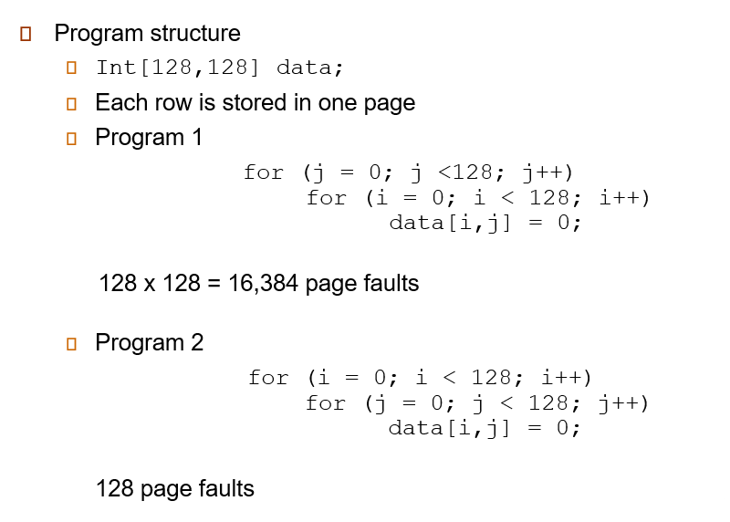
Program Structure

