Slide 1
Unit 6 : Storage Management
by:
Manojeet Roy

Slide 2
Table of Contents
Why File System (FS) ?
FS to File
FS Levels
File (Abstract level Interpretation)
File Naming System (FNS)
Concept of Namespace in CS
File system structure
File attributes
File operations
File types

Slide 3
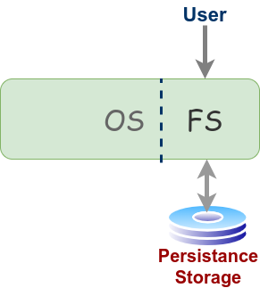
Why FS?
Need of persistence storage.
Hardware for persistence storage:
Magnetic Disk
HDD
SDD
NVMe
OS requires to manage persistence storage.
FS: OS by FS manages mechanism and policies of persistence storage
Types of FS implementations:
Simple – Ext2/3/4
Complex – XFS, JFS
Networked – NFS, CIFS, AFS, Coda
Non-Unix – VFAT, NTFS
Pseudo – Procfs, Sysfs, Configfs, Debugfs

Slide 4
FS to File
[Filesystem (FS)]:
[DEF1]: The FS is a system that implements, organizes, manages, and accesses the files and directories on a device's persistent/secondary storage.
Empowered by OS, FS is a software by which users and applications organizes and manage their files.
This means whenever we do any operation on file, FS get involved.
File (basic definition as user):
File is a sequenced collection of information that have some structure.
One hope following basic operations on file:
[1]: Right privileged user can operate/access (e.g. create/delete, read/write) on file.
[2]: User should able to locate the file in secondary (persistence) memory.

Slide 5
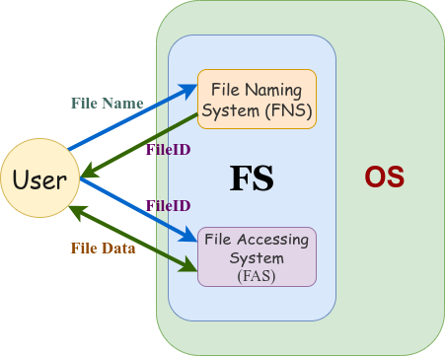
OS provide above 2 basic ops through FS. Therefore, top level components of FS are:
File Naming System (FNS):
File Accessing System (FAS):
Remark:
Using FNS, user can provide “name” to a file. In return, FNS gives a number to a file called fileID (FID).
This FID is used by FAS to access file data.
FS also needs to keep information about file (meta data)
[DEF: file]:
A file is a named sequenced collection of information
that have some structure and have some associated
meta-information about file itself.
The 2 main parts of a FS

Slide 6
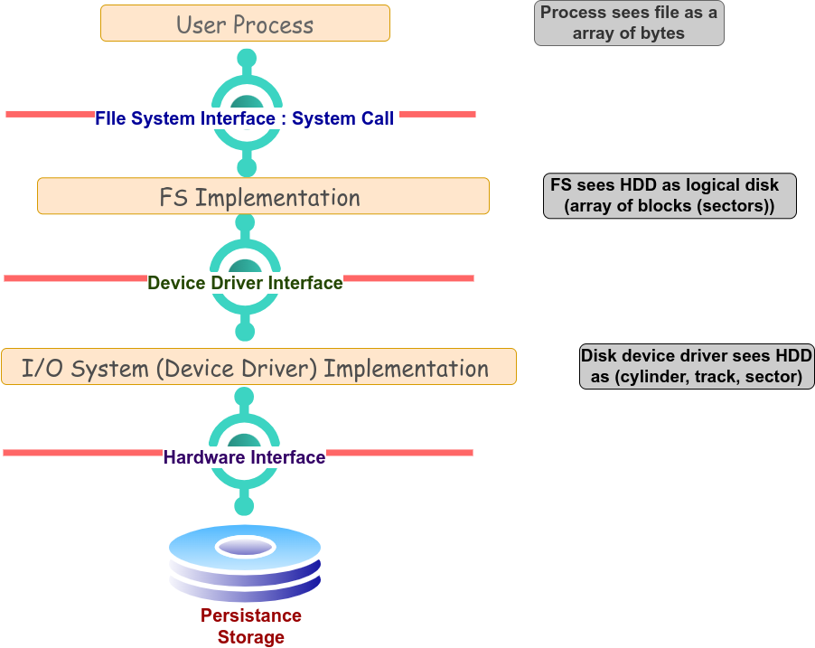
FS Levels
User Process interact with FS by using system call.
FS interface abstracts the details of logical blocks arrangements
FS implementation manages reading and writing of blocks using policies of allocation methods.
Disk device driver interface abstracts the physical details of the drive and represent disk as logical disk
I/O Disk driver implementation interact with hardware interface to manages the actual reading and writing of blocks to the physical disk

Slide 7
File (Abstract level Interpretation)
It is a basic concept in FS
Usual Examples: txt, docx, pdf, bin, exe files, But they are more ……….
Concept of file is an abstraction of “sink for” and/or “source of” data/information.
This concept also provides abstraction for all devices, attached to computer.
[NOTE]: Linux/Unix abstracts everything as a file. For example
[SCREEN]:
It is a write-only file i.e. act as sink for data
It do not store information and only display (write) information on screen
[KEYBOARD]:
It is read-only file i.e. act as source of data
[PRINTER]
It is a write-only file i.e. act as sink for data
Remark:
Every running program starts with 3 files
[Stdin] : This file is responsible to captures the input from keyboard
[StdError]: This file is responsible to send error signals output to console
[Stdout]: This file is responsible to send output to console

Slide 8
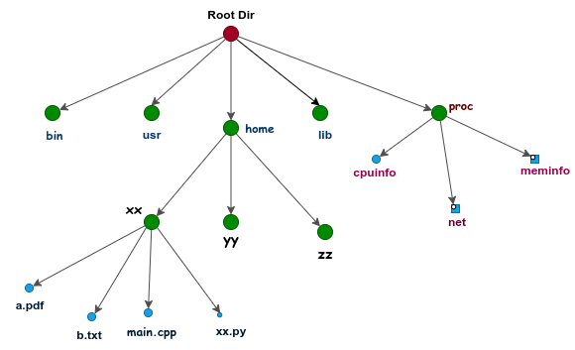
File Naming System (FNS)
Most OS follows “Hierarchical Naming System” (HNS) policy in which
Filenames are structured as a tree (shown in Fig) with following characteristics
Nodes are directories
Leafs are files
HNS named files with structured multipart filenames
A filename represents path from root directory to the file being named
Special Character (“\” or “/”) are used to separate names in the pathname.
For Linux:
Using HNS policy, we can naming and identification (location) of a file (e.g. /home/xx/main.cpp) for the given structural organization

Slide 9
File Naming System (FNS)
[Pathname]:
It consist of series of component names separated by separator character (“\” or “/”)
Main issues related to component names
[1]: What subset of character are allowed to populate component-names
[2]: What would be maximum length of component name.
Types of pathname
Absolute path name
Relative path name

Slide 10
Concept of Namespace in CS
[General Interpretation]:
A namespace is a container (or context) that holds a set of identifiers (e.g. name of a file or variables/objects in programming) that can be uniquely identified.
[OS specific Interpretation]
With respect to FS, namespace refers to the file system hierarchy such that each directory again acts as a namespace for its contents to uniquely identify them.

Slide 11
Concept of Namespace in CS
Example: Suppose, a file result.txt full path is /home/user/documents/result.txt, then
Wrt Home Directory Namespace:
The file result.txt can be uniquely identified by its full path /home/user/documents/report.txt.
This full path specifies the unique location of the file within the entire file system starting from the root directory /.
Wrt Documents Directory Namespace:
Within the documents directory namespace (context), result.txt is uniquely identified as result.txt.
This means The name result.txt is unique within the documents directory
[Observation]:
The identification of the file report.txt can vary based on the namespace context i.e.
Global (File System) Namespace: /home/user/documents/report.txt
Local (Documents Directory) Namespace: report.txt
More discussion on namespace when we study directory and its structure ……..

Slide 12
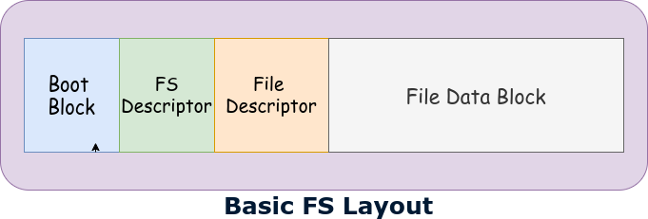
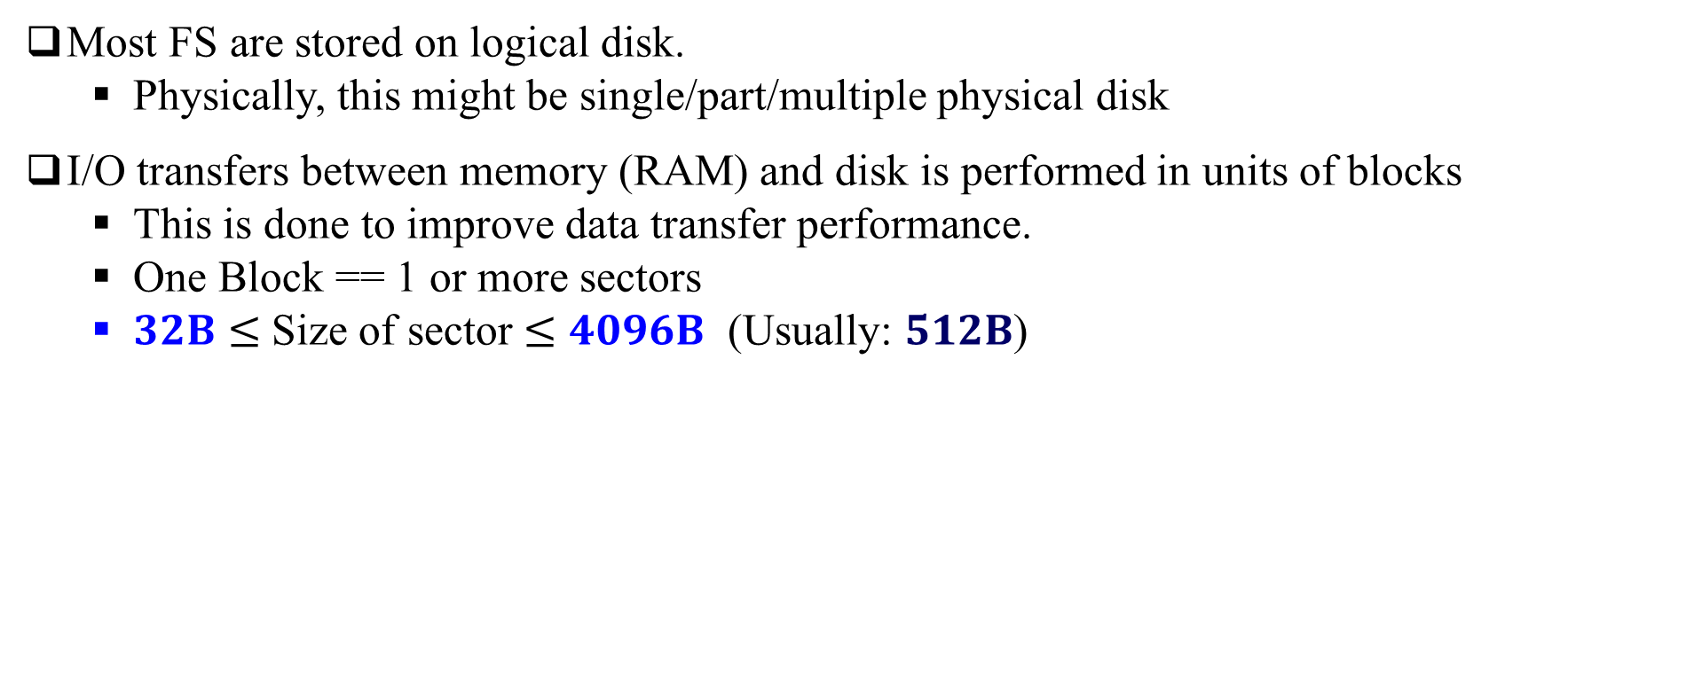
File system structure
Most FS are stored on logical disk.
Physically, this might be single/part/multiple physical disk
I/O transfers between memory (RAM) and disk is performed in units of blocks
This is done to improve data transfer performance.
One Block == 1 or more sectors
$32B≤$Size of sector $≤4096B$ (Usually: $512B$)

Slide 13
File system structure (contd …)
Building blocks of file system structure
Boot Block:
contains info needed by system to boot OS
FS descriptor :
Descriptor for entire FS
Content of FS descriptor area:
Total size of FS (in blocks)
Size of file descriptor area
Location of root directory file descriptor
Timestamp: when FS created, last modified, last used, etc.
Other FS meta data
In Unix it is called as Superblock

Slide 14
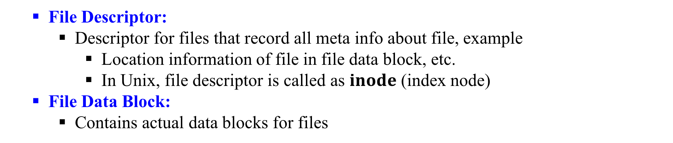
File system structure (contd …)
File Descriptor:
Descriptor for files that record all meta info about file, example
Location information of file in file data block, etc.
In Unix, file descriptor is called as $inode$ (index node)
File Data Block:
Contains actual data blocks for files

Slide 15
File attributes
Common attributes of files are:
Filename
File Type
Location
Size
Protection/Permission
Time stamp
Ownership
Directory Information

Slide 16
File operations
Common file operations:
Create: Allocate space for a new file.
Read: Fetch data from a file.
Write/Append: Add data to a file.
Delete: Remove a file from the file system.
Seek: Move to a specific location in a file.
Open/Close: Prepare file for use/end file usage

Slide 17
File types
File Type | Extensions | Description | Examples
Executable | exe, com, bin | Ready-to-run machine language programs | Windows applications, Linux binaries
Object | obj, o | Compiled machine language, not yet linked | Intermediate files in the compilation process
Source Code | c, cc, java, pas, asm, a | Source code in various programming languages | C source files, Java source files, Pascal programs
Batch | bat, sh | Commands for the command interpreter | Windows batch files, Unix shell scripts
Text | txt, doc | Textual data and documents | Notepad files, Word documents
Word Processor | wp, tex, rtf | Various word processor formats | Word processor documents, LaTeX files, Rich Text Format files
Library | lib, a, so, dll | Libraries of routines for programmers | Dynamic Link Libraries (DLLs), Static libraries (.lib)
Print or View | ps, pdf, jpg | ASCII or binary file in a format for printing or viewing | PDF files, PostScript files, JPEG images
Archive | arc, zip, tar | Related files grouped into one file, sometimes compressed | ZIP files, TAR archives
Multimedia | mpeg, mov, rm, mp3, avi | Binary files containing audio or A/V information | MPEG videos, MP3 audio files, AVI videos

Slide 19
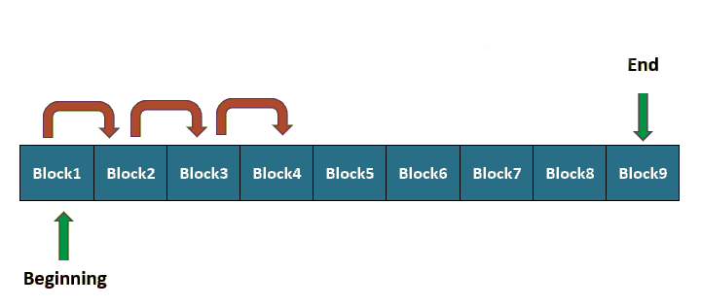
File access method
Contents of file can be accessed using different methods as listed below:
Sequential access
Accessing Way: In order, one record after another
Characteristics:
Simple and easy to implement.
Suitable for text files and log files.
Read and write operations move a pointer sequentially.
Example: Magnetic Tape.
Sequential Access Method

Slide 20
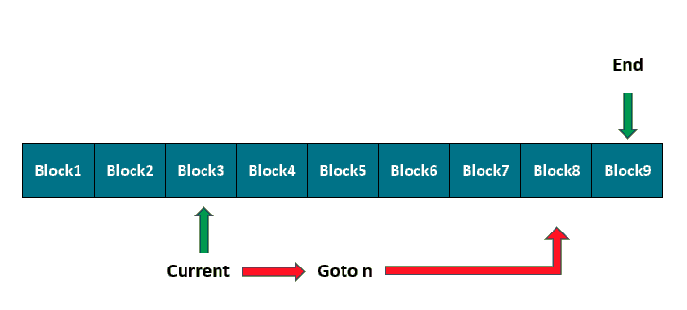
Direct access:
Accessing Way: In any order using a relative address or index, skipping the previous data blocks.
Characteristics:
Allows fast access to any part of the file.
Suitable for databases and large files where quick access is needed.
Each block or record has a unique identifier.
Example: Accessing a specific customer record in a database.
Direct Access Method

Slide 21
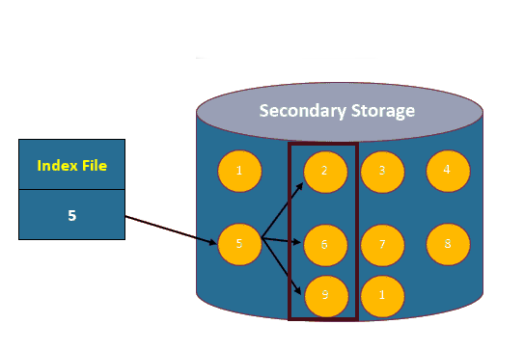
Indexed access:
Accessing Way: In any order, but accessed using particular key(s) or index to find the location of data blocks.
Characteristics:
Combines benefits of both sequential and direct access.
Index file points to data blocks, enabling quick access.
Suitable for large files with varied access patterns.
Example: Accessing chapters in an e-book using a table of contents.
Indexed Access Method

Slide 22
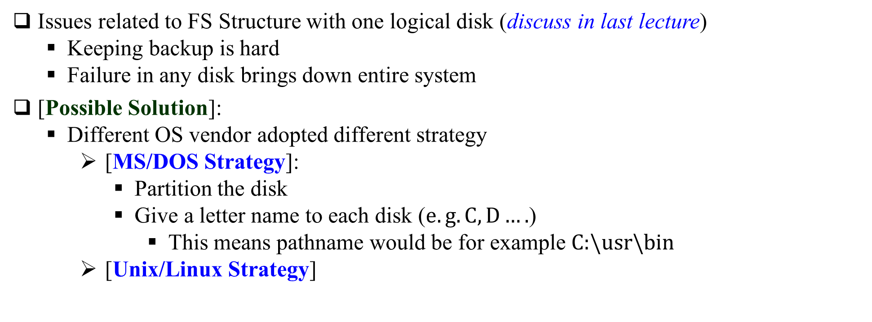
File system mounting
Issues related to FS Structure with one logical disk (discuss in last lecture)
Keeping backup is hard
Failure in any disk brings down entire system
[Possible Solution]:
Different OS vendor adopted different strategy
[MS/DOS Strategy]:
Partition the disk
Give a letter name to each disk ($e.g. C, D….$)
This means pathname would be for example $C:\backslash usr\backslash bin$
[Unix/Linux Strategy]

Slide 23
File system mounting
[Unix/Linux Strategy]
Use Concept of Mounting
Using this concept one can mount given FS into the directory of current OS
Mounting requires 2 arguments
[1] Mounting Point:
A directory in the FNS of current OS
[2] FS which needs to be mounted
[NOTE]: Mounting operation allow user to combine any number of FS into a single directory-tree.

Slide 24
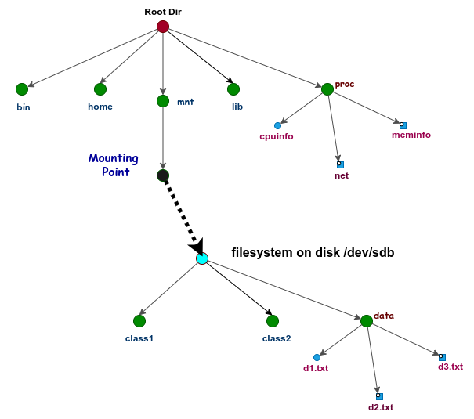
File system mounting ……
Linux FS Mounting

Slide 26
Table of Contents
Disk Structure
Block mapping problem
Disk Allocation Methods
Contiguous Allocation
Linked Allocation
Indexed Allocation

Slide 27
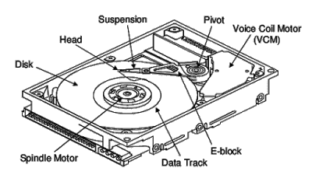
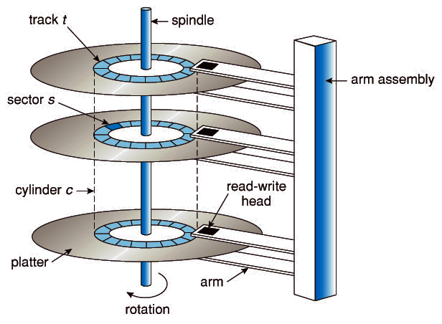
Disk Structure
Platter are staked on top of one another
All platter are attached with same spindle
Data is organized into concentric circle on the platter
These concentric circle are called sector
Motor run at fixed rate $7200 rpm \sim 10000 rpm$
Arm attached to R/W head
R/W head change/sense bit on magnetic surface
Disk Controller [not shown in figure]:
Control the operation on request to the device.
Cross Section
of HDD
Mechanical Structure
of HDD

Slide 28
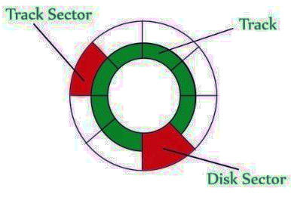
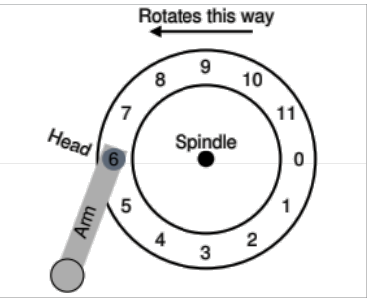
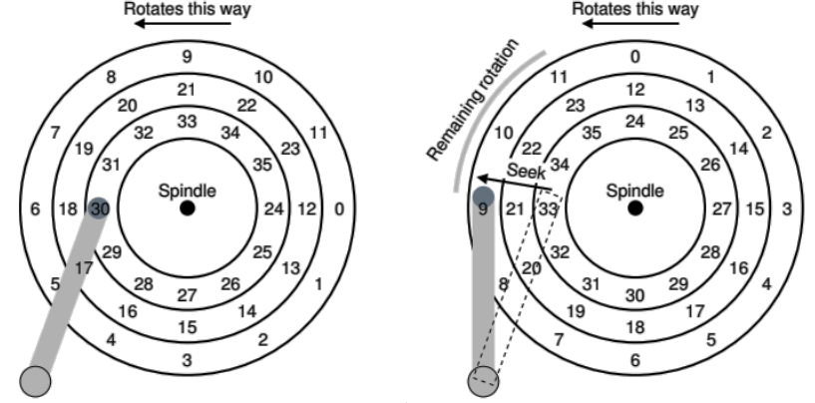
Disk Structure : Simplified
R/W process: (3 components)
SEEK: Positioning R/W head over correct track
ROTATION: Waiting for desired sector to rotate under head
Transfer: Do R/W
Remark
When arm goes from one track to another then due to rotational effect we need to consider Track Skew
Outer tracks covers more distance then inner track.
single track + Head
Geometric View
3 Tracks + Head
+ Seek (Right)

Slide 29
Block mapping problem
[Recall concept from File system structure]:
Disk operation is performed in units of blocks (blks)
Example: Suppose, a file requires 6658B and 1 blk size $=1024B$
We requires 7 blocks where 7th block is partially filled
Issues
Who keep track that How many blks are allocated to the file and size of last partially filled block
How file blks are mapped to actual disk such that
How to allocate space for file, considering the fact that the :
File may appear as variable size.
File can grow as per user’s need.
How efficiently (fast) one can search content within the file blks of a given file
What and where necessary information about files (blk locations etc.) needs to be recorded.
All above and related issues comes under blk-mapping problem which in turn answered by disk allocation methods

Slide 30
Disk Allocation Methods
An allocation method refers to how disk blocks are allocated for files:
Some of the commonly used methods are:
Contiguous Allocation
Linked Allocation
Indexed Allocation

Slide 31
Contiguous Allocation
Allocates a single contiguous set of blocks to a file.
Characteristics:
Simple and easy to implement.
Provides fast access to file data.
Can lead to external fragmentation.
Difficult to find a contiguous block of space for large files.
Advantages:
Fast read/write access due to sequential block placement.
Disadvantages:
Can cause external fragmentation.
Difficult to grow files if adjacent blocks are occupied.

Slide 32
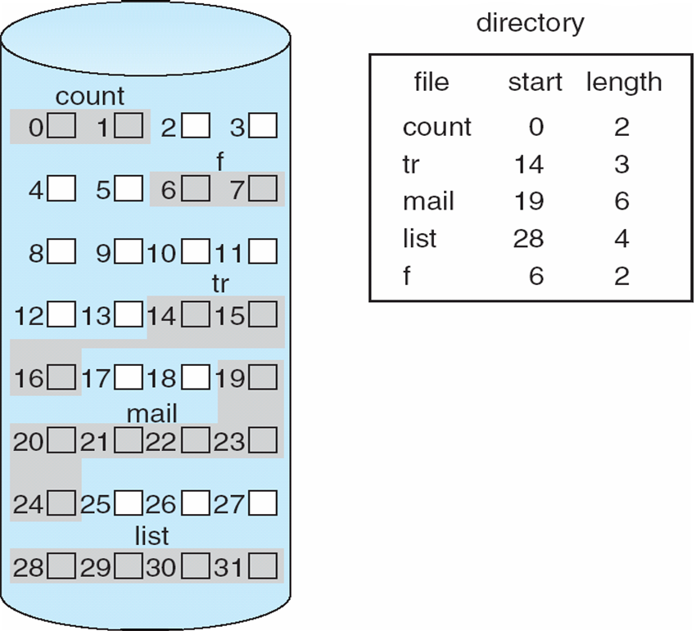
Example Contiguous Allocation

Slide 33
Linked Allocation
Definition: Each file is a linked list of disk blocks, where each block contains a pointer to the next block.
Characteristics:
No external fragmentation.
Only the block pointer is stored in each block.
Suitable for sequential access, not random access.
Advantages:
Simple to implement.
No need for contiguous space, reducing fragmentation.
Disadvantages:
Overhead of storing pointers.
Slower access times due to pointer traversal.

Slide 34
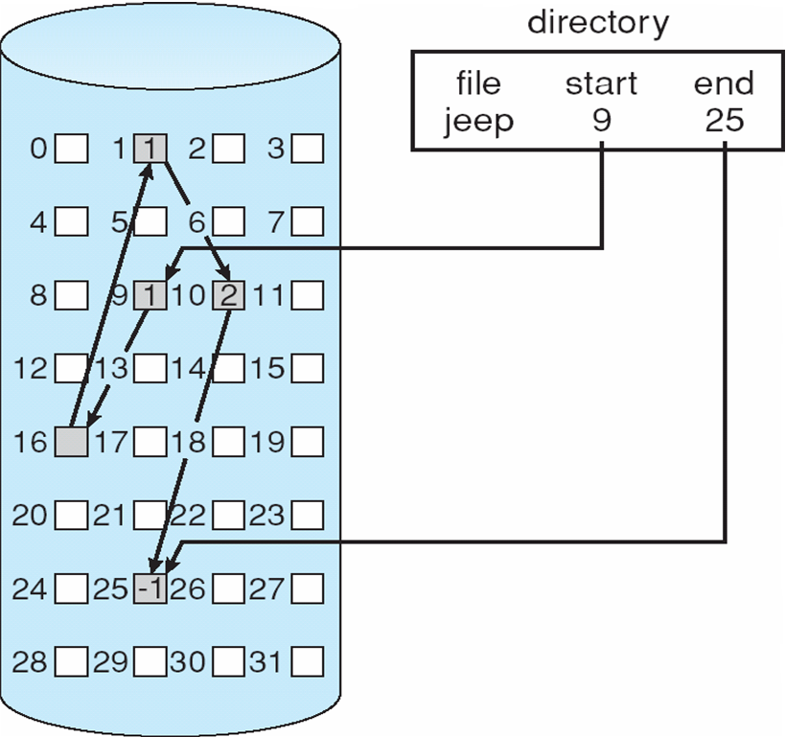
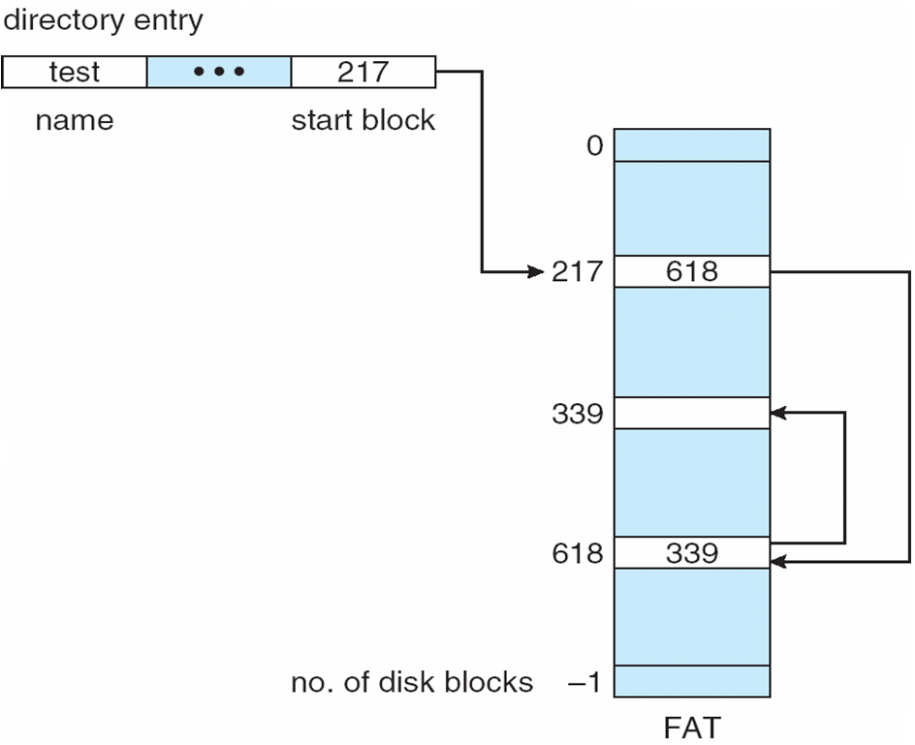
Example Linked Allocation

Slide 35
Indexed Allocation
Definition: Uses an index block to keep track of the blocks allocated to a file.
Characteristics:
An index block contains pointers to all other blocks used by the file.
Supports both sequential and random access efficiently.
Advantages:
No external fragmentation.
Efficient access for both sequential and random reads.
Disadvantages:
Overhead of index block storage.
Limited by the size of the index block.

Slide 36
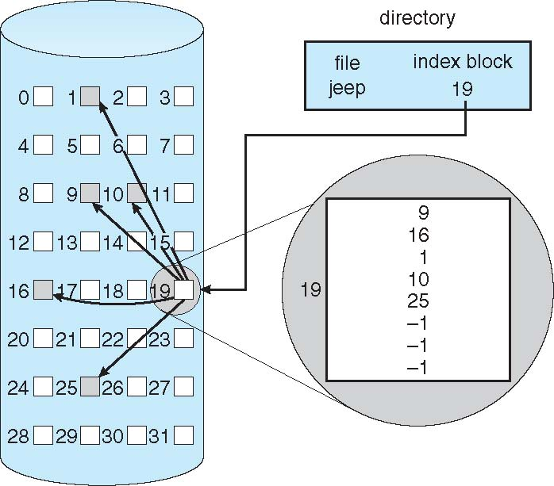
Example Indexed Allocation

Slide 38
Table of Contents
Disk scheduling algorithms

Slide 39
Disk Scheduling Algorithms
The operating system is responsible for using hardware efficiently — for the disk drives, this means having a fast access time and disk bandwidth.
Access time has two major components
Seek time is the time for the disk are to move the heads to the cylinder containing the desired sector.
Rotational latency is the additional time waiting for the disk to rotate the desired sector to the disk head.
Minimize seek time
Seek time ≈ seek distance
Disk bandwidth is the total number of bytes transferred, divided by the total time between the first request for service and the completion of the last transfer.

Slide 40
Disk Scheduling Algorithms
Several algorithms exist to schedule the servicing of disk I/O requests.
We illustrate them with a request queue (0-199).
98, 183, 37, 122, 14, 124, 65, 67
Head pointer 53

Slide 41
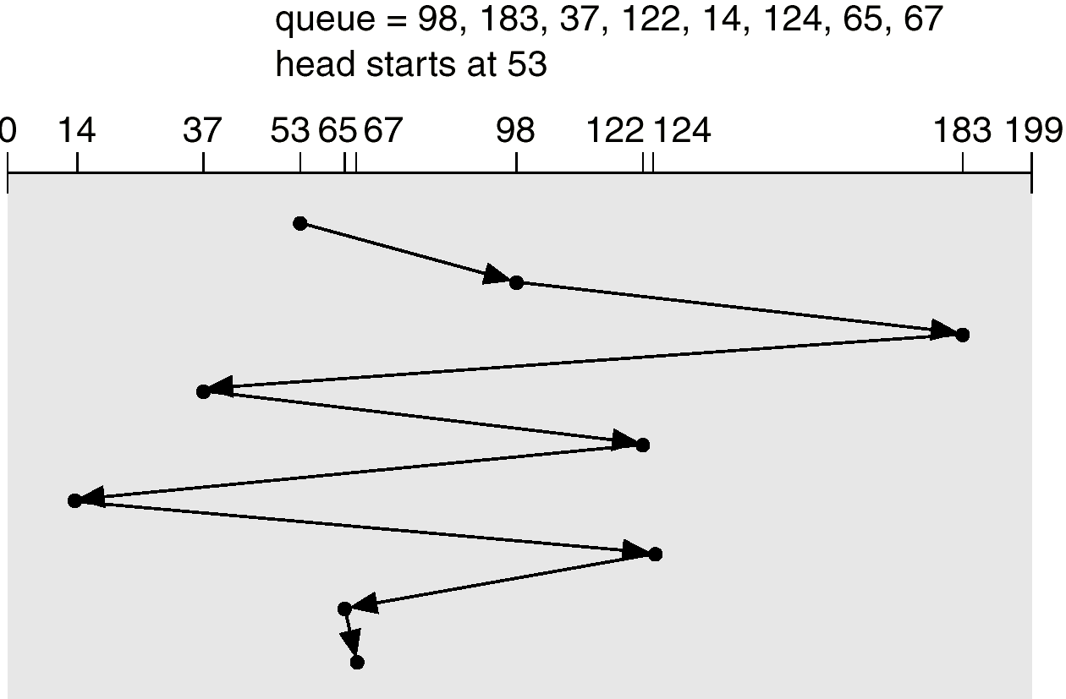
FCFS (First Come First Served)
FCFS algo serves disk I/O requests in the order they arrive as shown in figure.
Advantages
Easy to implement
[Fairness]: Every request has same priority
Preferred when simplicity is crucial despite its potential inefficiency
Disadvantages
Do not consider underline hardware characteristics
If requests are far apart we face long waiting times due to high seek time
Illustration shows total head movement of 640 cylinders.

Slide 42
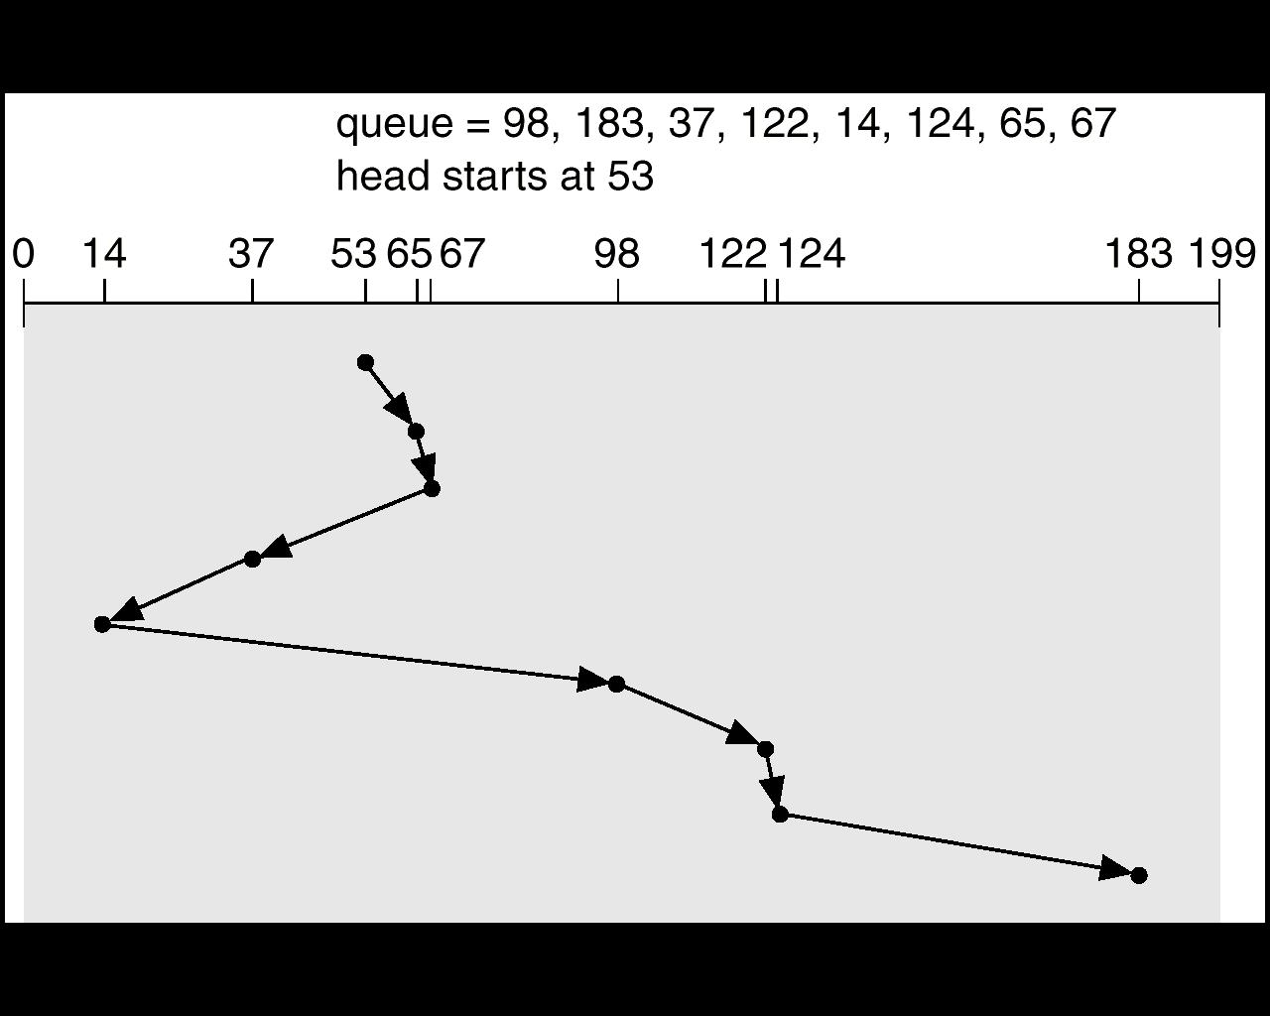
SSTF (Shortest Seek time first)
Pick the request from the queue with the minimum seek time from the current head position as shown in Figure.
Advantages:
By definition reduces total seek time
More efficient than FCFS in minimizing seek time.
Disadvantages:
Can cause starvation and leads to unfairness
More complex to implement than FCFS.
[Starvation in SSFT]: When certain disk I/O requests may be indefinitely delayed as shorter seek time requests keep on arriving and taking precedence.

Slide 43
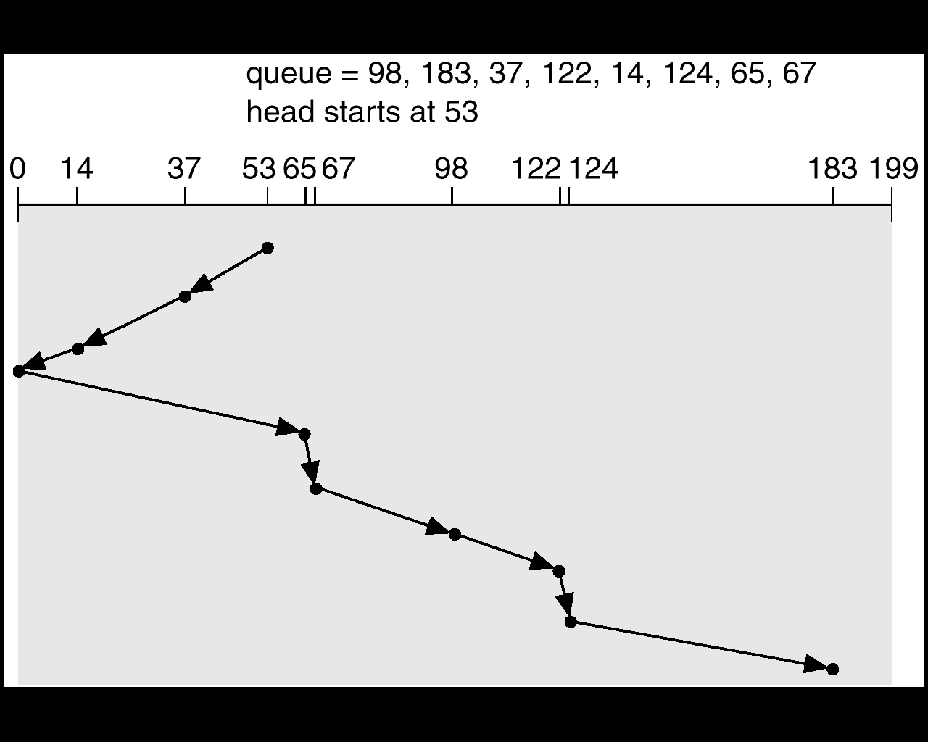
SCAN (Elevator Algorithm)
The disk arm starts at one end of the disk, and moves toward the other end, servicing requests until it gets to the other end of the disk, where the head movement is reversed and servicing continues.
Advantages:
More efficient than FCFS and SSTF in terms of overall seek time.
Provides a more uniform wait time.
Disadvantages:
Can still cause long wait times for requests just missed on the sweep.
More complex to implement than FCFS.
Illustration shows total head movement of 208 cylinders.

Slide 44
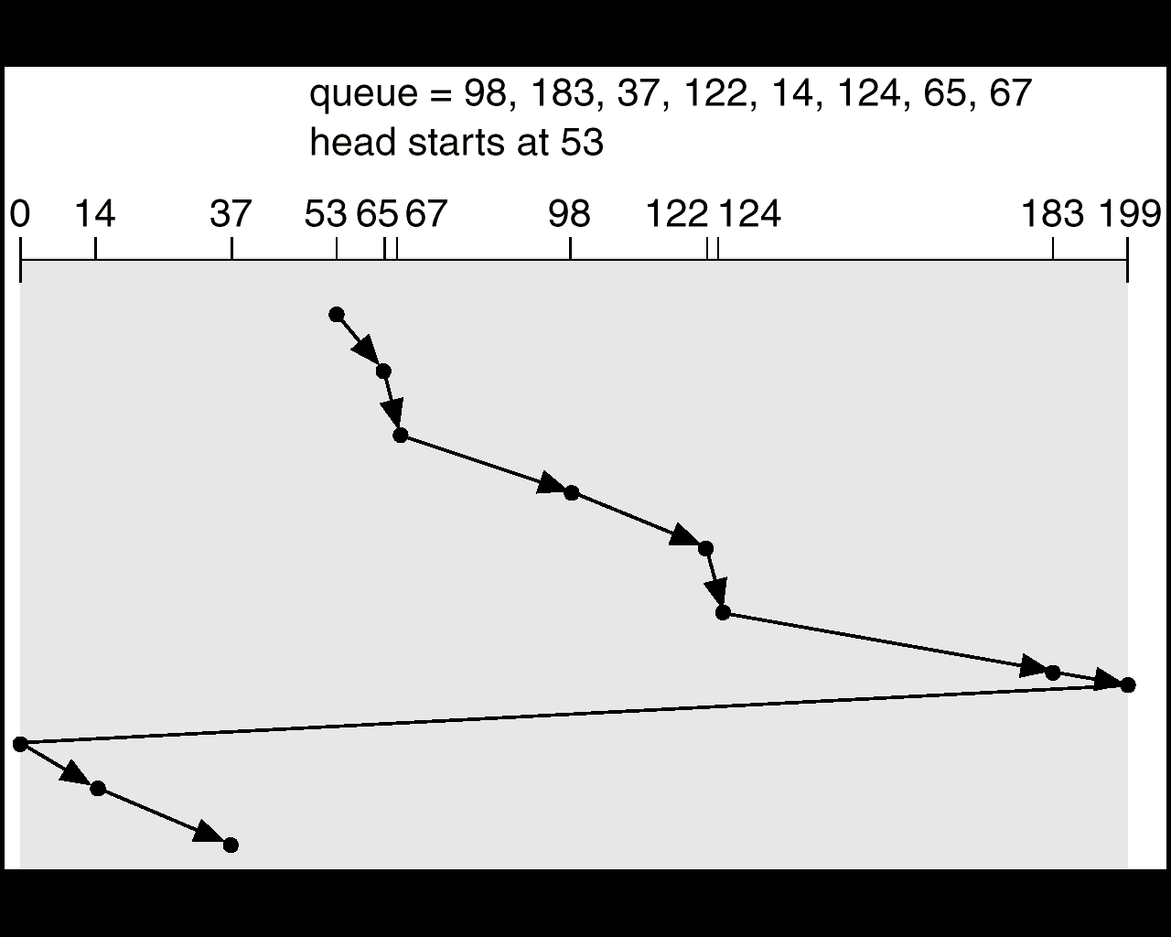
C-SCAN (Circular SCAN)
C-SCAN moves the disk arm towards one end of the disk, servicing requests, and then immediately returns to the beginning without servicing any requests on the return trip.
Treats the cylinders as a circular list that wraps around from the last cylinder to the first one.
Advantages :
Provides a more uniform wait time compared to SCAN.
Reduces the likelihood of starvation compared to SSTF.
Disadvantages :
Can be less efficient than SCAN due to the not serviced return trip.
More complex to implement than FCFS and SSTF

Slide 45
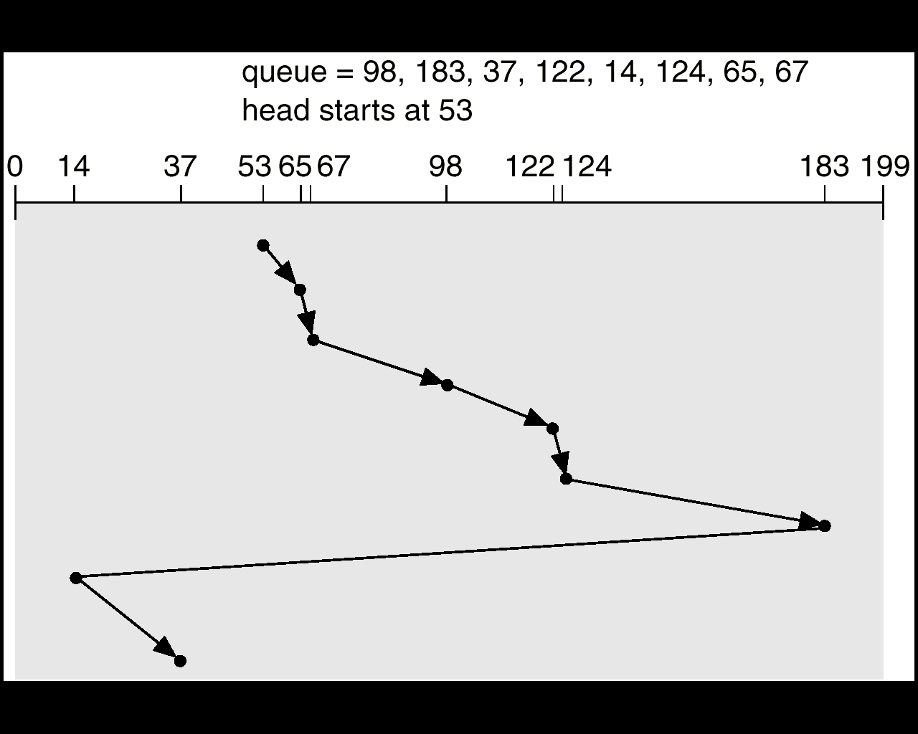
C-LOOK (Circular LOOK)
C-LOOK is similar to C-SCAN but only goes as far as the last request in each direction before reversing.
Advantages:
More efficient than C-SCAN as it avoids unnecessary traversal.
Provides a uniform wait time similar to C-SCAN.
Disadvantages :
Complex to implement.
May have slightly longer seek times than SSTF for some requests.

Slide 46
Selecting a Disk-Scheduling Algorithm
SSTF is common and has a natural appeal
SCAN and C-SCAN perform better for systems that place a heavy load on the disk.
Performance depends on the number and types of requests.
Requests for disk service can be influenced by the file-allocation method.
The disk-scheduling algorithm should be written as a separate module of the operating system, allowing it to be replaced with a different algorithm if necessary.
Either SSTF or LOOK is a reasonable choice for the default algorithm.

Slide 47

Reference Material
Crowley, Charles. Operating systems: a design-oriented approach. McGraw-Hill Professional, 1996.
Arpaci-Dusseau, Remzi H., and Andrea C. Arpaci-Dusseau. Operating systems: Three easy pieces. Arpaci-Dusseau Books, LLC, 2018.
Silberschatz, A., Galvin, P. B., & Gagne, G. (2006). Operating System Concepts, Windows XP update. John Wiley & Sons.

