Slide 1

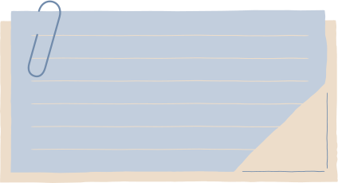


PROJECT PRESENTATION

Slide 2


PRESENTED BY
Kshitij Kardile (3rd Year AIDS)
Yasir Shaikh (3rd Year CSE)

Slide 3

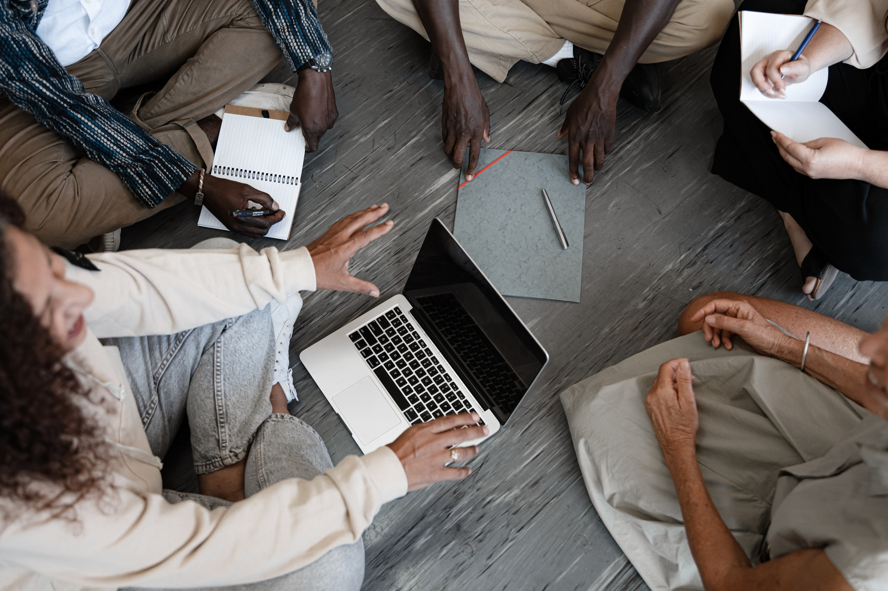
PROBLEM STATEMENT
THE RISE OF E-COMMERCE HAS DRAMATICALLY CHANGED THE WAY CONSUMERS BUY AND SELL PRODUCTS. ONE SEGMENT THAT HAS SEEN SUBSTANTIAL GROWTH IS THE MARKET FOR SECOND-HAND GOODS.
ONE OF THE BIGGEST CONCERNS IN THE SECOND-HAND PRODUCT MARKET IS THE PREVALENCE OF FAKE AND COUNTERFEIT ITEMS. THESE FRAUDULENT GOODS NOT ONLY DECEIVE CONSUMERS BUT ALSO UNDERMINE THE TRUST IN THE MARKETPLACE, POTENTIALLY CAUSING SUBSTANTIAL FINANCIAL LOSSES AND DAMAGING REPUTATIONS. TRADITIONAL METHODS OF VERIFYING PRODUCT AUTHENTICITY ARE OFTEN , INEFFICIENT, AND PRONE TO ERRORS.

Slide 4

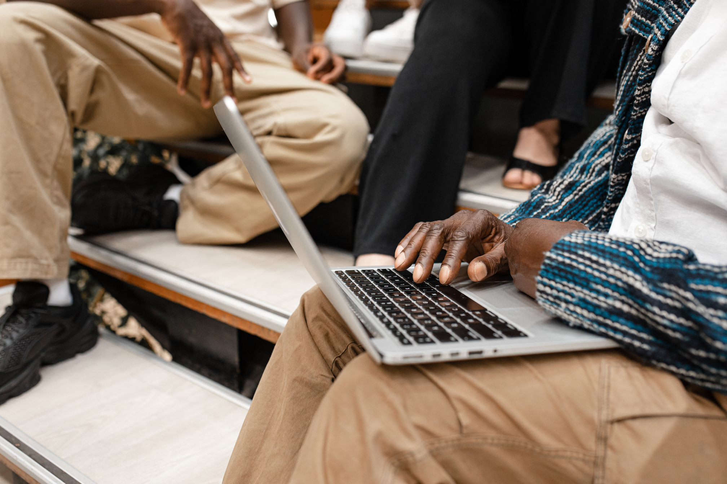
PROPOSED SOLUTION
To address these challenges, this project proposes the implementation of a blockchain-based system for the sale and verification of second-hand products. Blockchain technology offers a decentralized, transparent, and immutable ledger, making it an ideal solution for tracking the provenance and authenticity of products. By leveraging blockchain, we can create a secure and trustworthy platform that ensures the integrity of the second-hand market.

Slide 5


DETAILED DESCRIPTION OF THE PROJECT
The authenticity of the Second-Hand product will be verified through miners, where the seller will upload the images of the product which will then be verifed.
Similarly, once the buyers receive the product, they can upload images of the product to recheck the authenticity of the product.
If the product is counterfeit, then the payment will be returned to the buyer, and a penalty fee will also be deducted from the seller for returning the product.
We will be using IPFS to store images in hash format.

Slide 6
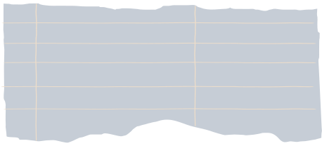
CONCLUSIONS AND NEXT STEPS
The integration of blockchain technology into the second-hand product market offers a promising solution to the pervasive problem of counterfeit goods. This project aims to establish a secure, transparent, and trustworthy marketplace where users can confidently buy and sell second-hand products, assured of their authenticity through blockchain verification.

