Slide 1

KEY MANAGEMENT SCHEME FOR SECURE COMMUNICATION
Name:- Kshitij Koul
University Roll No. :- 2018895
Mentor Name :- Prof. (Dr.) Mohammad Wazid
Designation :- Associate Professor

Slide 2
INTRODUCTION
In today's digital era, secure communication is of utmost importance due to the exponential growth of data transmission and the increasing number of malicious actors seeking unauthorized access to sensitive information. To ensure the confidentiality, integrity, and authenticity of data exchanged between communicating entities, a robust key management scheme is essential. Key management plays a pivotal role in facilitating secure communication by securely generating, distributing, and maintaining cryptographic keys used for encryption and decryption processes.
The primary objective of a key management scheme is to establish a secure and efficient method for generating, distributing, revoking, and updating cryptographic keys. A well-designed key management scheme ensures that only authorized parties can access and utilize these keys, minimizing the risk of unauthorized interception or tampering of sensitive information.

Slide 3
Key management schemes are widely employed in various communication systems, including virtual private networks (VPNs), secure messaging applications, secure email systems, and internet banking. These schemes rely on sophisticated cryptographic algorithms and protocols to protect the confidentiality and integrity of data while maintaining the availability of communication channels.
The key management scheme involves several crucial components, including key generation, key distribution, key storage, and key revocation. Key generation entails the creation of strong and random cryptographic keys that are computationally infeasible to guess or derive. Key distribution mechanisms establish secure channels for transmitting the keys to authorized entities, ensuring that they reach the intended recipients without interception or tampering.

Slide 4
METHODOLOGY
In this project we’ve developed a protocol in SPDL for management of keys using secure communication between sender and receiver entity.After designing the protocol we’ve verified it using Scyther tool.
Scyther is an automated security tool that is used for analyzing the security of cryptographic protocols. It can be used to detect vulnerabilities and weaknesses in protocols and verify their security properties.It was developed by Cas Cremers and his colleagues as a tool for formal analysis of cryptographic protocols. It is an open-source tool that is available for free and can be downloaded from the official Scyther website.The main purpose of Scyther is to analyze the security of cryptographic protocols by modeling them and then automatically searching for attacks or vulnerabilities. It uses formal verification techniques and symbolic analysis to explore the possible execution paths of a protocol and check for security properties such as confidentiality , integrity and authentication

Slide 5
Scyther supports various security models and cryptographic primitives, including symmetric and asymmetric encryption, digital signatures, key exchange protocols, and more. It provides a high-level language called the Scyther Security Protocol Description Language (SPDL), which allows users to describe their protocols in a concise and readable manner. One of the key features of Scyther is its ability to automatically generate attack scenarios and identify potential vulnerabilities in protocols. It can generate an attack tree that shows the different attack paths and the conditions required for each attack to succeed. This helps protocol designers and security analysts to understand the weaknesses in their protocols and take appropriate measures to address them.
Scyther is a powerful tool, but it is not a substitute for careful protocol design and analysis. It is always recommended to use Scyther as part of a comprehensive security evaluation process that includes other techniques such as formal verification, manual code review, and penetration testing.Tools below are the reqirements to run/verify protocol in Scyther.
GraphViz library
Python
wxPython libraries

Slide 6
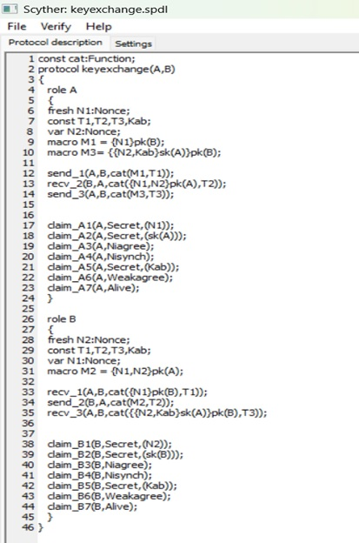
RESULT AND DISCUSSION
After this demo protocol verification , this is how it gives output. In the below results we can observe that the protocol is secured & completely verified.

Slide 7
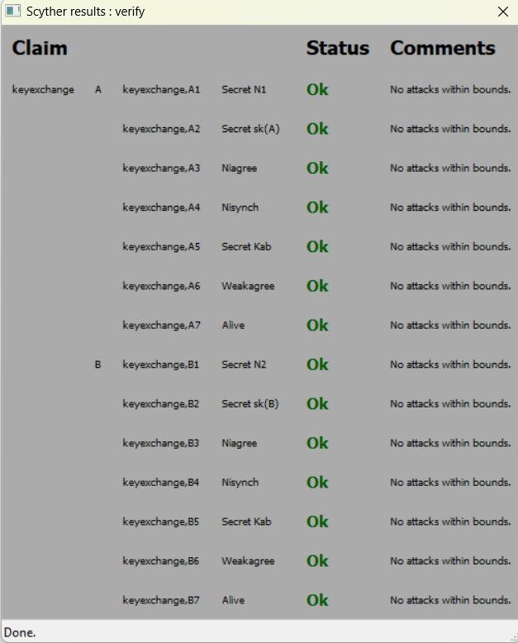

Slide 8
Conclusion and Future Work
A robust key management scheme utilizing secure communication techniques is crucial for ensuring the security of cryptographic systems. By employing secure communication protocols, such as symmetric and asymmetric encryption, key exchange protocols, and digital signatures, organizations can establish and maintain secure communication channels. Proper key generation, distribution, storage, and revocation mechanisms further enhance the security of cryptographic systems, protecting sensitive information from unauthorized access and ensuring the confidentiality, integrity, and authenticity of communication.

Slide 9
In future ,we can implement a key management scheme using secure communication having consideration of more secure aspects, such as:
a. Authentication: Ensuring the authenticity of communicating entities and preventing impersonation or man-in-the-middle attacks.
b. Secure Channels: Utilizing secure communication channels (e.g., encrypted connections, VPNs) to protect key exchange and transmission.
c. Access Controls: Applying appropriate access controls to restrict key access to authorized entities only.
d. Key Lifetime Management: Regularly reviewing and refreshing keys to minimize the risk of compromise due to prolonged exposure or weakened cryptographic algorithms.
e. Key Backup and Recovery: Implementing secure backup and recovery mechanisms to prevent data loss and facilitate key restoration.

