Slide 1
Implementation and optimization of machine learning algorithm
By
Yash Govilkar (4722)
Kshitij Mahajan(4739)
Shubham Kale(4730)

Slide 2
Aim of the Project
Implement a widely used machine learning algorithm using commonly available python libraries and optimize that ML algorithm to reinforce the performance of machine learning algorithm.

Slide 3
Scope and Objectives
The praposed optimization method should enhance the performance of algorithm and will outperform other methods. To choose a widely used machine learning algorithm. To implement ML algorithm for popular application. To optimize the given algorithm to reinforce the performance. To compare the results of praposed optimization method with methods that are being currently used.

Slide 4
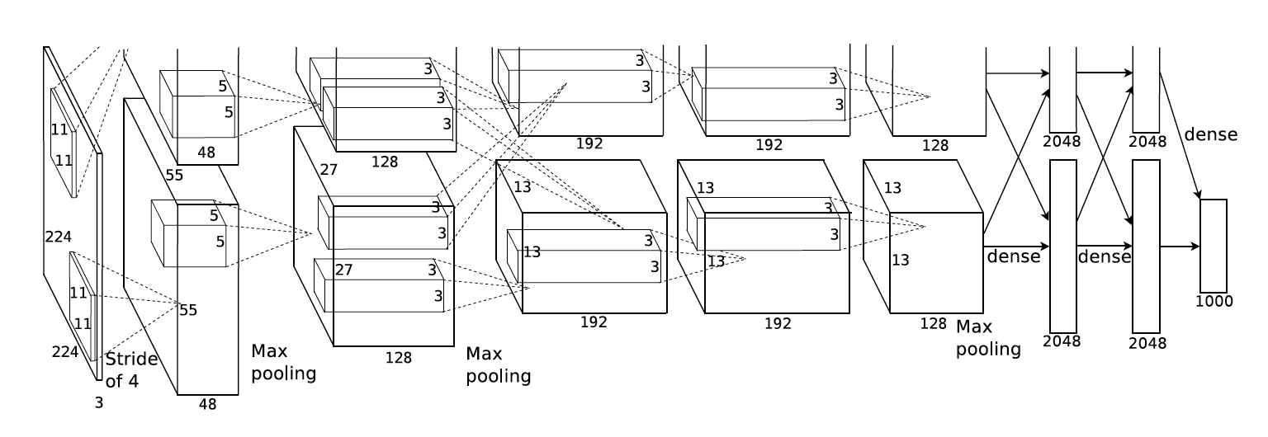
Alexnet Architecture

Slide 5
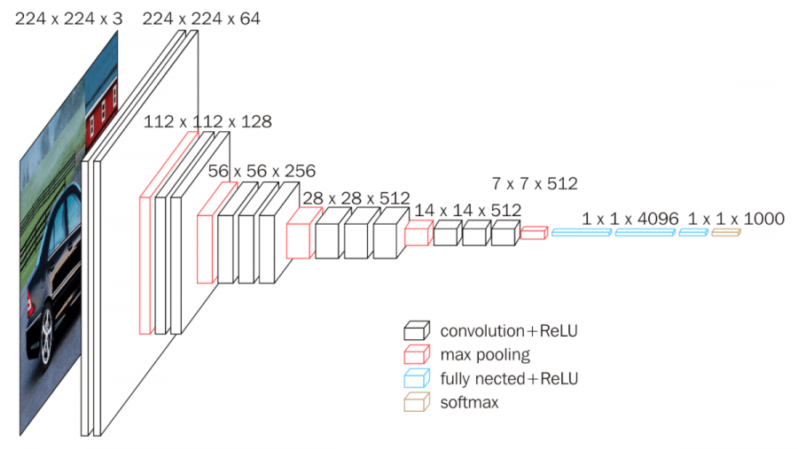
VGG Architecture

Slide 6
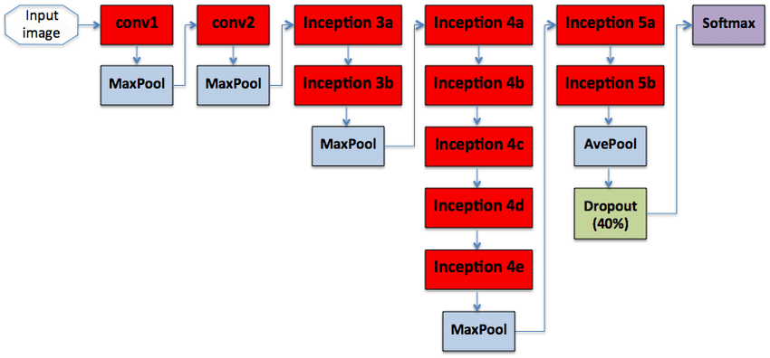
GoogleNet Architecture

Slide 7
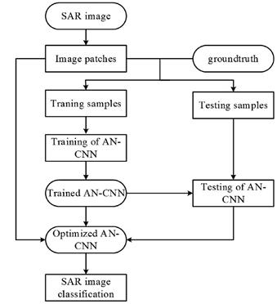
Flow Chart

Slide 8
Design of CNN
A Convolutional Neural Network (ConvNet/CNN)[20] is additionally a Deep Learning algorithm which could absorb an input image, assign importance (learnable weights and biases) to numerous aspects/objects within the image and be able to differentiate one from the choice. The pre-processing required during a ConvNet is way lower as compared to other classification algorithms. While in primitive methods filters are hand-engineered, with enough training, ConvNets have the power to be told these filters/characteristics. The architecture of a ConvNet is analogous thereto of the connectivity pattern of Neurons within the Human Brain and was inspired by the organization of the world. Individual neurons answer stimuli only during a restricted region of the sphere of regard called the Receptive Field. a bunch of such fields overlap to hide the full area.

Slide 9
Convolutional Layer:
When programming a CNN, the input is additionally a tensor with shape (number of images) x (image width) x (image height) x (image depth). Then after passing through a convolutional layer, the image becomes abstracted to a feature map, with shape (number of images) x (feature map width) x (feature map height) x (feature map channels). A convolutional layer within a neural network should have the subsequent attributes: 1.Convolutional kernels defined by a width and height (hyper-parameters). 2The number of input channels and output channels (hyper-parameter). 3.The depth of the Convolution filter (the input channels) must be adequate the amount channels (depth) of the input feature map.

Slide 10
Pooling Layer:
Convolutional networks may include local or global pooling layers to streamline the underlying computation. Pooling layers reduce the size of the information by combining the outputs of neuron clusters at one layer into one neuron within the subsequent layer. Local pooling clusters tiny clusters, typically 2 x 2. Global pooling layer works on all the neurons of the convolutional layer. additionally, pooling may compute a max or a median. Max pooling uses the utmost value from each of a cluster of neurons at the prior layer.Average pooling uses the everyday value from each of a cluster of neurons at the prior layer.

Slide 11
Fully Connected Layer:
Fully connected layers connect every neuron in one layer to each neuron in another layer. it's in theory the identical because the quality multi-layer perceptron neural network (MLP)[21]. The flattened matrix goes through a extremely connected layer to classify the images.

Slide 12
Dense Layer:
Every neuron during a layer accepts an input from all the neurons present within the previous layer—thus, they're densely connected. In other words, the dense layer is additionally a extremely connected layer, meaning all the neurons during a layer are connected to those within the subsequent layer.

Slide 13
ReLU Layer:
In a neural network, numeric data points, called inputs, are fed into the neurons within the input layer. Each neuron features a weight, and multiplying the input number with the burden gives the output of the neuron, which is transferred to the subsequent layer.The activation function is additionally a mathematical gate in between the input feeding this neuron and its output visiting the subsequent layer

Slide 14
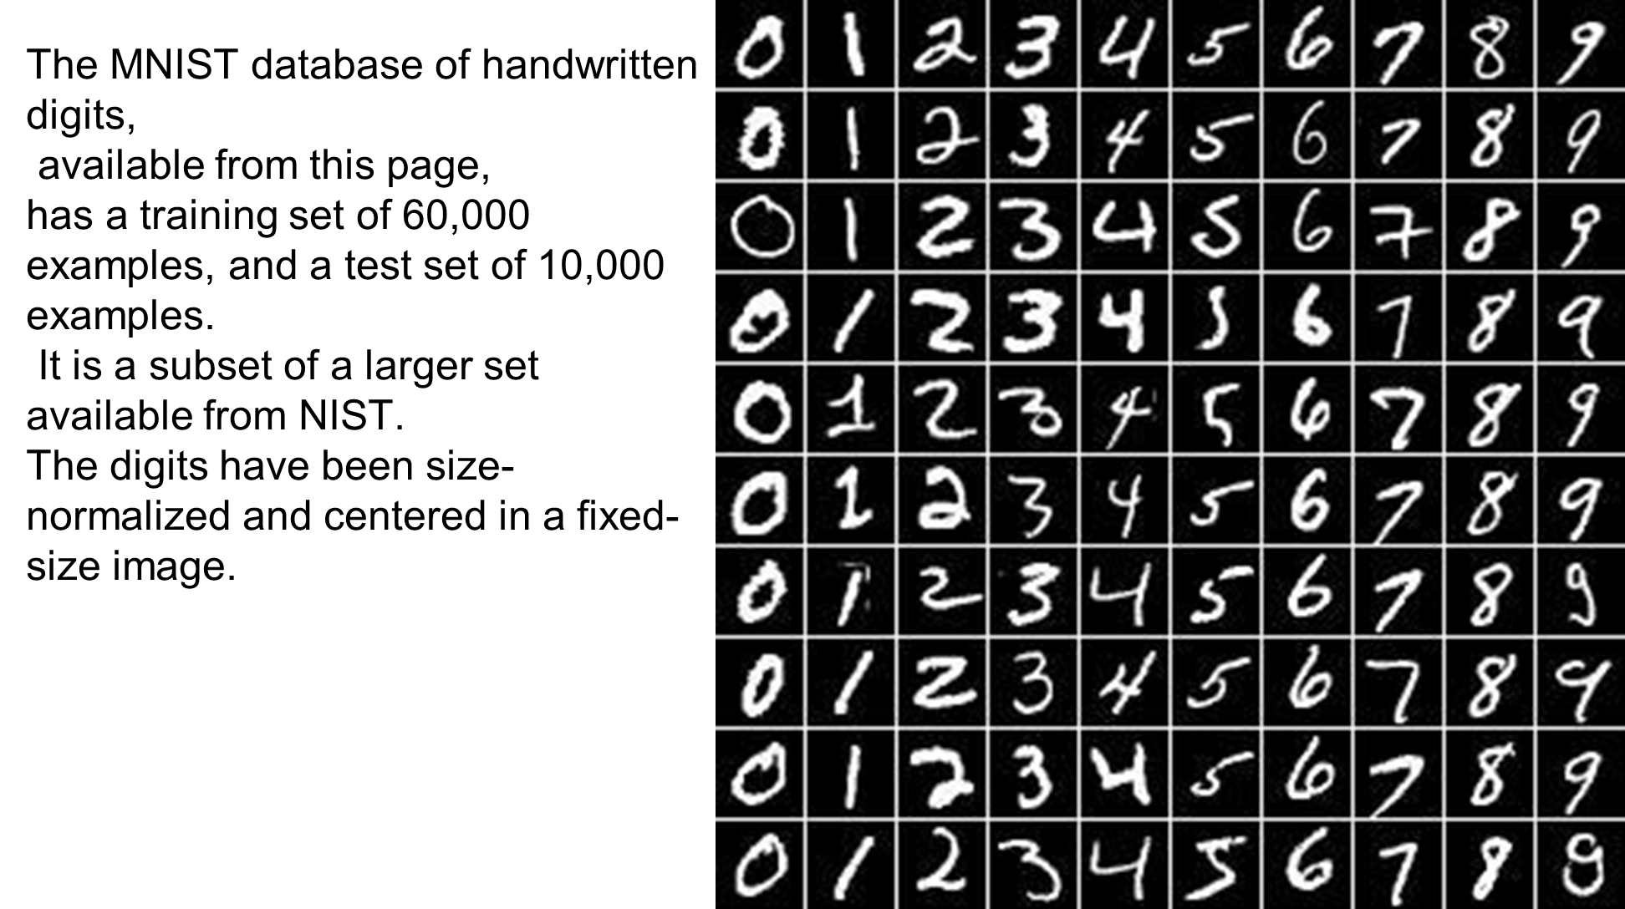
MNIST Dataset

Slide 15
Optimizers
Every time a neural network finishes passing a batch through the network and generating prediction results, it must decide how to use the difference between the results it got and the values it knows to be true to adjust the weights on the nodes so that the network steps towards a solution. The algorithm that determines that step is known as the optimization algorithm.
Some of the available optimizers
SGD
AdaGrad
AdaDelta
Adam

Slide 16
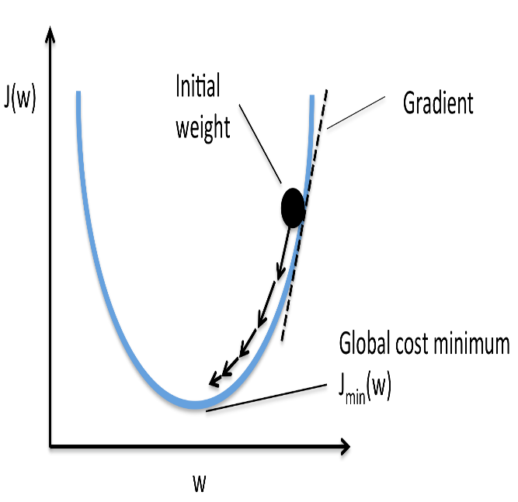
SGD
SGD, or stochastic gradient descent, is the "classical" optimization algorithm. In SGD we compute the gradient of the network loss function with respect to each individual weight in the network. Each forward pass through the network results in a certain parameterized loss function, and we use each of the gradients we've created for each of the weights, multiplied by a certain learning rate, to move our weights in whatever direction its gradient is pointing.
SGD is the simplest algorithm, recommended for shallow networks but not deep networks

Slide 17
Adam
Adam stands for Adaptive Moment Estimation.
In addition to storing an exponentially decaying average of past squared gradients like Adadelta and RMSprop, Adam also keeps an exponentially decaying average of past gradients, similar to momentum.
Whereas momentum can be seen as a ball running down a slope, Adam behaves like a heavy ball with friction, which thus prefers flat minima in the error surface

Slide 18
Diffgrad
Optimization techniques such as Adam and AMSGrad suffer from the problem of automatic adjustment of the learning rate.
The main problem is with controlling friction for the first moment in order to avoid over shooting near to an optimum solution.
The diffGrad optimization technique is based on the change in short-term gradients and controls the learning rate based on the need of dynamic adjustment of learning rate.
This means that diffGrad follows the norm that the parameter update should be smaller in low gradient changing regions and vice-versa.

Slide 19
Results
SGD Optimizer
937/937 [==============================] - 315s 336ms/step - loss: 0.3083 - accuracy: 0.9112 - val_loss: 0.0509 - val_accuracy: 0.9810
Epoch 2/5
937/937 [==============================] - 314s 335ms/step - loss: 0.1137 - accuracy: 0.9674 - val_loss: 0.0421 - val_accuracy: 0.9898
Epoch 3/5
937/937 [==============================] - 315s 336ms/step - loss: 0.0859 - accuracy: 0.9747 - val_loss: 0.0438 - val_accuracy: 0.9913
Epoch 4/5
937/937 [==============================] - 315s 336ms/step - loss: 0.0692 - accuracy: 0.9803 - val_loss: 0.0080 - val_accuracy: 0.9921
Epoch 5/5
937/937 [==============================] - 316s 337ms/step - loss: 0.0615 - accuracy: 0.9818 - val_loss: 0.1052 - val_accuracy: 0.9930

Slide 20
ADM Optimizer
Epoch 1/5
937/937 [==============================] - 423s 452ms/step - loss: 0.1237 - accuracy: 0.9618 - val_loss: 0.1119 - val_accuracy: 0.9717
Epoch 2/5
937/937 [==============================] - 417s 445ms/step - loss: 0.0515 - accuracy: 0.9840 - val_loss: 6.5839e-04 - val_accuracy: 0.9899
Epoch 3/5
937/937 [==============================] - 456s 486ms/step - loss: 0.0418 - accuracy: 0.9865 - val_loss: 0.0202 - val_accuracy: 0.9933
Epoch 4/5
937/937 [==============================] - 449s 479ms/step - loss: 0.0380 - accuracy: 0.9884 - val_loss: 0.0147 - val_accuracy: 0.9920
Epoch 5/5
937/937 [==============================] - 414s 442ms/step - loss: 0.0331 - accuracy: 0.9897 - val_loss: 0.0018 - val_accuracy: 0.9935

Slide 21
Diffgrad optimizer
Epoch 1/5
937/937 [==============================] - 321s 343ms/step - loss: 0.1424 - accuracy: 0.9569 - val_loss: 0.1124 - val_accuracy: 0.9894
Epoch 2/5
937/937 [==============================] - 317s 339ms/step - loss: 0.0533 - accuracy: 0.9835 - val_loss: 0.0040 - val_accuracy: 0.9907
Epoch 3/5
937/937 [==============================] - 317s 339ms/step - loss: 0.0431 - accuracy: 0.9866 - val_loss: 0.0994 - val_accuracy: 0.9864
Epoch 4/5
937/937 [==============================] - 331s 354ms/step - loss: 0.0367 - accuracy: 0.9884 - val_loss: 0.0314 - val_accuracy: 0.9892
Epoch 5/5
937/937 [==============================] - 338s 361ms/step - loss: 0.0338 - accuracy: 0.9895 - val_loss: 0.0315 - val_accuracy: 0.9940

Slide 22
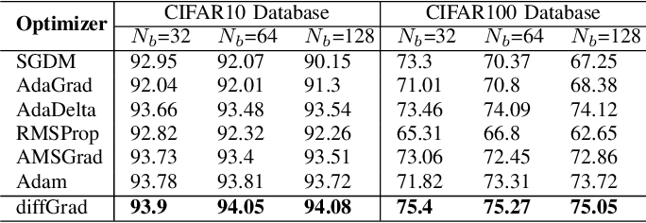
Comparison of optimizers
The comparison results in terms of the ‘Validation Classification Accuracy’over the CIFAR10 and CIFAR100 databases among SGDM, AdaGrad, AdaDelta, RMSProp, AMSGrad, Adam and proposed diffGrad optimization methods. The comparison is made for the batch sizes (Nb) of 32, 64 and 128. The best results among different optimization techniques are highlighted in bold.
The above table is taken from “diffGrad: An Optimization Method for Convolutional Neural Networks” by Shiv Ram Dubey et al.

Slide 23


