Slide 1
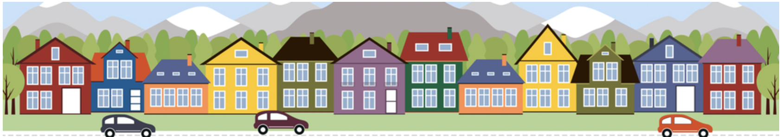
Unraveling House Sales Price: Analyzing the influencing factors
Kshitij Mahajan
08/08/2023

Slide 2
Dataset
Kaggle Competition – “Housing Prices in Ames, Lowa “
- Dataset of housing prices in Ames, Lowa
Variables/Features of the dataset:
- 79 variables present in the dataset
Variable named “Sale Price”
- Dependent Variable
- Represent price at which house was sold
Remaining 78 variables
- Represent different attributes of house like area, quality, and amenities etc

Slide 3
Hypothesis
Null Hypothesis: The sale price of a house is influenced by its size, quality, and luxury
Sale Price
Size
Quality
Luxury
No. of rooms and area
Overall quality and type of material used
Utilities and furnishment

Slide 4
Data Preprocessing
Removed extreme outliers
Dropped missing values
Reduced number of features from 79 to 39
Features that are irrelevant to our hypothesis
Features with more than 60% missing values
Multicollinear features
Features with no significant impact on sale price

Slide 5
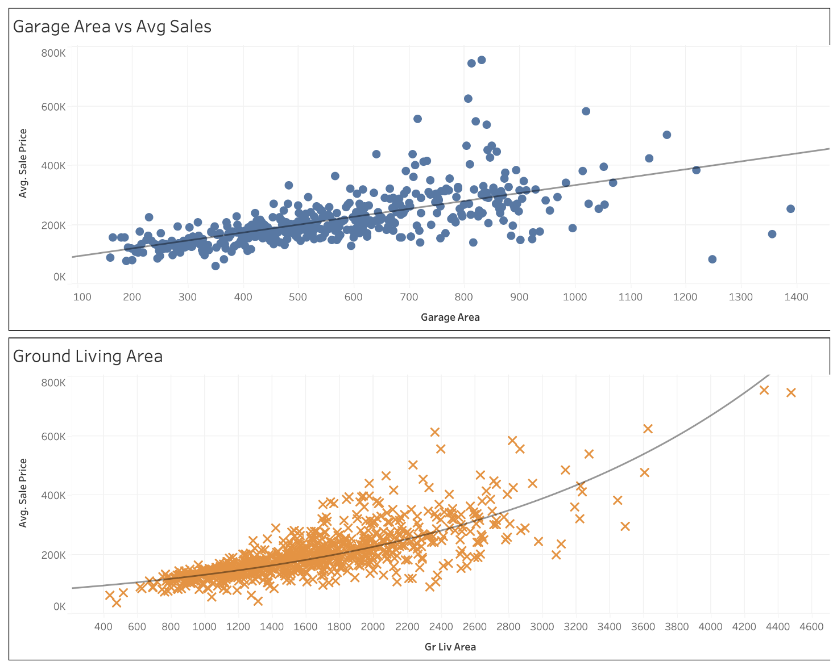
Impact of Size : Tableau Dashboard
As the area (size) increases, sales increase proportionally

Slide 6
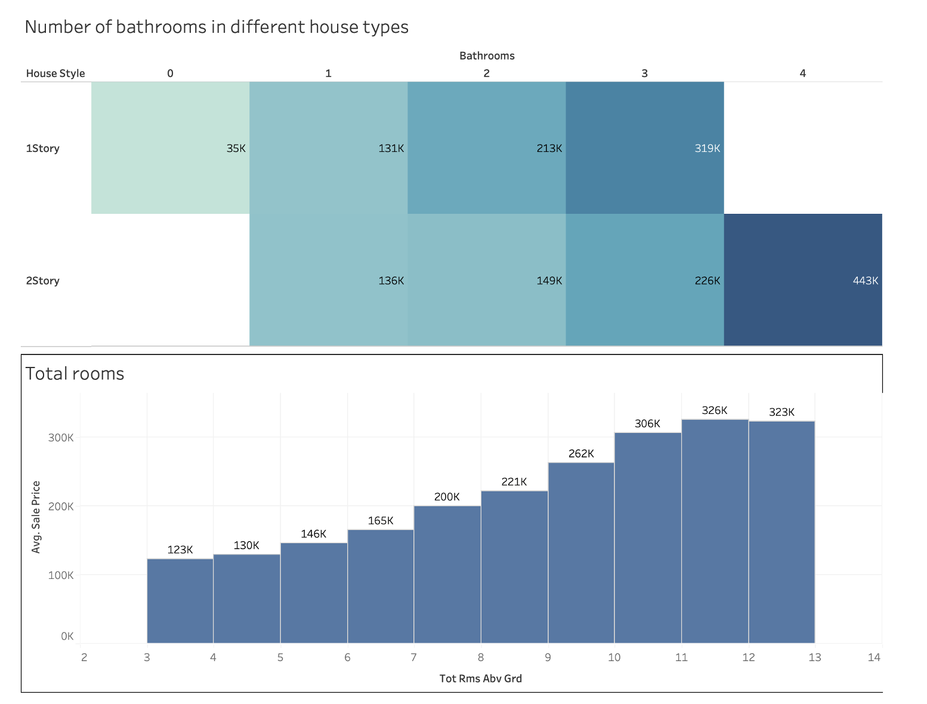
Impact of Size : Tableau Dashboard
2 story houses with 4 bathrooms have the highest selling price
As no. of rooms increase, sales price increase

Slide 7
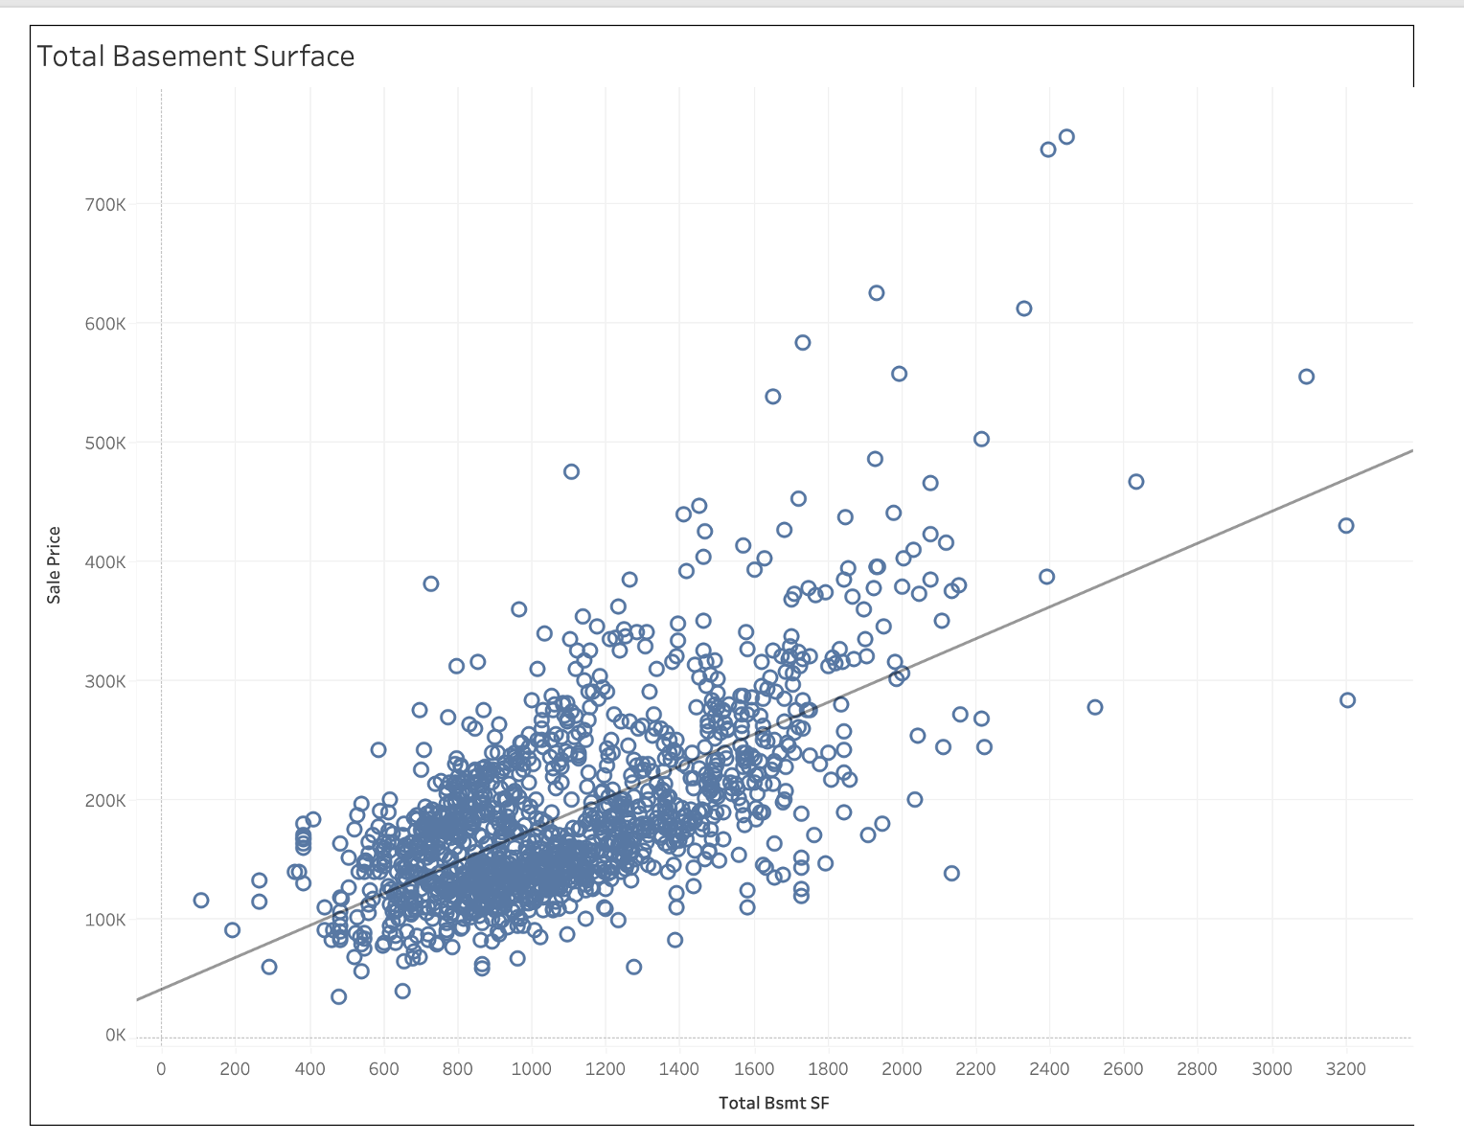
Impact of Size : Tableau Dashboard
Total basement area is directly proportional to sale price

Slide 8
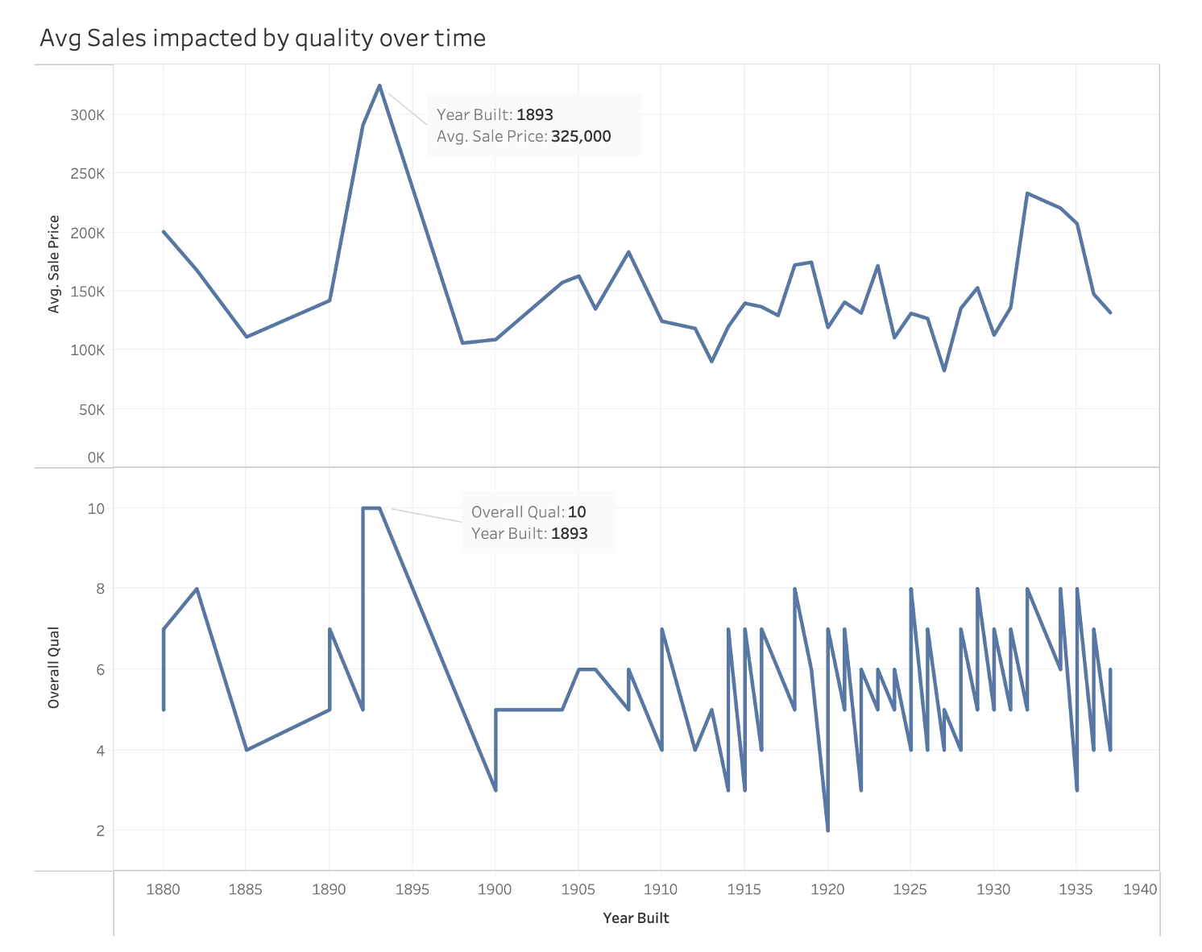
Impact of Quality : Tableau Dashboard
Overall quality of house correlates with sale price heavily

Slide 9
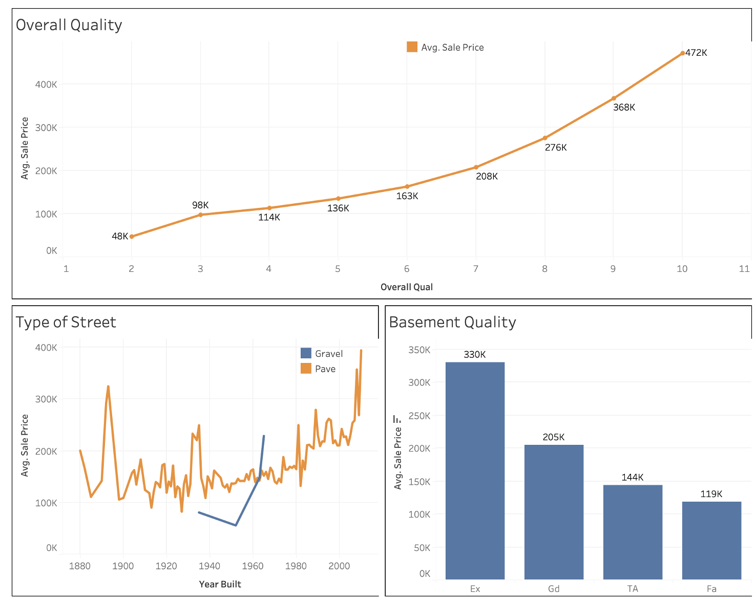
Impact of Quality : Tableau Dashboard
House with paved street (better quality) attract higher sale price
Basement quality impacts sale price of house

Slide 10
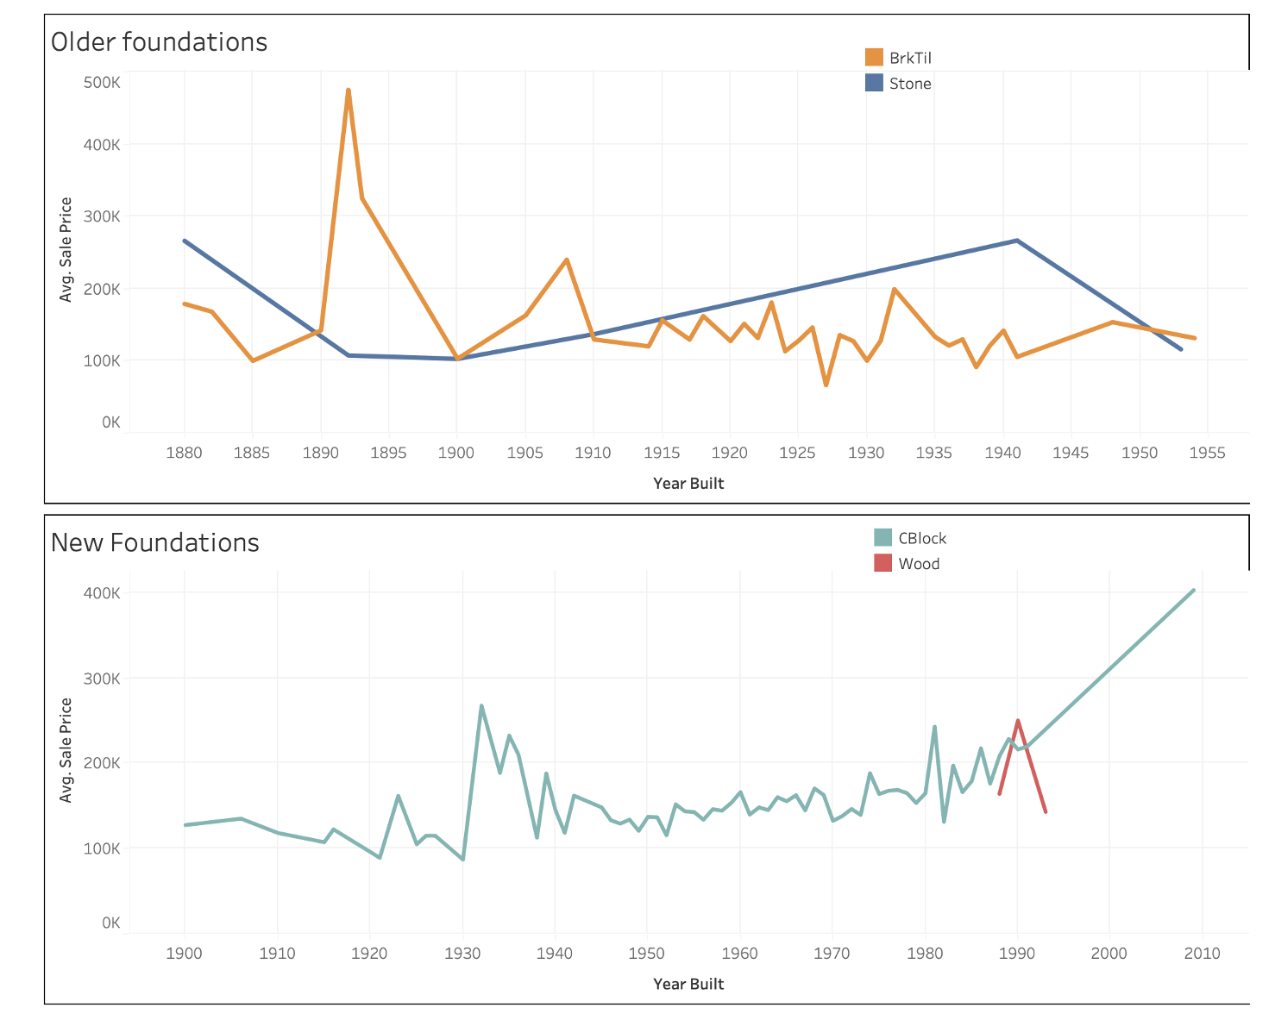
Impact of Quality : Tableau Dashboard
1880-1900 : Brick/Tile foundation is preferred
1900-1950 : CBlock, Stone,Brick/Tile are preferred
1950-present: CBlock is preferred

Slide 11
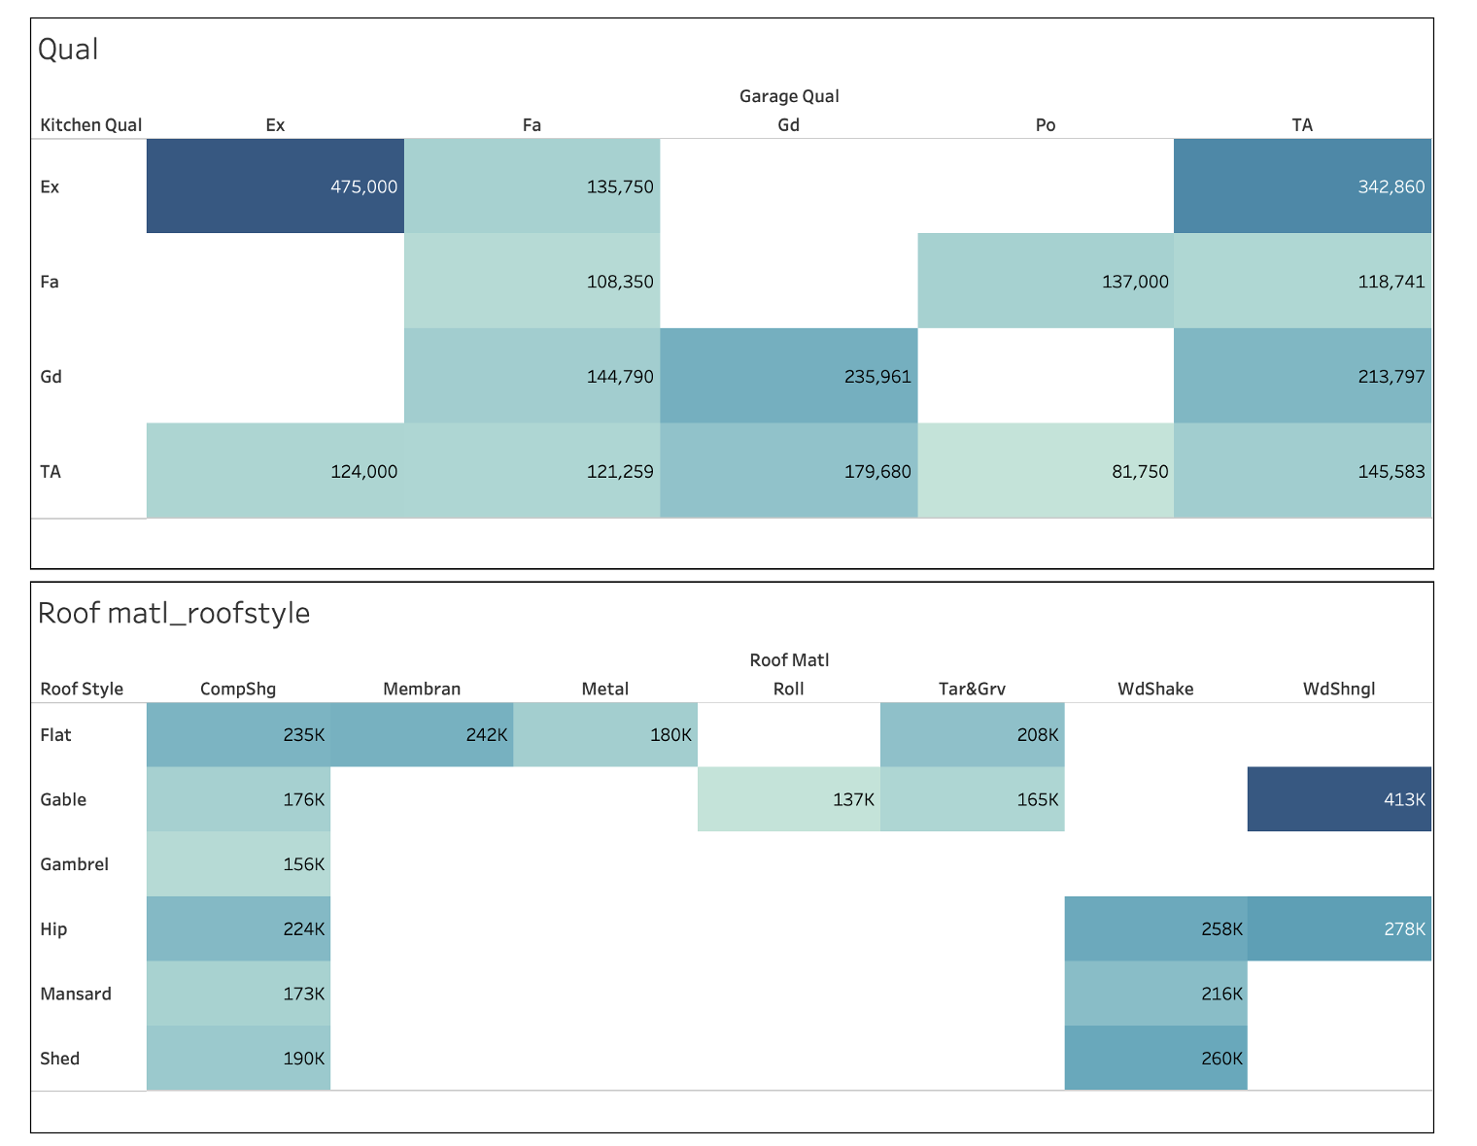
Impact of Quality : Tableau Dashboard
Wood Shingles are preferred
Kitchen quality is more important than garage quality while purchasing a house

Slide 12
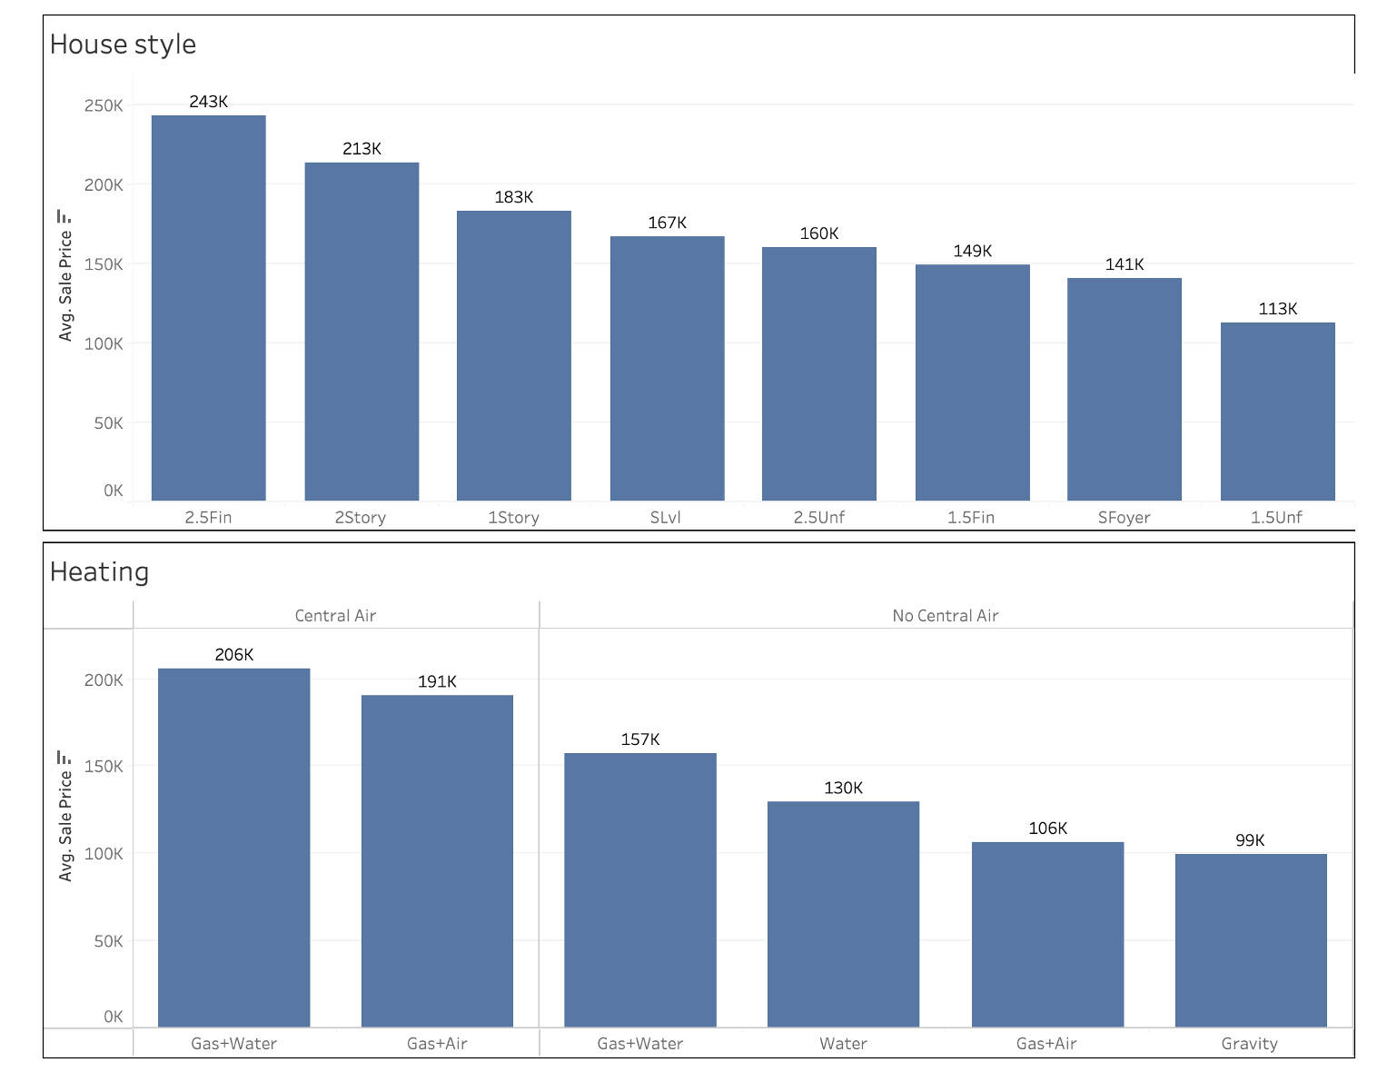
Impact of Luxury: Tableau Dashboard
Spacious and furnished house has higher sale price.
Heater type and centralized air conditioner impact sale price heavily.

Slide 13
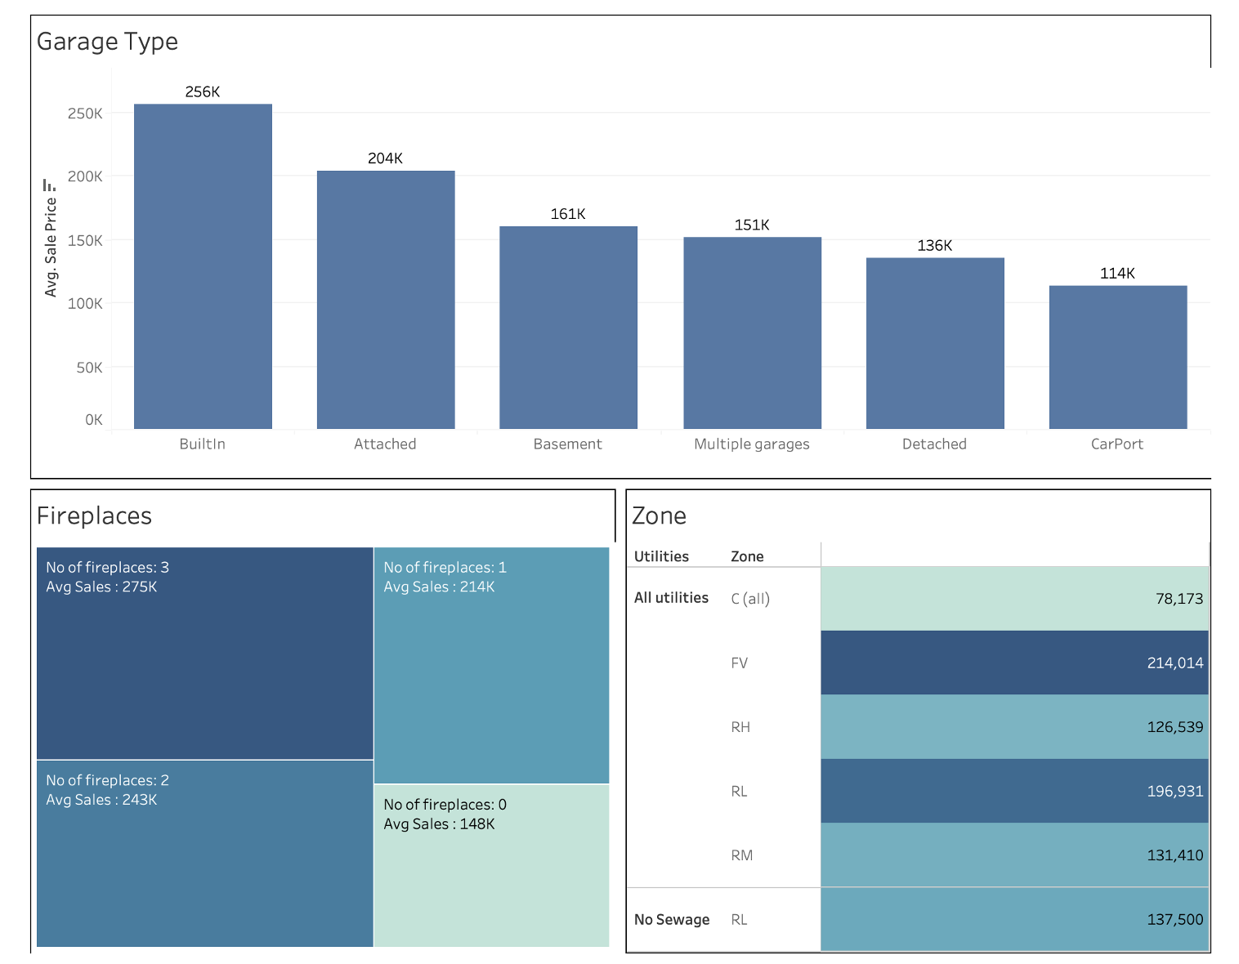
Impact of Luxury: Tableau Dashboard
Integrated garage is preferred
No. of fireplaces correlates with sale price heavily

Slide 14
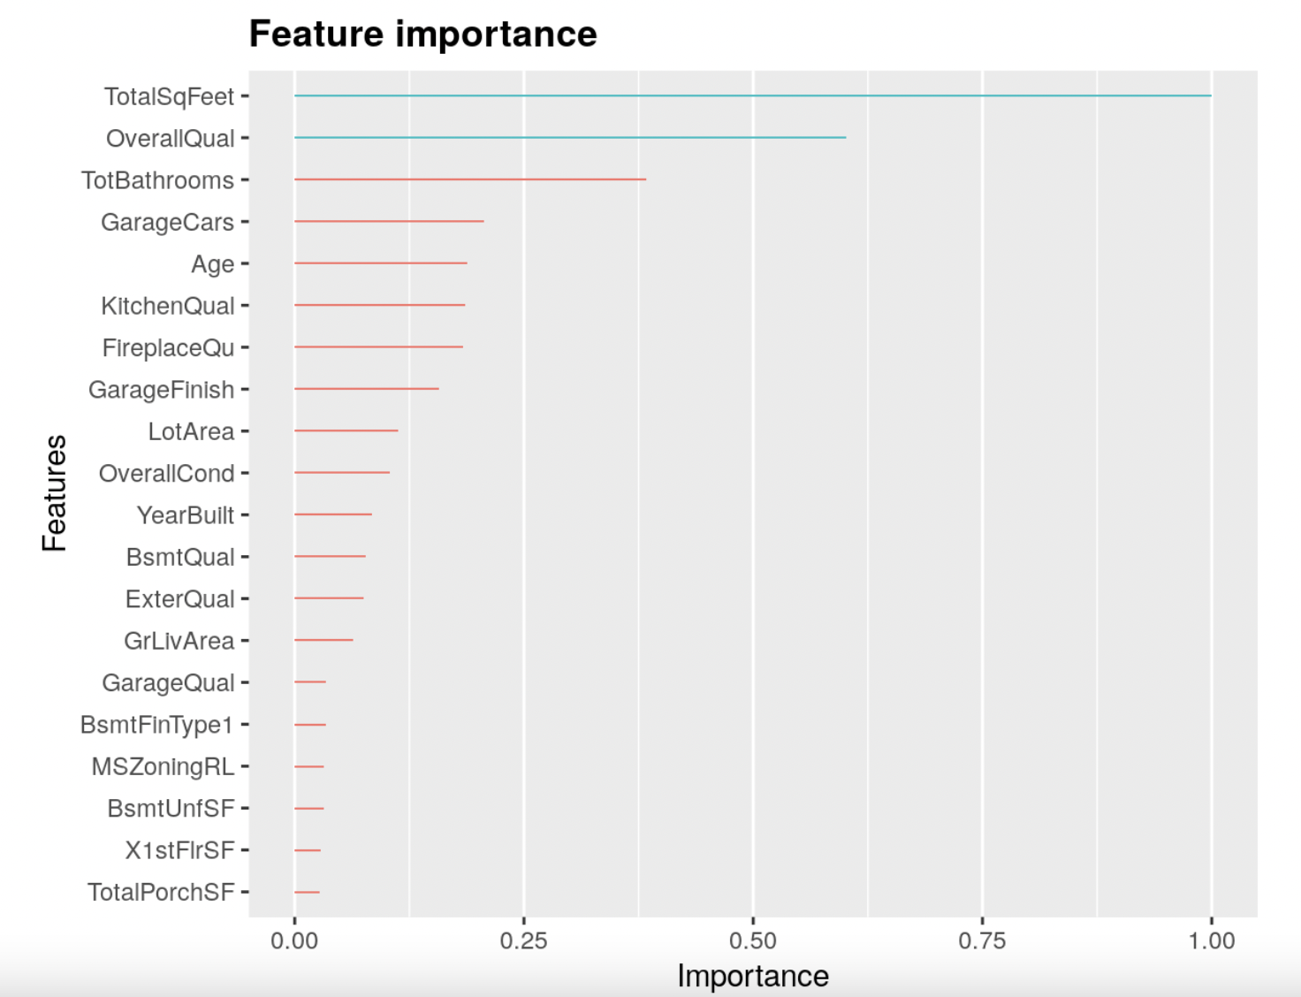
Quantitative Analysis
All variables explain 91% variability of sale price, showing that dropping missing values/features led to lose only 9% of information

Slide 15
Conclusion
Size Matters: Larger living areas (size) positively correlate with higher sale prices. Buyers are willing to pay a premium for more spacious properties, making square footage a crucial consideration in the real estate market.
Quality Commands Value: The overall quality of a house plays a pivotal role in determining its sale price. Properties with better material and finish quality tend to fetch higher prices due to their perceived value and desirability.
Luxury Features Elevate Prestige: Properties equipped with luxury features, such as high-end appliances, custom designs, spa-like bathrooms, and smart home technology, are associated with premium sale prices. These opulent elements cater to discerning buyers seeking an elevated lifestyle and exclusivity.
Hence, we confirm that our hypothesis that the sale price of a house is influenced by its size, quality, and luxury is accepted.

Slide 16

Thank you
Questions?

