Slide 1

POLISH COMPANIES Bankruptcy prediction
Project by:
Kaushik Holla and Kshitij Mayank

Slide 2
OBJECTIVE
Aim:
The goal of the the project is to identify the best classification model for predicting the bankruptcy of corporations based on the data collected by EMIS (Emerging Market Information Services)
Industry Relevance:
Detecting early signs of financial loss to avoid bankruptcy.
Assist policy makers on devising plans to help avoid financial distress.
Understand key drivers and model different scenarios.
Raw Data (.arff files)
Cumulate 5-forcast yrs data.
Imputation
SMOTE(Oversampling)
Fitting our Models
MEAN Imputation
KNN Imputation
Model Comparison And Evaluation

Slide 3
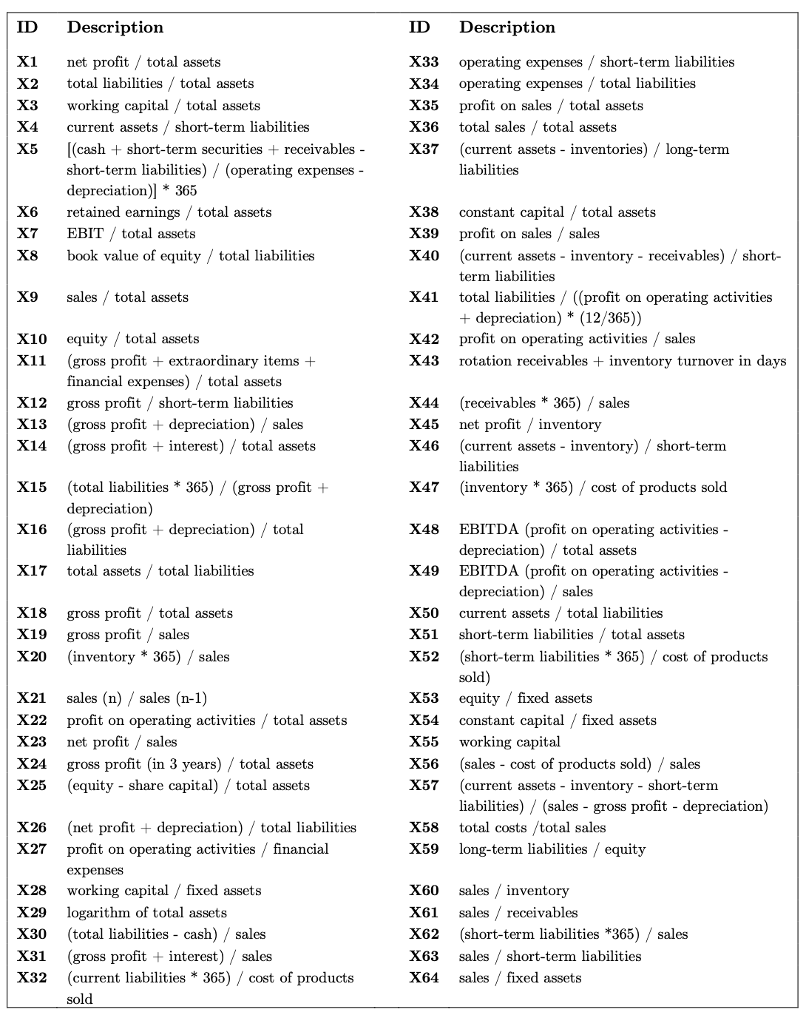
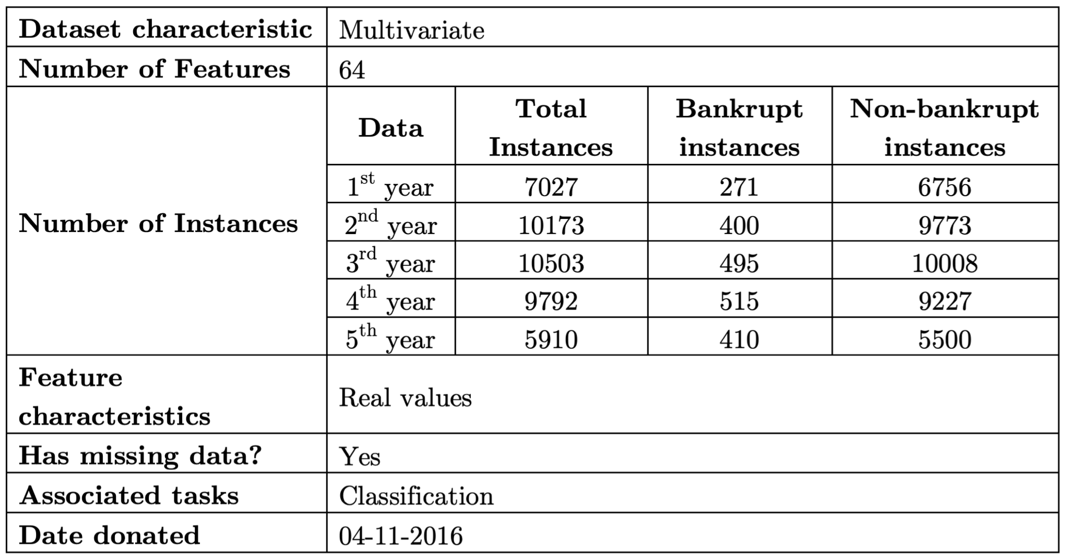
DATASET
Reference : dataset can be found here.

Slide 4
Handling Missing Values and Data Imbalance
Original Length | 43,405
Cleaned Length (drop-na values) | 19,967
Missing Values | 23,438
Missing % | ~54%
MEAN IMPUTATION
The missing value on a certain variable is replaced by the mean of the available cases.
&
KNN IMPUTATION
The assumption behind using KNN for missing values is that a point value can be approximated by the values of the points that are closest to it, based on other variables.
Imputations
Missing Data
Note: dropping so many values will lead to bias and loss of information
Class | # Values
0-(Not-Bankrupt) | 41314
1-(Bankrupt) | 2091
Minority % | ~5%
SMOTE Analysis
To balance class distribution by randomly increasing minority class examples by replicating them. SMOTE synthesizes new minority instances between existing minority instances.
Oversampled Data (KNN and Mean)
Class | # Values
0-(Not-Bankrupt) | 41314
1-(Bankrupt) | 41314
Minority % | ~0%
Oversampling
Imbalanced Data
Note: Such imbalance could lead to heavy bias and models won't perform well.

Slide 5
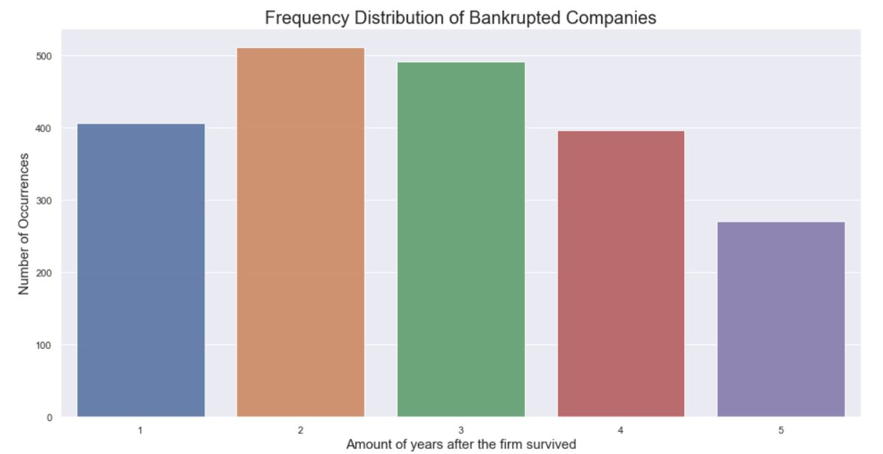
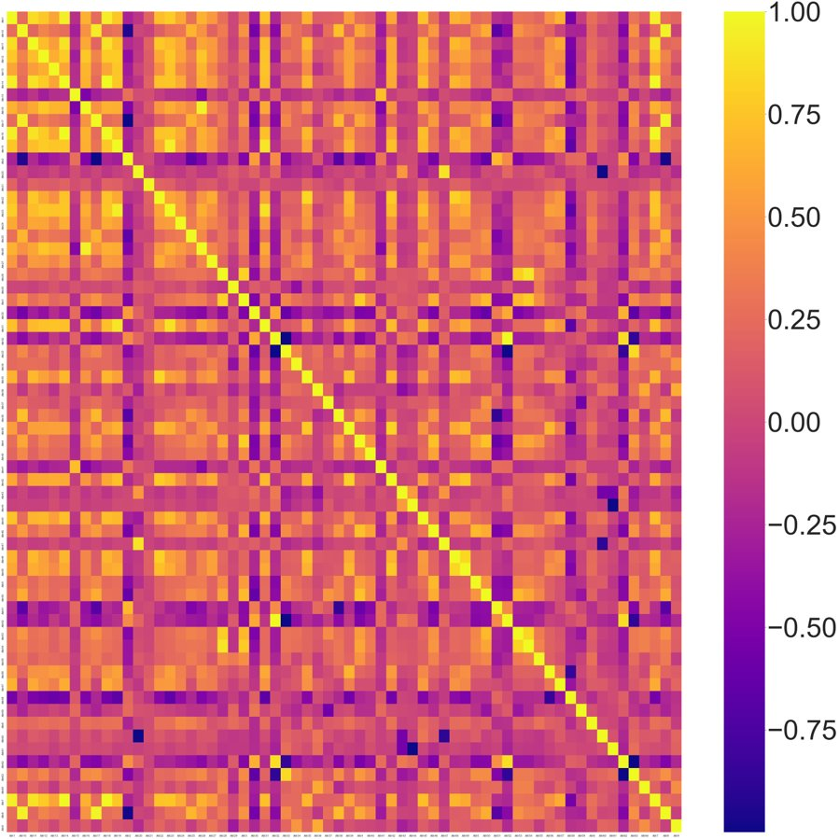
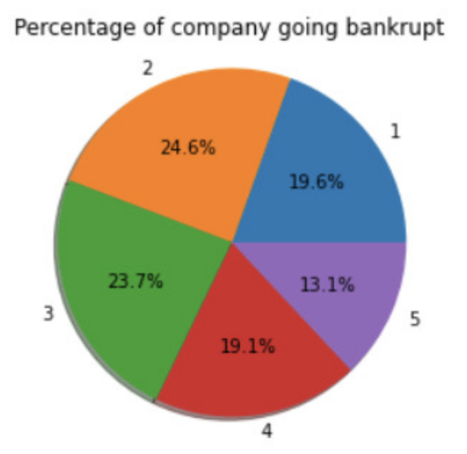
Exploratory Data Analysis
HEATMAP-Correlation
TOP 5 POSITIVELY CORRELATED VALUES
Features | Correlation Value
Attr14, Attr18 | 0.999873
Attr14, Attr7 | 0.999839
Attr18, Attr7 | 0.999712
Attr32, Attr52 | 0.994654
Attr10, Attr8 | 0.963546
TOP 5 NEGATIVELY CORRELATED VALUES
Features | Correlation Value
Attr56, Attr58 | -0.846339
Attr33, Attr62 | -0.859020
Attr38, Attr51 | -0.862847
Attr52, Attr63 | -0.868084
Attr32, Attr63 | -0.868939
~44% of the companies went Bankrupt in first two forecasting years.
Dropped Top 10 highly correlated features to avoid overfitting.

Slide 6
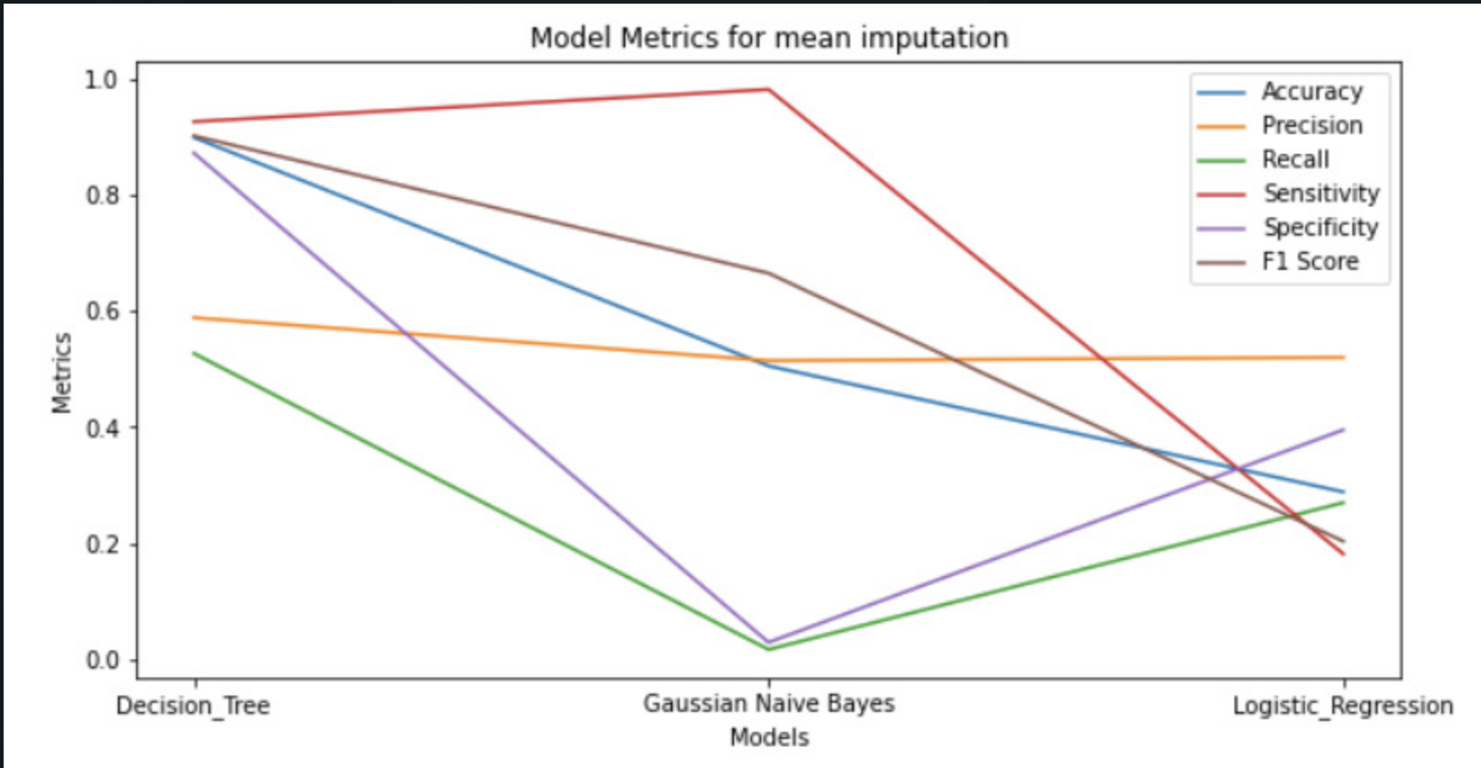
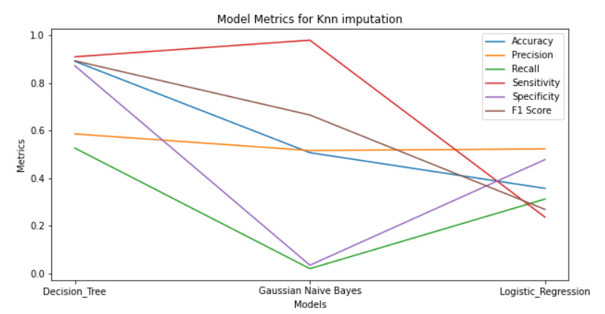
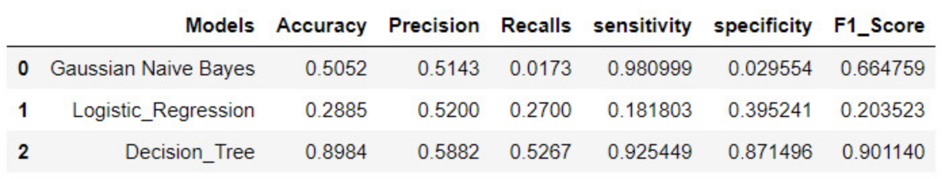
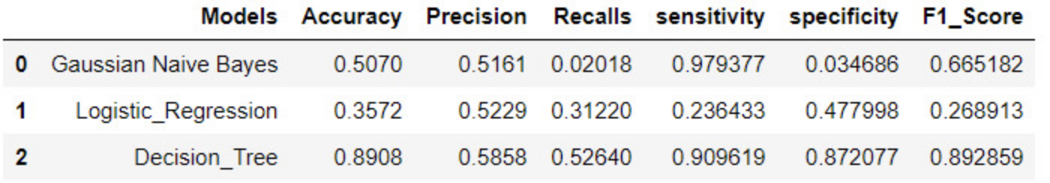
ML-Model Performance
MODELS USED
Gaussian Naïve Bayes
Logistic Regression
Decision Tree
OBSERVATIONS
Decision Tree Model has the highest accuracy for both imputation techniques.
Logistic Regression gave better performance for K-NN Imputation technique.
CHALLENGES
To deal with the missing data.
Since all the companies being evaluated for bankruptcy don’t operate on the same timelines, it is difficult to gather meaningful data and organize it.
MEAN-Imputed Data
KNN-Imputed Data

Slide 7
Future work
Models to implement
SVM
Improve Accuracy
Try various other imputation techniques like EM Imputation.
Validate if down-sampling fetches better results than up-sampling(SMOTE).

Slide 8

THANK YOU.

