Slide 1
Tableau_Dashboard
File created on: 5/19/2023 4:55:48 PM

Slide 2
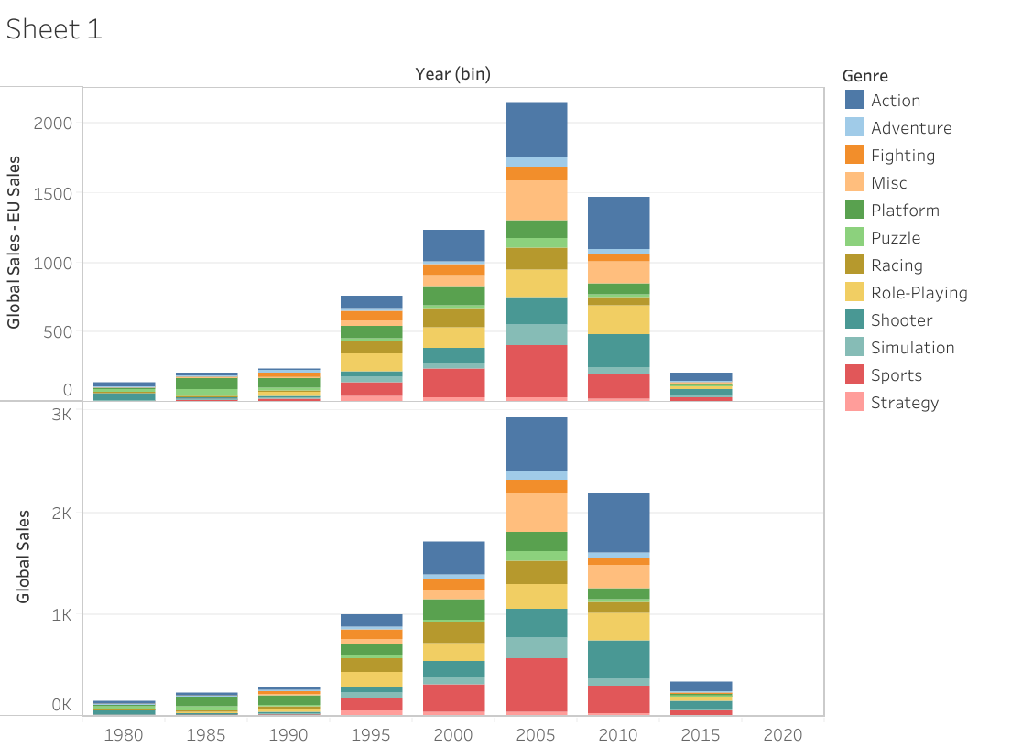

Slide 3
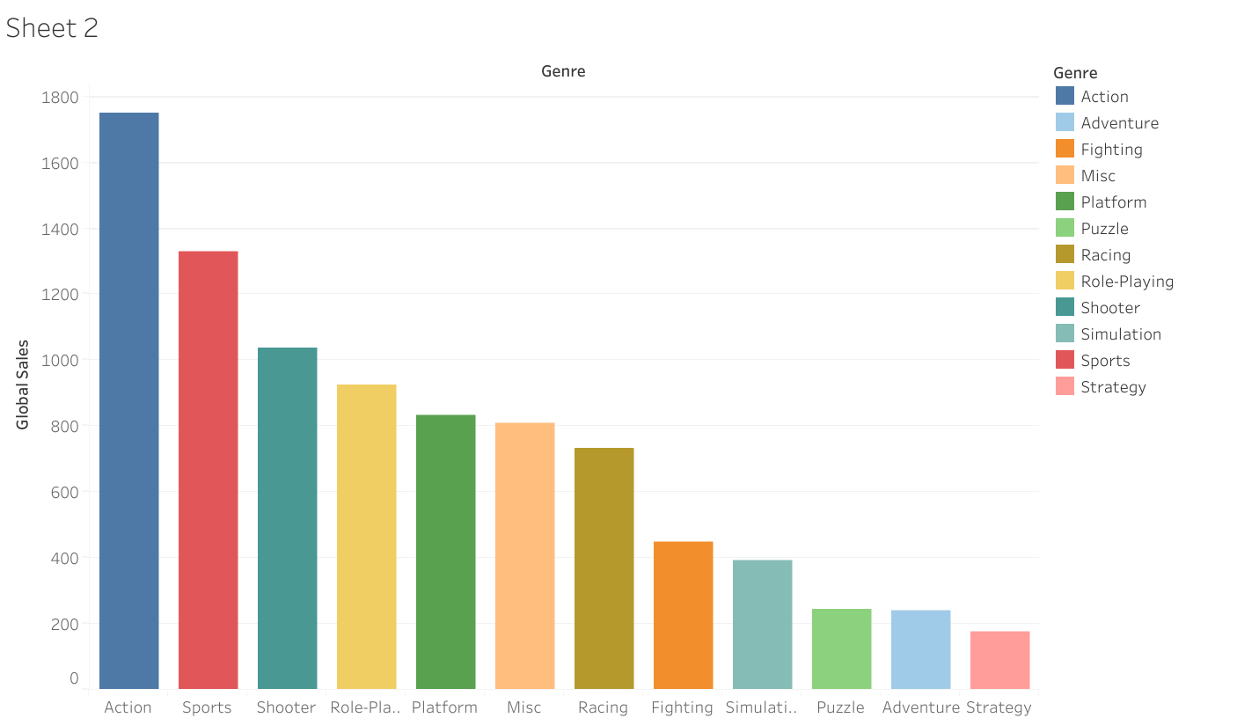

Slide 4
